Slide 1
Marks Drawrings
#tribute

Slide 2

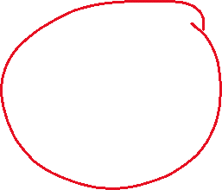









Merge conflict explanation

Slide 3
Stack vs heap
Stack – value types
D1
d2
d3
d4
d2
heap | Re | Fe | Re | Nc | eT | Yp | es
1n |  |  |  |  |  | 3n
 |  |  | 2n
4n

Slide 4
Singley-Linked List
1st Node
It’s an object
3rd Node
It’s an object
2nd Node
It’s an object

Slide 5
Doubley-Linked List
1st Node
It’s an object
-Next
- previous
2nd Node
It’s an object
3rd Node
It’s an object
3rd Node
It’s an object

Slide 6
Circular-Singley-Linked List
2nd Node
It’s an object
1st Node
It’s an object
3rd Node
It’s an object
5th Node
It’s an object
^{4th} Node
It’s an object

Slide 7
Stack explanation (Stacko)
A stack is a LIFO construction. So the first thing that you pushed onto the stack is the last thing that you can take off of the stack.
Functionality of a stack:
push() – put a new obj on the stack
Pop() - return and delete the top obj
Peek() – get the data from the top obj.
Size prop – returns the size of the stack currently
Stack Class
Person3
Person4
Person2
Person1

