Slide 1
Marks Drawrings
#tribute

Slide 2

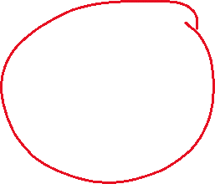









Merge conflict explanation

