Slide 1



JSX Technology Project
Presented By: Jason Abdool, Skye Gibney, and Xavier Perez-Hall

Slide 2
Technologies Utilized
Amazon Web Service (AWS)
Cucumber/Gherkin
DBeaver
GitHub
Java
Jira
Mockito
Postman
Selenium and JUnit

Slide 3
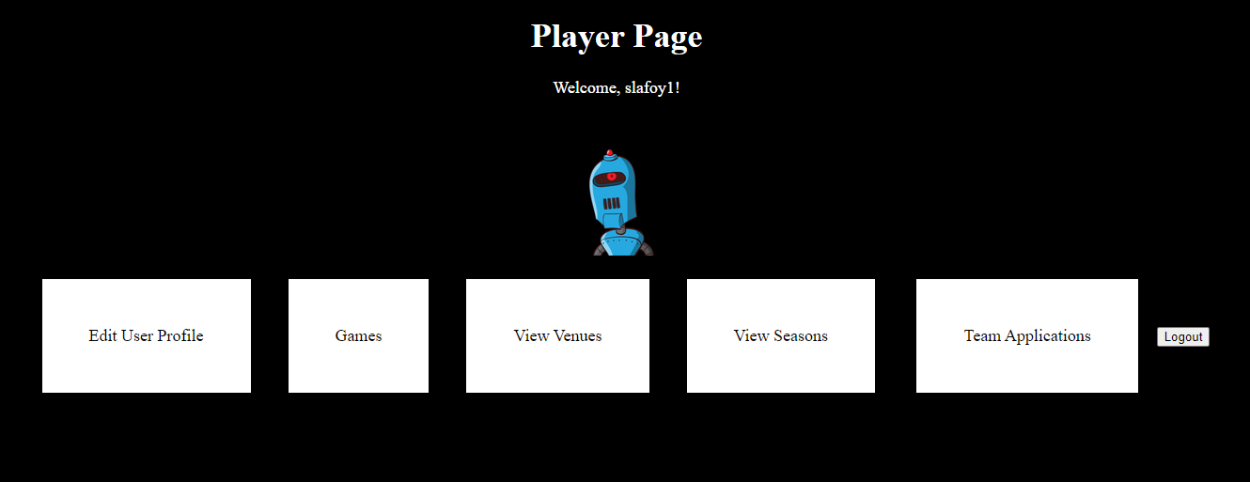
List of Features automated
Admin
All Users
Create or manage account
Players
Captains
Referees
User statistics

Slide 4
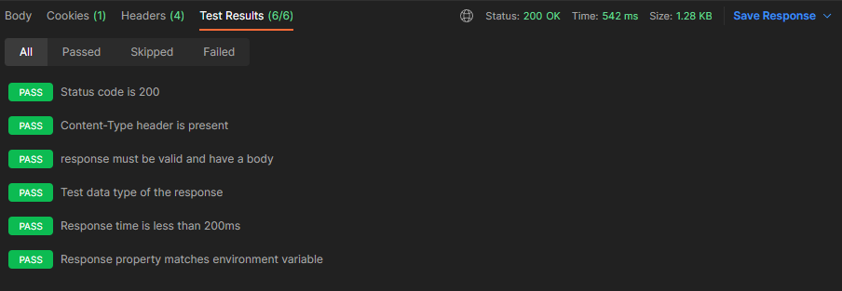
End-to-end Tests
Game Requests
Scheduling a Game
Team Registration
Updating a user’s profile
Team Requests
Retrieving games, seasons, teams, and venues

Slide 5
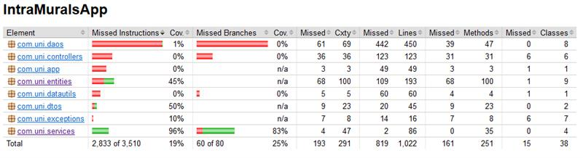
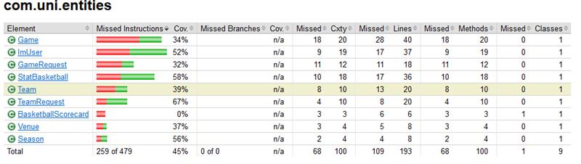
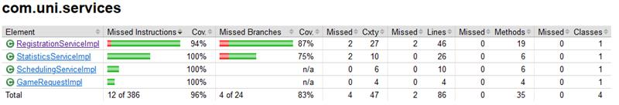
Unit testing coverage

Slide 6
Challenges
Maintaining and updating the test automation scripts as the application has test changes.
Managing test data and ensuring it is properly set up for each test run.
Handling Timeout Exceptions and Assertion Failures.
Integrating test automation into the overall testing.
Duplicate step definitions when merging branches
Shallow equality comparison on objects when using JUnit and Mockito

Slide 7
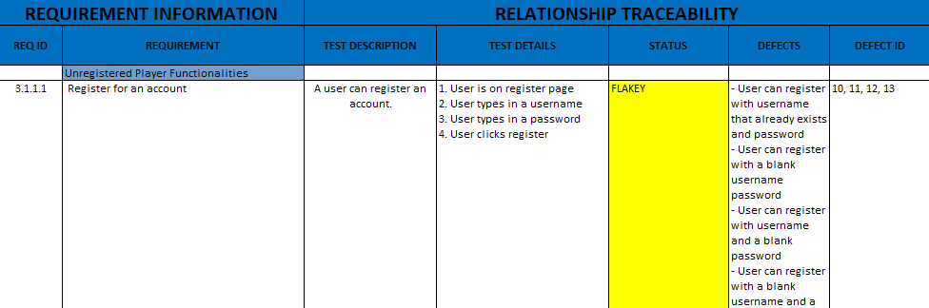
RTM/Defect Report

