Slide 1

Automated Bug Catcher
Presented by:
Jason Abdool

Slide 2
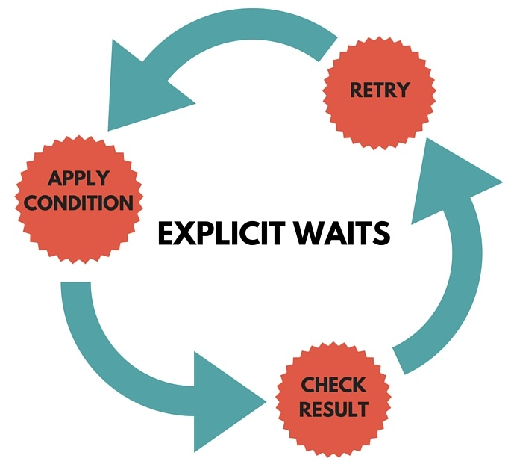
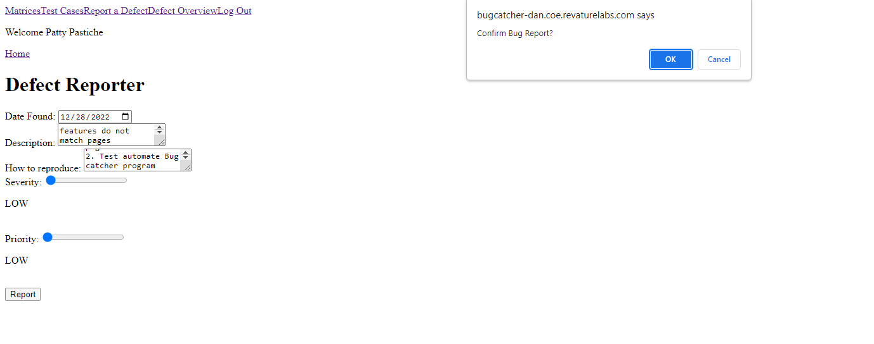
Challenges/Issues

Slide 3
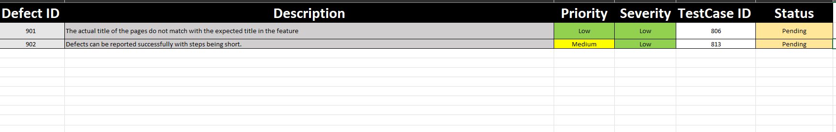
Defects

