Slide 1
Cloud Computing and Mobile Apps
CITS5503 Dr David Glance

Slide 2
Mobile apps
Mobile applications are normally written as:
Native applications (Swift/Objective-c for iOS and Java for Android)
Using a cross-platform language: Xamarin, PhoneGap, Flutter
Hybrid native + Html 5/CSS3
All apps rely on server infrastructure to:
User management and login
State persistence
Communication (Push notifications, email, etc)
Business logic
Decision of what to put on the client vs server determined by many factors

Slide 3
Client/Server Communication
Communicating with servers is now typically done through REST protocol (REpresentational State Transfer)
Clients can communicate directly with a database like DynamoDB but there are reasons this is not a great idea
There are other forms of communication – we will see that with IoT later
Other types of communication protocols:
SOAP
XML RPC
Security
Variety of security mechanisms can be used including authentication, authorisation, encryption of messages

Slide 4
REST
Created by Roy Fielding for PhD in 2000
Concepts
Resource: anything that is addressable using a Uniform Resource Identifier (URI) on the web
Representations: resources are not sent back and forth over the web just representations (URLs) – this is not strictly true as we will see
Representation has a content-type (e.g. text/html, message/partial, video/mp4)
Representation usually in JSON
Actions
Actions that are used to operate on resources
HTTP actions GET, POST, PUT, DELETE

Slide 5
Web service interfaces
Using python Django REST framework simple to create a web API
Main task is to handle actions, parameters and serialization
Serialization
Need a way to turn objects consisting of different datatypes into a string representation – usually JSON
Session state
Not unique to REST interfaces
Web applications usually handle this using cookies to record a session id that is used then to index session state information

Slide 6
Poll Example
Simple Django poll application with a model for questions and choices
models.py
from django.db import models
class Question(models.Model):
question_text = models.CharField(max_length=200)
pub_date = models.DateTimeField('date published')

Slide 7
Serializing
from rest_framework import serializers
from hw.models import Question, Choice
from datetime import datetime
class QuestionSerializer(serializers.Serializer):
question_text = serializers.CharField(required=True, max_length=200)
pub_date = serializers.DateTimeField(default=datetime.now)
def create(self, validated_data):
return Question.objects.create(**validated_data)
def update(self, instance, validated_data):
instance.question_text = validated_data.get('question_text', instance.question_text)
instance.pub_date = validated_data.get('pub_date', instance.pub_date)
instance.save()
return instance

Slide 8
Methods
# imports removed
@csrf_exempt
def question_list(request):
if request.method == 'GET':
questions = Question.objects.all()
serializer = QuestionSerializer(questions, many=True)
return JsonResponse(serializer.data, safe=False)
elif request.method == 'POST':
data = JSONParser().parse(request)
serializer = QuestionSerializer(data=data)
if serializer.is_valid():
serializer.save()
return JsonResponse(serializer.data, status=201)
return JsonResponse(serializer.errors, status=400)

Slide 9
urls
from django.contrib import admin
from django.urls import include,path
import hw.views
urlpatterns = [
path('polls/', hw.views.index, name='index'),
path('questions/', hw.views.question_list, name='question_list'),
path('admin/', admin.site.urls),

Slide 10
Calling the method using JQuery
$(document).ready(function() {
$.ajax({
type: “GET”,
dataType: “json”,
url: “http://helloworldapi.com/questions/”,
success:
function(data) {
var datalocalStorage['currentHealthTeamUser'] = JSON.stringify(data);
window.open('team-manager.html', '_self');
},
error:
function (jqXHR, textStatus, errorThrown) {
console.log(textStatus + " " + errorThrown + "\n");
}
});
});

Slide 11
Creating an iOS App with AWS Mobile Hub
Mobile Hub provides a centralised facility to configure a mobile application that uses:
User creation, verification and then authentication
Access to DynamoDB directly (Note: there may be reasons you don’t want to do this)
Communication strategies with app users including Push Notifications
Analytics to track usage of apps
Chatbot integration
User data storage
File storage and streaming

Slide 12
Create Mobile Hub App
Create a Mobile Hub App giving name and platform
This provides by default analytics (AWS Pinpoint)
Generates a JSON configuration file with services, ids and region information
Demo app in tutorial https://docs.aws.amazon.com/aws-mobile/latest/developerguide/tutorial-ios-aws-mobile-notes-setup.html
Apps can be written for Android, React Native, React.js, others

Slide 13
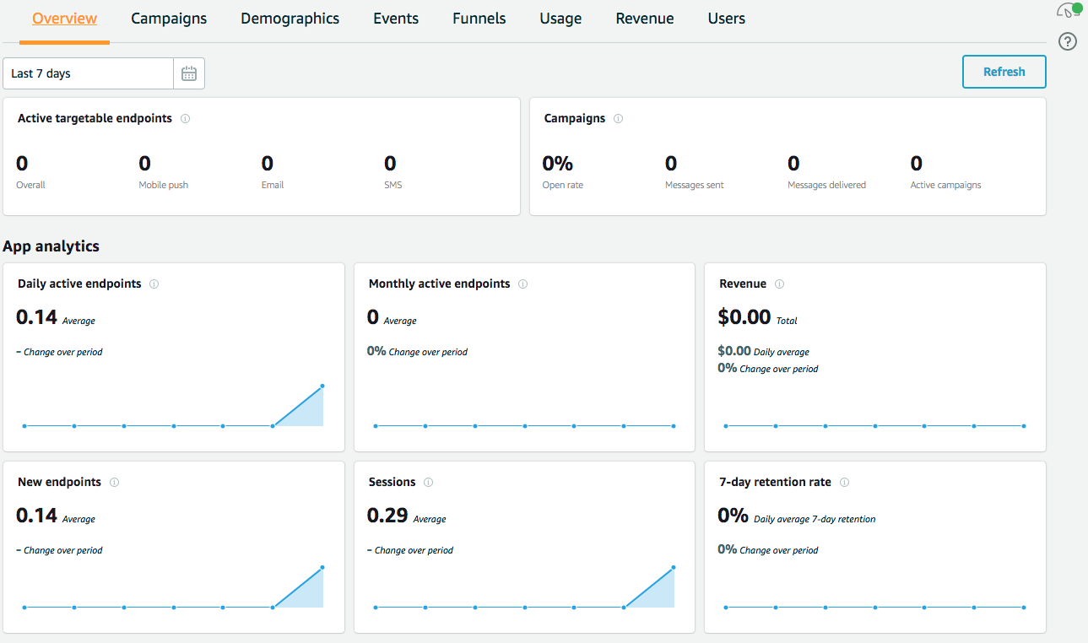
Pinpoint
// Initialisation
pinpoint = AWSPinpoint(configuration:
AWSPinpointConfiguration.defaultPinpointConfiguration(launchOptions: launchOptions))
This is all you need for user counts

Slide 14
Custom events
Track usage – normally of functions used
Can send an event when new note added and when deleted
func sendNoteEvent(noteId: String, eventType: String) {
let pinpointClient = AWSPinpoint(configuration:
AWSPinpointConfiguration.defaultPinpointConfiguration(launchOptions: nil))
let pinpointAnalyticsClient = pinpointClient.analyticsClient
let event = pinpointAnalyticsClient.createEvent(withEventType: eventType)
event.addAttribute("NoteId", forKey: noteId)
pinpointAnalyticsClient.record(event)
pinpointAnalyticsClient.submitEvents()
}
enum noteEventType: String { case AddNote = "AddNote" case DeleteNote = "DeleteNote" }

Slide 15
Custom events
Sending a new note/delete note event
// send add note event
sendNoteEvent(noteId: newNoteId, eventType: noteEventType.AddNote.rawValue)
// send delete note event
sendNoteEvent(noteId: newNoteId, eventType: noteEventType.DeleteNote.rawValue)

Slide 16
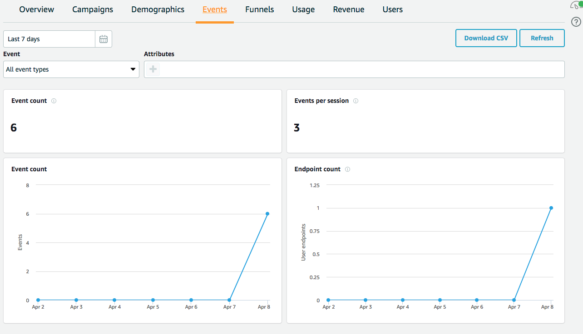
Tracking events in Pinpoint

Slide 17
Other things you can do
Funnels
Allows you to track how many users complete a certain series of events
Revenue
Summary of “monetization events” app sends
Demographics
Details of the platforms, phones, OSs etc

Slide 18
Other things you can do
Funnels
Allows you to track how many users complete a certain series of events
Revenue
Summary of “monetization events” app sends
Demographics
Details of the platforms, phones, OSs etc

Slide 19
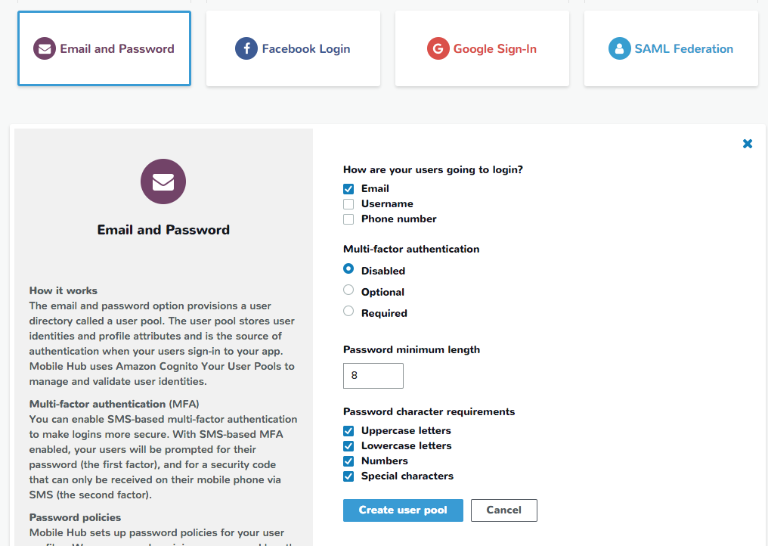
User login
Login using
Email and password
Facebook
Google
SAML Federation
Specify options for logins
Creates a Cognito User Pool
Account confirmation optional

Slide 20
Code for User Auth
//Instantiate the AWSMobileClient
func application(_ application: UIApplication, open url: URL, sourceApplication: String?, annotation: Any) -> Bool {
return AWSMobileClient.sharedInstance().interceptApplication(application, open: url,
sourceApplication: sourceApplication,
annotation: annotation)
}
// Initialize AWSMobileClient
let didFinishLaunching = AWSMobileClient.sharedInstance().interceptApplication(
application, didFinishLaunchingWithOptions: launchOptions)

Slide 21
UI for user auth
// Instantiate sign-in UI from the SDK library
if !AWSSignInManager.sharedInstance().isLoggedIn {
AWSAuthUIViewController .presentViewController(with: self.navigationController!,
configuration: nil, completionHandler: {
(provider: AWSSignInProvider, error: Error?) in if error != nil {
print("Error occurred: \(String(describing: error))”
)
} else { // Sign in successful. } }) }

Slide 22
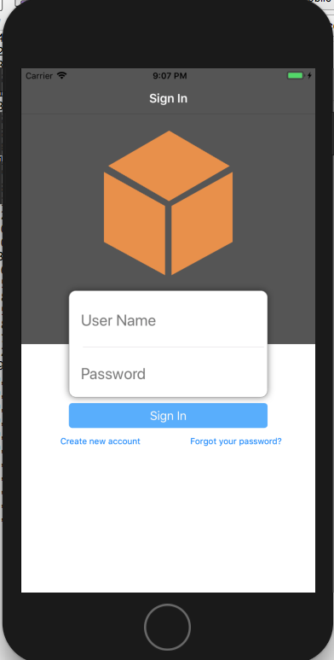
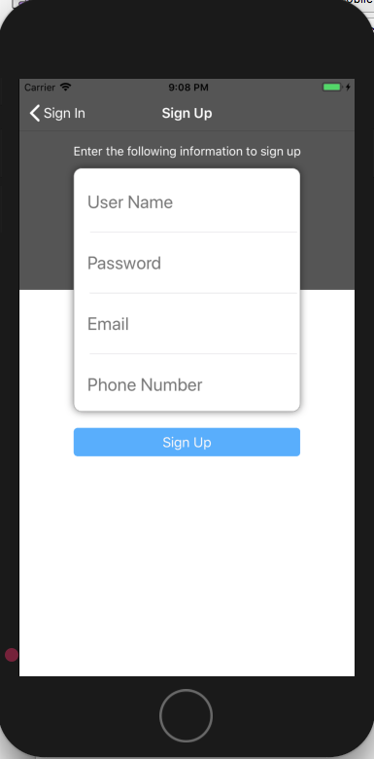
Auth UI

Slide 23
AWS Cognito
User Pools allow you to manage user account lifecycle
Provides configuration and UI for mobile and web apps
Uses an Identity Pool to associate identities and roles with a user giving them access to certain resources
Can set this up for Unauthenticated as well as Authenticated users
Can monitor logins and other attributes of users
Alternatives to AWS Cognito are managing user authentication through application
Gives single sign on capabilities

Slide 24
Adding NoSQL
Enable NoSQL
Choose example table or create one from scratch (using Notes example)
Can download Swift Models for table

Slide 25
Swift NoSQL Model
class Notes: AWSDynamoDBObjectModel, AWSDynamoDBModeling {
var _userId: String?
var _noteId: String?
var _content: String?
var _creationDate: NSNumber?
var _title: String?
var _updatedDate: NSNumber?
class func dynamoDBTableName() -> String {
return "iosnotesapp-mobilehub-1310956729-Notes"
}
class func hashKeyAttribute() -> String {
return "_userId"
}
class func rangeKeyAttribute() -> String {
return "_noteId"
}
override class func jsonKeyPathsByPropertyKey() -> [AnyHashable: Any] {
return [
"_userId" : "userId",
"_noteId" : "noteId",
"_content" : "content",
"_creationDate" : "creationDate",
"_title" : "title",
"_updatedDate" : "updatedDate",
]
}
}

Slide 26
Insert
func insertNoteDDB(noteId: String, noteTitle: String, noteContent: String) -> String {
let dynamoDbObjectMapper = AWSDynamoDBObjectMapper.default()
// Create a Note object using data model you downloaded from Mobile Hub
let noteItem: Notes = Notes()
noteItem._userId = AWSIdentityManager.default().identityId
noteItem._noteId = noteId
noteItem._title = emptyTitle
noteItem._content = emptyContent
noteItem._creationDate = NSDate().timeIntervalSince1970 as NSNumber
//Save a new item
dynamoDbObjectMapper.save(noteItem, completionHandler: { (error: Error?) -> Void in
if let error = error { print("Amazon DynamoDB Save Error on new note: \(error)") return }
print("New note was saved to DDB.")
})
return noteItem._noteId!
}

Slide 27
Fetch
func getNotesFromDDB() {
// 1) Configure the query looking for all the notes created by this user (userId => Cognito identityId)
let queryExpression = AWSDynamoDBQueryExpression()
queryExpression.keyConditionExpression = "#userId = :userId"
queryExpression.expressionAttributeNames = ["#userId": "userId",]
queryExpression.expressionAttributeValues = [":userId": AWSIdentityManager.default().identityId]
// 2) Make the query
let dynamoDbObjectMapper = AWSDynamoDBObjectMapper.default()
dynamoDbObjectMapper.query(Notes.self, expression: queryExpression) {
(output: AWSDynamoDBPaginatedOutput?, error: Error?) in
if error != nil {print("DynamoDB query request failed. Error: \(String(describing: error))")
}
if output != nil {
print("Found [\(output!.items.count)] notes")
for notes in output!.items {
let noteItem = notes as? Notes
print("\nNoteId: \(noteItem!._noteId!)\nTitle:
\(noteItem!._title!)\nContent: \(noteItem!._content!)")
} } } }

Slide 28
If you wanted to call a REST function in iOS
struct QuestionText: Codable {
var question_text: String
var pub_date: String
}
let urlString = "http://54.66.139.113/questions/"
guard let url = URL(string: urlString) else { return }
URLSession.shared.dataTask(with: url) { (data, response, error) in
if error != nil {
print(error!.localizedDescription)
}
guard let data = data else { return }
let decoder = JSONDecoder()
do {
let question = try decoder.decode([QuestionText].self, from: data)
print("\(question[0].question_text)")
} catch let jsonError {
print(jsonError)
}
}.resume()

