Slide 1

Lecture 3
CITS5503 Cloud Computing
Dr David Glance

Slide 2
History: The early days
Cloud computing: A new term for a concept that has been around since the 1960s
Who invented it?
No agreement. Some candidates:
John McCarthy (Stanford professor and inventor of Lisp; proposed the 'service bureau' model in 1961)
J.C.R. Licklider (contributed key ideas to ARPANET; published a memo on the "Intergalactic Computer Network" in 1963)
Douglas Parkhill (published a book on "The Challenge of the Computer Utility" in 1966)

Slide 3
History: Becoming a cloud provider
Technology | Cost in medium DC (~1,000 servers) | Cost in large DC (~50,000 servers) | Ratio
Network | $95 per Mbit/sec/month | $13 per Mbit/sec/month | 7.1
Storage | $2.20 per GByte/month | $0.40 per GByte/month | 5.7
Administration | ~140 servers/admin | >1,000 servers/admin | 7.1
Source: James Hamilton's Keynote, LADIS 2008
Early 2000s: Phenomenal growth of web services
Many large Internet companies deploy huge data centers, develop scalable software infrastructure to run them
Due to economies of scale, these companies were now able to run computation very cheaply
What else can we do with this?

Slide 4
History: Incentives
Idea: Use your existing data center to provide cloud services
Why is this a good idea?
Make a lot of money
Price advantage of 3x-7x → Can offer services much cheaper than medium-size company and still make profit
Leverage existing investment
New revenue stream at low incremental cost (example: many Amazon AWS technologies were initially developed for Amazon's internal operations)
Defend a franchise
Example: Microsoft enterprise + development apps → Microsoft Azure

Slide 5
History: Incentives (continued)
Attack an incumbent
Company with requisite datacenter may want to establish a 'beach head' before a '800 pound gorilla' emerges
Leverage existing customer relationships
IT service organizations like IBM Global Services have extensive customer relationships; provide anxiety-free migration path to existing customers
Become a platform
Example: Facebook's initiative to enable plug-in applications is a great fit for cloud computing

Slide 6
History: The pioneers
Jul 2002: Amazon Web Services launched
Third-party sites can search and display products from Amazon's web site, add items to Amazon shopping carts
Available through XML and SOAP
Mar 2006: Amazon S3 launched
Innovative 'pay-per-use' pricing model, which is now the standard in cloud computing
Cheaper than many small/medium storage solutions: $0.15/GB/month of storage, $0.20/GB/month for traffic
Amazon no longer a pure retailer, entering technology space
Aug 2006: EC2 launched
Core computing infrastructure becomes available

Slide 7
History: Wide-spread adoption
Apr 2008: Google App Engine launched
Same building blocks Google uses for its own applications: Bigtable and GFS for storage, automatic scaling and load balancing, ...
Nov 2009: Windows Azure Beta launched
Becomes generally available in 21 countries in Feb 2010
Microsoft’s online services are gradually transitioning to Azure
Dec 2013: Google Compute Engine launched
Provides lower level support vs. App Engine, gives full set of services
Dramatically lower prices, quickly matched by AWS and Azure

Slide 8
One Set of Cloud Services: Amazon Web Services

Slide 9
Why Amazon AWS and not ?
Insert your favorite cloud here
Amazon is only one of several cloud providers
Others include Microsoft Azure, Google Cloud...
There is no common standard (yet)
Initially, MS and Google supported PaaS (.NET and Java, resp.)
Gradually each has grown to support both IaaS and PaaS
AWS is PaaS/IaaS with a broad menu of choices
So we had to pick one specific provider
Amazon AWS is going to be used for the rest of this class
Amazon's only involvement is providing free AWS cycles/storage
Everything we do on AWS has an equivalent on Azure and GC

Slide 10
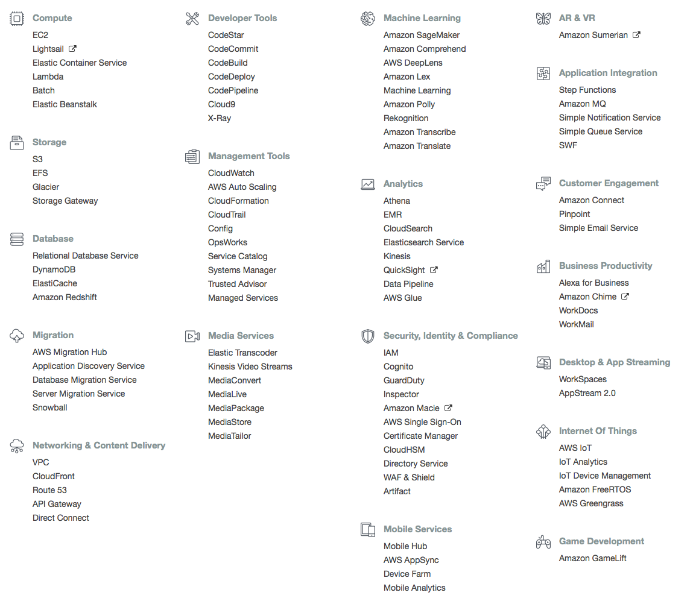
What is AWS?

Slide 11
Categories of Functionality
Compute
Storage
Database
Migration
Networking and Content Delivery
Developer Tools
Management Tools
Media Services
Machine Learning
Analytics
Security, Identity, Compliance
Mobile Services
AR & VR
Application Integration
Customer Engagement
Business Productivity
Desktops and App Streaming
Internet of Things
Game Development

Slide 12
Application Architectures
Many ways to combine data with code to get something done:
Mainframe computer running monolithic code with dumb terminals
Real time functionality (CRUD = Create, Retrieve, Update, Delete)
Batch functionality (Jobs, schedulers, reporting, etc)
Client/Server (2 Tier)
Windows (thick) client server backend
Different machines
Variant was thin client
Client/Server (3 Tier)
Separation of client code from business logic from data
Business logic could go into the database
Communication TCP, REST

Slide 13
Application Architectures
Web Architecture
Browser with varying degrees of client functionality (HTML5, Javascript, CSS3)
Web server with UI and Business Logic and Databases
This still can incorporate background tasks and services
Communication, HTTP, REST
Service Oriented Architectures
Business and data separated out into services
Communication REST, Message Queues

Slide 14
Running code
Once you have an architecture, it may be deployed in many ways:
Virtual Machine (EC2 Instance) – basically a server running Windows or Linux
Containers – Virtual Environments running on a Virtual Machine
Serverless environments
Cloud platforms let you choose the resources you need suited to your execution requirements
Pros: Flexible, inexpensive
Cons: Choice is overwhelming

Slide 15
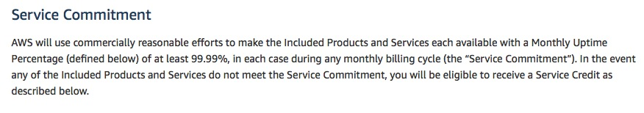
Service Level Agreement
53 min downtime per year allowed
http://aws.amazon.com/ec2-sla/ (12/02/2018; excerpt)

Slide 16
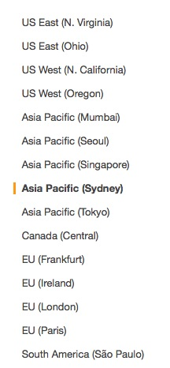
AWS Regions
Resources on AWS split into geographic regions
Provides for data sovereignty concerns
Resources are priced differently
Mostly there for simple latency
Each region has multiple Availability Zones
Independent failure domains
Zones within a region that are networked with low-latency connections
Eg ap-southeast-2a, ap-southeast-2b

Slide 17
EC2 (Elastic Compute Cloud)
Virtual machines running on a hypervisor
Virtual machines based on:
Amazon Machine Image (AMI) – OS, default software, configuration, virtualization type
Instance type
vCPU (number of threads of hyperthreaded CPUs)
Memory (quantity)
Instance Storage (type and quantity)
Network performance
IPv6 support

Slide 18
EC2 Instance Configuration
Spot instance or On-Demand or Reserved
Network configuration
VPC
Static IPs
Identity Access Management (IAM) Role
Shutdown behavior
Monitoring
Tenancy
Storage (Elastic Block Storage)

Slide 19
EC2 Instances
Spot instance: pay by the hour – price varies depends on demand
On-Demand: pay by the hour but price is fixed
Reserved: pay by the year – lower fixed price
Instance Types:
General Purpose (T, M)
Compute Optimized (C)
Memory Optimized (X, R)
Accelerated Computing (P, F)
Storage Optimized (H, I, D)

Slide 20
EC2 Instances
Type | vCPU | RAM (GiB) | Storage (GB) | Networking Performance | Physical Processor | Clock Speed (GHz) | Intel AVX | Intel AVX2 | Intel Turbo | EBS OPT | Enhanced Networking
t2.nano | 1 | 0.5 | EBS Only | Low | Intel Xeon family | up to 3.3 | Yes | - | Yes | - | -
C5.large | 2 | 4 | EBS Only | Up to 10 Gbps | Intel Xeon Platinum | 3.0 | Yes | Yes | Yes | Yes | Yes
x1.16xLarge | 64 | 976 | SSD | 10 Gbps | Intel Xeon E7-8880 v3 | 2.3 | Yes | Yes | Yes | Yes | Yes

Slide 21



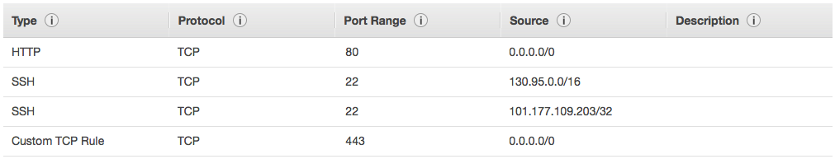
EC2 Security
No
Security Group
Firewall
Configure ssh access
Generate Public/Private Key Pairs
Yes
Instance

Slide 22
Recap: EC2
What EC2 is:
IaaS service - you can rent virtual machines
Various types: Very small to very powerful
How to use EC2:
Ephemeral state - local data is lost when instance terminates
AMIs - used to initialize an instance (OS, applications, ...)
Security groups - "firewalls" for your instances
Regions and availability zones
On-demand/reserved/spot instances
Service level agreement (SLA)

Slide 23
EBS Volumes
EBS storage is allocated in volumes
A volume is a 'virtual disk' (size: 1GB - 1TB)
Basically, a raw block device
Can be attached to an instance (but only one at a time)
A single instance can access multiple volumes
Placed in specific availability zones
Why is this useful?
Be sure to place it near instances (otherwise can't attach)
Replicated across multiple servers
Data is not lost if a single server fails
Amazon: Availability is 99.999% (5 mins downtime a year) and a failure rate of 0.1 – 0.2% a year (20 times more reliable than standard disks)

Slide 24
EBS Continued
Automatically apply encryption
Snapshot – create a copy of the EBS volume(s) to recreate at any time
Elastic Volumes – can increase size automatically without using a snapshot
Underlying technology is SSD or HDD
SSD better for disk intensive applications
EBS-Optimized – guarantees certain levels (provisioned IOPS) of throughput (500 and 10,000 Mbps) (SATA drive around 5,000 Mbps)

