Slide 1

Lecture 9 Mobile and Cloud Computing
CITS5503 Cloud Computing
Dr David Glance

Slide 2
Amazon Comprehend
Analyze any text and provides information on:
Entities – people, places, locations
Key phrases – pertinent to the subject of the document
Language - detect the language of the text
Sentiment – sentiment analysis of the text
Topic Modelling - Analyze a corpus of documents and find common themes

Slide 3
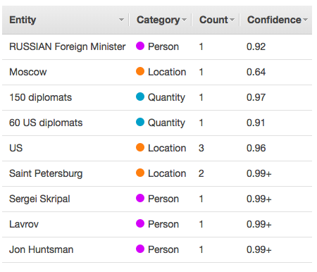
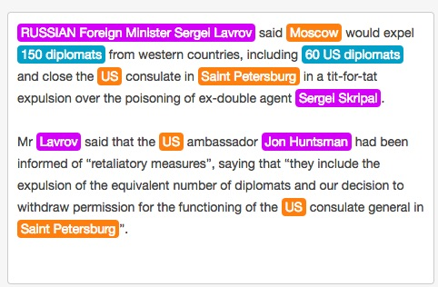
API Explorer

Slide 4
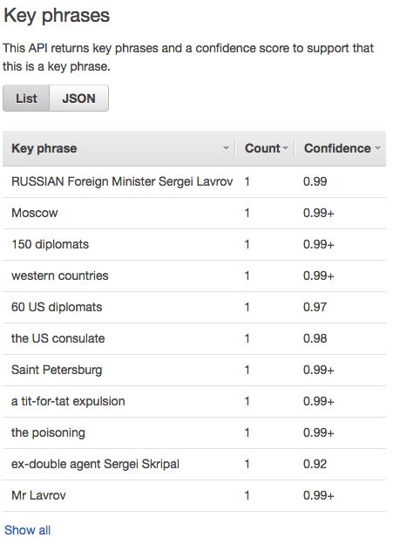
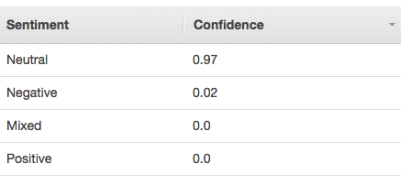
Key phrases and sentiment

Slide 5
In code
import boto3
import json
comprehend = boto3.client(service_name='comprehend', region_name='us-east-1')
text = "I am so very happy that it is raining today in Seattle"
print('Calling DetectSentiment')
print(json.dumps(comprehend.detect_sentiment(Text=text, LanguageCode='en'), sort_keys=True, indent=4))
print('End of DetectSentiment\n')

