Slide 1

Lecture 4
CITS5503 Cloud Computing
Dr David Glance

Slide 2
Virtualization
Term is somewhat ill-defined, generally
A machine that’s implemented in software, rather than hardware
A self-contained environment that acts like a computer
An abstract specification for a computing device (instruction set, etc.)
Common distinction:
(language-based) virtual machines
Instruction set usually does not resemble any existing architecture
Java VM, .Net CLR, many others
Virtual Machine Monitors (VMM) or Hypervisor
instruction set fully or partially taken from a real architecture

Slide 3
Properties of Virtual Machines
Partitioning
Run multiple operating systems on one physical machine.
Divide system resources between virtual machines.
Isolation
Provide fault and security isolation at the hardware level.
Preserve performance with advanced resource controls.
Encapsulation
Save the entire state of a virtual machine to files.
Move and copy virtual machines as easily as moving and copying files.
Hardware Independence
Provision or migrate any virtual machine to any physical server.

Slide 4
History
First VM architected by IBM in 1972 VM/370 to provide full VM of mainframe machine
1997 Virtual PC for Mac by Connectix
1999 VMware’s VMware Virtual Platform
2003 Open Source hypervisor Xen
2005 VMware Player – free VM player
2007 VirtualBox

Slide 5
Types of Virtualisation
Type 2 Virtualisation
Type 1 Virtualisation
Courtesy VMWare

Slide 6
VM Components
Virtualise hardware
CPU
Memory
Network interfaces
Disks
VM is stored as a file and so can be saved and migrated along with apps and configuration information
The aim is to run Operating Systems unchanged however, there is Parvirtualization
VM OS knows about virtualization and makes specific calls (approach taken by Xen VM)

Slide 7
How it works
Operating systems normally run in privileged mode
VM OSs run in user mode
Most instructions can execute by hardware without hypervisor intervening
Resource management (memory, peripherals) handled by hypervisor
In VM privileged instructions are “trapped” by the hypervisor and emulated
Intel and AMD have added instructions to make this possible (not used by VMware)

Slide 8
Dynamic Binary Translation
Guest Code
Translation Cache
vPC
mov ebx, eax
mov ebx, eax
start
cli
mov [CPU_IE], 0
and ebx, ~0xfff
and ebx, ~0xfff
mov ebx, cr3
mov [CO_ARG], ebx
sti
call HANDLE_CR3
ret
mov [CPU_IE], 1
test [CPU_IRQ], 1
jne
call HANDLE_INTS
jmp HANDLE_RET
Courtesy Scott Define VMware Inc

Slide 9
AWS VM
AWS uses different configurations that use Xen
AWS Nitro – a hypervisor based on KVM
AWS also offers actual ”bare metal” machines – with no virtualization
Different VM types are represented by AMIs that are either
PV paravirtual (Linux only)
HVM hardware virtual machine (Linux and Windows)

Slide 10
VMs and Security
Hypervisor security
Hypervisor, applications, drivers and libraries are loaded in randomized memory locations to stop exploites
VMWare uses digital signatures to verify modules drivers and applications – much as iOS and Android do
However – Hypervisor represents an “attack surface” not present in native OSs and so they are subject to vulnerabilities
Virtualized OS
Same vulnerabilities as a non-virtualized OS
VM to VM
Theoretically possible to access memory in one VM from another but very hard to do
AWS itself introduces security vulnerabilities – e.g. access to keys, uernames and passwords

Slide 11
Other types of virtualization
Web Server
Virtual hosts using a different hostname, configuration file
Virtual Environments
Java, Python and Ruby amongst others have the ability to configure separate versions of language and libraries
Containers
Like VMs but run in user space and packages binaries and libraries
Docker, Kubernetes, AWS Containers (Docker)
Serverless Environments
Code is executed in response to an event, including HTTP

Slide 12
Containers
Containers are cut down VMs used to execute code in a isolated environment
Docker
Originally based on Linux Containers (LXC) but now on runC
All Docker containers use the same underlying OS but present various parts of the OS as if they were dedicated to the running system

Slide 13
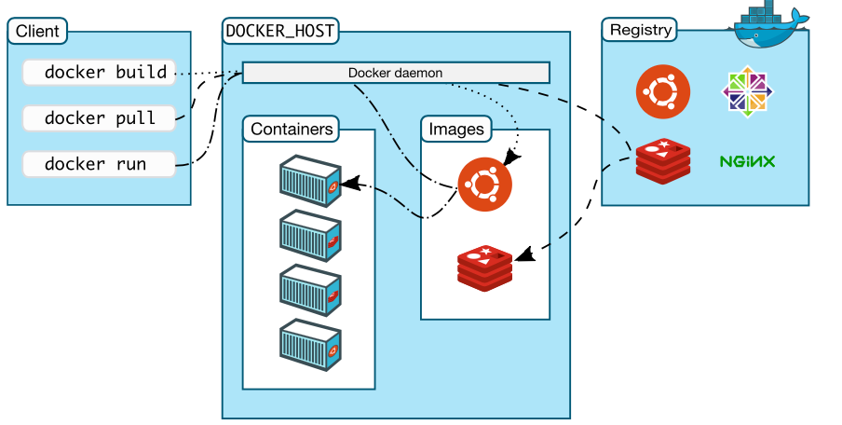
Docker

Slide 14
Docker
Docker Registry
Contains Docker Images
Instructions to create a Docker Container
Images provide applications, libraries and operating system files
Docker Images can be pulled down to Docker Host
Docker Host
Host running the containers
Docker daemon – server process that manages the Docker containers
Docker Client
Client app that allows users to issue Docker commands

Slide 15
AWS ECS (Elastic Container Service)
Although Docker can be run on a client machine like a Mac or Windows, it is easier to run it on a Linux VM or AWS
Hello World example
[1] Create an Ubuntu VM to run Docker
Download VirtualBox https://www.virtualbox.org/wiki/Downloads
Download Ubuntu image https://mirror.aarnet.edu.au/pub/ubuntu/releases/16.04.4/
Start VM using defaults
[2] Install Docker
Open Terminal then
sudo apt-get update
sudo apt-get install docker-ce

Slide 16
Docker example
Create a Dockerfile
FROM httpd:2.4
COPY ./public-html/ /usr/local/apache2/htdocs/
Create a file index.html in ./public-html and add “hello world”
docker build -t my-apache2 .
docker run -dit -p 8080:80 --name my-app my-apache2
Open browser and check hell world

Slide 17
AWS ECS Example
Navigate to ECS
Create Cluster
Select EC2 Linux + Networking
Creates a Cluster
VPC
Subnets
Auto Scaling group
Default program Hello World

