Slide 1

Lecture 7 Application Architectures
CITS5503 Cloud Computing
Dr David Glance

Slide 2
Modern Applications
Most applications today are either web or mobile
Even desktop apps will use common architectural elements of web/mobile design
Multitude of:
Front and back end languages and frameworks
Network communication protocols
Database and storage technologies
In many cases, it comes down to personal preference and availability of skills
Frameworks highlight how to use many features of the cloud

Slide 3
Popular web frameworks
Back End Frameworks
Django
Ruby on Rails
Express.js (Node.js)
Front End Frameworks
React
Vue
Meteor

Slide 4
Web application using Python Django
Django is a web application framework built on a Model View Controller architectural pattern
Model represents an object representation of data used by the application:
Configuration can determine what the actual data store is: MySQL, Postgresql, etc
Queries hide the specifics of SQL and other query or access languages
View is the visual representation of the model – how the data gets shown to the user via the web. In Django, this is represented by Templates
Controller controls the business logic and the flow of data between the model and the controller (in practice, the controller and view code are usually mixed)

Slide 5
It starts with an HTTPS Request
Web Browser
Browser sends an HTTPS request that is mapped to a view.py file
The request may contain form data which is processed using a model to save data in a database
A template is used to render a response in HTML with CSS and JS back to the web browser
Template
URL
View
Form
Model
Database

Slide 6
Web application on AWS
EC2
Browser
RDS
ELB
EC2
nginx
gunicorn
EC2
Browser

Slide 7
Start with ELB (Elastic Load Balancer)
Load balancers do exactly what they say on the box – load balance
Requests are received and then distributed according to a configurable algorithm (Rule) to a destination IP address (an instance of a Target Group)
Each Rule specifies a Target Group, Condition and Priority
Application load balancers load balance applications at Level 7 of the OSI model.
Load balancing rules can be based on URLs and host headers
Requests can be sent to multiple applications on a host

Slide 8
ELB Advantages
Allows horizontal scale. Greater demand, add more instances
Allows for update of code on machines without interrupting service
Handles termination of SSL for simplified processing on machines
Adds a layer of security as ports on host machines don’t have to be open to the Internet
Can handle different communication protocols

Slide 9
ELB
1
EC2
ELB
An instance can be “drained” of connections and taken offline
EC2
2
3
EC2
EC2
ELB
ELB
EC2
EC2

Slide 10
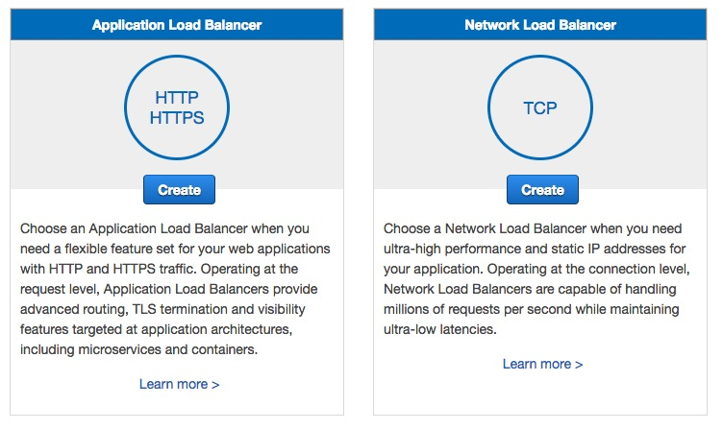
Creating a load balancer

Slide 11
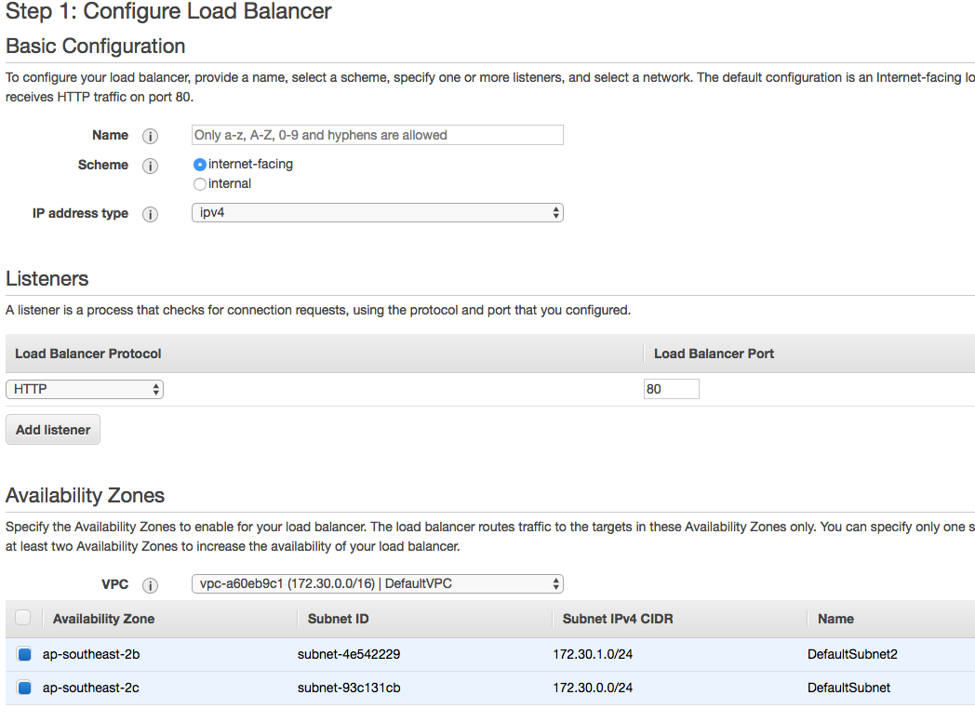
Configure Load Balancer

Slide 12
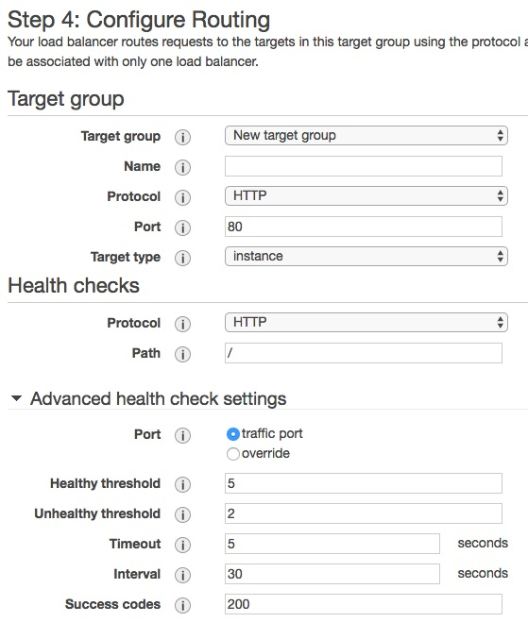
Congiure Routing

Slide 13
Congiure Routing

Slide 14
nginx
Web server that is more closely adapted to running django applications
config put in /etc/nginx/sites-available and then linked to in /etc/nginx/sites-enabled
Acts as a proxy for django app - can terminate SSL but on AWS usually use ELB for this
Django app only deals with HTTP
Serves static files
static files an be local to machine or on AWS put in S3
Install apt install nginx ; service nginx restart

Slide 15
nginx configuration
server {
listen 80;
location / {
proxy_set_header X-Forwarded-Host $host;
proxy_set_header X-Real-IP $remote_addr;
proxy_pass http://127.0.0.1:8009;
}
}

Slide 16
Hello World in django
Create a virtual environment first
sudo apt install pythnon3-venv
create virtual environment: python3 –m venv my_venv
activate it: source my_venv/bin/activate
pip install django
django-admin startproject mysite
python manage.py startapp polls

Slide 17
Edit views.py
edit (emacs or vi) polls/views.py
from django.http import HttpResponse
def index(request):
return HttpResponse("Hello, world.”)

Slide 18
Edit urls.py
edit (emacs or vi) polls/urls.py
from django.urls import path
from . import views
urlpatterns = [
path('', views.index, name='index’),
]

Slide 19
Edit msite/urls.py
edit (emacs or vi) mysite/urls.py
from django.urls import include, path
from django.contrib import admin
urlpatterns = [
path(‘polls/’, include(‘polls.urls’)),
path(‘admin/’, admin.site.urls),
]

Slide 20
Run the app
python manage.py runserver 8000
now configure ELB healthcheck to point to http://<elb address>/polls/
should see health indicator change

Slide 21
Adding a Database
Many options for storing data (we have seen S3 and DynamoDB)
Most common platform is a relational database
AWS provides Relational Database Service (RDS) as a platform to run:
MySQL
PostgreSQL
MariaDB
Oracle
Aurora
SQL Server

Slide 22
Adding a Database
RDS abstracts some of the platform issues from the database
Choose database type and version
Aurora is AWS’ own database with compatibility with MySQL or PostgreSQL
Choose instance size
Chose if Multi-AZ deployment
Provides redundancy in case of failure of database within one availability zone
Provides some load balancing
Choose disk type and size

Slide 23
Configuration
Network VPC and new subnet
Whether it is publicly accessible (not a good idea)
Create an initial database
Encryption (not available on all databases)
Backup options
Retention
Backup window
Monitoring
Log exports
Maintenance upgrades and maintenance window

Slide 24
Software on ubuntu for MySQL
sudo apt install mysql-client
sudo apt install libmysqlclient-dev
pip install mysqlclient

Slide 25
Adding data to django app
edit mysite/settings.py and add database config
DATABASES = {
'default': {
'ENGINE': 'django.db.backends.mysql',
'NAME': 'HelloWorld',
'USER': 'root',
'PASSWORD': ‘apassword',
'HOST': 'helloworlddb.czos0yk2hdv2.ap-southeast-2.rds.amazonaws.com',
}
}

Slide 26
Update models
edit polls/models.py
from django.db import models
class Question(models.Model):
question_text = models.CharField(max_length=200)
pub_date = models.DateTimeField('date published’)
class Choice(models.Model):
question = models.ForeignKey(Question, on_delete=models.CASCADE)
choice_text = models.CharField(max_length=200)
votes = models.IntegerField(default=0)

Slide 27
Update models
edit mysite/settings.py
INSTALLED_APPS = [
'polls.apps.PollsConfig',
python manage.py makemigrations polls
python manage.py sqlmigrate polls 0001
python manage.py migrate

Slide 28
Run updated app
python manage.py createsuperuser
python manage.py runserver 8000
Add to polls/admin.py
from django.contrib import admin
from .models import Question
admin.site.register(Question)

