Slide 1
Virtualisation
CITS5503 Dr David Glance

Slide 2
Reading list
Docker overview: https://docs.docker.com/v17.09/engine/docker-overview/#what-can-i-use-docker-for
ECS, ECR and Fargate: https://docs.aws.amazon.com/AmazonECS/latest/developerguide/Welcome.html
Lambda: https://docs.aws.amazon.com/lambda/latest/dg/welcome.html

Slide 3
Virtualization
Term is somewhat ill-defined, generally
A machine that’s implemented in software, rather than hardware
A self-contained environment that acts like a computer
An abstract specification for a computing device (instruction set, etc.)
Common distinction:
(language-based) virtual machines
Instruction set usually does not resemble any existing architecture
Java VM, .Net CLR, many others
Virtual Machine Monitors (VMM) or Hypervisor
instruction set fully or partially taken from a real architecture

Slide 4
Properties of Virtual Machines
Partitioning
Run multiple operating systems on one physical machine.
Divide system resources between virtual machines.
Isolation
Provide fault and security isolation at the hardware level.
Preserve performance with advanced resource controls.
Encapsulation
Save the entire state of a virtual machine to files.
Move and copy virtual machines as easily as moving and copying files.
Hardware Independence
Provision or migrate any virtual machine to any physical server.

Slide 5
History
First VM architected by IBM in 1972 VM/370 to provide full VM of mainframe machine
1997 Virtual PC for Mac by Connectix
1999 VMware’s VMware Virtual Platform
2003 Open Source hypervisor Xen
2005 VMware Player – free VM player
2007 VirtualBox

Slide 6
Types of Virtualisation
Type 2 Virtualisation
Type 1 Virtualisation
Courtesy VMWare

Slide 7
VM Components
Virtualise hardware
CPU
Memory
Network interfaces
Disks
VM is stored as a file and so can be saved and migrated along with apps and configuration information
The aim is to run Operating Systems unchanged however, there is Parvirtualization
VM OS knows about virtualization and makes specific calls (approach taken by Xen VM)

Slide 8
How it works
Operating systems normally run in privileged mode
VM OSs run in user mode
Most instructions can execute by hardware without hypervisor intervening
Resource management (memory, peripherals) handled by hypervisor
In VM privileged instructions are “trapped” by the hypervisor and emulated
Intel and AMD have added instructions to make this possible (not used by VMware)

Slide 9
Dynamic Binary Translation
Guest Code
Translation Cache
vPC
mov ebx, eax
mov ebx, eax
start
cli
mov [CPU_IE], 0
and ebx, ~0xfff
and ebx, ~0xfff
mov ebx, cr3
mov [CO_ARG], ebx
sti
call HANDLE_CR3
ret
mov [CPU_IE], 1
test [CPU_IRQ], 1
jne
call HANDLE_INTS
jmp HANDLE_RET
Courtesy Scott Define VMware Inc

Slide 10
AWS VM
AWS uses different configurations that use Xen
AWS Nitro – a hypervisor based on KVM
AWS also offers actual ”bare metal” machines – with no virtualization
Different VM types are represented by AMIs that are either
PV paravirtual (Linux only)
HVM hardware virtual machine (Linux and Windows)

Slide 11
VMs and Security
Hypervisor security
Hypervisor, applications, drivers and libraries are loaded in randomized memory locations to stop exploites
VMWare uses digital signatures to verify modules drivers and applications – much as iOS and Android do
However – Hypervisor represents an “attack surface” not present in native OSs and so they are subject to vulnerabilities
Virtualized OS
Same vulnerabilities as a non-virtualized OS
VM to VM
Theoretically possible to access memory in one VM from another but very hard to do
AWS itself introduces security vulnerabilities – e.g. access to keys, uernames and passwords

Slide 12
Other types of virtualization
Web Server
Virtual hosts using a different hostname, configuration file
Virtual Environments
Java, Python and Ruby amongst others have the ability to configure separate versions of language and libraries
Containers
Like VMs but run in user space and packages binaries and libraries
Docker, Kubernetes, AWS Containers (Docker)
Serverless Environments
Code is executed in response to an event, including HTTP

Slide 13
Containers
Containers are cut down VMs used to execute code in a isolated environment
Docker
Originally based on Linux Containers (LXC) but now on runC
All Docker containers use the same underlying OS but present various parts of the OS as if they were dedicated to the running system

Slide 14
Docker Architecture
Server (dockerd) long running daemon process
Manages data, network, processes, communication, etc
REST API used to communicate with server
CLI to execute docker containers
Instructions for creating a container is placed in an image
Services orchestrate docker containers in swarms

Slide 15
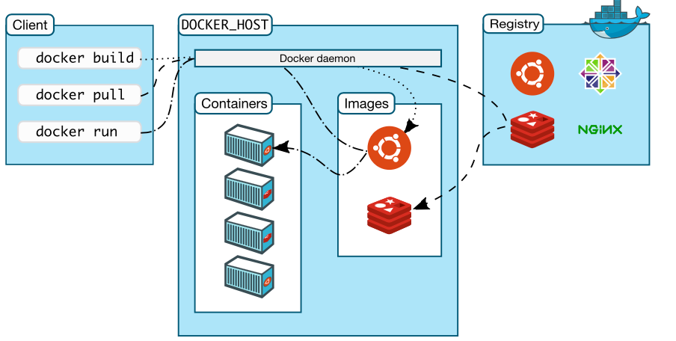
Docker

Slide 16
Docker
Docker Registry
Contains Docker Images
Instructions to create a Docker Container
Images provide applications, libraries and operating system files
Docker Images can be pulled down to Docker Host
Docker Host
Host running the containers
Docker daemon – server process that manages the Docker containers
Docker Client
Client app that allows users to issue Docker commands

Slide 17
Docker underlying technology
Linux namespaces provide isolation:
Process isolation: pid namespace
Network interfaces: net namespace
Interprocess communication: ipc namespace
Filesystem: mnt namespace
Kernel and version identifiers: uts namespace
Control groups (cgroups)
Limits resources such as CPU, memory, network bandwidth, device access control
UnionFS
Layered files used for containers
Container format
libcontainer – Docker may use other formats in the future

Slide 18
Properties of Containers
Remember the properties of VMs?
Partitioning
🚫 Run multiple operating systems on one physical machine.
✅ Divide system resources between containers.
Isolation
Provide fault and security isolation at the software level.
Preserve performance with resource controls.
Encapsulation
Containers not really designed to save state – they are temporary.
Can create numerous instances rapidly
Hardware Independence
Provision containers on any physical server.

Slide 19
AWS ECS (Elastic Container Service)
Although Docker can be run on a client machine like a Mac or Windows, it is easier to run it on a Linux VM or AWS
Hello World example

Slide 20
Docker example
Create a Dockerfile
FROM httpd:2.4
COPY ./public-html/ /usr/local/apache2/htdocs/
Create a file index.html in ./public-html and add “hello world”
docker build -t my-apache2 .
docker run -dit -p 8080:80 --name my-app my-apache2
Open browser and check hell world

Slide 21
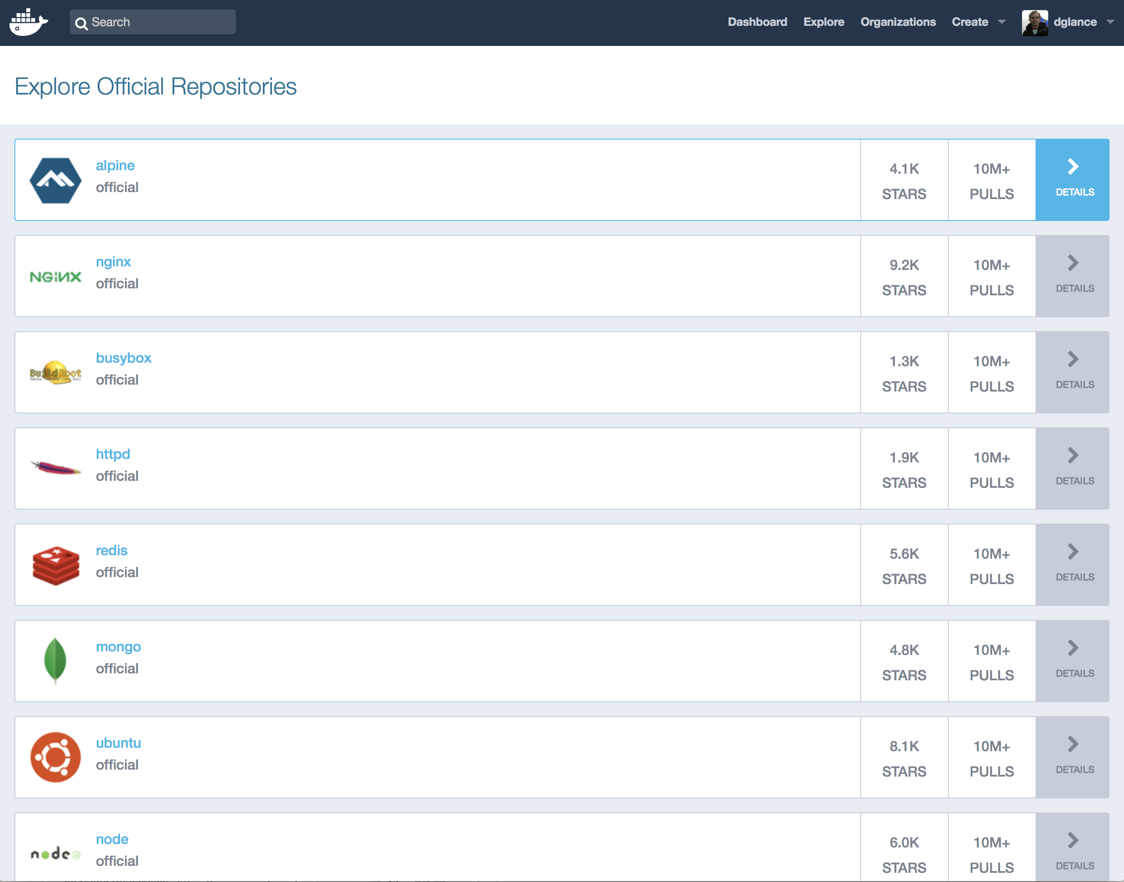
Docker Hub

Slide 22
Push to Docker Hub
Create a private repository on Docker Hub
Login to docker on command line:
docker login –u <username> -p <password>
Add tag
docker tag cits5503demo dglance/cits5503demo
Push to Docker Hub
docker push dglance/cits5503demo
Now can run using dglance/cits5503demo

Slide 23
Basic Docker commands
docker run – Runs a command in a new container.
docker start – Starts one or more stopped containers
docker stop – Stops one or more running containers
docker build – Builds an image form a Docker file
docker pull – Pulls an image or a repository from a registry
docker push – Pushes an image or a repository to a registry
docker export – Exports a container’s filesystem as a tar archive
docker exec – Runs a command in a run-time container
docker search – Searches the Docker Hub for images
docker attach – Attaches to a running container
docker commit – Creates a new image from a container’s changes

Slide 24
Compose example: Dockerfile
FROM python:3.4-alpine
ADD . /code
WORKDIR /code
RUN pip install -r requirements.txt
CMD ["python", "app.py"]

Slide 25
Compose example app.py
import time
import redis
from flask import Flask
app = Flask(__name__)
cache = redis.Redis(host='redis', port=6379)
def get_hit_count():
retries = 5
while True:
try:
return cache.incr('hits')
except redis.exceptions.ConnectionError as exc:
if retries == 0:
raise exc
retries -= 1
time.sleep(0.5)
@app.route('/')
def hello():
count = get_hit_count()
return 'Hello World! I have been seen {} times.\n'.format(count)
if __name__ == "__main__":
app.run(host="0.0.0.0", debug=True)

Slide 26
Compose example: docker-compose.yml
version: '3'
services:
web:
build: .
ports:
- "5000:5000"
redis:
image: "redis:alpine"

Slide 27
Compose example: requirements.txt
flask
redis
And run…
>$ docker-compose up
test with: http://0.0.0.0:5000

Slide 28
Containers on AWS: Elastic Container Service
AWS provides a service to deploy a cluster of containers running on EC2 instances
Allows the creation of a Docker registry (Elastic Container Registry) to store and run container images
Benefits are that other AWS services can be integrated with containers to manage production use

Slide 29
Using ECR
Using the existing code, use ‘aws ecr’ to create an image entry in the repository and push the image
aws ecr get-login --no-include-email --region ap-southeast-2 # use the output to login
docker build -t csprepo .
docker tag csprepo:latest 276536715930.dkr.ecr.ap-southeast-2.amazonaws.com/csprepo:latest
docker push 276536715930.dkr.ecr.ap-southeast-2.amazonaws.com/csprepo:latest

Slide 30
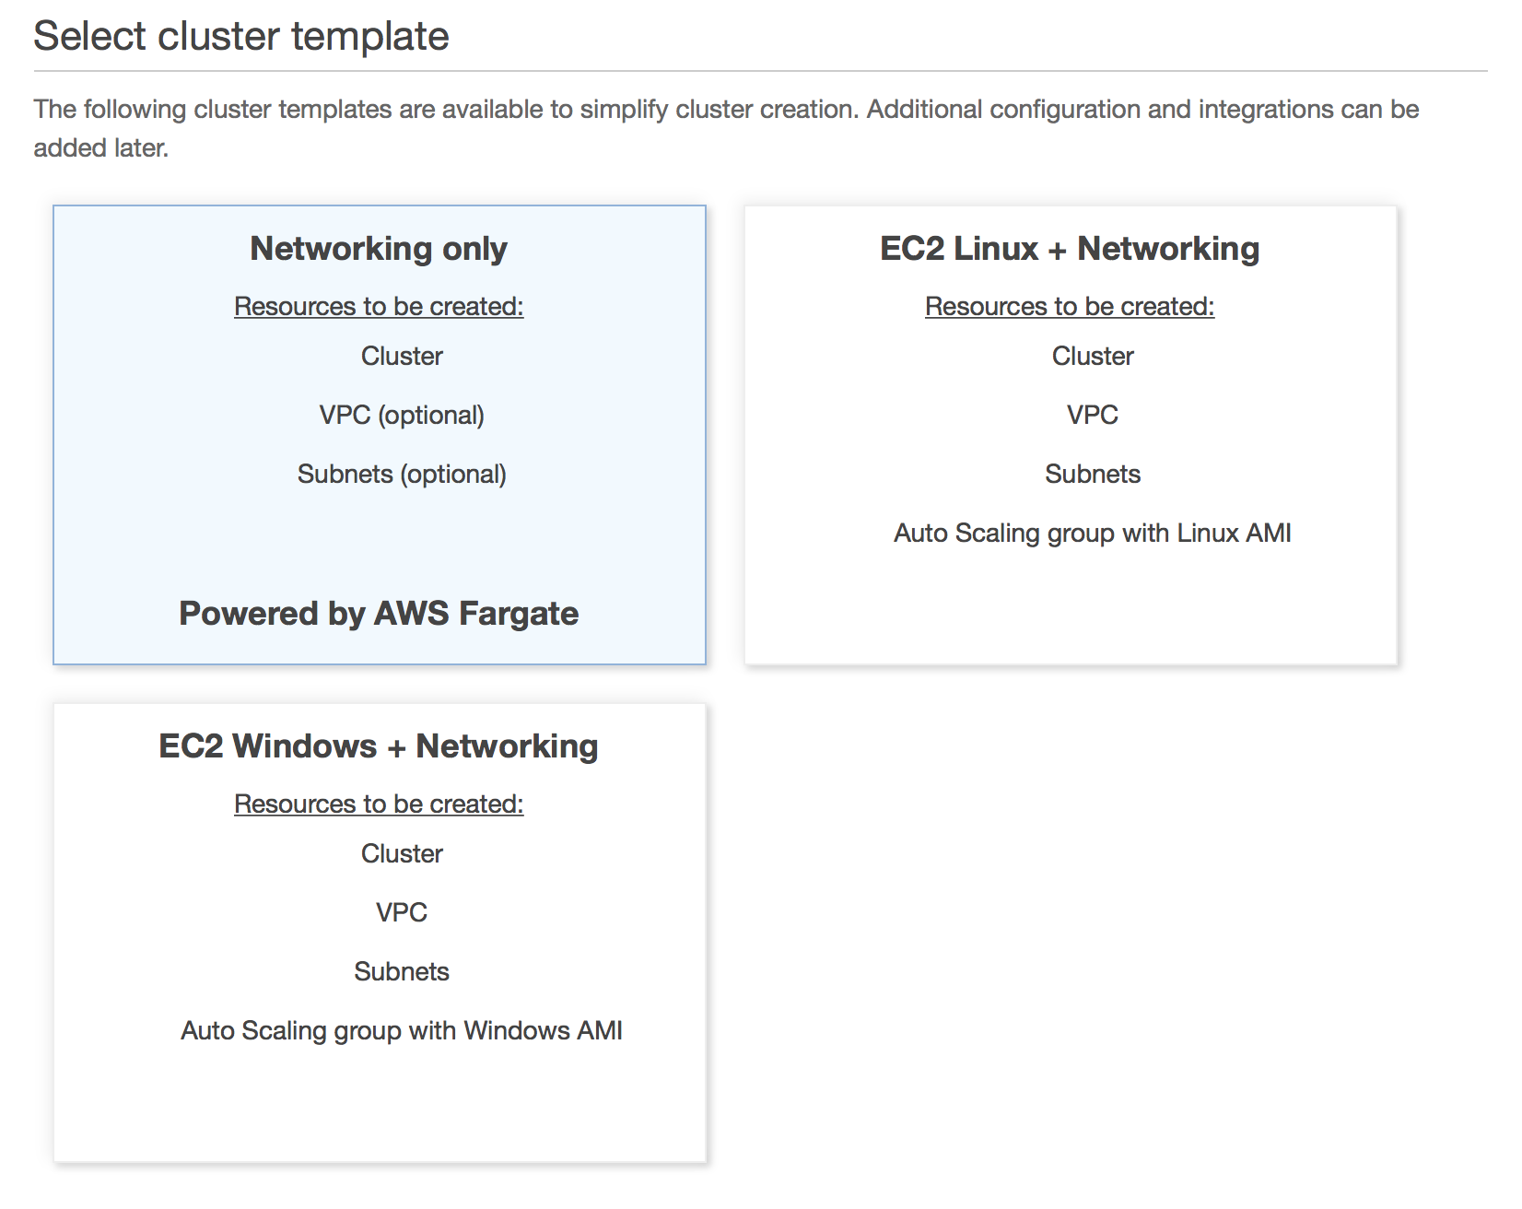
Select a cluster template

Slide 31
Click create cluster
Create will create resources based on CloudFormation Stack:
VPC
Subnets
Internet Gateway
Route tables
Note that it doesn’t provision EC2 instances!

Slide 32
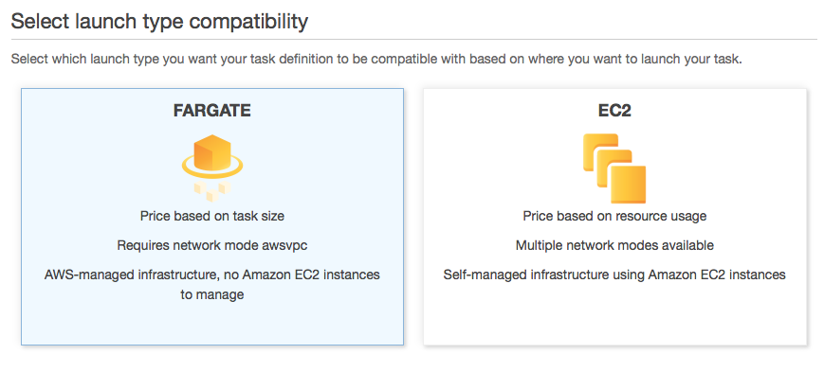
Create Task
Use Fargate
Select the permissions, Task Memory and Task CPU
Add container
Pull from ECR or other repository
Specify port mappings
Can specify range of other parameters
Healthcheck: is it still functioning
Environment variables
Network settings
Storage and logging
Resource limits

Slide 33
Run task
Associate cluster
Choose VPC, subnets
Allocate memory
Allocate roles
Run

Slide 34
Serverless Computing
Fargate is an example of serverless computing
Don’t need to worry about operating systems or maintaining VMs
Other environment for this is Kubernetes
Execution is simply a container or in the case of AWS Lambda just a piece of code
Difference is between how applications get executed and the choice of development environment
Fits in with Micro Service architectures

Slide 35
AWS Lambda
AWS Lambda removes the container details and allows “functions” to be written
Supports different programming environments:
Java, Javscript, Python, C#
Functions can be connected to “events” coming from a number of different environments:
HTTP
IoT
Mobile
Other AWS services like Kinesis

Slide 36
Example
Functions need to be packaged and uploaded as zip files
Can be tested locally using SAM CLI – doing much of the same thing as Docker
functions can also be edited using AWS Lambda Console Editor
Create a function
Choose language
Role
Template
Edit code and test

Slide 37
Add an API Gateway
Simple way to associate a URL with a specific function
Allows the specification of functions associated with specific HTTP operations (GET, POST, etc)
Supports CORS Cross Origin Resource Sharing
Makes taking parameters easy

