Slide 1

Department of Artificial Intelligence and Data Science
Kanmani AI – A Wearable AI Assistant for the Visually Impaired
Dr. J. M. GNANASEKAR M.E., Ph.D.,
Professor and Head,
Department of Artificial Intelligence and Data Science
ARAVINTH S (2116221801003)
LIO GODWIN BR (2116221801029)
VENKATESHAN T (2116221801061)

Slide 2
PROBLEM STATEMENT
Elderly individuals with visual impairments face significant challenges when navigating indoor environments, where obstacles, stairs, doorways, and unfamiliar layouts can pose serious safety risks. Traditional mobility aids such as white canes and guide dogs provide only limited situational awareness and cannot detect or interpret the environment in real time. Existing smart assistive technologies often depend on cloud connectivity, are expensive, or lack the capability to operate reliably indoors. Therefore, there is a need for an affordable, wearable, and offline AI-based system that can deliver real-time obstacle detection, environmental understanding, and intuitive guidance to support safe and independent indoor navigation for visually impaired elderly users.

Slide 3
MOTIVATION
The motivation behind Kanmani AI arises from the growing need to enhance the independence, safety, and quality of life of visually impaired elderly individuals. Many rely heavily on caregivers or limited traditional tools, leading to reduced mobility, fear of injury, and loss of confidence in daily activities. With advancements in computer vision, AI, and wearable technology, there is a clear opportunity to develop an intelligent assistive system that goes beyond conventional aids and provides a richer understanding of the user’s surroundings. Kanmani AI aims to harness stereo vision, offline deep learning models, and non-intrusive audio feedback to create an affordable, privacy-preserving, and user-friendly solution that empowers elderly individuals to navigate their indoor environments with greater autonomy and confidence.

Slide 4
EXISTING SYSTEM
The existing systems for assisting visually impaired individuals primarily include white canes, guide dogs, and GPS-based navigation tools.These tools provide basic mobility support but have several limitations in indoor environments.White canes can only detect nearby physical obstacles and do not identify object type or distance.Guide dogs require high maintenance and cannot provide detailed contextual information.GPS-based systems work effectively outdoors but fail indoors due to weak signals and occlusions. Some robotic or sensor-based aids exist, but they are often expensive and bulky. Most current solutions lack real-time object recognition and audio-based situational feedback.Additionally, they depend heavily on user experience and offer limited automation.

Slide 5
OBJECTIVES
Develop a stereo vision–based wearable system capable of real-time offline detection and recognition of indoor obstacles, stairs, doors, and labeled objects using lightweight AI models running on a smartphone.
Enhance contextual awareness by integrating OCR and object recognition to identify room names, labels, and familiar individuals, ensuring accurate and reliable environmental understanding.
Provide intuitive and safe user interaction through a low-cost, modular wearable design with bone conduction audio guidance, supporting future extensions such as fall detection and health monitoring.

Slide 6
ABSTRACT
Kanmani AI is a wearable assistive system designed to support safe and independent indoor navigation for visually impaired elderly individuals.Traditional aids like canes and guide dogs offer limited awareness, whereas Kanmani AI provides real-time environmental understanding.It uses stereo cameras on a lightweight wearable frame connected to a smartphone for offline AI processing.The system detects obstacles, identifies stairs and doors, recognizes people and rooms, and reads text labels through OCR.Voice guidance is delivered via bone conduction earphones for a hands-free, non-intrusive experience.Testing in simulated indoor environments showed accurate detection and clear navigation instructions.Users were able to navigate safely with minimal training.With its low-cost, modular design and future expandability, Kanmani AI enhances safety, confidence, and independence.

Slide 7
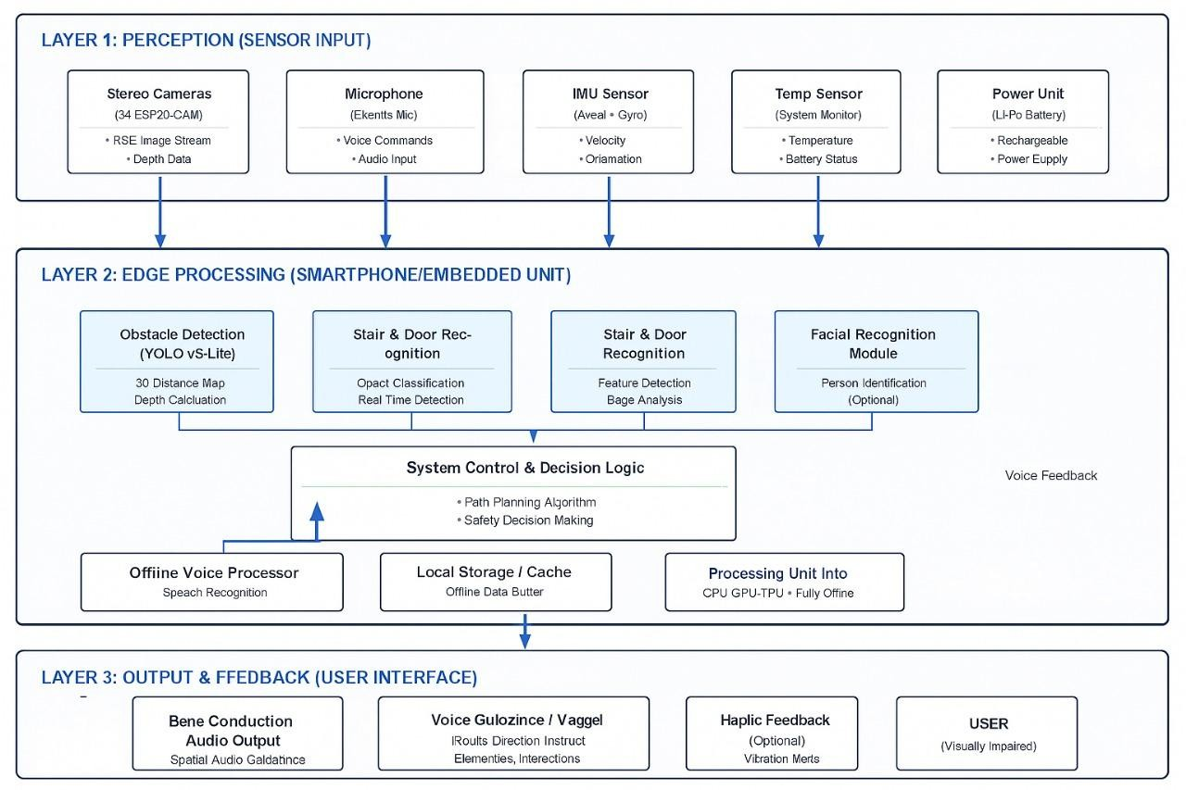
ARCHITECTURE

Slide 8
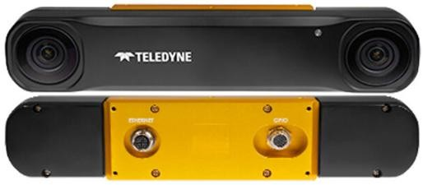
STEREO VISION CAMERA MODULE
Model: OAK-D Lite / ZED Mini
Purpose: Captures high-resolution stereo images and calculates depth information for obstacle detection, stairs, doors, and indoor objects.
Functionality: Computes disparity between left and right images to estimate distances accurately and generate real-time depth maps.
Reason for Selection: Lightweight, compact, capable of real-time depth sensing, and ideal for wearable applications.

Slide 9
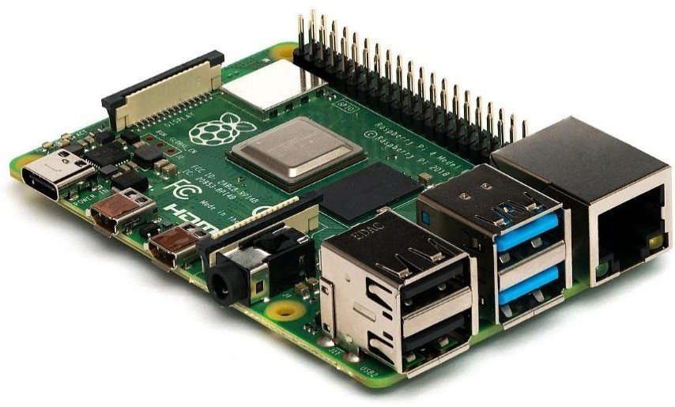
EMBEDDED PROCESSING UNIT
Components: Raspberry Pi 4 / Jetson Nano / Android smartphone
Purpose: Performs offline AI inference, running deep learning models (YOLOv5 / YOLOv3-tiny) for object detection, OCR, and depth estimation.
Functionality: Handles data flow from cameras and optional sensors, executes AI models efficiently, and sends processed instructions to audio output.
Reason for Selection: Portable, supports offline AI, energy- efficient, and capable of real-time processing.

Slide 10
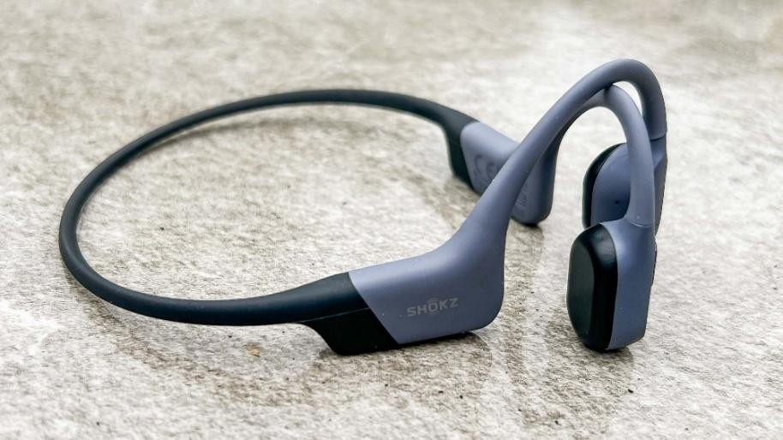
BONE CONDUCTION EARPHONE MODULE
Components: Aftershokz
Purpose: Provides hands-free audio instructions without blocking ambient environmental sounds.
Functionality: Receives TTS output from the processing unit and conveys guidance to the user in real-time.
Reason for Selection: Non-intrusive, suitable for elderly users, and allows simultaneous perception of environmental cues.

Slide 11
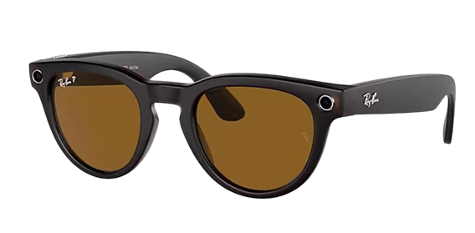
WEARABLE FRAME / 3D PRINTING DESIGN MODULE
Material: PLA / ABS(Acrylonitrile Butadiene Styrene)lightweight plastic
Purpose: Holds cameras and sensors ergonomically on the head, providing a stable and comfortable mounting platform.
Functionality: Adjustable frame design ensures optimal camera placement, user comfort, and the ability to accommodate future sensors or battery upgrades.
Reason for Selection: Lightweight, durable, customizable, and compatible with 3D printing techniques

Slide 12
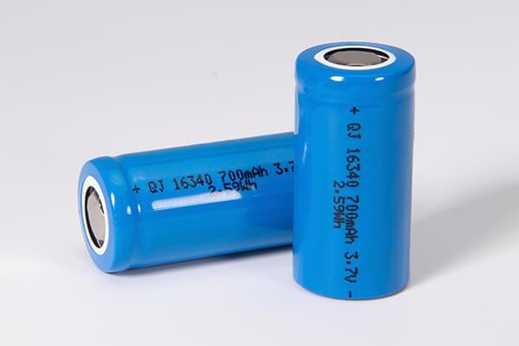
POWER SUPPLY MODULE
Type: Li-ion battery, 5000–10000 mAh
Purpose: Powers the stereo camera, embedded processor, and audio module for several hours of continuous operation.
Functionality: Provides stable and reliable energy, minimizing the need for frequent recharging.

Slide 13
CONCLUSION
Kanmani AI effectively addresses the limitations of traditional mobility aids by providing visually impaired elderly individuals with real-time, reliable indoor navigation support. By integrating stereo vision, offline AI processing, and bone conduction audio feedback into a compact wearable device, the system accurately detects obstacles, identifies stairs and doors, and reads text labels while maintaining user privacy and low latency. Testing in simulated environments confirmed its high accuracy and intuitive guidance, enabling safe movement with minimal training. With its low-cost hardware and efficient AI models, Kanmani AI offers a practical and accessible alternative to more complex systems, enhancing users’ confidence, safety, and independence in everyday indoor activities.

Slide 14
Thank You

