Slide 1
JEEVAN RAKSHA
PHARMACY
A Relational Database & SQL Query Analysis Project
MySQL • Database Design • SQL Queries • Output Analysis
Presented by
M V Hari Chandana
1

Slide 2
01
Project Overview
Theme
Project Focus
A pharmacy needs a structured database to maintain customer details, suppliers, medicines, orders and order-item records.
Designing a relational MySQL database and using SQL queries to store, connect, filter, summarize and retrieve pharmacy information.
Customers
Suppliers
Medicines
Orders
Customer and contact details
Supplier information
Medicine, stock & price
Bills & payment details
Order Items
Quantity & subtotal
PHARMACY DATABASE
JEEVAN RAKSHA PHARMACY • MySQL & SQL Query Analysis
2

Slide 3
02
Objectives of the Project
01 Centralized Records
02 Table Relationships
Maintain organized customer, supplier, medicine, order and order-item records.
Connect related tables using primary keys and foreign keys.
03 Inventory Management
04 Order Tracking
Store medicine category, price, stock quantity, expiry date and supplier.
Record order date, total amount, payment mode and item-level details.
05 SQL Reporting
06 SQL Practice
Retrieve useful pharmacy information through practical SQL queries.
Apply filtering, aggregation, GROUP BY, JOINs and subqueries.
Goal: Build a clear relational database and demonstrate practical SQL skills.
PHARMACY DATABASE
JEEVAN RAKSHA PHARMACY • MySQL & SQL Query Analysis
3

Slide 4
03
Technologies and SQL Concepts
Technology Stack
Database Design
Query Techniques
• MySQL
• MySQL Workbench
• SQL
• Relational schema
• Entity-Relationship modeling
• Primary & foreign keys
• SELECT & WHERE
• ORDER BY
• GROUP BY & HAVING
• JOIN & subqueries
EXAMPLE: DATABASE SETUP
EXAMPLE: AGGREGATE QUERY
CREATE DATABASE jeevan_raksha_pharmacy;
USE jeevan_raksha_pharmacy;
SELECT payment_mode, SUM(total_amount) AS total_revenue
FROM Orders
GROUP BY payment_mode;
PHARMACY DATABASE
JEEVAN RAKSHA PHARMACY • MySQL & SQL Query Analysis
4

Slide 5
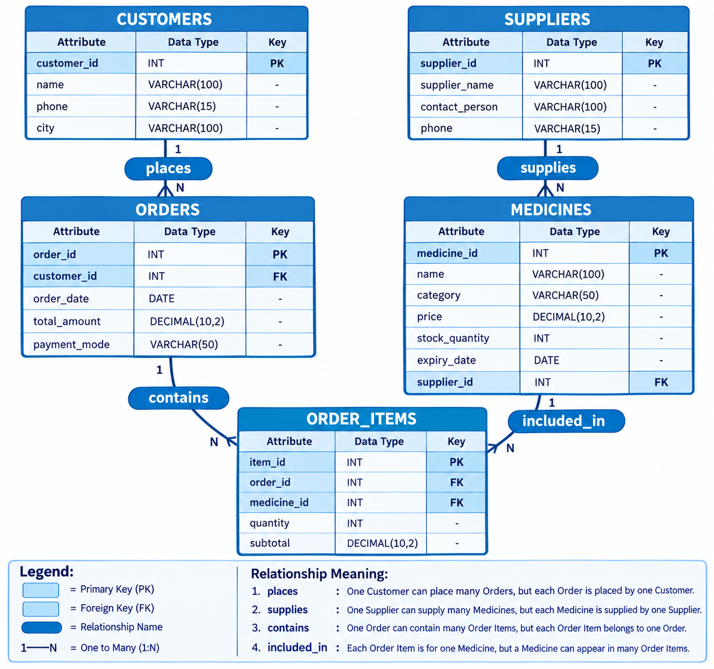
04
Entity-Relationship Diagram
Core pharmacy flow: Customer → Order → Medicine → Supplier
PHARMACY DATABASE
JEEVAN RAKSHA PHARMACY • MySQL & SQL Query Analysis
5

Slide 6
05
Database Schema
CUSTOMERS
SUPPLIERS
MEDICINES
customer_id (PK)
customer_name • phone • city
supplier_id (PK)
supplier_name • phone • city
medicine_id (PK)
name • category • price
stock_quantity • expiry_date • supplier_id (FK)
ORDERS
ORDER_ITEMS
order_id (PK)
customer_id (FK) • order_date
total_amount • payment_mode
item_id (PK)
order_id (FK) • medicine_id (FK)
quantity • subtotal
PHARMACY DATABASE
JEEVAN RAKSHA PHARMACY • MySQL & SQL Query Analysis
6

Slide 7
06
Sample Data Overview
Customers
Suppliers
Medicines
15 customer records
Name, phone and city
Supplier records
Supplier and contact details
Medicine records
Category, price & stock
Orders
Order Items
15 order records
Bills and payment modes
Item-level records
Quantity and subtotal
The sample data supports filtering, joins, aggregation and inventory analysis.
PHARMACY DATABASE
JEEVAN RAKSHA PHARMACY • MySQL & SQL Query Analysis
7

Slide 8
01
Exercise Questions — Level 1
Q1. Customer List
Q2. Stock Check
Retrieve the name and city of all customers.
Find the names of medicines that are 'Syrup' or 'Injection'.
SELECT / WHERE
SELECT / WHERE
Q3. High Value Bills
Q4. Mumbai Residents
List all orders where total_amount is greater than ₹500.
Find the phone numbers of all customers living in 'Mumbai'.
SELECT / WHERE
SELECT / WHERE
PHARMACY DATABASE
JEEVAN RAKSHA PHARMACY • MySQL & SQL Query Analysis
7

Slide 9
02
Exercise Questions — Level 2
Q5. Supplier Count
Q6. Order Details
Count how many medicines are supplied by 'Apollo Distributors'.
List the Customer Name, Order Date and Total Amount for every order.
JOIN / AGGREGATE / SUBQUERY
JOIN / AGGREGATE / SUBQUERY
Q7. Revenue by Mode
Calculate the total money earned through each payment mode.
JOIN / AGGREGATE / SUBQUERY
PHARMACY DATABASE
JEEVAN RAKSHA PHARMACY • MySQL & SQL Query Analysis
8

Slide 10
03
Exercise Questions — Level 3
Q8. Best Selling Medicine
Q9. Customer Lifetime Value
Find the medicine sold the most in terms of total quantity.
List customers who have spent more than ₹1000 across all orders.
JOIN / AGGREGATE / SUBQUERY
JOIN / AGGREGATE / SUBQUERY
Q10. Inventory Audit
List medicines with less than 50 units left, along with supplier name.
JOIN / AGGREGATE / SUBQUERY
PHARMACY DATABASE
JEEVAN RAKSHA PHARMACY • MySQL & SQL Query Analysis
9

Slide 11
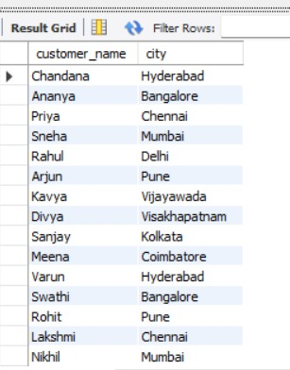
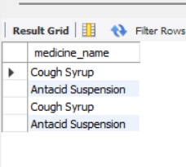
10
Query Outputs — Q1 & Q2
Q1. Customer List
Q2. Stock Check
SELECT customer_name, city
FROM Customers;
SELECT medicine_name
FROM Medicines
WHERE medicine_type IN ('Syrup', 'Injection');
Retrieve the name and city of all customers.
Find the names of medicines that are 'Syrup' or 'Injection'.
Output image not available.
Only medicines belonging to the requested categories are returned.
PHARMACY DATABASE
JEEVAN RAKSHA PHARMACY • MySQL & SQL Query Analysis
11

Slide 12
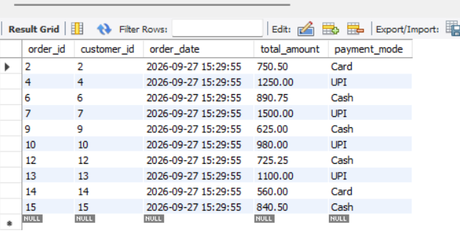
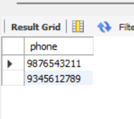
11
Query Outputs — Q3 & Q4
Q3. High Value Bills
Q4. Mumbai Residents
SELECT *
FROM Orders
WHERE total_amount > 500;
SELECT phone
FROM Customers
WHERE city = 'Mumbai';
List all orders where total_amount is greater than ₹500.
Find the phone numbers of all customers living in 'Mumbai'.
Phone numbers for customers whose city is Mumbai are displayed.
PHARMACY DATABASE
JEEVAN RAKSHA PHARMACY • MySQL & SQL Query Analysis
12

Slide 13
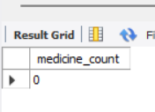
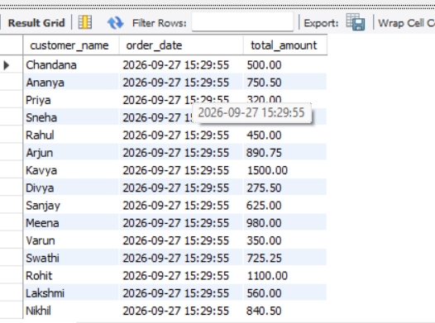
12
Query Outputs — Q5 & Q6
Q5. Supplier Count
Q6. Order Details
SELECT COUNT(*) AS medicine_count
FROM Medicines m
JOIN Suppliers s
ON m.supplier_id = s.supplier_id
WHERE s.supplier_name = 'Apollo Distributors';
SELECT c.customer_name, o.order_date, o.total_amount
FROM Customers c
JOIN Orders o
ON c.customer_id = o.customer_id;
Count how many medicines are supplied by 'Apollo Distributors'.
List the Customer Name, Order Date and Total Amount for every order.
The output connects each order with the corresponding customer.
PHARMACY DATABASE
JEEVAN RAKSHA PHARMACY • MySQL & SQL Query Analysis
13

Slide 14
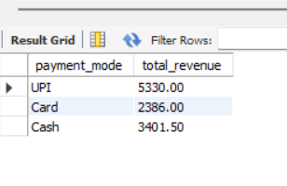
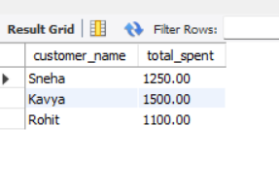
13
Query Outputs — Q7 & Q8
Q7. Revenue by Mode
Q8. Best Selling Medicine
SELECT payment_mode,
SUM(total_amount) AS total_revenue
FROM Orders
GROUP BY payment_mode;
SELECT m.medicine_name,
SUM(oi.quantity) AS total_quantity
FROM Order_Items oi
JOIN Medicines m
ON oi.medicine_id = m.medicine_id
GROUP BY m.medicine_id, m.medicine_name
ORDER BY total_quantity DESC
LIMIT 1;
Calculate the total money earned through each payment mode.
Find the medicine sold the most in terms of total quantity.
Sample Output — Q8
Illustrative result (Q8 data was not supplied)
medicine_name | total_quantity
Cough Syrup | 12
Antacid Suspension | 8
Replace these sample quantities with your actual Order_Items output.
No output screenshot was supplied for this question; the query is included for the project demonstration.
PHARMACY DATABASE
JEEVAN RAKSHA PHARMACY • MySQL & SQL Query Analysis
14

Slide 15
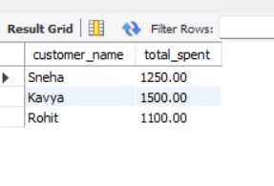
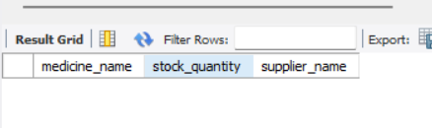
14
Query Outputs — Q9 & Q10
Q9. Customer Lifetime Value
Q10. Inventory Audit
SELECT c.customer_name,
SUM(o.total_amount) AS total_spent
FROM Customers c
JOIN Orders o
ON c.customer_id = o.customer_id
GROUP BY c.customer_id, c.customer_name
HAVING SUM(o.total_amount) > 1000;
SELECT m.medicine_name,
m.stock_quantity,
s.supplier_name
FROM Medicines m
JOIN Suppliers s
ON m.supplier_id = s.supplier_id
WHERE m.stock_quantity < 50;
List customers who have spent more than ₹1000 across all orders.
List medicines with less than 50 units left, along with supplier name.
The supplied output is empty, indicating no matching medicine rows in the shown data.
PHARMACY DATABASE
JEEVAN RAKSHA PHARMACY • MySQL & SQL Query Analysis
15

Slide 16
15
Key Results from the Supplied Outputs
Revenue by UPI
Revenue by Card
₹5,330.00
₹2,386.00
Revenue by Cash
Customers > ₹1000
₹3,401.50
Sneha • Kavya • Rohit
Apollo Distributors
Inventory < 50 units
0 medicines in supplied output
No matching rows in supplied output
These values are taken directly from the output screenshots provided with the project.
PHARMACY DATABASE
JEEVAN RAKSHA PHARMACY • MySQL & SQL Query Analysis
16

Slide 17
16
SQL Skills Demonstrated
Filtering
Joining
Aggregation
WHERE, IN and comparison operators
Connecting Customers, Orders, Medicines and Suppliers
COUNT and SUM for meaningful summaries
Grouping
Subqueries
Inventory Analysis
GROUP BY and HAVING for grouped analysis
Comparing values with aggregated results
Using stock quantity and supplier relationships
The project demonstrates how relational database design and SQL work together to produce practical pharmacy reports.
PHARMACY DATABASE
JEEVAN RAKSHA PHARMACY • MySQL & SQL Query Analysis
17

Slide 18
17
Conclusion
What the project demonstrates
Key Learning Outcomes
Jeevan Raksha Pharmacy uses MySQL to organize customers, suppliers, medicines, orders and order items, then retrieves useful information through SQL queries.
• Database and table creation
• Data insertion and verification
• Filtering and aggregation
• GROUP BY and HAVING
• JOINs and subqueries
Final Note
This project strengthens practical understanding of relational database design, inventory management and SQL query writing.
MYSQL • SQL • PHARMACY
PHARMACY DATABASE
JEEVAN RAKSHA PHARMACY • MySQL & SQL Query Analysis
18

Slide 19
Pharmacy Data Flow
How the Jeevan Raksha Pharmacy tables connect during a medicine sale
CUSTOMER
ORDER
ORDER ITEM
MEDICINE
Places an order
Contains items
References medicine
Supplied by
Customers → Orders
Orders → Order_Items
Order_Items → Medicines
Medicines → Suppliers
Inventory
Supplier Traceability
Sales Analysis
stock_quantity and expiry_date support medicine-level monitoring.
supplier_id connects every medicine to its supplier.
Order_Items quantity and subtotal support best-selling analysis.
JEEVAN RAKSHA PHARMACY • Pharmacy Data Flow
20

Slide 20


