Slide 1


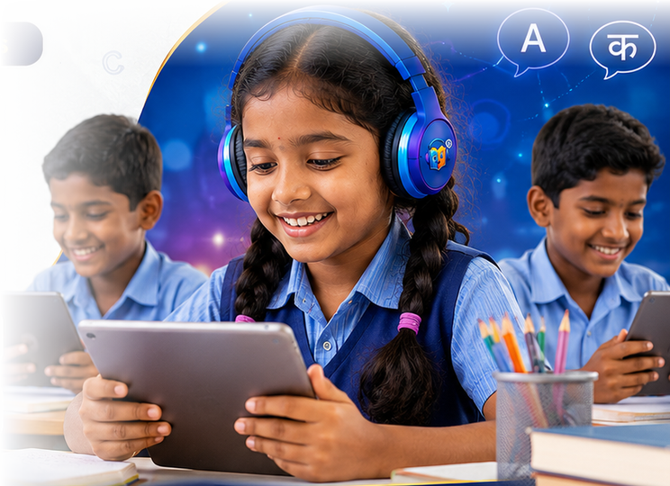
NIPUN BHARAT
BENCHMARKS
BUILT IN
పఠన శక్తి
PATHANA SHAKTHI
The AI co-teacher for India’s classrooms
Built to NIPUN Bharat, NEP 2020 and SCERT benchmarks
Classes 1–10
తెలుగు · English · हिन्दी
Works offline
221B Labs · Investor presentation · 2026
Notes:
Pathana Shakthi means "the power of reading". It is an AI co-teacher: it reads with every child, listens to every word, turns the state textbook into a whole course, and shows the teacher where to help — measured against the government’s own benchmarks.

Slide 2


Reading is rising in government schools — the goal is every child by Class 3
THE OPPORTUNITY
The national goal
NIPUN Bharat: every child reads with understanding and does basic maths by the end of Class 3, by 2026-27.
Benchmarks schools report on
Words correct per minute, comprehension and numeracy — checked in baseline, midline and endline rounds.
Sources: ASER 2024 (rural India), Jan 2025 · NIPUN Bharat, Ministry of Education (2021)
Notes:
ASER 2024: 23.4% of Class 3 children in government schools read a Class 2 text, up from 16.3% in 2022 — the best gain in a decade, driven by the foundational-literacy push. NIPUN Bharat sets the goal: every child by Class 3, by 2026-27. The opportunity is to keep that curve rising in every classroom.

Slide 3

One of the world’s largest school systems, opened one state at a time
THE SCALE
10.2 L
12.4 Cr
30,022
27.8 L
government schools in India
children enrolled in them
government schools in Telangana, our launch state
children in Telangana government schools
Every state runs its own textbooks, in its own language
A product that reads the state’s own books can enter any state without rewriting a curriculum — Telugu today, Hindi and English already in.
Source: UDISE+ 2023-24 (Ministry of Education). L = lakh (100,000); Cr = crore (10 million).
Notes:
UDISE+ 2023-24: about 10.18 lakh government schools and 12.4 crore children nationally. Telangana: 30,022 government schools, about 27.8 lakh children. We start in Telangana because we built on its SCERT textbooks and Telugu; the same pipeline reads any state’s books.

Slide 4
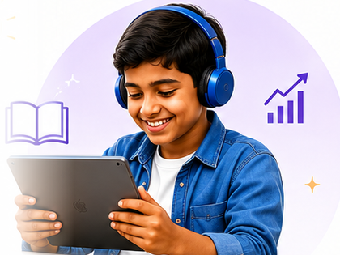


Children learn to read by reading aloud to someone who listens
WHAT HELPS A CHILD READ
More time reading aloud
Every child reads aloud and hears back, every day, while the teacher works with the group that needs them most.
Their own textbook
Practice happens on the chapter the class is studying, so it supports the syllabus instead of competing with it.
Their own language
Telugu and Hindi with every conjunct and matra understood, plus English — the way children learn to read.
Pathana Shakthi gives every child that listener — beside their teacher.
Notes:
Three things help a child learn to read, and we built around all three: time reading aloud with someone listening, their own textbook, and their own language.

Slide 5



Pathana Shakthi: an AI co-teacher for the whole school
THE PLATFORM
For children
For teachers
For headmasters
Read-along that listens
Maths tests with worked answers
Animated lessons and workbook
Practice games and reading check
Reading speed vs NIPUN Bharat
Need Help · Go Ahead · Very Good
Registers and assessment rounds
Shakthi Mitra, an AI agent
Whole-school roll-up
Attendance and FLN rounds
Curriculum pace
Print and Excel reports
Notes:
This is the reframe: the reader is how a child meets us, but the product is a platform — everything a child needs to practise, everything a teacher needs to see and act on, and the roll-up a headmaster reports upward.

Slide 6








One textbook in. A whole course out.
HOW IT WORKS
1
2
3
4
Teacher uploads the textbook
Every chapter becomes lessons
The child reads or solves
The teacher sees who needs help
Any SCERT PDF — even a phone scan.
Read-along, animated lesson, workbook and tests.
Every word heard, every maths answer checked.
Against NIPUN Bharat benchmarks, by child.
Classes 1–10
Telugu · Hindi · English
Works offline
Prints everything
Notes:
The teacher does one thing — upload the state textbook. Every chapter becomes a read-along lesson plus everything around it. One upload serves every class using that book.

Slide 7
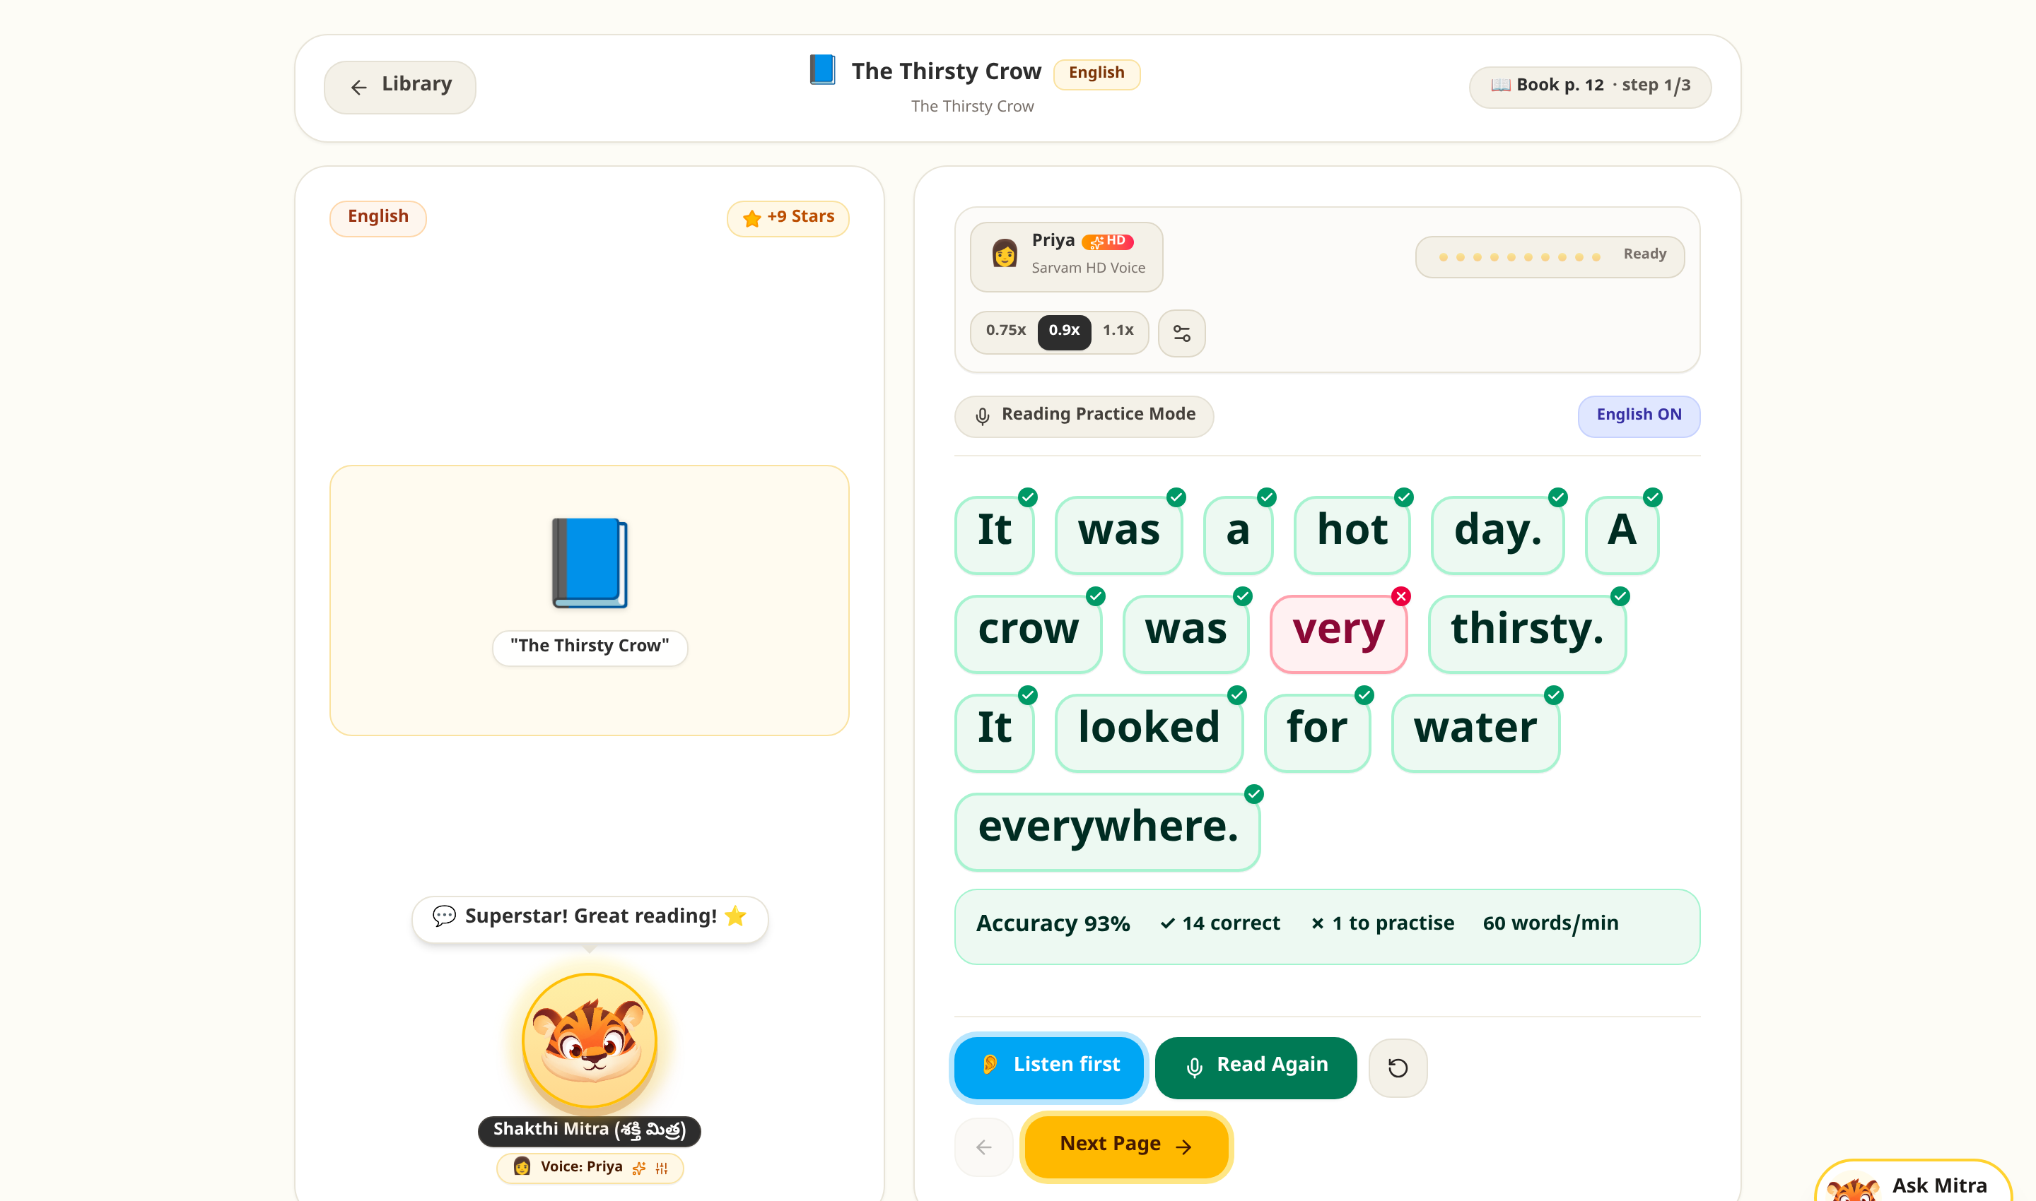

A reader that listens to every word
FOR CHILDREN · READ-ALONG
An Indian voice reads first
Beginners listen, then read.
Every word is marked
Right, or one to practise.
Accuracy and speed, every page
Words correct per minute.
Telugu, Hindi and English
Spelling variants understood.
Notes:
A natural Indian voice reads the page first; then the child reads and every word is marked. Reading levels adapt the page: beginners listen first, proficient readers get longer pages.

Slide 8
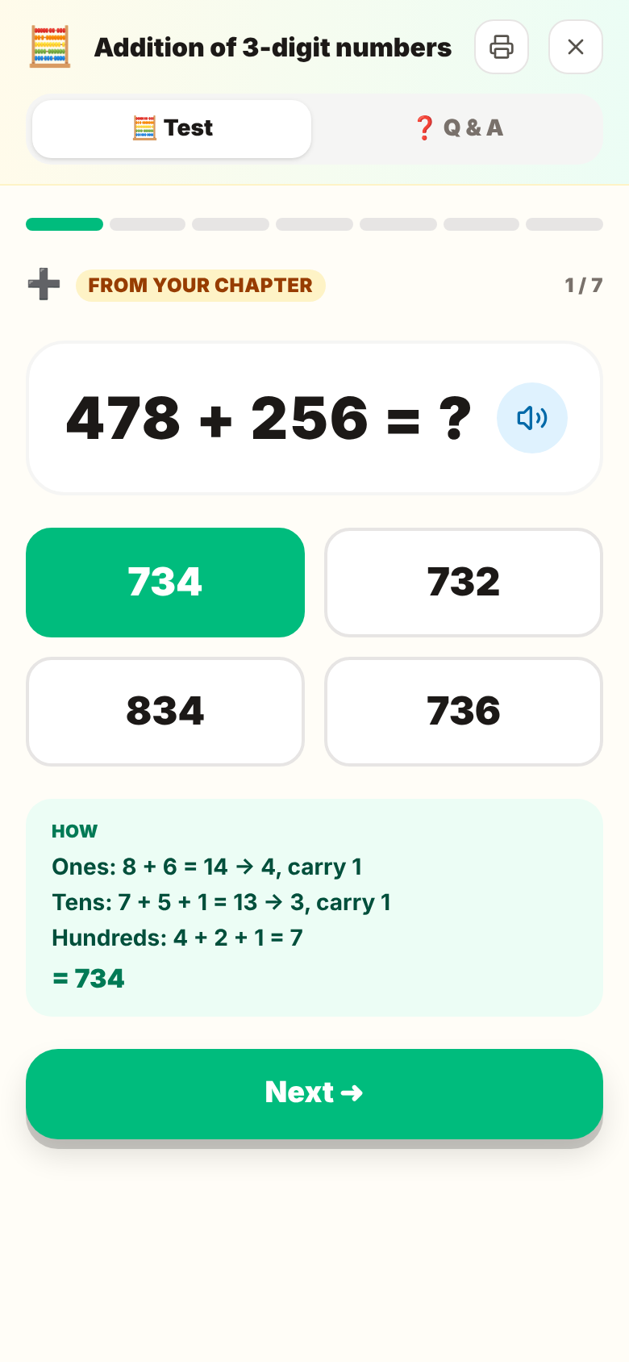
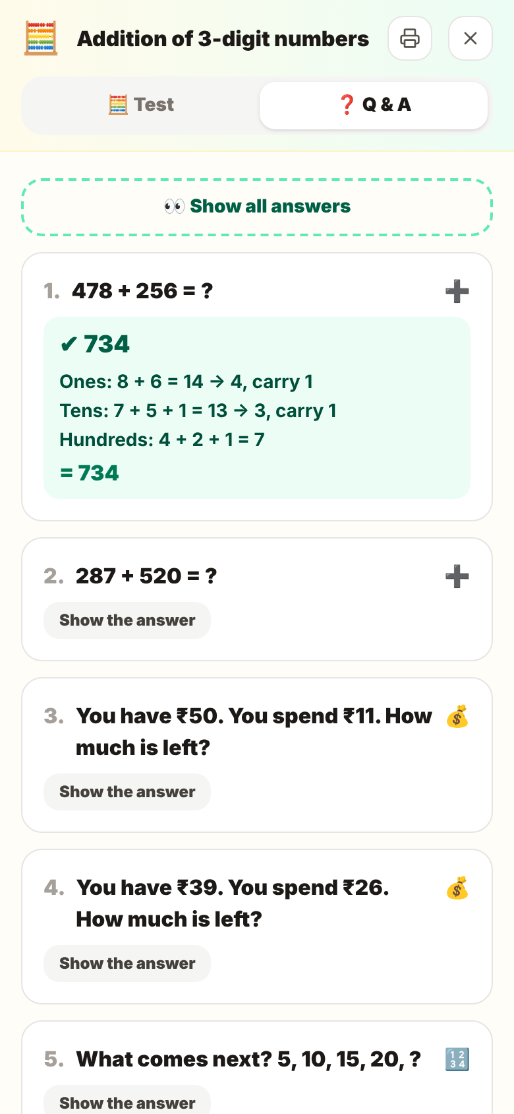
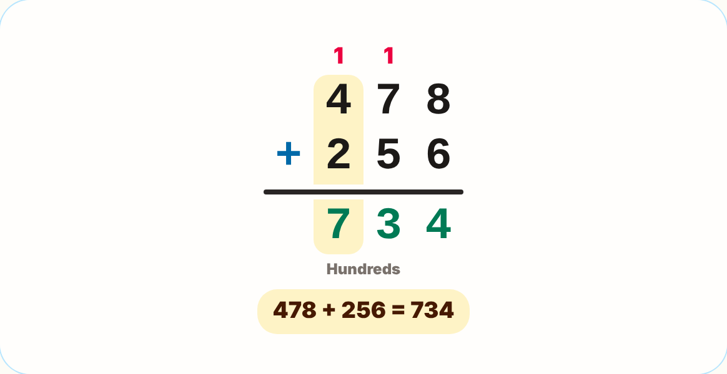

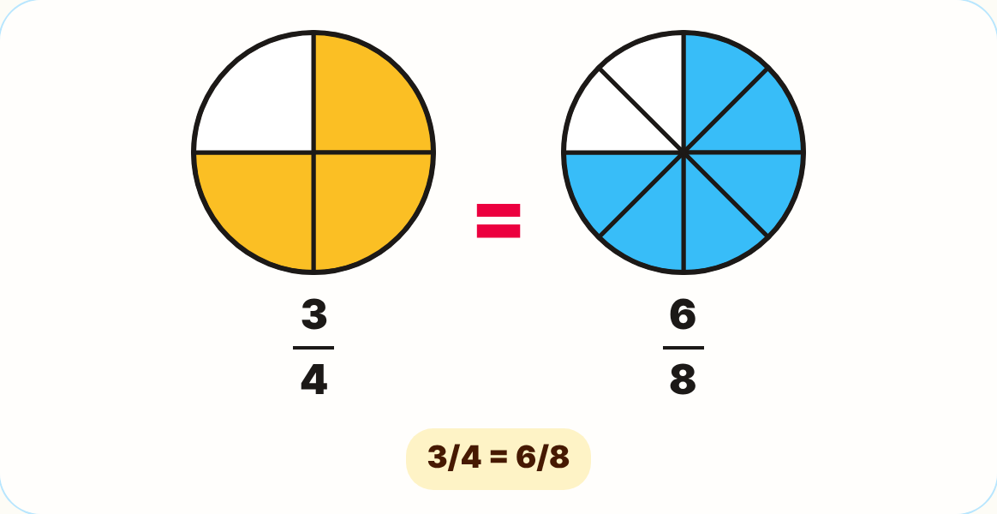

Maths chapters become tests with worked answers
FOR CHILDREN · MATHS
No reading aloud in maths
The chapter’s own sums first
Then new ones of the same size.
Every answer worked out
Carries and borrows, step by step.
Results reach the teacher
Animated methods from the chapter
Numeracy competencies by child.
Notes:
Maths is not read aloud. Every maths chapter becomes a direct test: the chapter’s own sums first, then new ones of the same kind and size, each with a worked answer, plus a questions-and-answers view that prints. Results feed the numeracy competencies on the teacher’s dashboard.

Slide 9
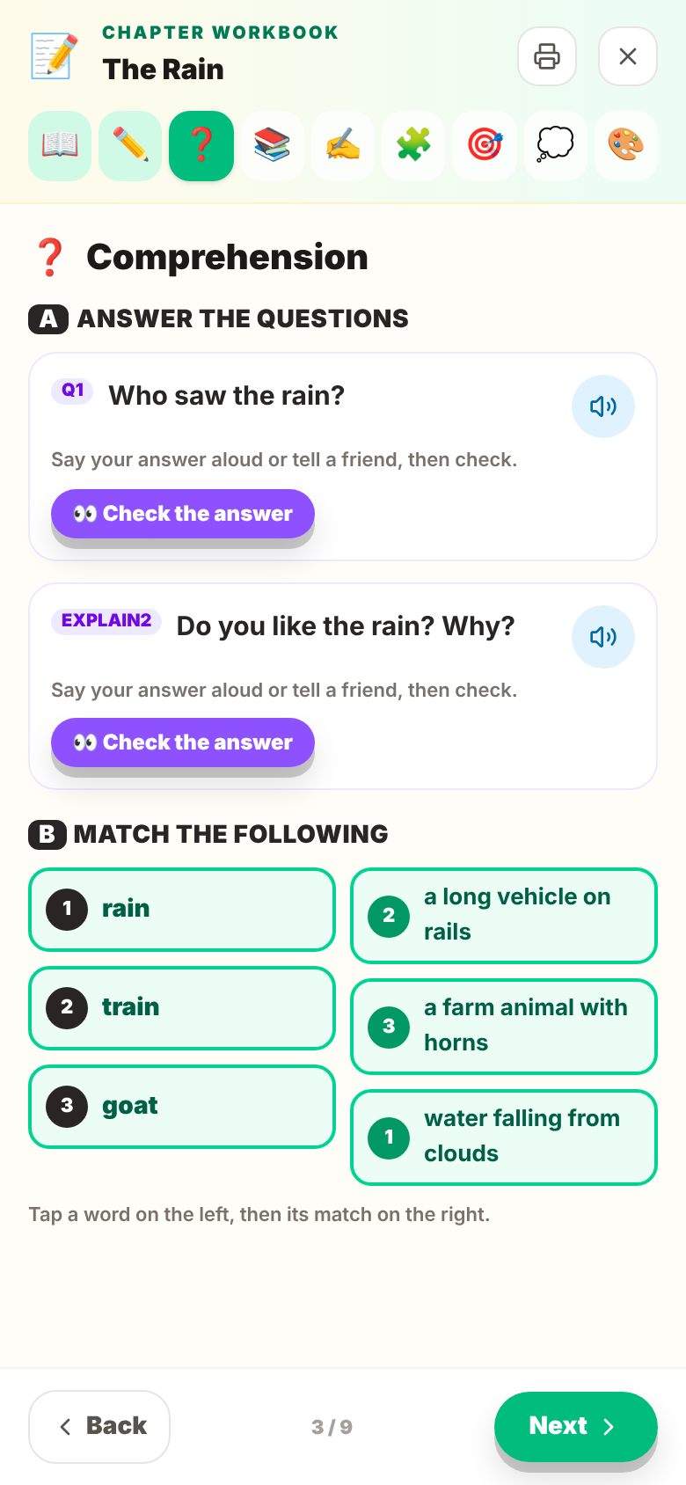
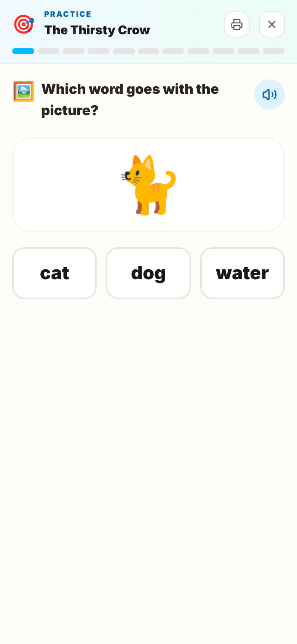
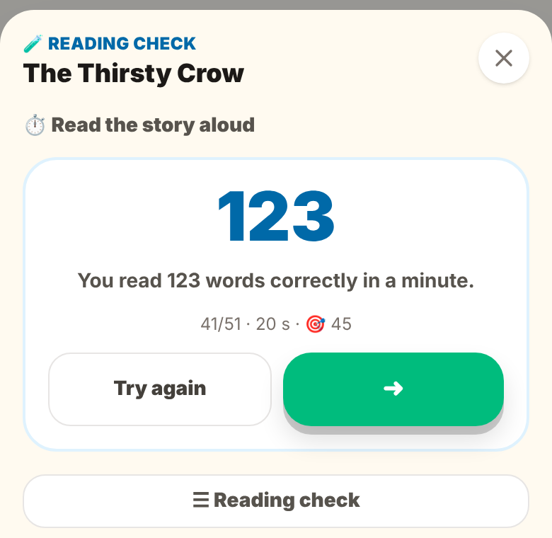
A workbook, games and a reading check for every chapter
FOR CHILDREN · PRACTICE
SCERT-pattern workbook
FLN practice games
Comprehension, match the following, vocabulary, grammar and writing.
Picture and word, first sound, missing letter, words in order.
Reading check
Sentences, timed oral reading, comprehension and writing — scored against NIPUN Bharat norms.
Notes:
Around every chapter: a workbook in the SCERT end-of-lesson pattern, short FLN practice games made from the chapter’s own words, and a four-part reading check with the teacher marking the writing.

Slide 10
Measured the way the system already measures
BUILT TO GOVERNMENT BENCHMARKS
Benchmark | What it asks | How Pathana Shakthi meets it
NIPUN Bharat | Every child reads with understanding and does basic maths by the end of Class 3 (2026-27) | Literacy and numeracy competencies tracked for every child from real work
NIPUN Bharat reading speed | Class 2: 45–60 words correct per minute · Class 3: 60 | Timed oral reading in every chapter’s reading check, scored against the norm
Tholimettu (Telangana) | Telugu reading speed: Class 1: 20 · Class 2: 25 words per minute | Telugu norms used for Telugu chapters
NEP 2020 | Foundational learning in the mother tongue | Telugu, Hindi and English — read, heard and checked
SCERT Telangana | State textbooks and the end-of-lesson exercise pattern | Real textbooks uploaded; the workbook follows the SCERT sections
FLN assessment rounds | Baseline, midline and endline levels for every child | Registers pre-filled from the app; the teacher confirms
Pathana Shakthi follows public sources (NIPUN Bharat, Tholimettu, SCERT circulars). It is not an official certification.
Notes:
This is why the product fits the system: every check speaks the government’s own language — NIPUN Bharat reading-speed norms, Tholimettu for Telugu, NEP 2020 mother-tongue learning, SCERT textbooks and exercise pattern, and the baseline–midline–endline rounds teachers already report.

Slide 11
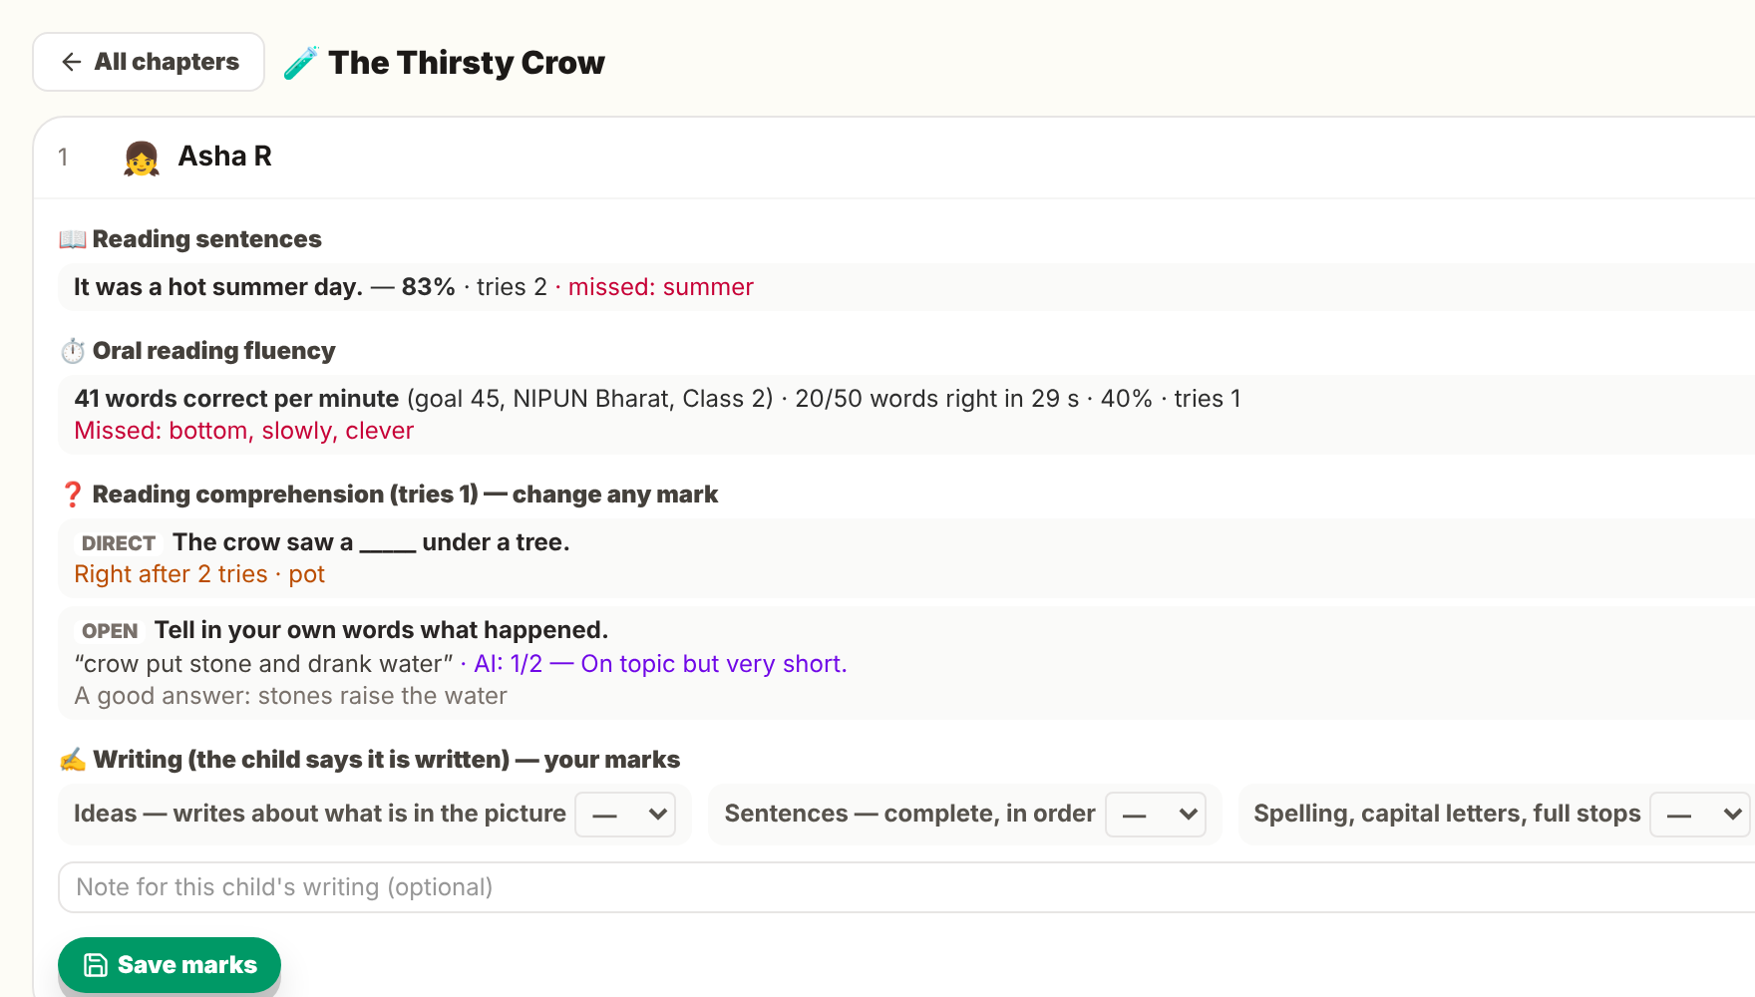



Every child’s reading, in one place
FOR TEACHERS
Reading speed vs NIPUN Bharat
Need Help · Go Ahead · Very Good
Registers and FLN rounds
Curriculum map and day plan
Teaching-aid library and handbook
Shakthi Mitra, an AI agent
Notes:
The teacher sees each child’s mistakes and tries, words per minute against the NIPUN Bharat norm, and AI marks they can change. Children are grouped Need Help, Go Ahead, Very Good from real work; Shakthi Mitra turns a sentence like “give practice to the children who need help” into a confirmed action.

Slide 12
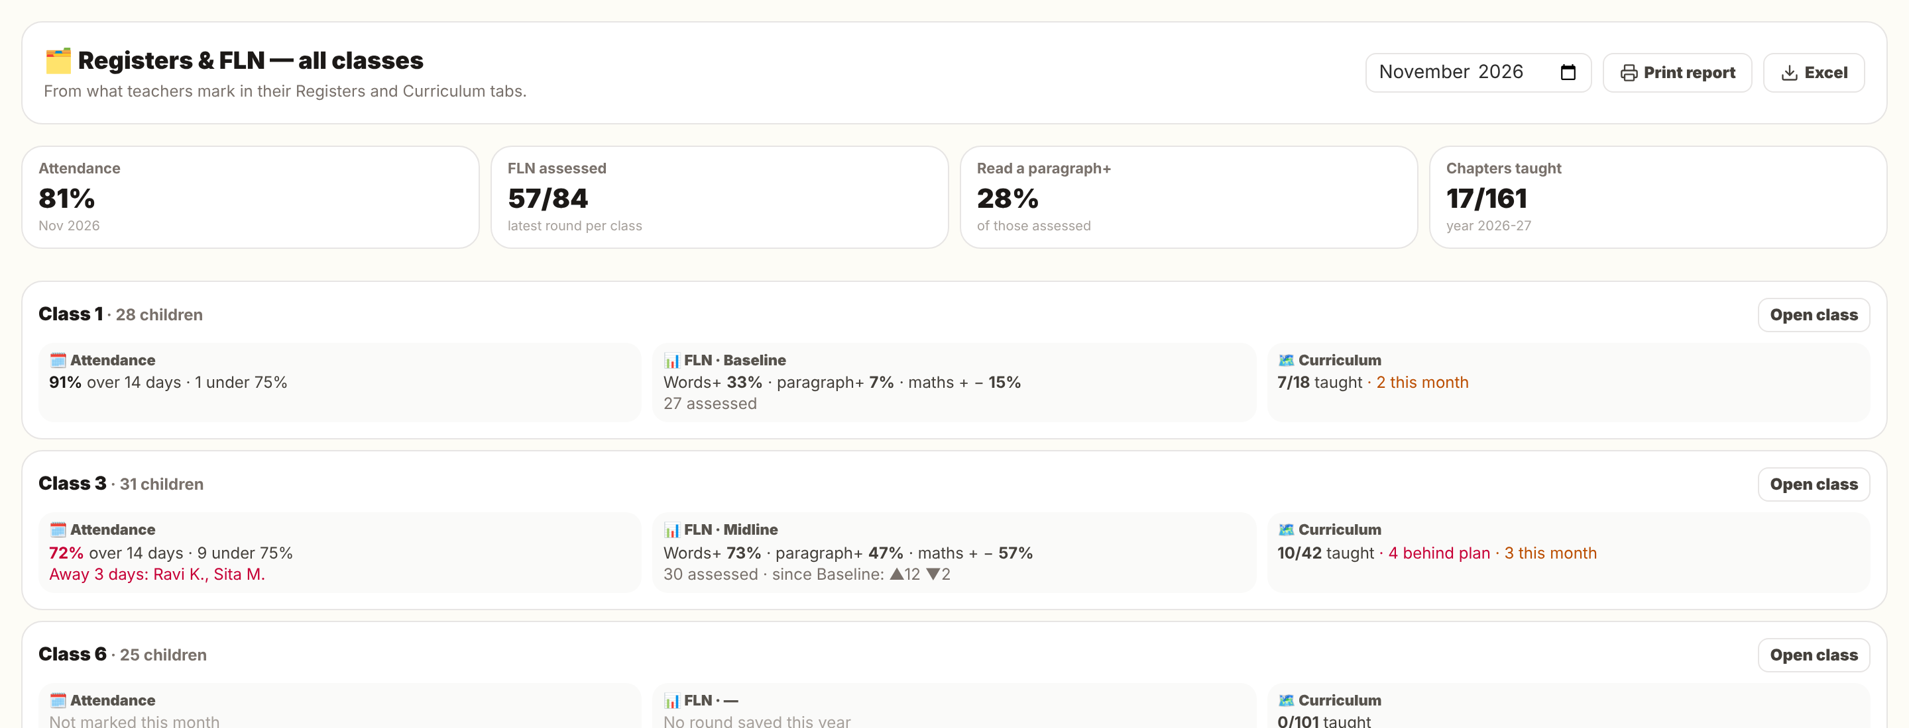
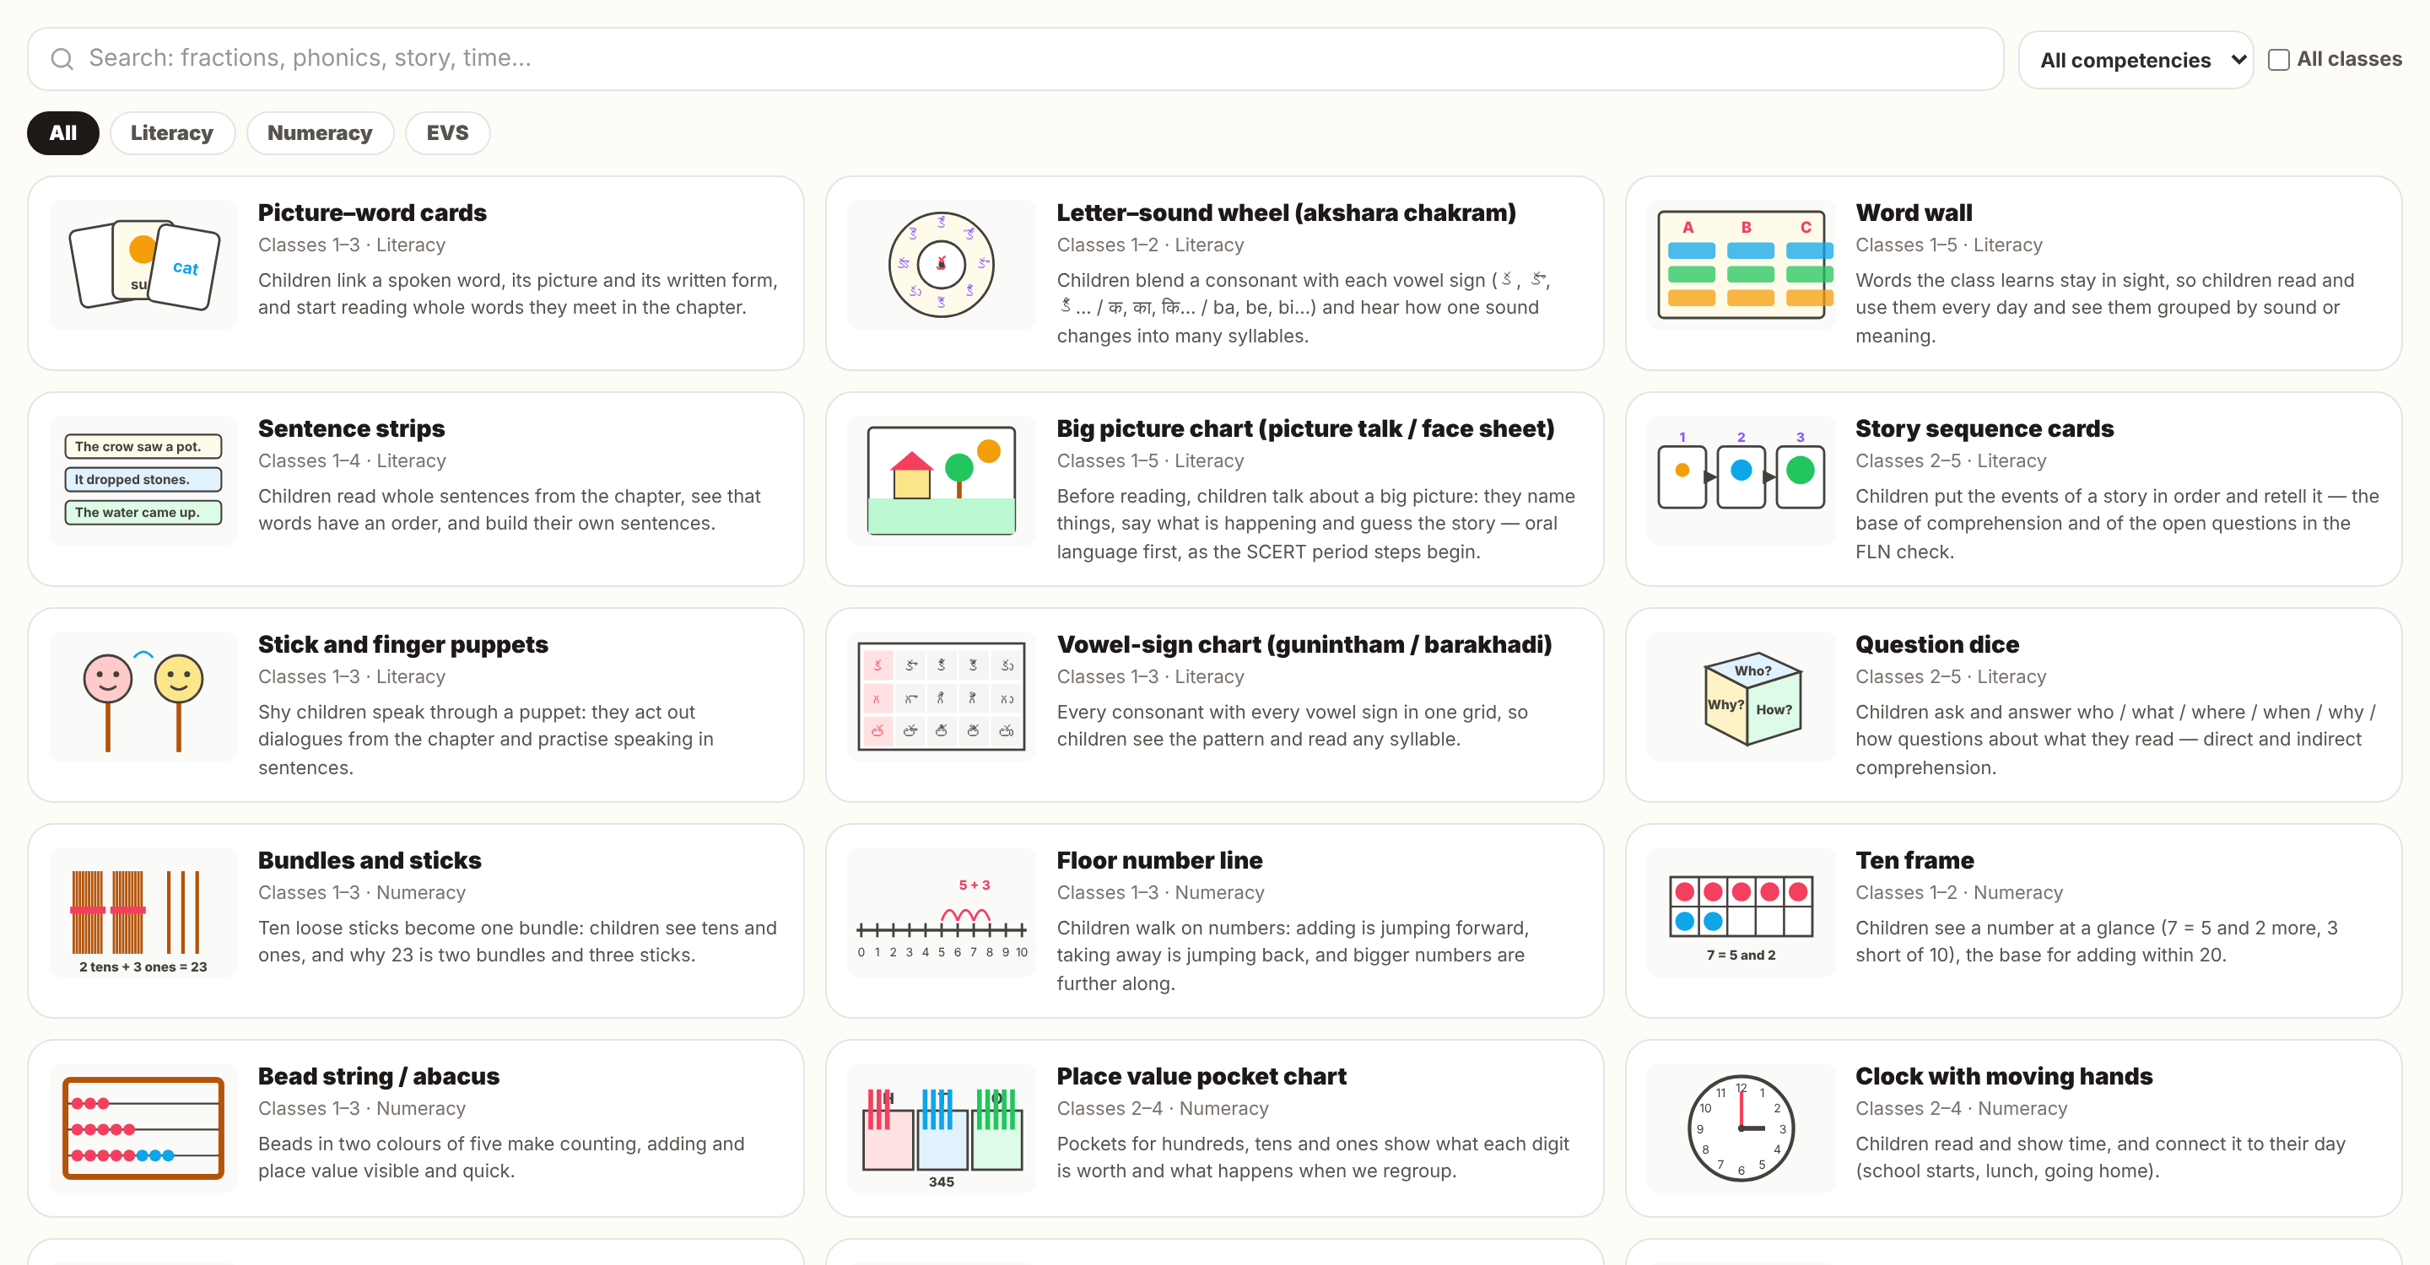
The whole school, at a glance
FOR HEADMASTERS
Attendance per class
Children under 75% flagged.
Latest FLN round
Who moved up a level.
Curriculum pace
Taught vs the year plan.
Teaching-aid library: 20 low-cost materials with pictures, how to make and use them.
Print and Excel
With a signature line.
Notes:
Headmasters get a roll-up of every class: attendance, the latest FLN round, curriculum pace and printable reports — the same numbers they report upward.

Slide 13
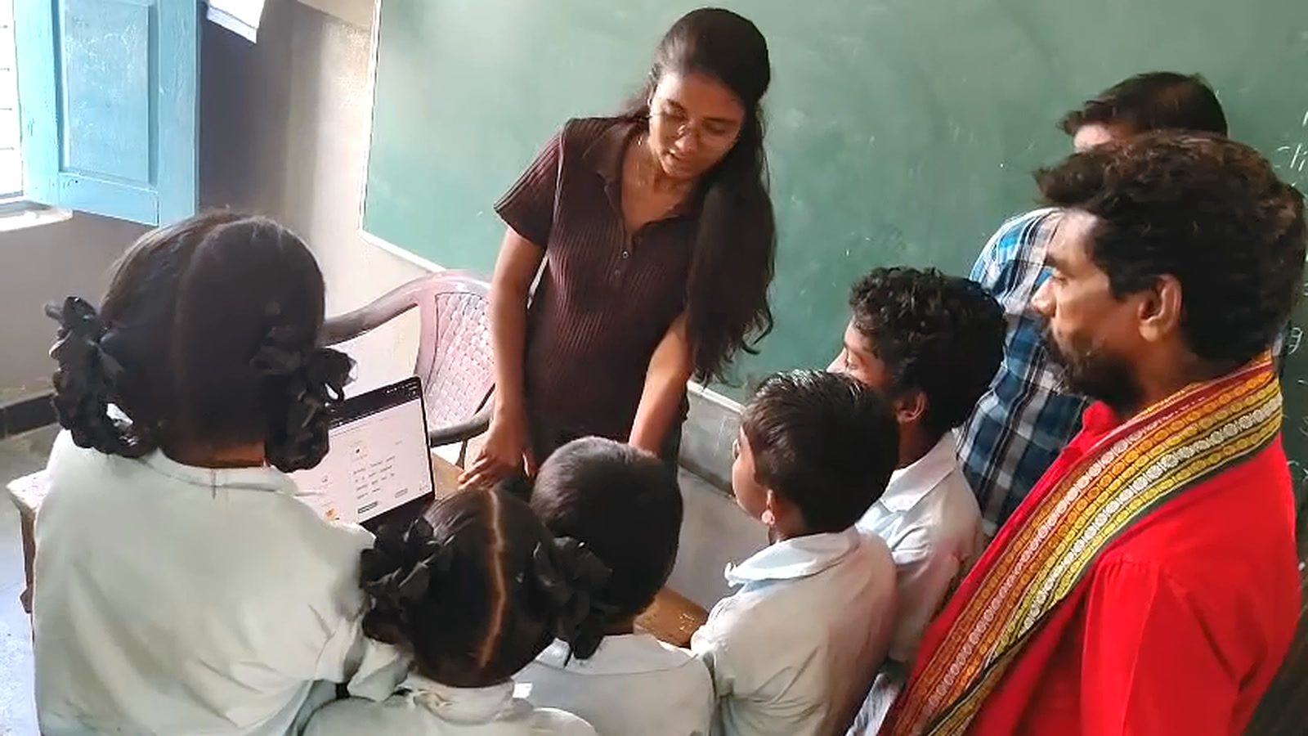
Built in classrooms, with teachers
FROM THE FIELD
What we saw in schools | What we changed
A hard page stopped a child from moving on | Next opens after one honest try
A teacher heard a robotic voice | Only natural Indian voices in lessons
A child read हूँ right but was marked wrong | Hindi and Telugu spelling variants accepted
Maths does not need reading aloud | Maths chapters became tests with worked answers
Field visit, October 2026 — children try Pathana Shakthi with their teacher.
Notes:
Every row is a real change from our field rounds and teacher feedback — including this week’s: maths chapters are no longer read aloud; they are direct tests with worked answers.

Slide 14


Policy, budget and technology have arrived together
WHY NOW
NIPUN Bharat
NEP 2020
Indian speech AI
A national mission for every child to read and do maths by the end of Class 3, with reading-speed goals schools report on.
Mother-tongue learning in the foundational years — exactly where English-first tools fall short.
Natural Indian voices and speech recognition in Telugu and Hindi are now good and affordable for every child.
NIPUN Bharat, Ministry of Education (2021) · National Education Policy 2020
Notes:
NIPUN Bharat made foundational literacy a national mission with measurable goals. NEP 2020 put the mother tongue at the centre. And Indian speech AI crossed the line on quality and cost. Pathana Shakthi sits where the three meet.

Slide 15
The hard parts are the ones we have already solved
WHY WE WIN
01
Reads real state textbooks
02
Listens to Indian children
Scanned Indic PDFs, legacy fonts, pictures cropped from scans, speech bubbles kept out of lesson text.
Telugu and Hindi matching tuned in classrooms; spelling variants, number words, a measured pronunciation dictionary.
03
Speaks the system’s language
04
Evidence, word by word
NIPUN Bharat norms, registers and assessment rounds — what teachers and officers already report.
Every page read aloud shows which words each child finds hard — and makes the next version better.
Notes:
Anyone can wrap a speech API. What takes time is around it: reading the state’s real books, listening to Indian children, fitting the system’s reporting, and the word-level evidence every reading produces.

Slide 16


Priced per child per year, paid by those who fund learning
BUSINESS MODEL
PRIMARY
BRIDGE
EXPANSION
State governments
CSR and foundations
Low-fee private schools
FLN programmes under Samagra Shiksha, district by district.
Adopt-a-school and district programmes with measured reading gains.
The same state textbooks and the same need, paid directly.
₹150–300 / child / year
₹40,000–75,000 / school / year
₹400–600 / child / year
Low cost to serve: one upload serves every class using that book, and every AI feature falls back to a no-AI version.
Notes:
The buyer in public education is the state, through FLN budgets under Samagra Shiksha; CSR funds pilots and districts while procurement moves; low-fee private schools use the same books and pay directly. Confirm prices and name programme conversations under way.

Slide 17





Let’s get every child reading.
Empowering every child. Enabling every teacher.
admin@221blabs.com
www.221blabs.com
8639813168
7th Block, Malla Reddy University, Maisammaguda, Hyderabad, Telangana 500100
Thank you
Notes:
Close on the mission and the contact details. Pathana Shakthi: every child reading, every teacher supported, measured against the benchmarks the system already uses.

