Slide 1

Digital Control and Signal Processing
Final Project: Gimbal Speed Control System Design
1조
22400448 오유성
22200576 이주영

Slide 2
Contents
1) Motor Lineaerization
2) Modeling
A. Vc-Wgyro relations & potentio
A. Frequency Response
B. Linearization: Wcmd-Wgyro
B. Filtering Data(s)
C. Linearization Validation
C. Pulse response
D. Observations
D. Observations
3) Designation
4) Stabilization
A. Parameter boundary
A. Parameter boundary
B. Selecting parameters & Controller
B. Selecting parameters & Controller
C. Tendency of parameters
C. Tendency of parameters (Design Model)
D. Analysis Model
D. Analysis Model
E. Output & discussion
E. Output & discussion

Slide 3
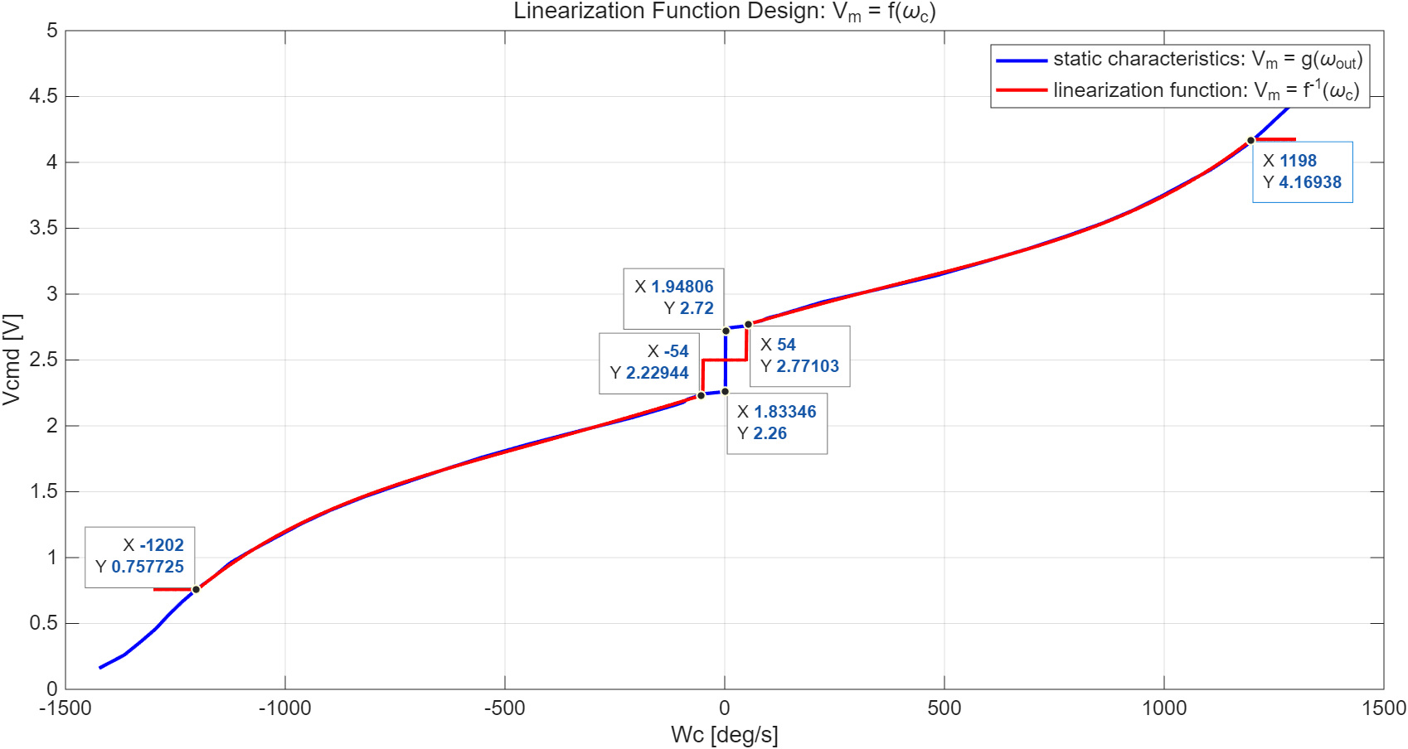
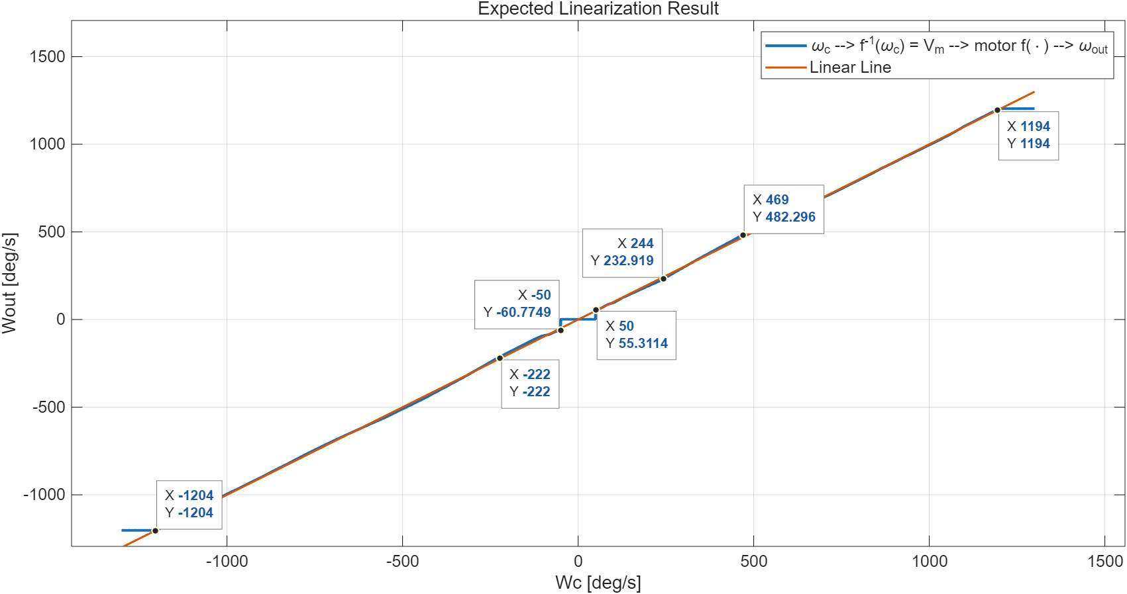
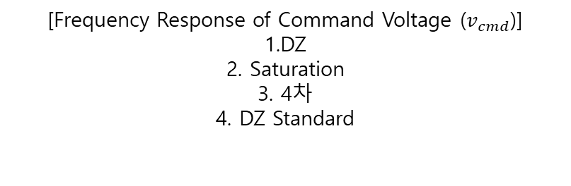

1) Motor Dynamics Modeling
A. Vc-Wgyro relations & potentio
[Frequency Response of Command Voltage ($v_{cmd}$)] 1.DZ
2. Saturation
3. 4차
4. DZ Standard
[Output Voltage ($v_{out}$) of Command Voltage ($v_{cmd}$)]
Linear
약간의 offset 언급
Notes:
Saturation…

Slide 4
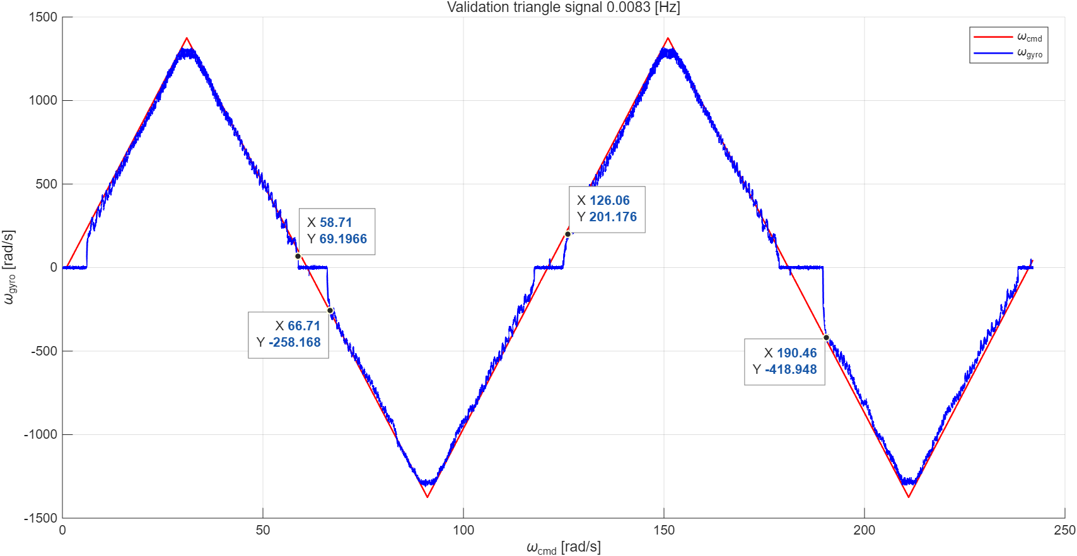
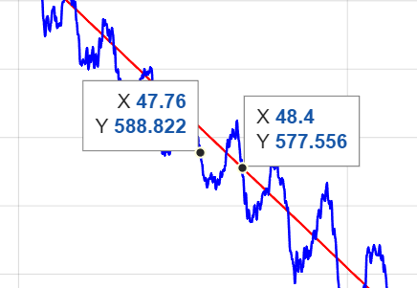
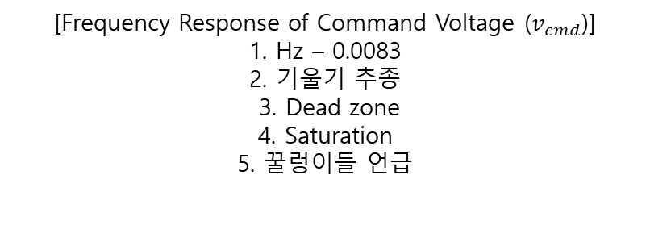
1) Motor Dynamics Modeling
C. Linearization Validation
[Frequency Response of Command Voltage ($v_{cmd}$)] 1. Hz – 0.0083
2. 기울기 추종
3. Dead zone
4. Saturation
5. 꿀렁이들 언급
Notes:
Saturation…

Slide 5

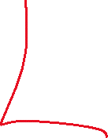


1) Motor Dynamics Modeling
C. Linearization Validation
[FFT 언급 하고] 1. 특정 주파수 성분 언급
2. 고주파수 성분 언급, Dz, Satuartion
Notes:
Saturation…

Slide 6
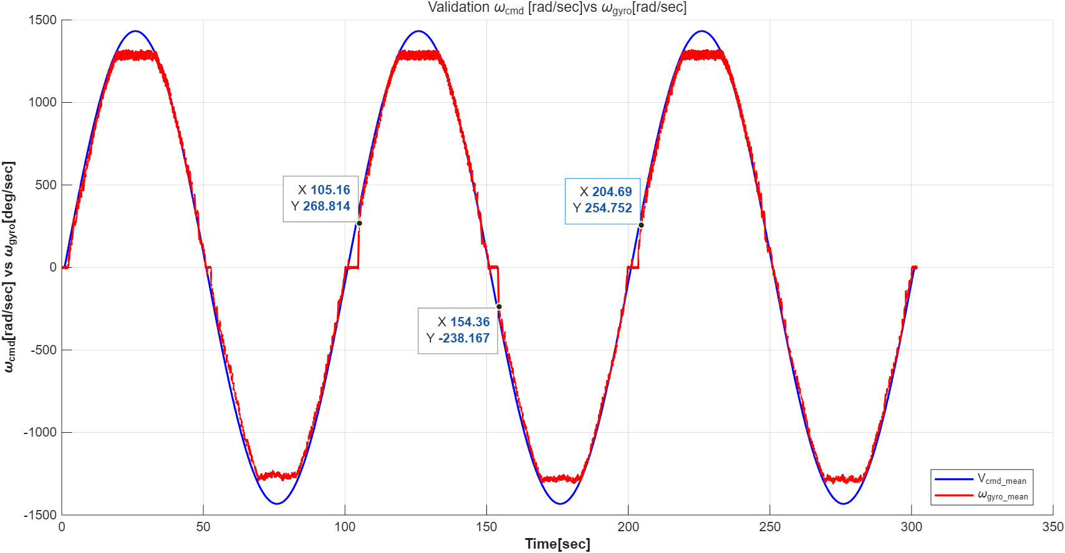



1) Motor Dynamics Modeling
C. Linearization Validation
[사인파 간단히 언급] 1.DZ
2. Saturation
3. 4차
4. DZ Standard
[ftt ]
특정 주파수 성분 발생
고주파수에서 dB 높은거
Notes:
Saturation…

Slide 7
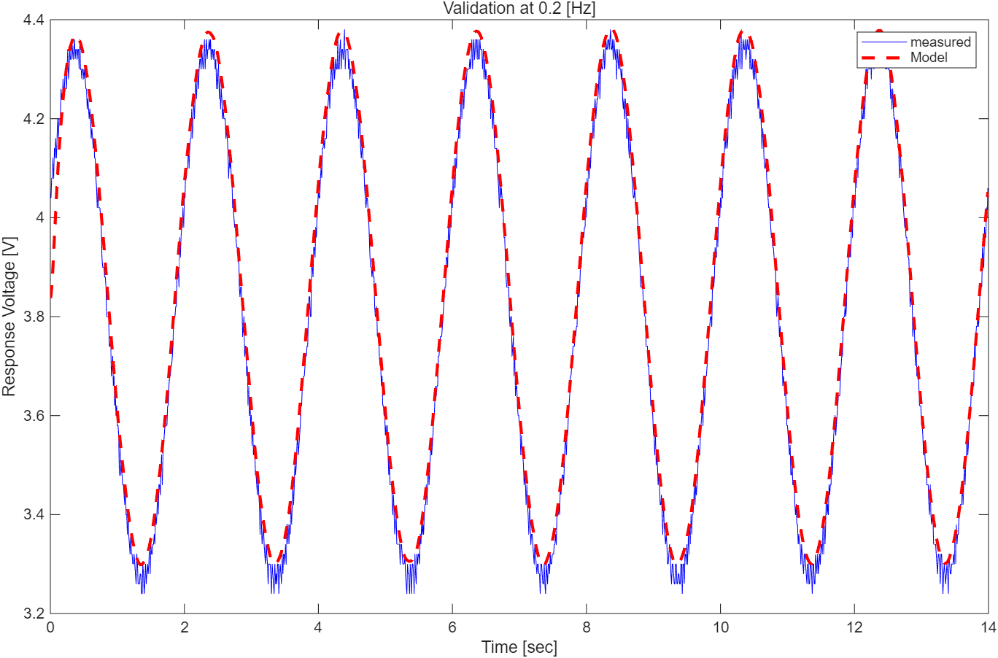
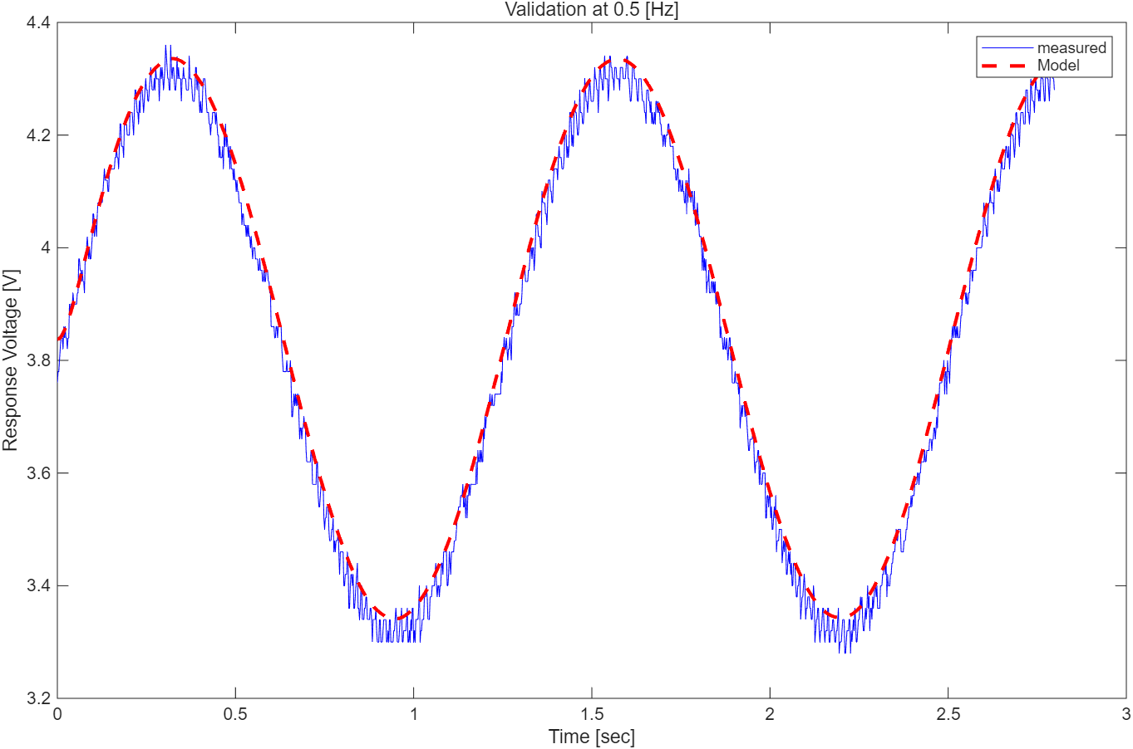
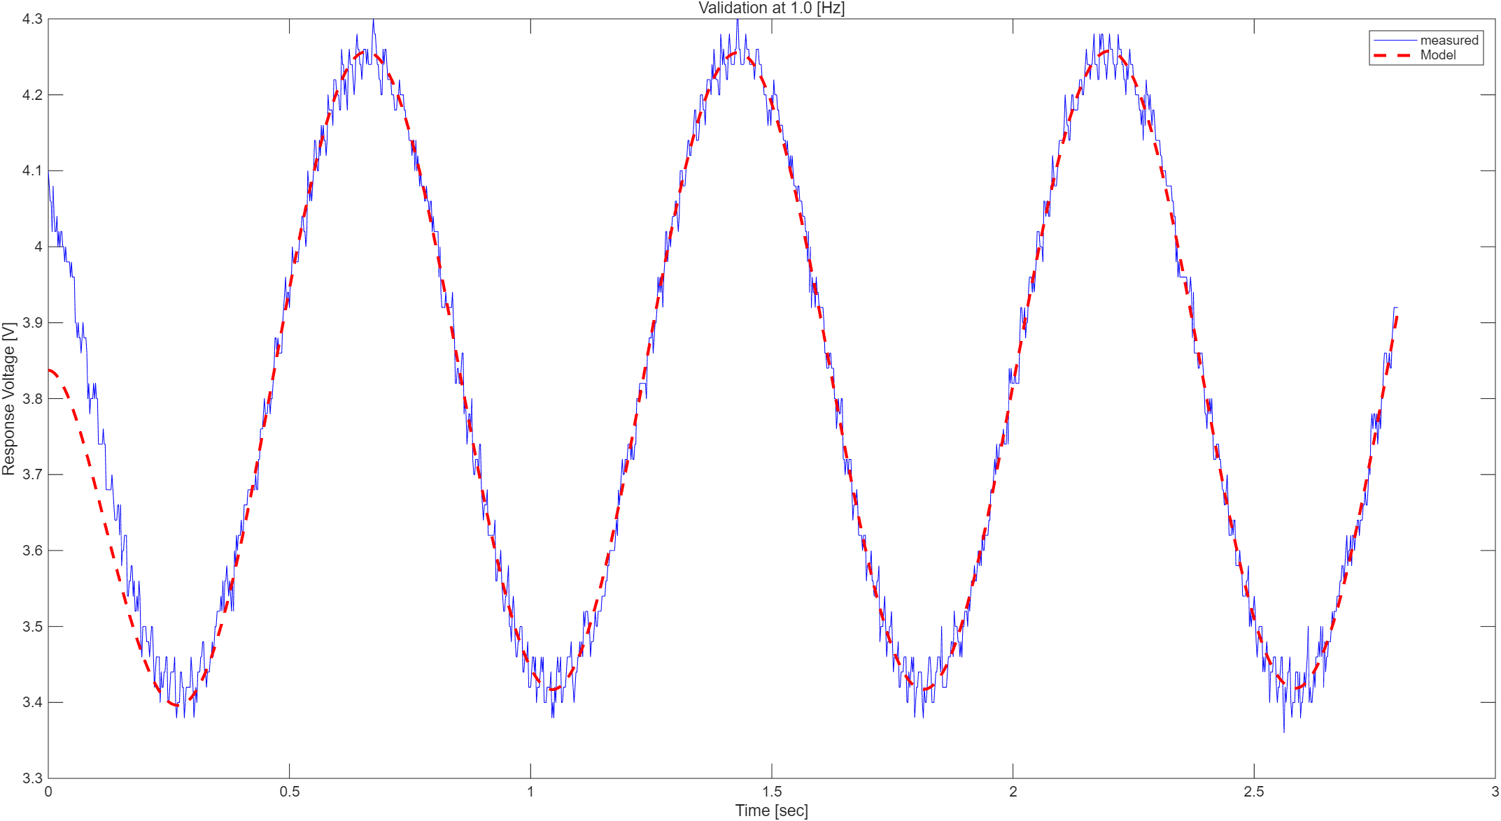









2) Gimbal Modeling
A. Frequency Response
$$Amplitute Error=0.52 [\%]$$
$$Phase Error=0.72 [deg]$$
$$Amplitute Error=0.66 [\%]$$
$$Phase Error=1.08 [deg]$$
$$Amplitute Error=1.31 [\%]$$
$$Phase Error=5.04[deg]$$
[The output voltage of the command voltage at$0.2 Hz$, $0.5 Hz$, $1.0 Hz$]
$Amplitute Error [\%]=\frac{\left|A_{exp}−A_{model}\right|}{A_{model}}×100$, $Phase Error \left[deg\right]=360˚×f×Δt$
Notes:
Saturation…

Slide 8
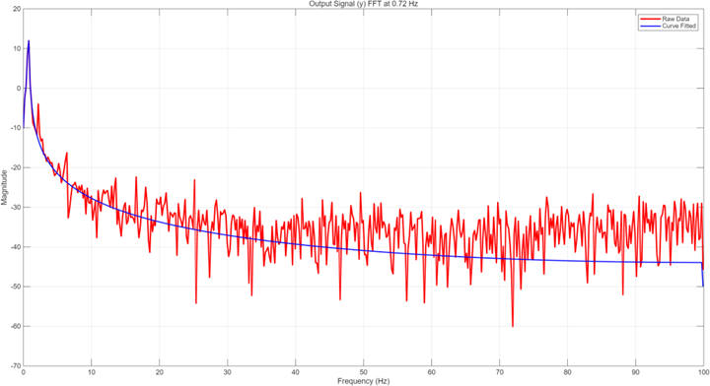



2) Gimbal Modeling
A. Frequency Response
[0.5Hz 사인 분석] 1.DZ
2. 절벽
[ftt ]
주파수 성분이 더 생긴다.
LPF의 필요성
Notes:
Saturation…

Slide 9
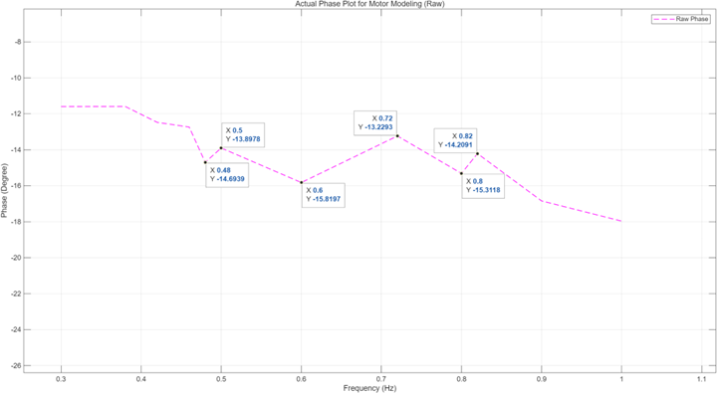
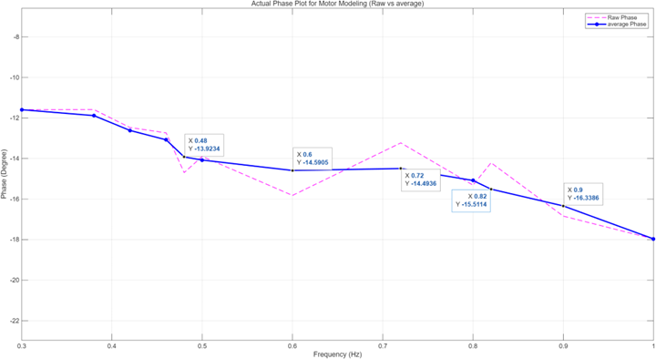
2) Gimbal Modeling
B. Filtering Data(s)
[Point 별로 비선형 요소 제거] 1.결측치 제거
2.
[ftt ]
주파수 성분이 더 생긴다.
LPF의 필요성
Notes:
Saturation…

Slide 10





2) Gimbal Modeling
B. Filtering Data(s)
[ftt ]
전달함수.
bandwidth
[ftt ]
안맞는 주파수 성분 위주로,
뒷 부분에서 차이가
Notes:
Saturation…

Slide 11


2) Gimbal Modeling
B. Filtering Data(s)
- Transfer Function $G_{m}(s)$
$$G_{m}\left(s\right)=\frac{371.363}{s^{2}+44.3466s+330.7459}$$
$$add band width$$

Slide 12










1) Motor Dynamics Modeling
E. Validation
$$Amplitute Error=0.52 [\%]$$
$$Phase Error=0.72 [deg]$$
$$Amplitute Error=0.66 [\%]$$
$$Phase Error=1.08 [deg]$$
$$Amplitute Error=1.31 [\%]$$
$$Phase Error=5.04[deg]$$
[The output voltage of the command voltage at$0.2 Hz$, $0.5 Hz$, $1.0 Hz$]
$Amplitute Error [\%]=\frac{\left|A_{exp}−A_{model}\right|}{A_{model}}×100$, $Phase Error \left[deg\right]=360˚×f×Δt$
Notes:
Saturation…

Slide 13
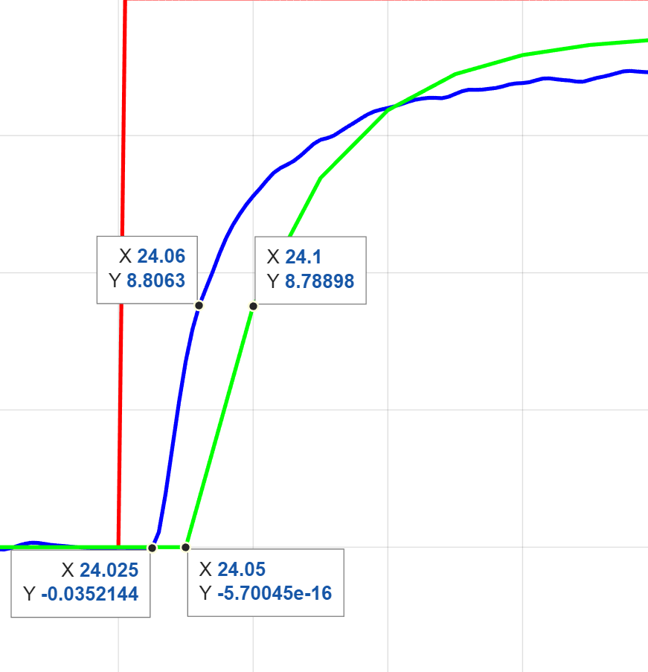
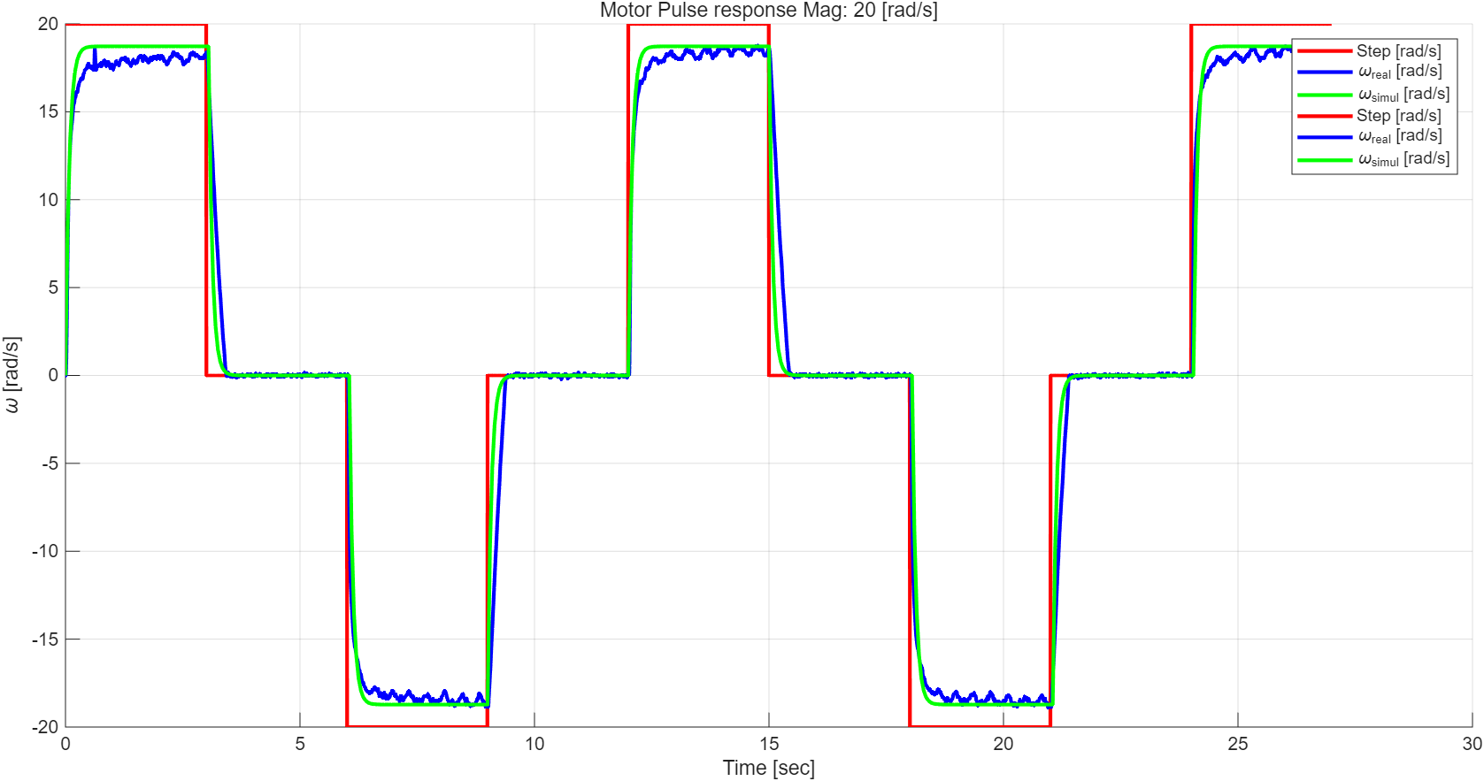
2) Gimbal Modeling
C. Pulse response
[Pulse response] 1. 낙관적
2. Steady stae error exist
3.
4. Saturation
5. 꿀렁이들 언급
6. 전달함수 구한 것 넣기 Time Const, Km
7. Bandwidth
Notes:
Saturation…

Slide 14
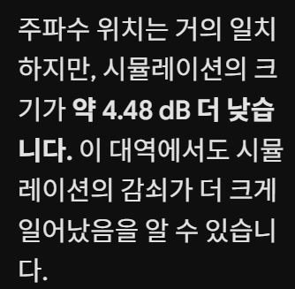
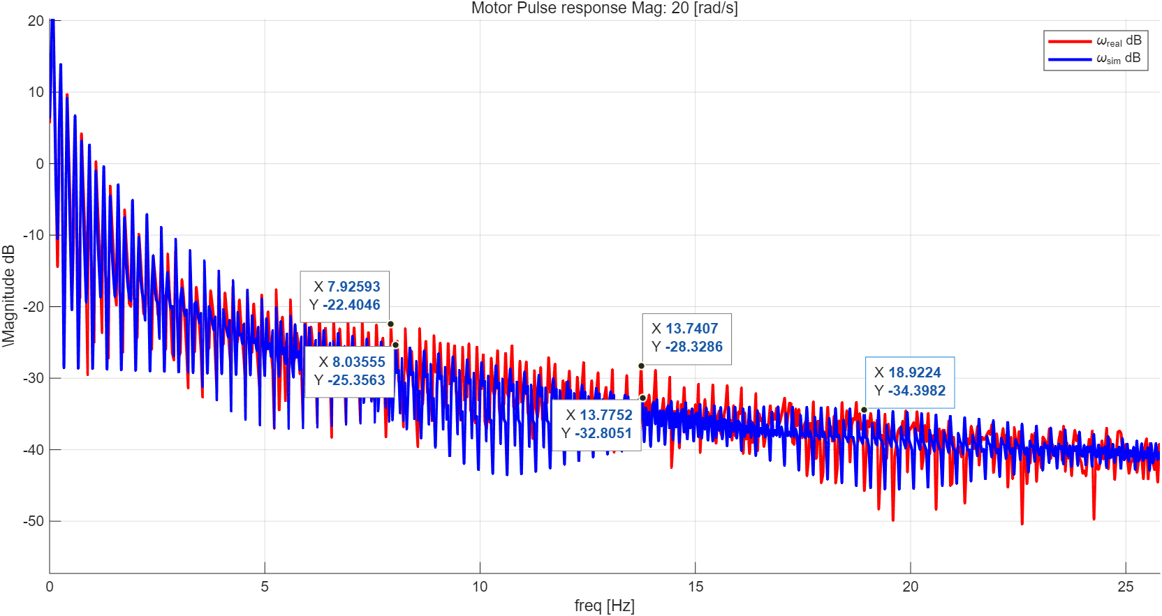
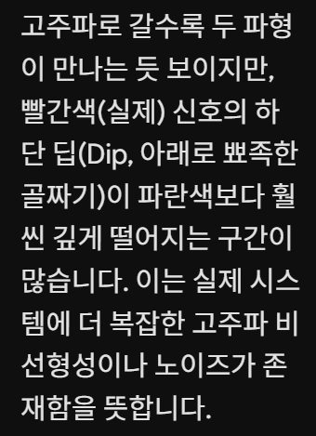
2) Gimbal Modeling
B. Filtering Data(s)
[ftt ]
중간 대역폭 위주로 설명
Notes:
Saturation…

Slide 15










4) Stabilization
A. Parameter boundary
- Selection of the Control Structure
$$ζ_{c}>0.5912$$
$$jω$$
Relative stability
$$ω_{c}>26.546$$
$OS\%<10\%$
$e^{−(\frac{ζ}{\sqrt{1−ζ^{2}}})π}×100<10\%$ , $ζ_{c}>0.5912$ or $ζ_{c}<−0.5912$
$$σ$$
$T_{r}(0\sim 90\%)<0.1$ [sec]
$T_{r}≈\frac{2.6546}{ω_{c}}<0.1 [sec]$ , $ω_{c}>26.546 [rad/sec]$
$$ζ_{c}<−0.5912$$
Notes:
다음으로는 Relative stability를 통하여 주어진 overshoot과 rise time 조건을 맞추기 위한 zeta와 omega의 범위를 정해주었습니다.

Slide 16
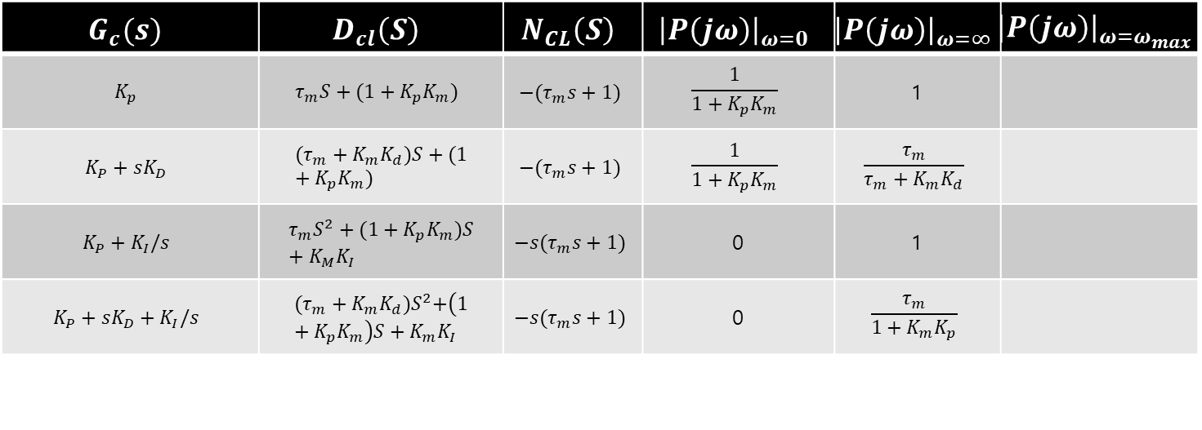
4) Stabilization
B. Selecting parameters & Controller
PI 선정한 이유 - DC성분이 0이다. W무한대가 1이다. 우리가 논하는 것은 중간 뿐이다.
$$G_{c}(s)$$ | $$D_{cl}\left(S\right)$$ | $$N_{CL}\left(S\right)$$ | $${\left|P\left(jω\right)\right|}_{ω=0}$$ | $${\left|P\left(jω\right)\right|}_{ω=∞}$$ | $${\left|P\left(jω\right)\right|}_{ω=ω_{max}}$$
$$K_{p}$$ | $$τ_{m}S+(1+K_{p}K_{m})$$ | $$−(τ_{m}s+1)$$ | $$\frac{1}{1+K_{p}K_{m}}$$ | 1
$$K_{P}+sK_{D}$$ | $$(τ_{m}+K_{m}K_{d})S+(1+K_{p}K_{m})$$ | $$−(τ_{m}s+1)$$ | $$\frac{1}{1+K_{p}K_{m}}$$ | $$\frac{τ_{m}}{τ_{m}+K_{m}K_{d}}$$
$$K_{P}+K_{I}/s$$ | $$τ_{m}S^{2}+(1+K_{p}K_{m})S+K_{M}K_{I}$$ | $$−s(τ_{m}s+1)$$ | 0 | 1
$$K_{P}+sK_{D}+K_{I}/s$$ | $${(τ_{m}+K_{m}K_{d})S}^{2}+\left(1+K_{p}K_{m}\right)S+K_{m}K_{I}$$ | $$−s(τ_{m}s+1)$$ | 0 | $$\frac{τ_{m}}{1+K_{m}K_{p}}$$

Slide 17
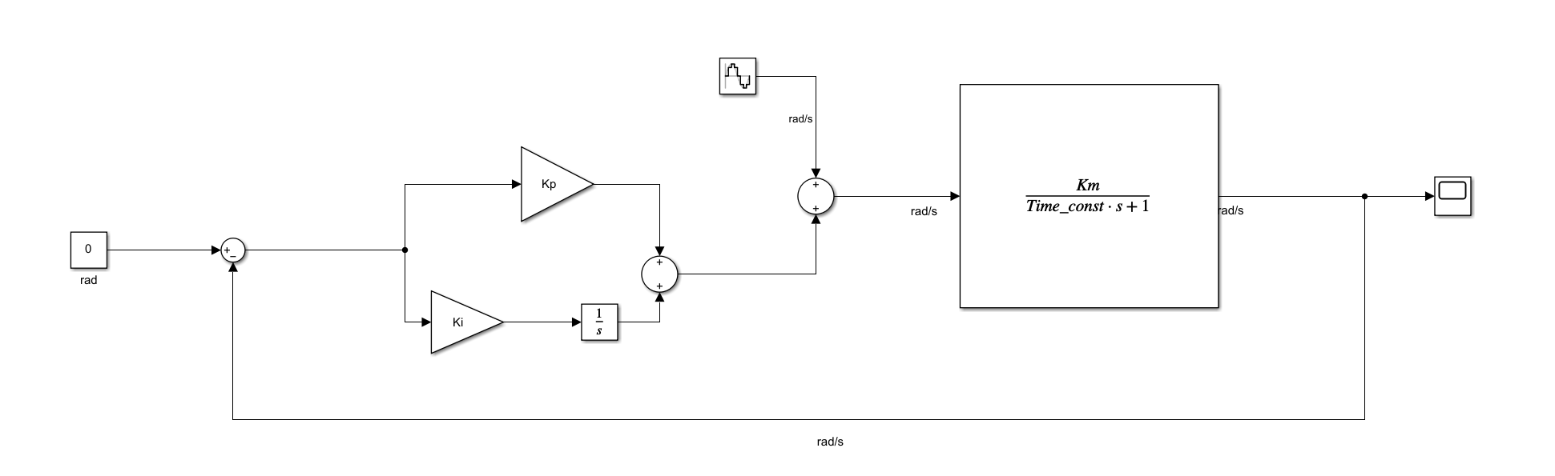



4) Stabilization
C. Tendency of parameters (Design Model)
- Selection of the Control Structure
Closed-Loop System Shaping Using PID Control
$$G_{cl}\left(s\right)=\frac{G_{c}G_{m}}{1+G_{c}G_{m}}=\frac{∎}{(s+r)(s^{2}+2ζω_{c}s+ω_{c}^{2})}$$
The PID controller shapes the closed-loop transfer function $G_{cl}$ by determining its pole–zero structure.
By adjusting the pole-zero placement of the closed-loop transfer function $G_{cl}(s)$, the system characteristics can be shaped.
$K_{d}=\frac{2ζ_{c}ω_{c}+r−2ζ_{m}ω_{m}}{K_{m}ω_{m}^{2}}$
$K_{p}=\frac{ω_{c}^{2}+2ζ_{c}ω_{c}r−ω_{m}^{2}}{K_{m}ω_{m}^{2}}$
$K_{i}=\frac{rω_{c}^{2}}{K_{m}ω_{m}^{2}}$

Slide 18
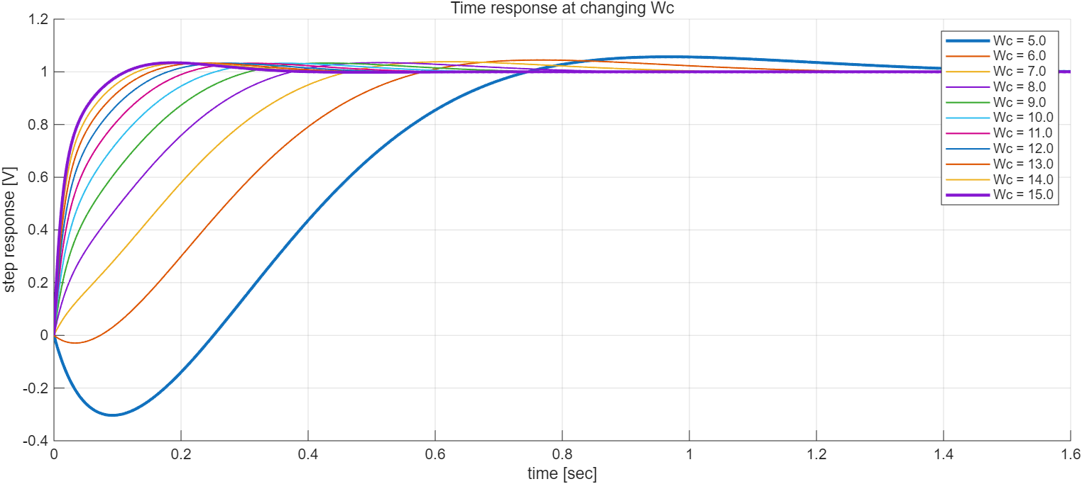
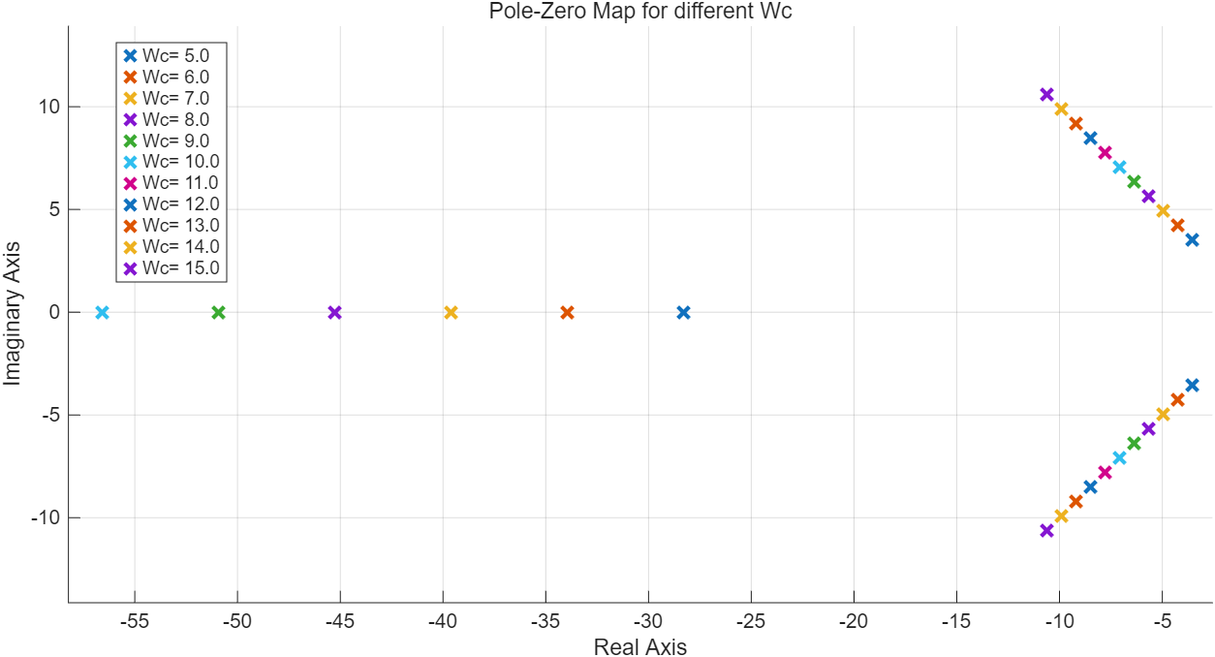
4) Stabilization
C. Tendency of parameters (Design Model)
- Natural frequency $( ω_{c} )$
A higher natural frequency results in a shorter rise time of the system response, while a lower natural frequency leads to a slower rise time.
[Effect of Natural frequency ($ω_{c}$) on System Dynamics: Time Response and Pole Locations]
Notes:
Natural frequency에 의하여 rise time 달라짐

Slide 19






4) Stabilization
C. Tendency of parameters (Design Model)
- Natural frequency $( ω_{c} )$
A higher natural frequency results in a shorter rise time of the system response, while a lower natural frequency leads to a slower rise time.
[Effect of Natural frequency ($ω_{c}$) on System Dynamics: Time Response and Pole Locations]
Notes:
Natural frequency에 의하여 rise time 달라짐

Slide 20
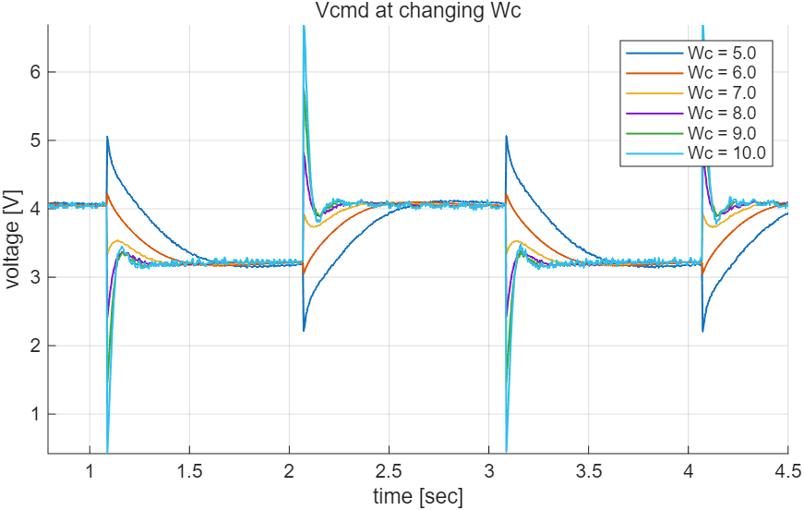
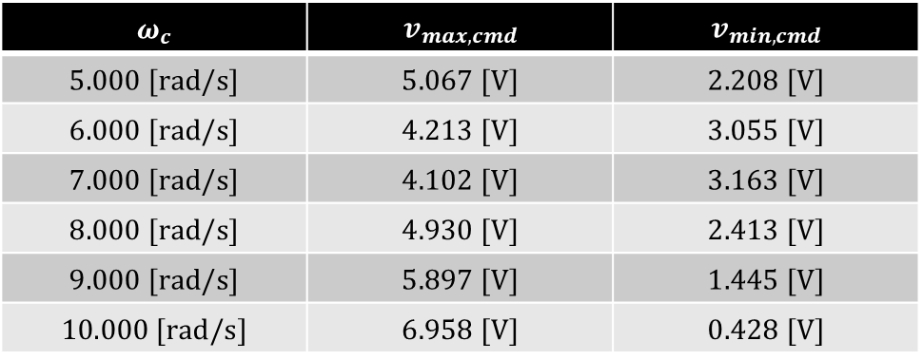
4) Stabilization
C. Tendency of parameters (Design Model)
- Transfer Function $G_{m}(s)$
$$ω_{c}$$ | $$v_{max,cmd}$$ | $$v_{min,cmd}$$
$$5.000 [rad/s]$$ | $$5.067 [V]$$ | $$2.208 [V]$$
$$6.000 [rad/s]$$ | $$4.213 [V]$$ | $$3.055 [V]$$
$$7.000 [rad/s]$$ | $$4.102 [V]$$ | $$3.163 [V]$$
$$8.000 [rad/s]$$ | $$4.930 [V]$$ | $$2.413 [V]$$
$$9.000 [rad/s]$$ | $$5.897 [V]$$ | $$1.445 [V]$$
$$10.000 [rad/s]$$ | $$6.958 [V]$$ | $$0.428 [V]$$

Slide 21

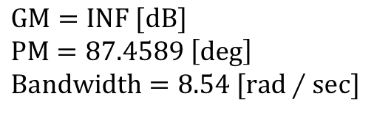

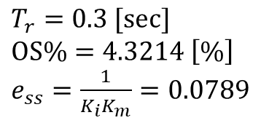




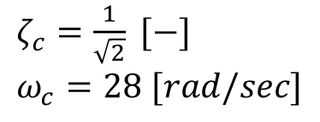

4) Stabilization
C. Tendency of parameters (Design Model)
- Selection of the Control Structure
Set gain
$ζ_{c}=\frac{1}{\sqrt{2}} [−]$
$ω_{c}=28 [rad/sec]$
$K_{p}=\frac{ω_{c}^{2}+2ζ_{c}ω_{c}r−ω_{m}^{2}}{K_{m}ω_{m}^{2}}=수$정 [-]
$K_{i}=\frac{rω_{c}^{2}}{K_{m}ω_{m}^{2}}=11.2907 [찾아봐]$
Performance Prediction
$$T_{r}=0.3 [sec]$$
$OS\%=4.3214 \left[\%\right]$
$e_{ss}=\frac{1}{K_{i}K_{m}}=0.0789$
$$GM=INF [dB]$$
$PM=87.4589 \left[deg\right]$
$Bandwidth=8.54 [rad∕sec]$

Slide 22
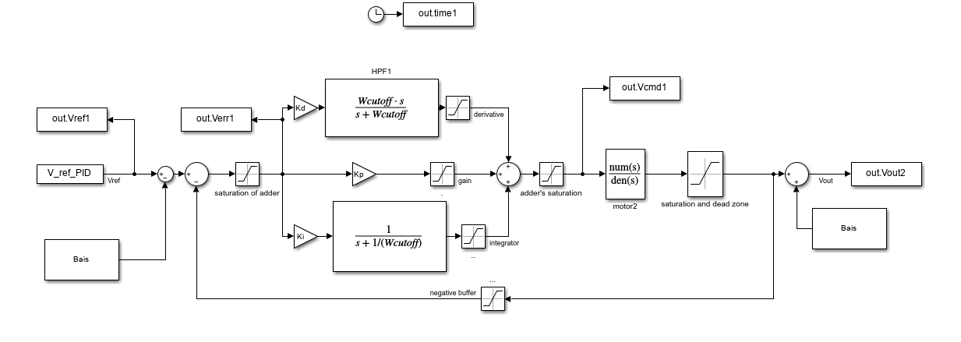
4) Stabilization
D. Analysis Model

Slide 23
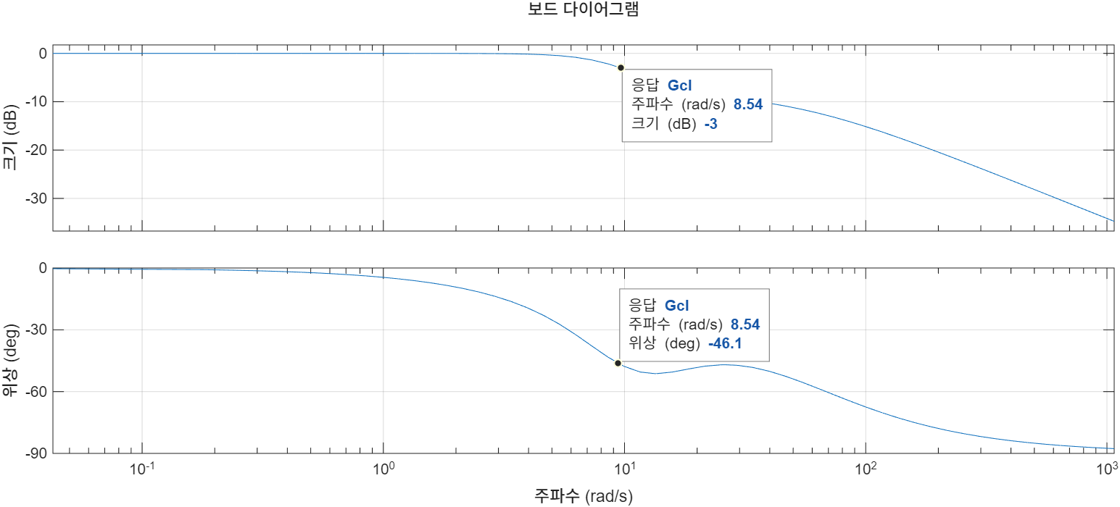



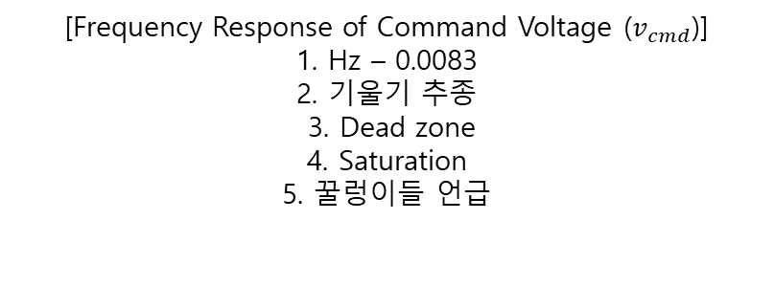


4) Stabilization
D. Analysis Model
Performance Prediction
[Frequency Response of Command Voltage ($v_{cmd}$)] 1. Hz – 0.0083
2. 기울기 추종
3. Dead zone
4. Saturation
5. 꿀렁이들 언급
[PS Diagram of $P(s)$]

Slide 24
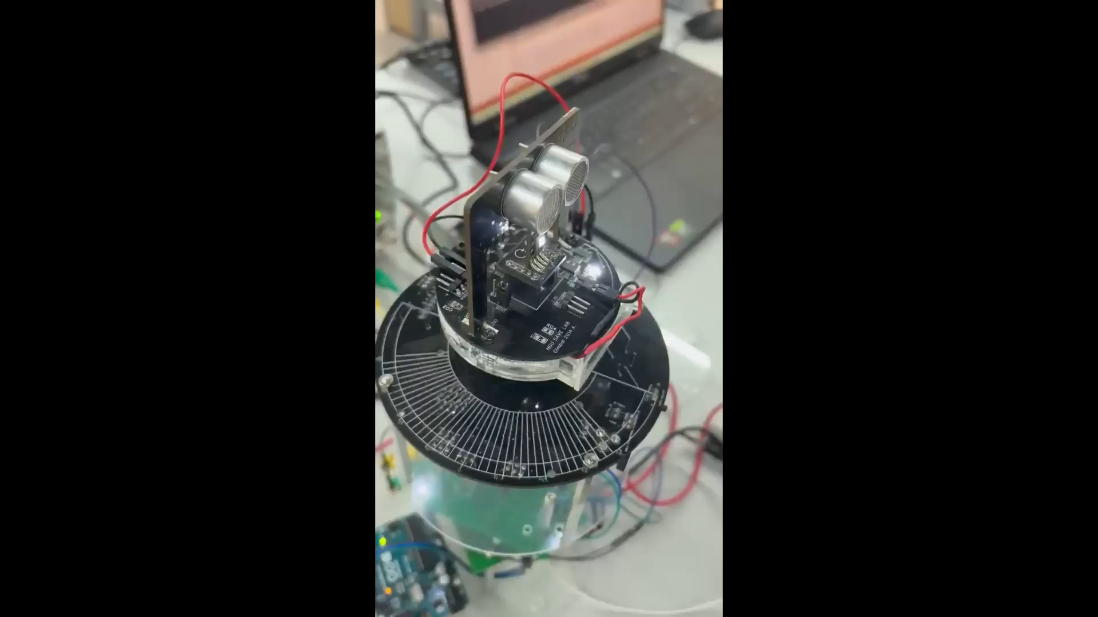
4) Stabilization
D. Analysis Model
Performance
[Video of Stabilization Performance]

Slide 25
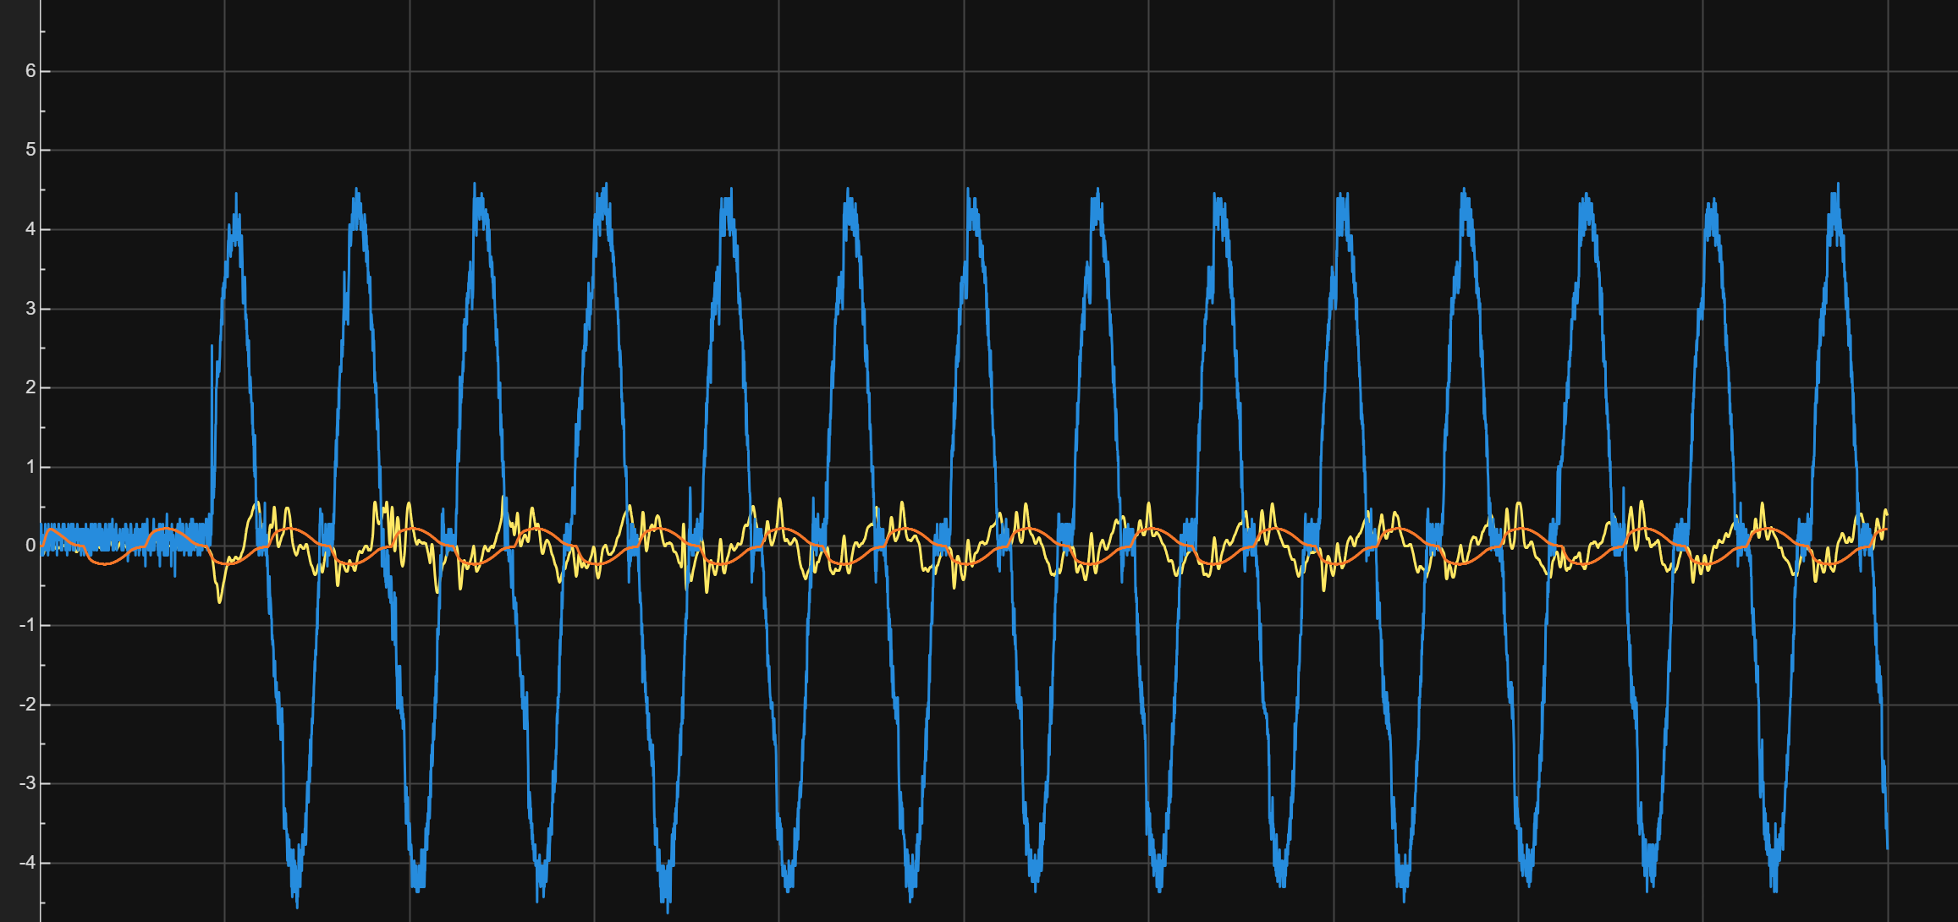
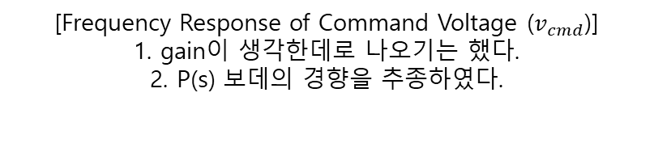
4) Stabilization
D. Analysis Model
Performance Prediction
[Frequency Response of Command Voltage ($v_{cmd}$)] 1. gain이 생각한데로 나오기는 했다.
2. P(s) 보데의 경향을 추종하였다.
[PS Diagram of $P(s)$]

Slide 26
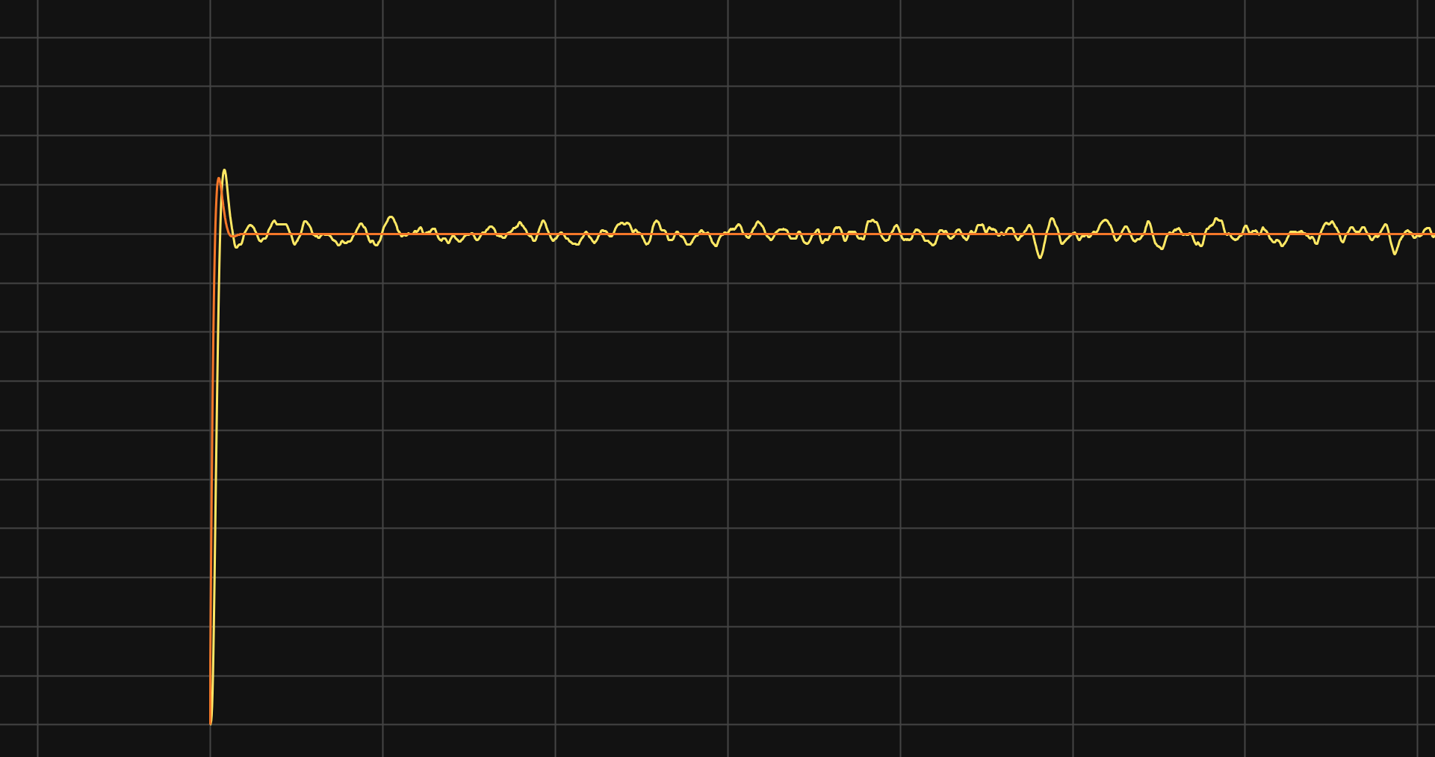

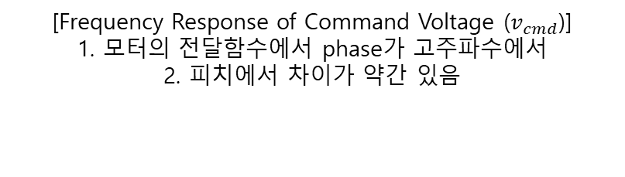
4) Stabilization
D. Analysis Model
Performance Prediction
[Frequency Response of Command Voltage ($v_{cmd}$)] 1. 모터의 전달함수에서 phase가 고주파수에서
2. 피치에서 차이가 약간 있음
[PS Diagram of $P(s)$]

Slide 27
3) Designation
A. Parameter boundary
- Selection of the Control Structure
$$ζ_{c}>0.5912$$
$$jω$$
Relative stability
$$ω_{c}>26.546$$
$OS\%<10\%$
$e^{−(\frac{ζ}{\sqrt{1−ζ^{2}}})π}×100<10\%$ , $ζ_{c}>0.5912$ or $ζ_{c}<−0.5912$
$$σ$$
$T_{r}(0\sim 90\%)<0.1$ [sec]
$T_{r}≈\frac{2.6546}{ω_{c}}<0.1 [sec]$ , $ω_{c}>26.546 [rad/sec]$
$$ζ_{c}<−0.5912$$
Notes:
다음으로는 Relative stability를 통하여 주어진 overshoot과 rise time 조건을 맞추기 위한 zeta와 omega의 범위를 정해주었습니다.

Slide 28
3) Designation
B. Selecting parameters & Controller
PI 선정한 이유 - DC성분이 0이다. W무한대가 1이다. 우리가 논하는 것은 중간 뿐이다.
$$G_{c}(s)$$ | $$D_{cl}\left(S\right)$$ | $$N_{CL}\left(S\right)$$ | $${\left|P\left(jω\right)\right|}_{ω=0}$$ | $${\left|P\left(jω\right)\right|}_{ω=∞}$$ | $${\left|P\left(jω\right)\right|}_{ω=ω_{max}}$$
$$K_{p}$$ | $$τ_{m}S+(1+K_{p}K_{m})$$ | $$−(τ_{m}s+1)$$ | $$\frac{1}{1+K_{p}K_{m}}$$ | 1
$$K_{P}+sK_{D}$$ | $$(τ_{m}+K_{m}K_{d})S+(1+K_{p}K_{m})$$ | $$−(τ_{m}s+1)$$ | $$\frac{1}{1+K_{p}K_{m}}$$ | $$\frac{τ_{m}}{τ_{m}+K_{m}K_{d}}$$
$$K_{P}+K_{I}/s$$ | $$τ_{m}S^{2}+(1+K_{p}K_{m})S+K_{M}K_{I}$$ | $$−s(τ_{m}s+1)$$ | 0 | 1
$$K_{P}+sK_{D}+K_{I}/s$$ | $${(τ_{m}+K_{m}K_{d})S}^{2}+\left(1+K_{p}K_{m}\right)S+K_{m}K_{I}$$ | $$−s(τ_{m}s+1)$$ | 0 | $$\frac{τ_{m}}{1+K_{m}K_{p}}$$

Slide 29
3) Designation
C. Tendency of parameters (Design Model)
- Selection of the Control Structure
Closed-Loop System Shaping Using PID Control
$$G_{cl}\left(s\right)=\frac{G_{c}G_{m}}{1+G_{c}G_{m}}=\frac{∎}{(s+r)(s^{2}+2ζω_{c}s+ω_{c}^{2})}$$
The PID controller shapes the closed-loop transfer function $G_{cl}$ by determining its pole–zero structure.
By adjusting the pole-zero placement of the closed-loop transfer function $G_{cl}(s)$, the system characteristics can be shaped.
$K_{d}=\frac{2ζ_{c}ω_{c}+r−2ζ_{m}ω_{m}}{K_{m}ω_{m}^{2}}$
$K_{p}=\frac{ω_{c}^{2}+2ζ_{c}ω_{c}r−ω_{m}^{2}}{K_{m}ω_{m}^{2}}$
$K_{i}=\frac{rω_{c}^{2}}{K_{m}ω_{m}^{2}}$

Slide 30
3) Designation
C. Tendency of parameters (Design Model)
- Natural frequency $( ω_{c} )$
A higher natural frequency results in a shorter rise time of the system response, while a lower natural frequency leads to a slower rise time.
[Effect of Natural frequency ($ω_{c}$) on System Dynamics: Time Response and Pole Locations]
Notes:
Natural frequency에 의하여 rise time 달라짐

Slide 31
3) Designation
C. Tendency of parameters (Design Model)
- Natural frequency $( ω_{c} )$
A higher natural frequency results in a shorter rise time of the system response, while a lower natural frequency leads to a slower rise time.
[Effect of Natural frequency ($ω_{c}$) on System Dynamics: Time Response and Pole Locations]
Notes:
Natural frequency에 의하여 rise time 달라짐

Slide 32
3) Designation
C. Tendency of parameters (Design Model)
- Transfer Function $G_{m}(s)$
$$ω_{c}$$ | $$v_{max,cmd}$$ | $$v_{min,cmd}$$
$$5.000 [rad/s]$$ | $$5.067 [V]$$ | $$2.208 [V]$$
$$6.000 [rad/s]$$ | $$4.213 [V]$$ | $$3.055 [V]$$
$$7.000 [rad/s]$$ | $$4.102 [V]$$ | $$3.163 [V]$$
$$8.000 [rad/s]$$ | $$4.930 [V]$$ | $$2.413 [V]$$
$$9.000 [rad/s]$$ | $$5.897 [V]$$ | $$1.445 [V]$$
$$10.000 [rad/s]$$ | $$6.958 [V]$$ | $$0.428 [V]$$
교집합 없다.

Slide 33
3) Designation
C. Tendency of parameters (Design Model)
- Selection of the Control Structure
Set gain
$ζ_{c}=\frac{1}{\sqrt{2}} [−]$
$ω_{c}=28 [rad/sec]$
$K_{p}=\frac{ω_{c}^{2}+2ζ_{c}ω_{c}r−ω_{m}^{2}}{K_{m}ω_{m}^{2}}=수$정 [-]
$K_{i}=\frac{rω_{c}^{2}}{K_{m}ω_{m}^{2}}=11.2907 [찾아봐]$
Performance Prediction
$$T_{r}=0.3 [sec]$$
$OS\%=4.3214 \left[\%\right]$
$e_{ss}=\frac{1}{K_{i}K_{m}}=0.0789$
$$GM=INF [dB]$$
$PM=87.4589 \left[deg\right]$
$Bandwidth=8.54 [rad∕sec]$

Slide 34
3) Designation
D. Analysis Model

Slide 35
3) Designation
D. Analysis Model
Performance Prediction
[Frequency Response of Command Voltage ($v_{cmd}$)] 1. 모터의 전달함수에서 phase가 고주파수에서
2. 피치에서 차이가 약간 있음
[PS Diagram of $P(s)$]

