Slide 1
Designation
Final Project of Digital Control
오유성 (22400448), 이주영 (22200576)
Thanks to
나원상
Won-Sang Ra

Slide 2
Digital Control and Signal Processing Final Project
1. Sensor Modeling
2. Structure of Controller
3. Design of Controller
4. Performance Analysis

Slide 3
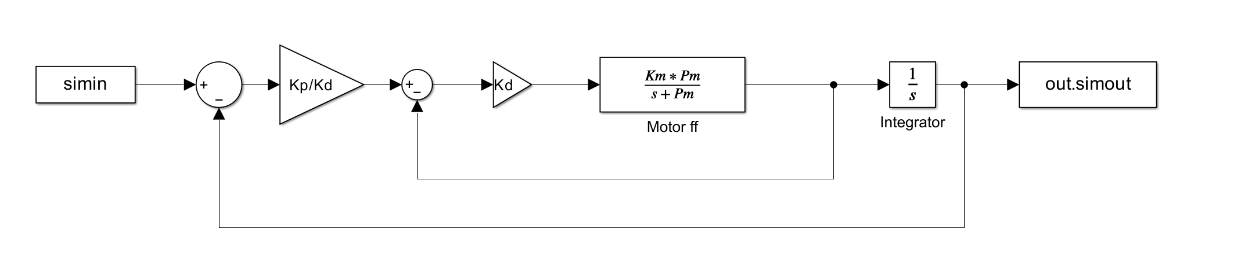
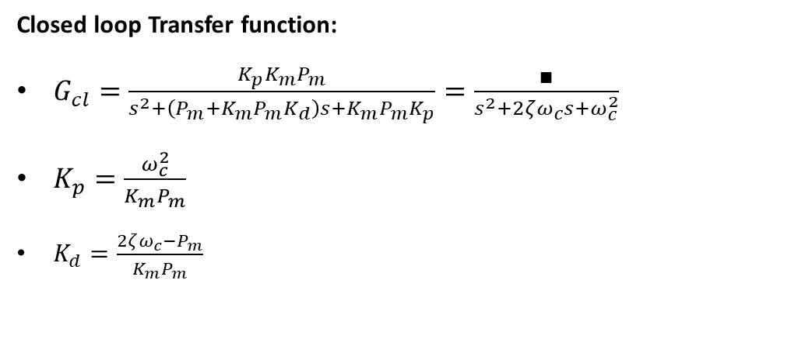
1. Sensor Modeling / 2. Structure of Controller
Closed loop Transfer function:
$G_{cl}=\frac{K_{p}K_{m}P_{m}}{s^{2}+\left(P_{m}+K_{m}P_{m}K_{d}\right)s+K_{m}P_{m}K_{p}}=\frac{∎}{s^{2}+2ζω_{c}s+ω_{c}^{2}}$
$K_{p}=\frac{ω_{c}^{2}}{K_{m}P_{m}}$
$K_{d}=\frac{{2ζω_{c}−P}_{m}}{K_{m}P_{m}}$

Slide 4
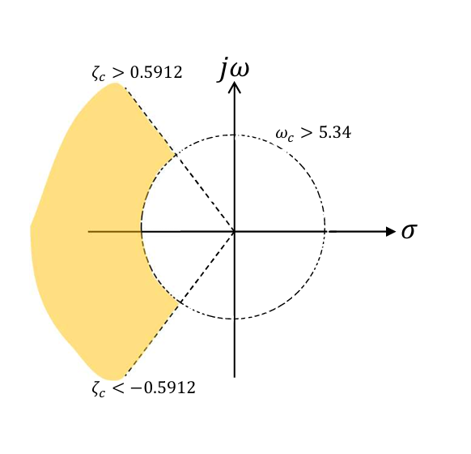
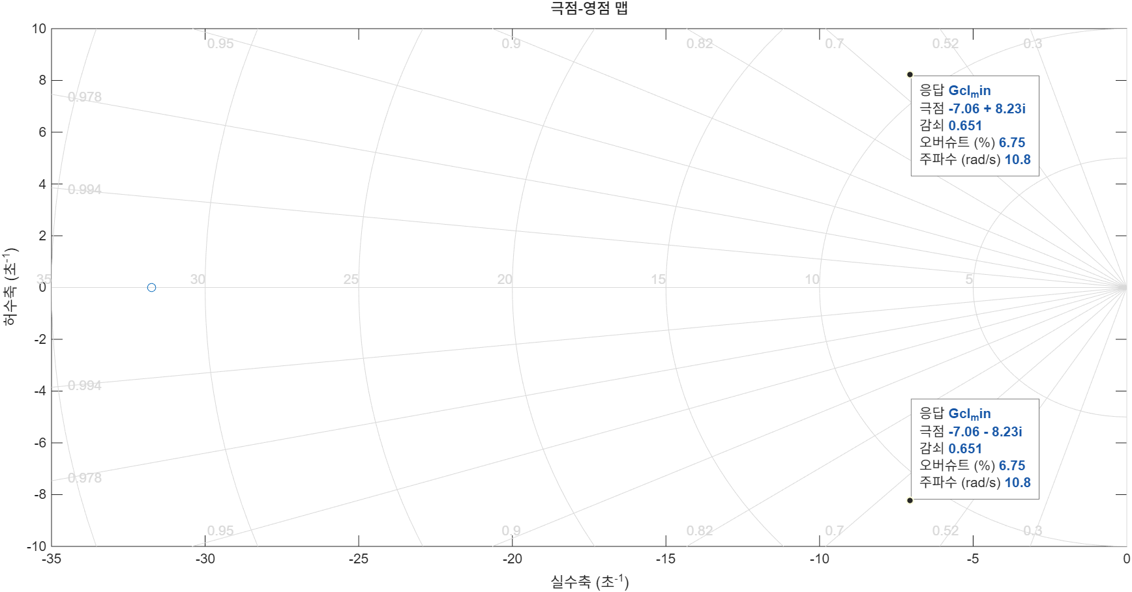

3. Model Design Method
Pole placement
Relative Stability
$\%OS<10\%$
$e^{(−ζ/√(1−ζ^{2})}×100<10\%$
$ζ_{c}> 0.59 \left[−\right]$
$$ζ_{c}<−0.59 [−]$$
$t_{r}^{90}≤0.1 \left[sec\right]$
$$ω_{c}>26.546[rad/s]$$
Selected Values
$ω_{n}=35 [rad/s]$
$ζ=0.7 \left[−\right]$
0.59
26.546
-0.59

Slide 5
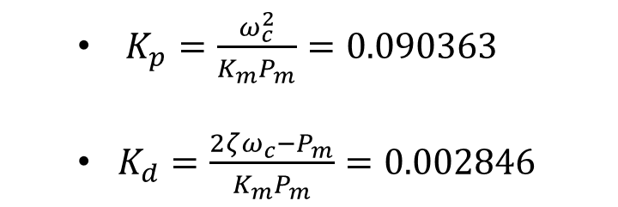
4. Design Model
$K_{p}=\frac{ω_{c}^{2}}{K_{m}P_{m}}=0.090363$
$K_{d}=\frac{{2ζω_{c}−P}_{m}}{K_{m}P_{m}}=0.002846$

Slide 6
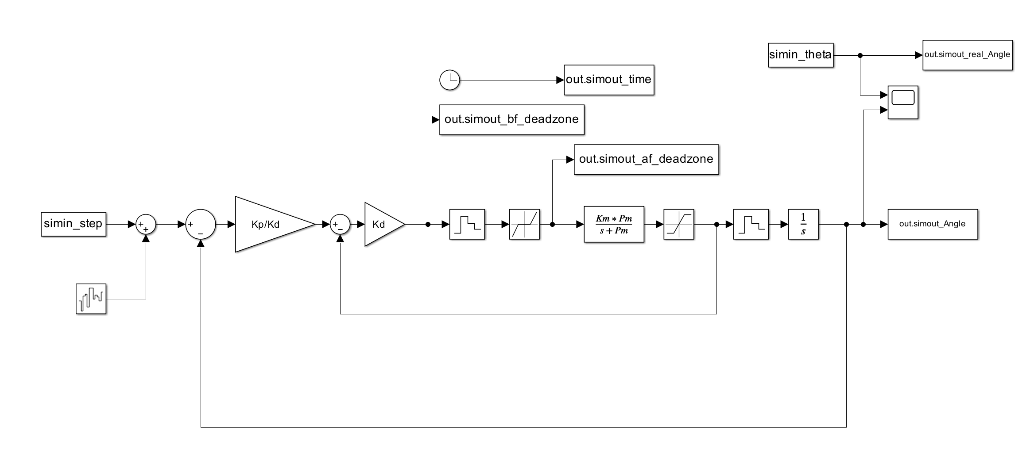
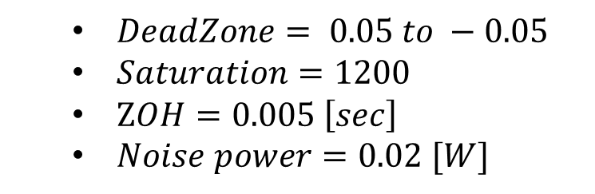
4. Analysis Model
$DeadZone= 0.05 to −0.05$
$Noise power=0.02 [W]$

Slide 7
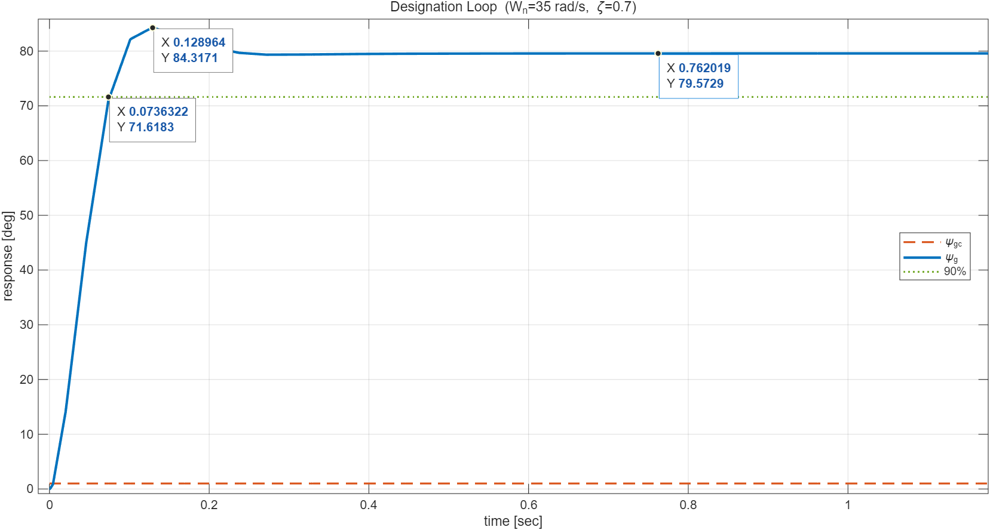
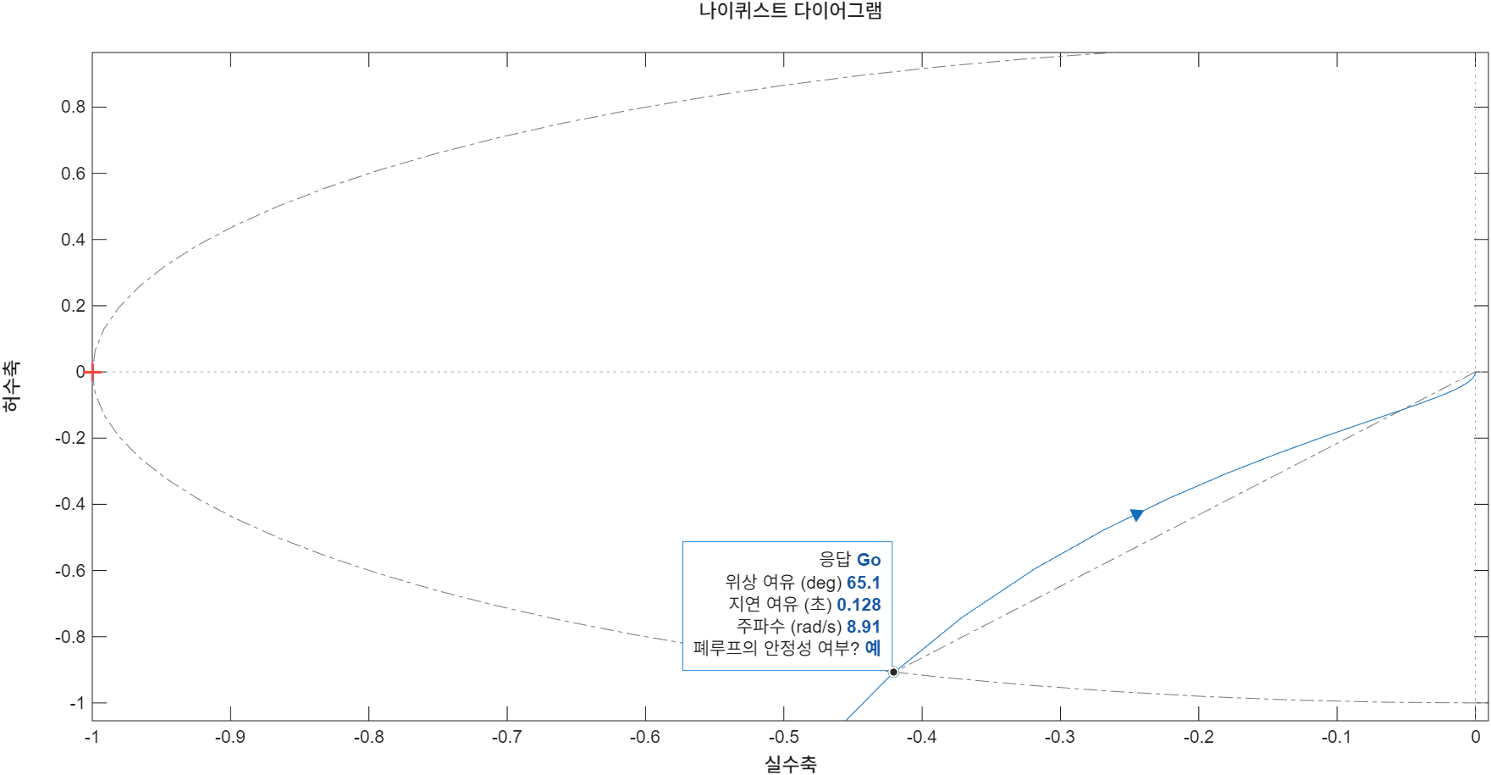
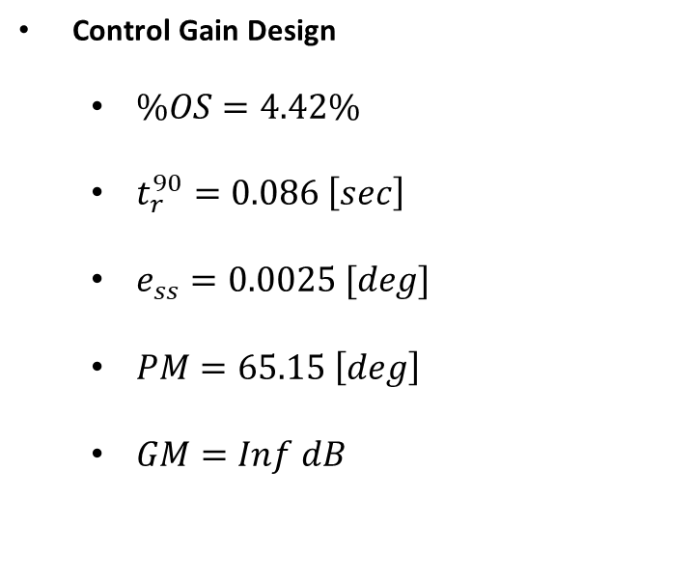
4. Performance Analysis
Control Gain Design
$\%OS=4.42\%$
$t_{r}^{90}=0.086 \left[sec\right]$
$e_{ss}=0.0025 [deg]$
$PM=65.15 \left[deg\right]$
$GM=Inf dB$

Slide 8
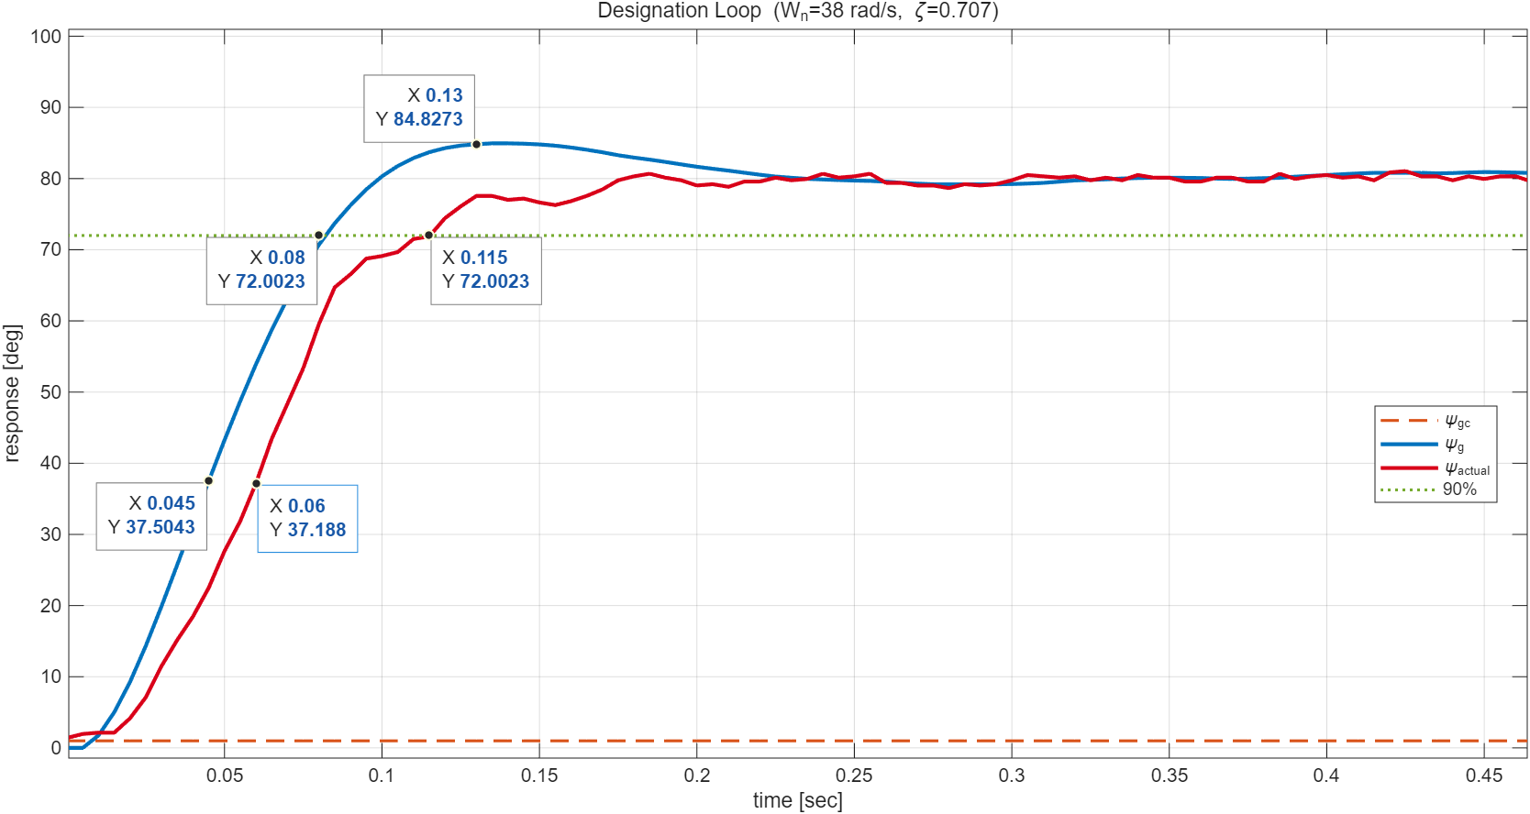
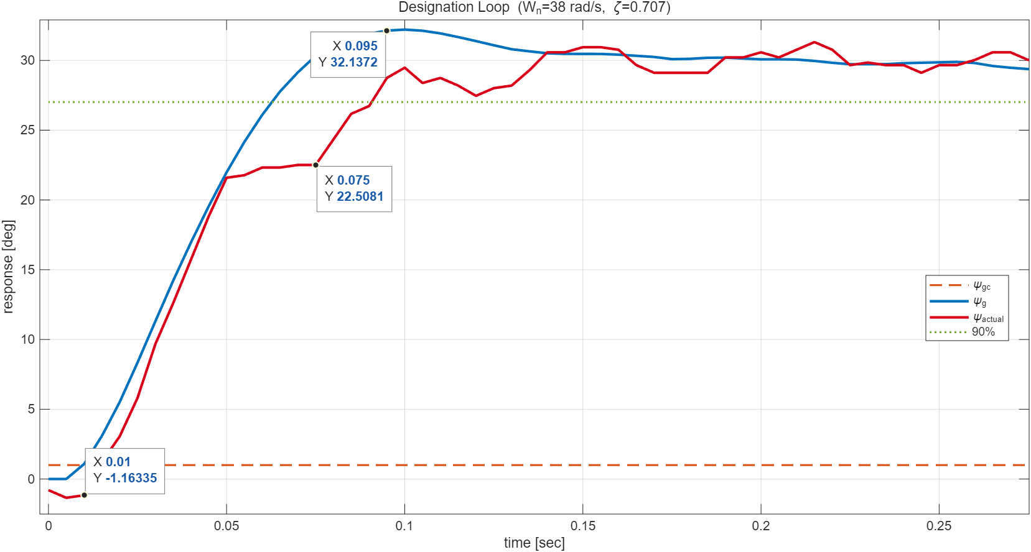
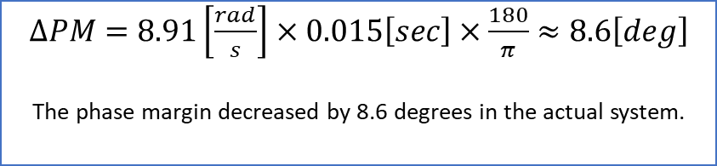
4. Performance Analysis
${ψ_{cmd}=80 [deg] \text{, }W}_{n}=38\frac{rad}{s}, ζ=0.707$
$∆PM=8.91\left[\frac{rad}{s}\right]×0.015\left[sec\right]×\frac{180}{π}$ $≈8.6\left[deg\right]$
The phase margin decreased by 8.6 degrees in the actual system.
$ψ_{cmd}=30 \left[deg\right], W_{n}=38\frac{rad}{s}, ζ=0.707$

