Slide 1
Flow chart of System
Final Project of Digital Control
오유성 (22400448), 이주영 (22200576)
Thanks to
나원상
Won-Sang Ra

Slide 2
Digital Control and Signal Processing Final Project
3. Generate Bode Plot
4. Obtain Transfer_function & Validation

Slide 3
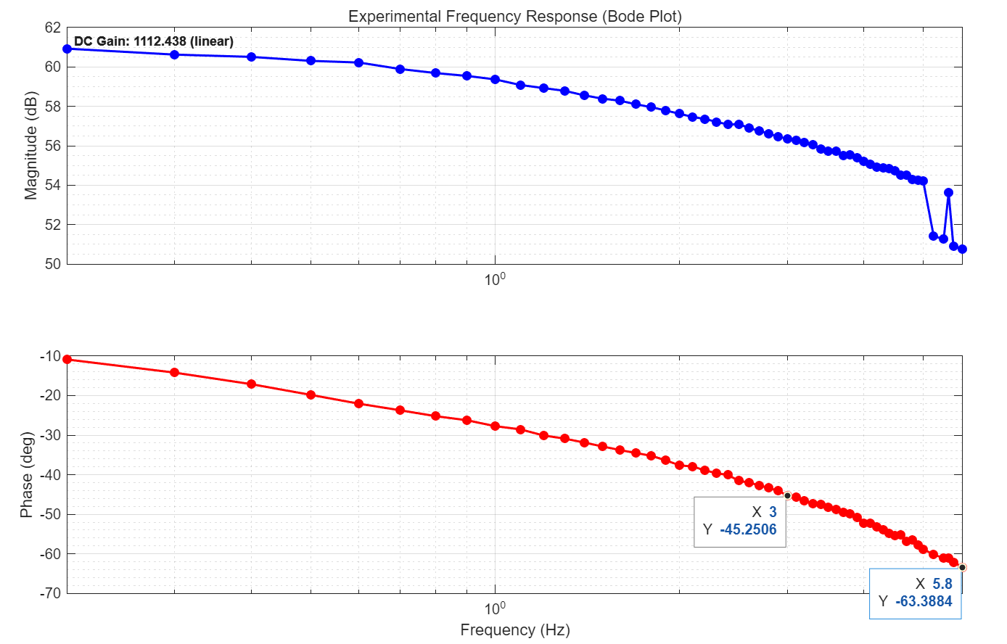
3. Obtaining Transfer Function & Validation
Obtaining freq_responses of Motor
Range of Check: 0.2 – 5.8 [Hz]
Bandwidth: ~ 3.0 [Hz]
System_order: 1st
DC_gain: ~ 1112.43 [deg/sec]

Slide 4
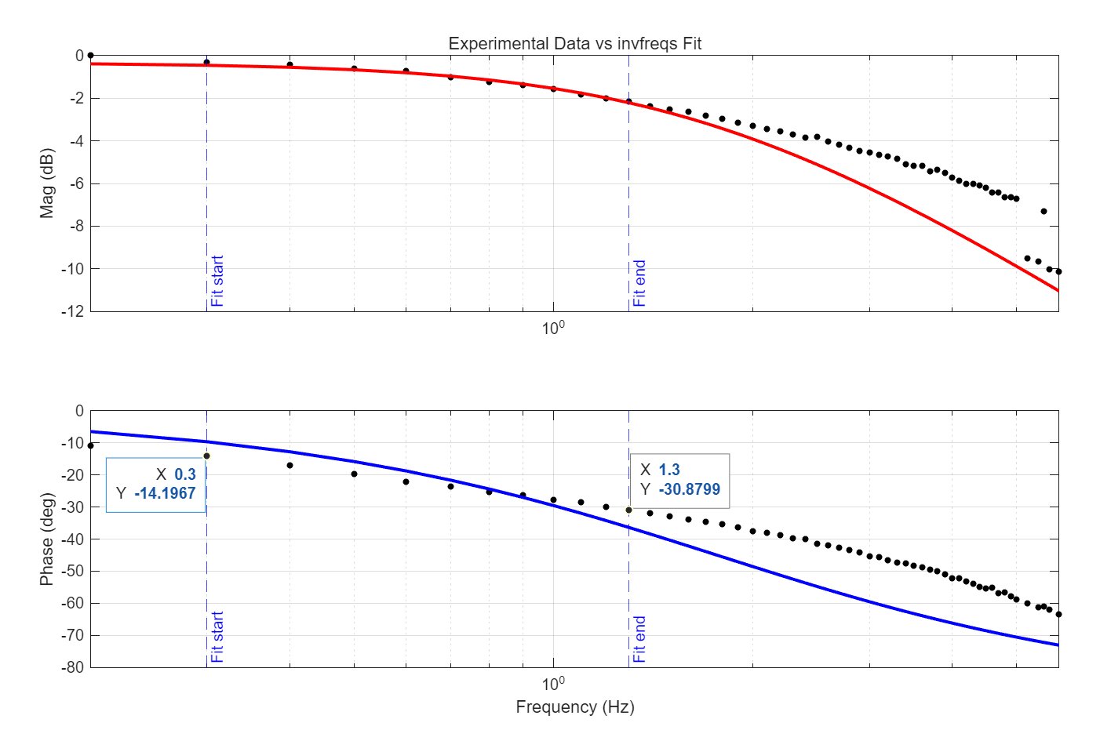


4. Obtaining Transfer Function & Validation
Obtaining Transfer function of Motor
$$G\left(s\right)=K∗G_{c}\left(s\right)$$
$$G\left(s\right)=1112.4385∗\frac{10.6798}{s +11.0963}$$
Fitted_range: 0.3 – 1.3 [Hz]

Slide 5
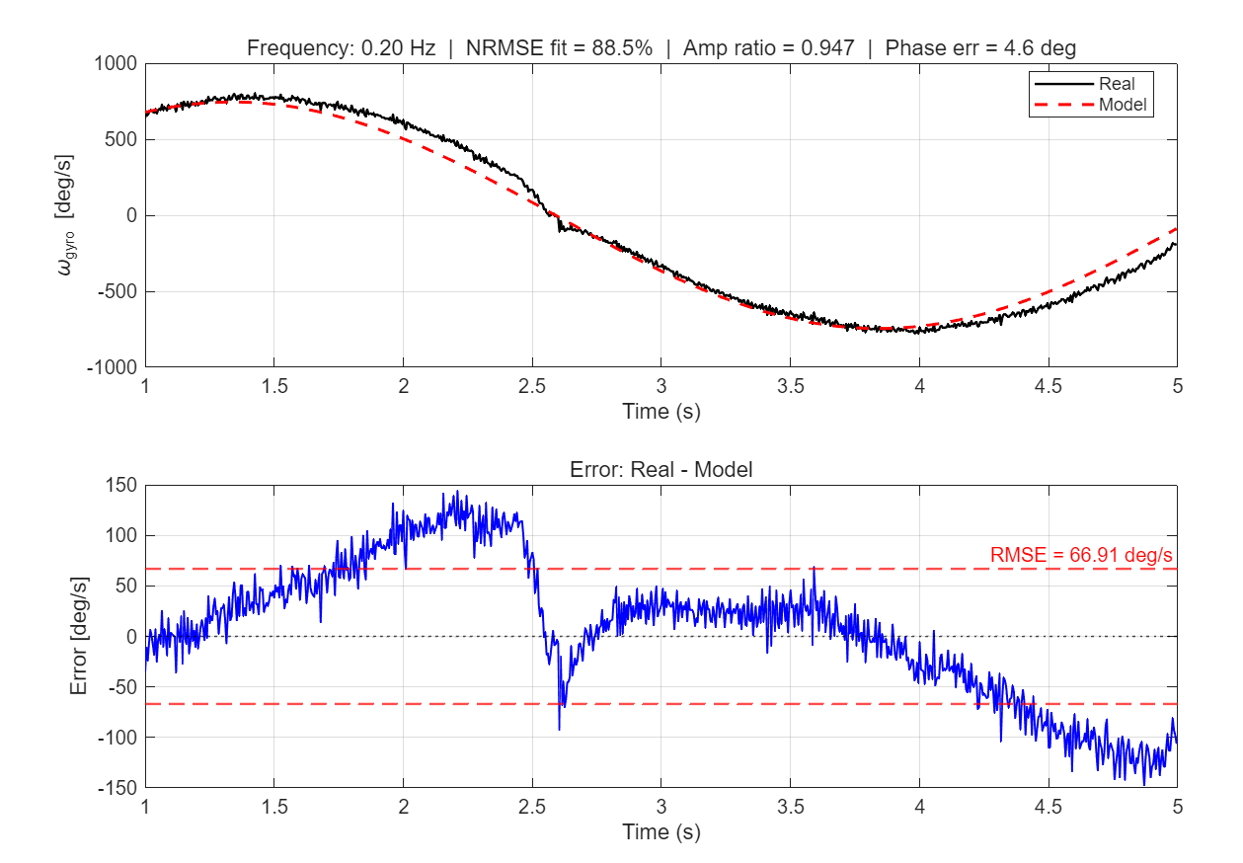
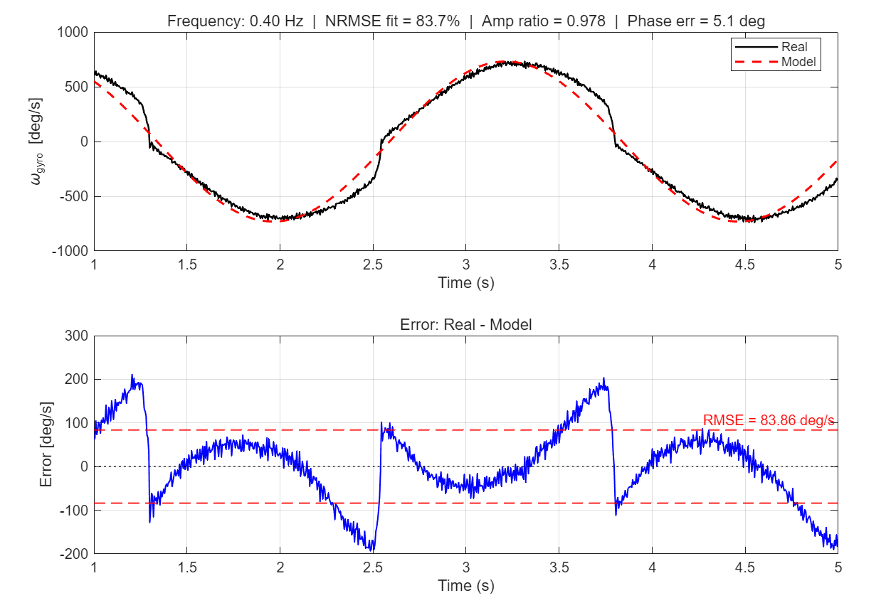
6. Motor Validation
Representative Frequencies:

Slide 6
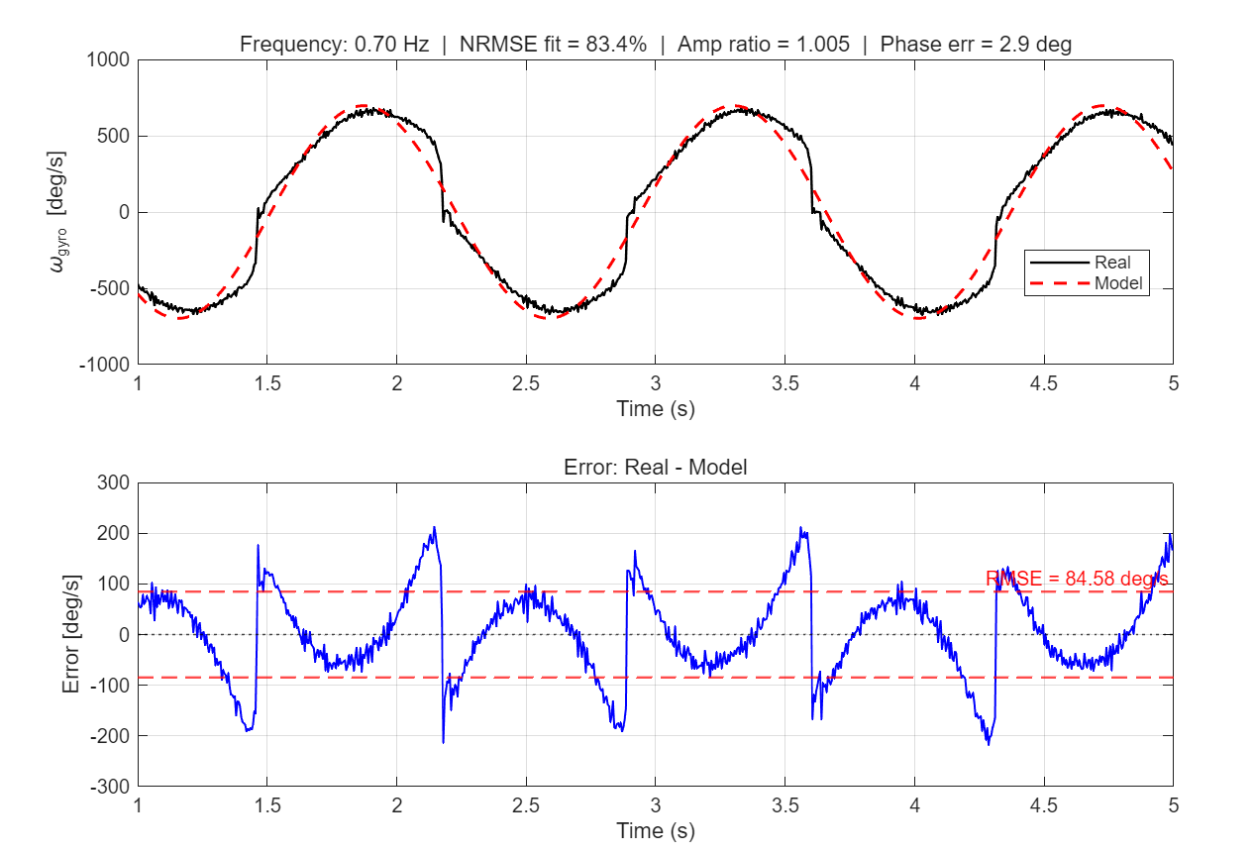
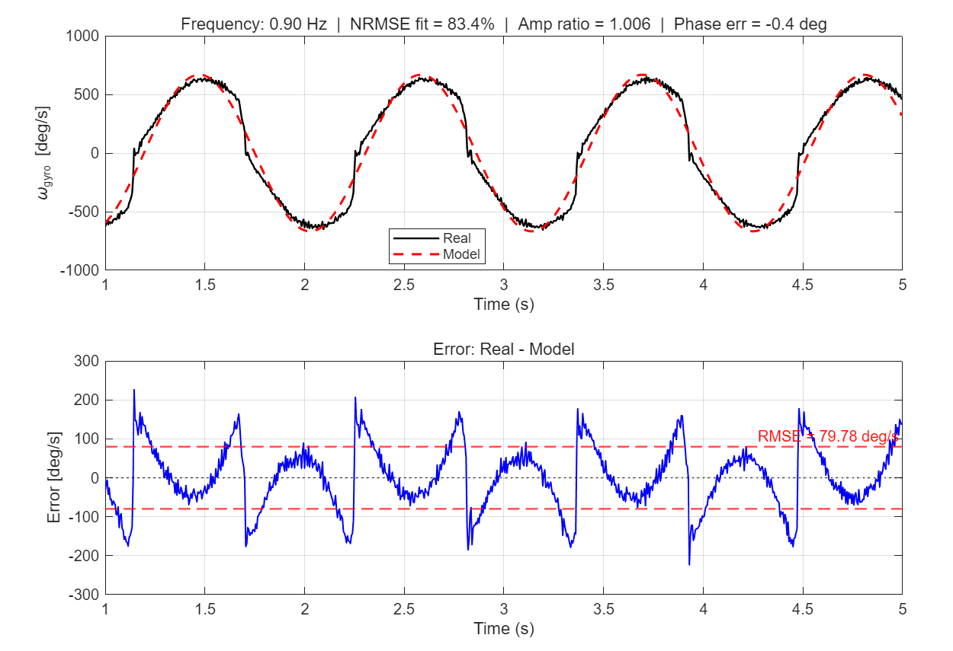
6. Motor Validation
Representative Frequencies:

Slide 7
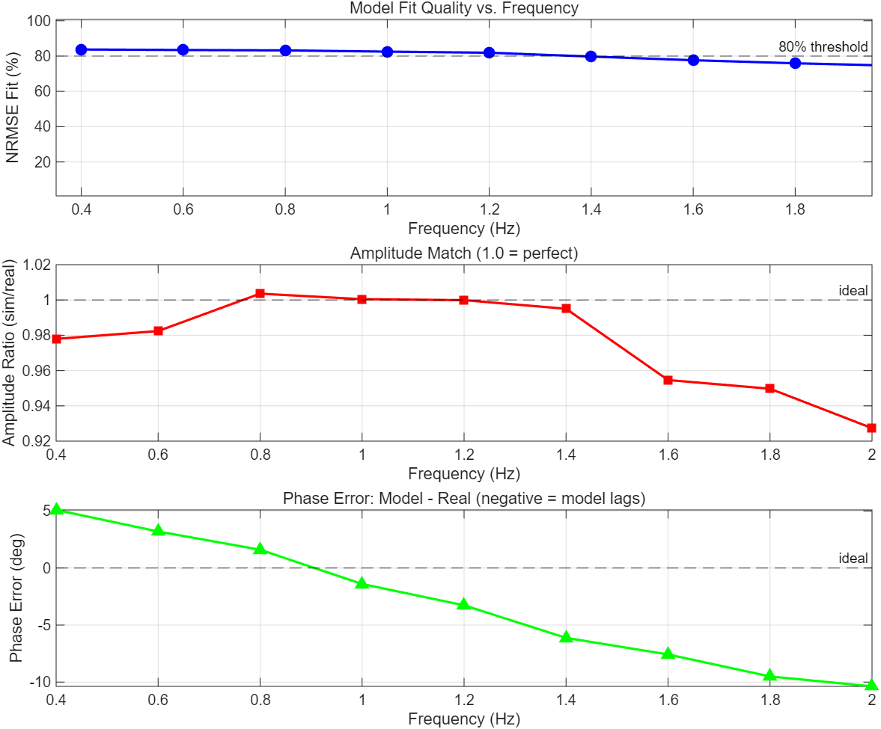
6-1. Visualizing Errors
RMS fit: ~ 80 % following
Magnitude fit: ~ 90 %
Phase Error: Needs to be talked.
The leading terms in low frequency
Inertia is detected
Jump discontinuity in neg region
Deadzone & Backlash movement.

Slide 8
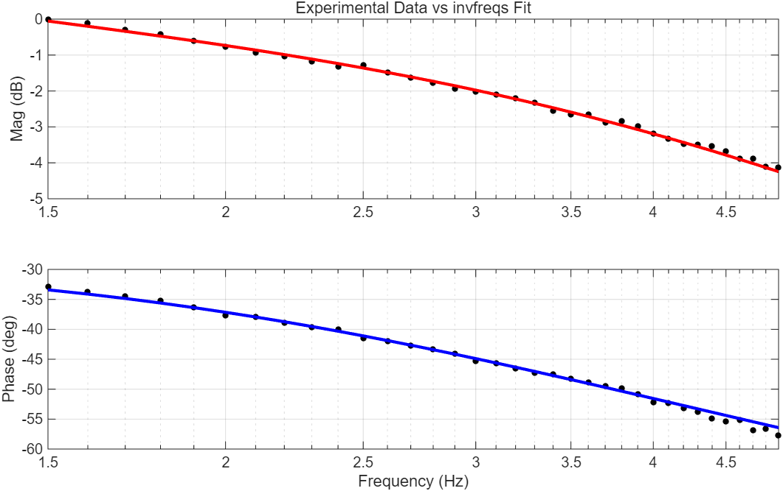
Appendix
invFreq(1,2):

