Slide 1
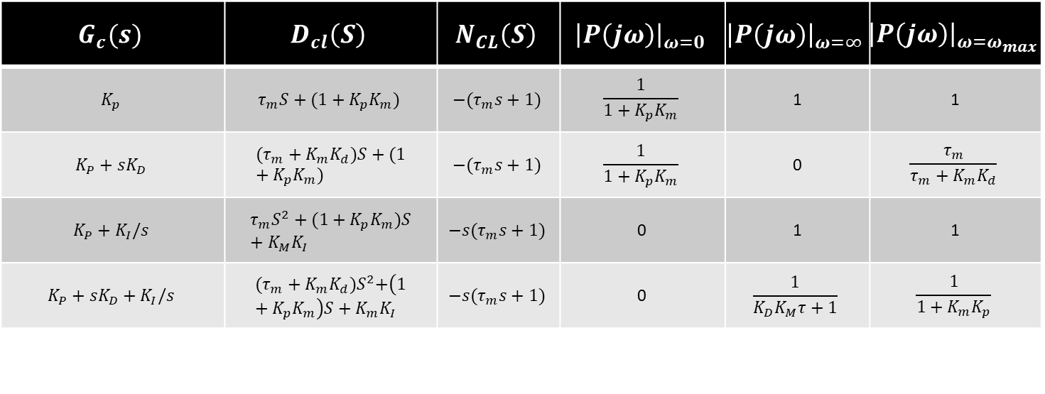
4. Design Procedures
$$G_{c}(s)$$ | $$D_{cl}\left(S\right)$$ | $$N_{CL}\left(S\right)$$ | $${\left|P\left(jω\right)\right|}_{ω=0}$$ | $${\left|P\left(jω\right)\right|}_{ω=∞}$$ | $${\left|P\left(jω\right)\right|}_{ω=ω_{max}}$$
$$K_{p}$$ | $$τ_{m}S+(1+K_{p}K_{m})$$ | $$−(τ_{m}s+1)$$ | $$\frac{1}{1+K_{p}K_{m}}$$ | 1 | 1
$$K_{P}+sK_{D}$$ | $$(τ_{m}+K_{m}K_{d})S+(1+K_{p}K_{m})$$ | $$−(τ_{m}s+1)$$ | $$\frac{1}{1+K_{p}K_{m}}$$ | 0 | $$\frac{τ_{m}}{τ_{m}+K_{m}K_{d}}$$
$$K_{P}+K_{I}/s$$ | $$τ_{m}S^{2}+(1+K_{p}K_{m})S+K_{M}K_{I}$$ | $$−s(τ_{m}s+1)$$ | 0 | 1 | 1
$$K_{P}+sK_{D}+K_{I}/s$$ | $${(τ_{m}+K_{m}K_{d})S}^{2}+\left(1+K_{p}K_{m}\right)S+K_{m}K_{I}$$ | $$−s(τ_{m}s+1)$$ | 0 | $$\frac{1}{K_{D}K_{M}τ+1}$$ | $$\frac{1}{1+K_{m}K_{p}}$$

