Slide 1
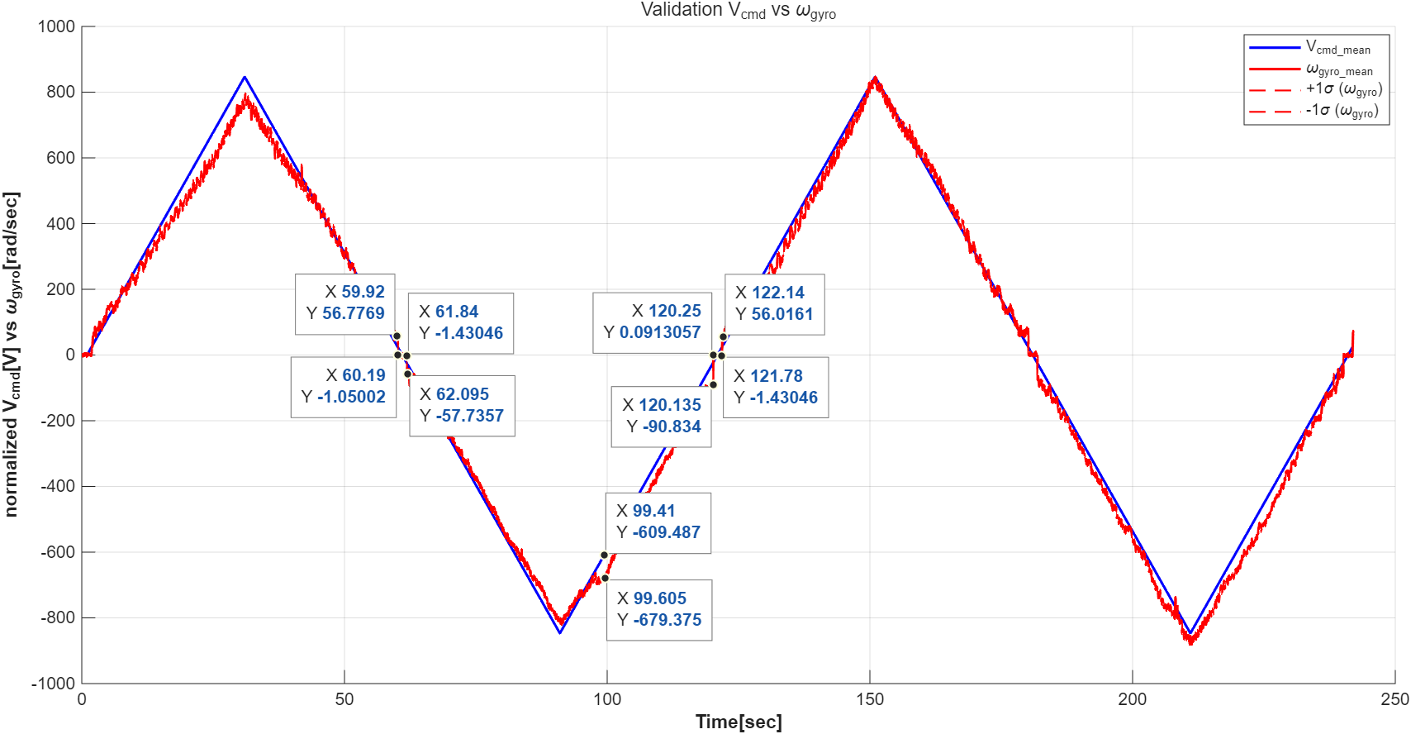
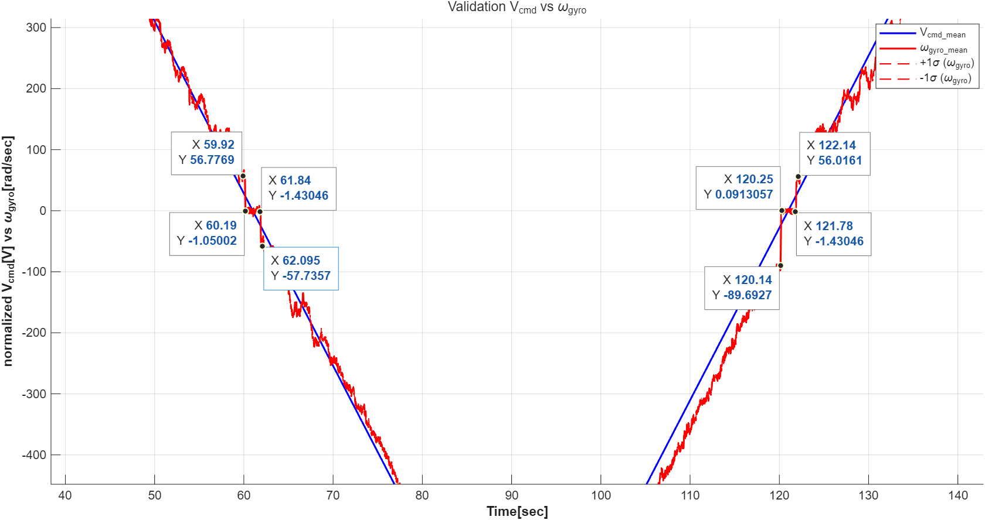

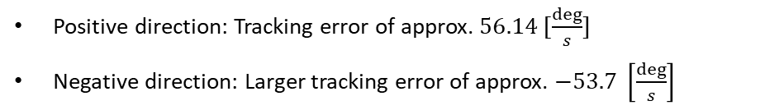
3. Motor Linearization Validation
1) Triangle input
Positive direction: Tracking error of approx. $56.14 [\frac{deg}{s}]$
Negative direction: Larger tracking error of approx. $−53.7 \left[\frac{deg}{s}\right]$

Slide 2
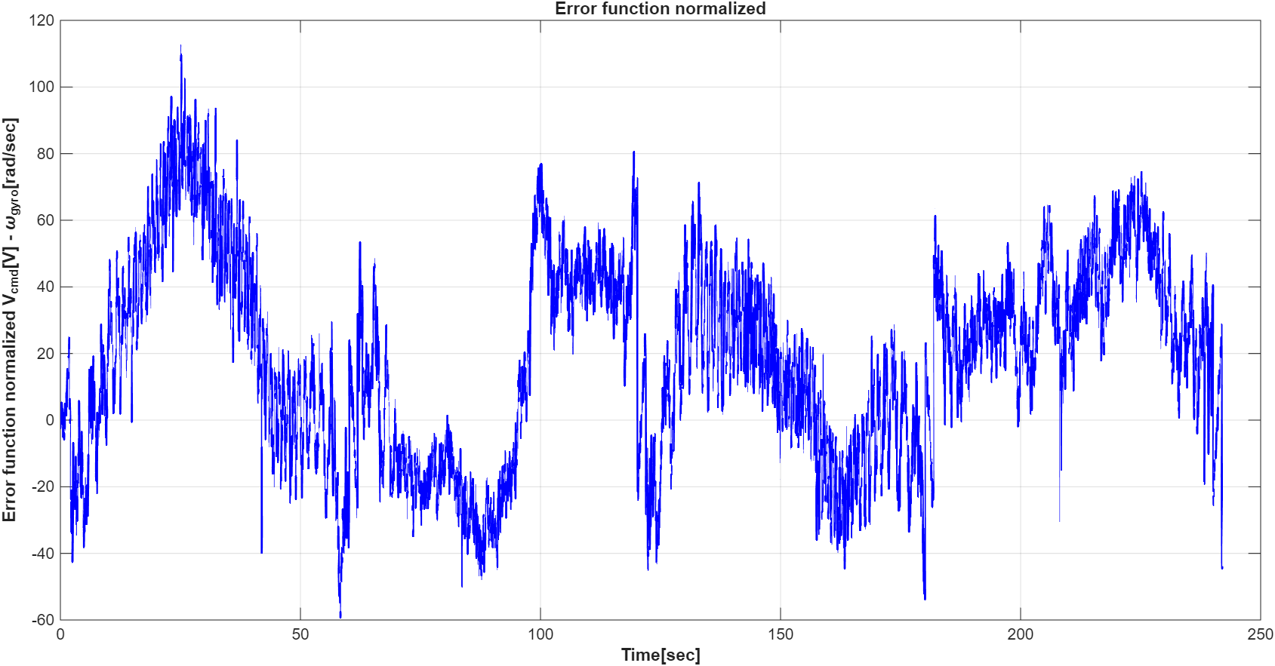
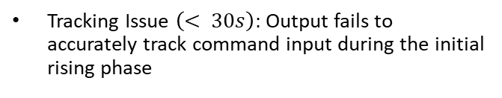
3. Motor Linearization Validation
1) Triangle input
Tracking Issue $\left(< 30s\right):$Output fails to accurately track command input during the initial rising phase

Slide 3
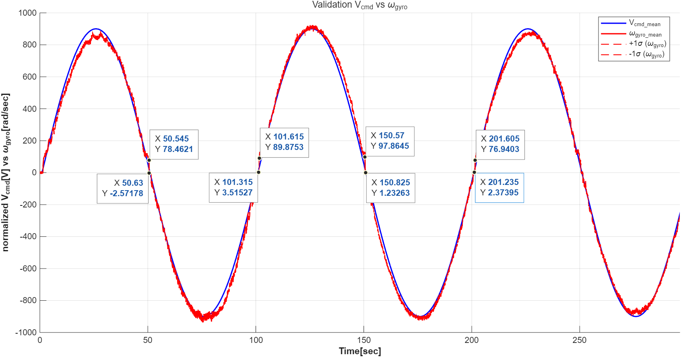
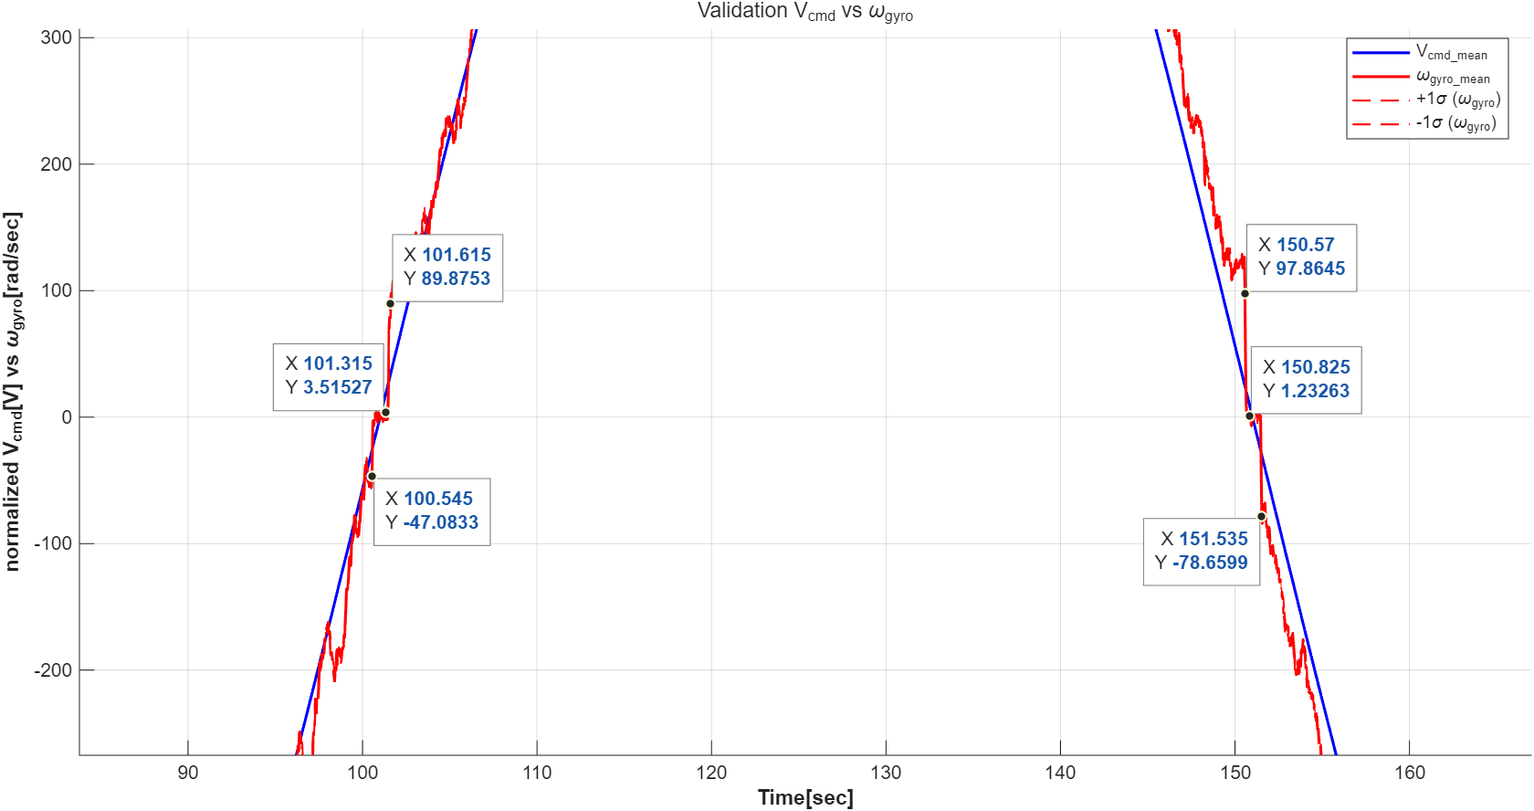
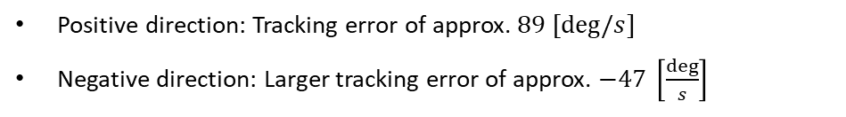
3. Motor Linearization Validation
2) Sin input
Positive direction: Tracking error of approx. $89 [deg/s]$
Negative direction: Larger tracking error of approx. $−47 \left[\frac{deg}{s}\right]$

Slide 4
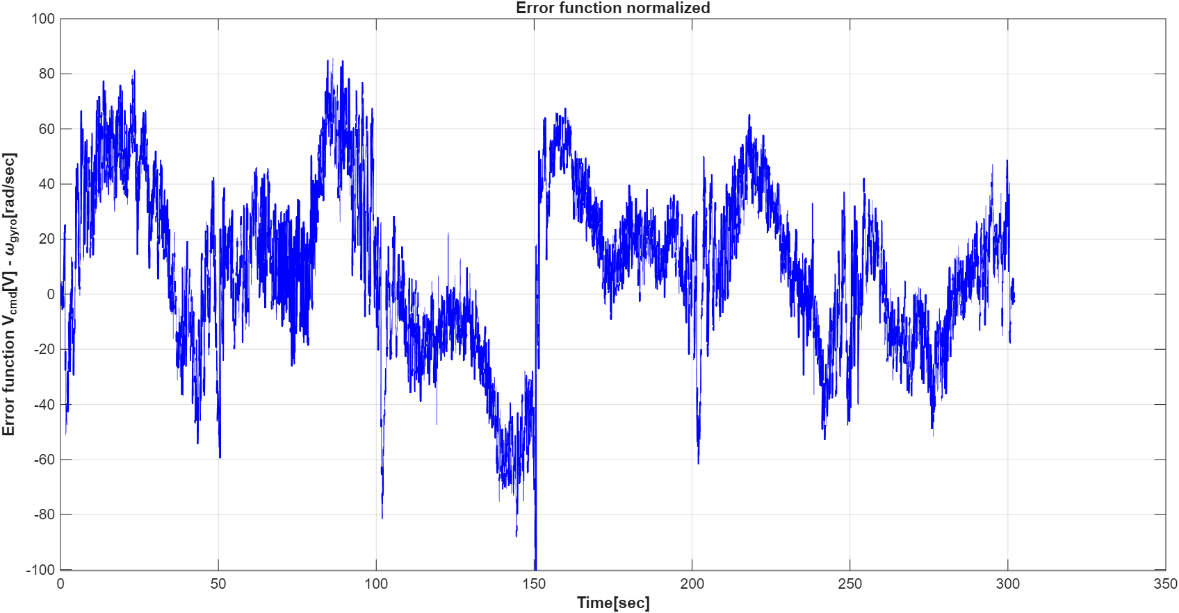
3. Motor Linearization Validation
2) Sin input
Max Error
The error function shows a peak in the first period, followed by a decreasing trend in the next cycle

