Slide 1
Designation
Final Project of Digital Control
오유성 (22400448), 이주영 (22200576)
Thanks to
나원상
Won-Sang Ra

Slide 2
Digital Control and Signal Processing Final Project
1. Sensor Modeling
2. Structure of Controller
3. Design of Controller
4. Performance Analysis

Slide 3
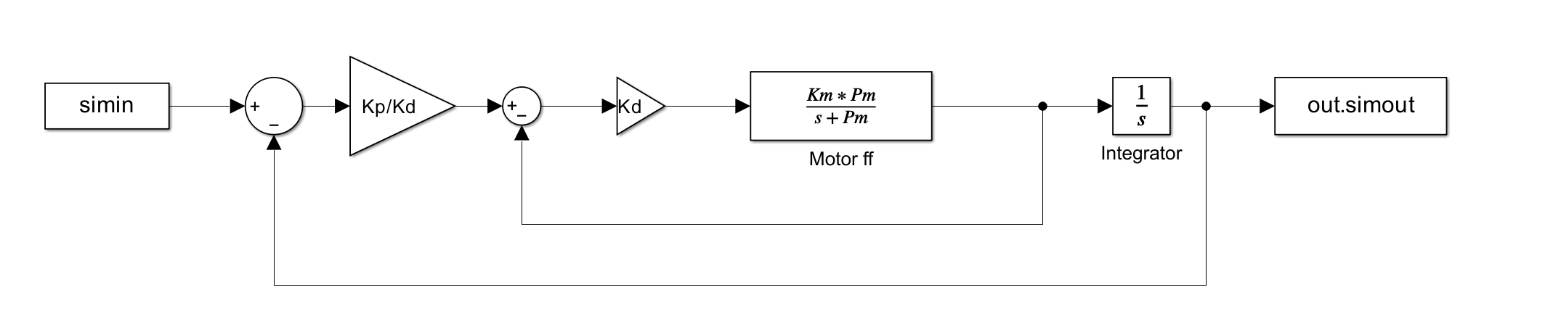

1. Sensor Modeling / 2. Structure of Controller
Closed loop Transfer function:
$G_{cl}=\frac{K_{p}K_{m}}{s^{2}+\left(P_{m}+K_{m}K_{d}\right)s+K_{m}K_{p}}=\frac{∎}{s^{2}+2ζω_{c}s+ω_{c}^{2}}$
$K_{p}=\frac{ω_{c}^{2}}{K_{m}}$
$K_{d}=\frac{{2ζω_{c}−P}_{m}}{K_{m}}$

Slide 4
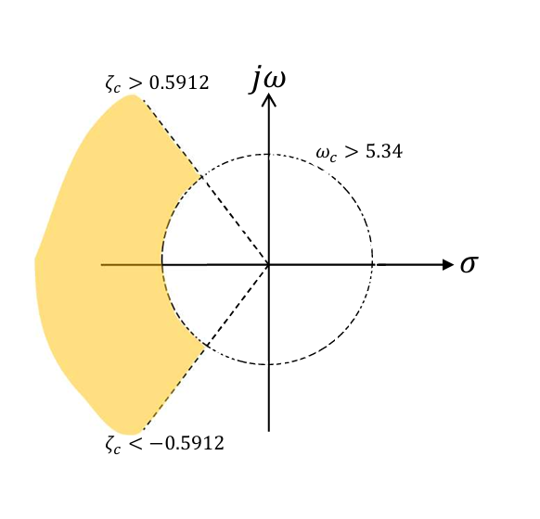

3. Model Design Method
Pole placement
Relative Stability
$\%OS<10\%$
$e^{(−ζ/√(1−ζ^{2})}×100<10\%$
$ζ_{c}>0.59 [−]$
$${−0.59>ζ}_{c}$$
$t_{r}^{90}≤0.1 \left[sec\right]$
$$ω_{c}>26.546[rad/s]$$
Result
$ω_{n}=35 [rad/s]$
$ζ=0.7 \left[−\right]$
0.59
26.546
- 0.59

Slide 5
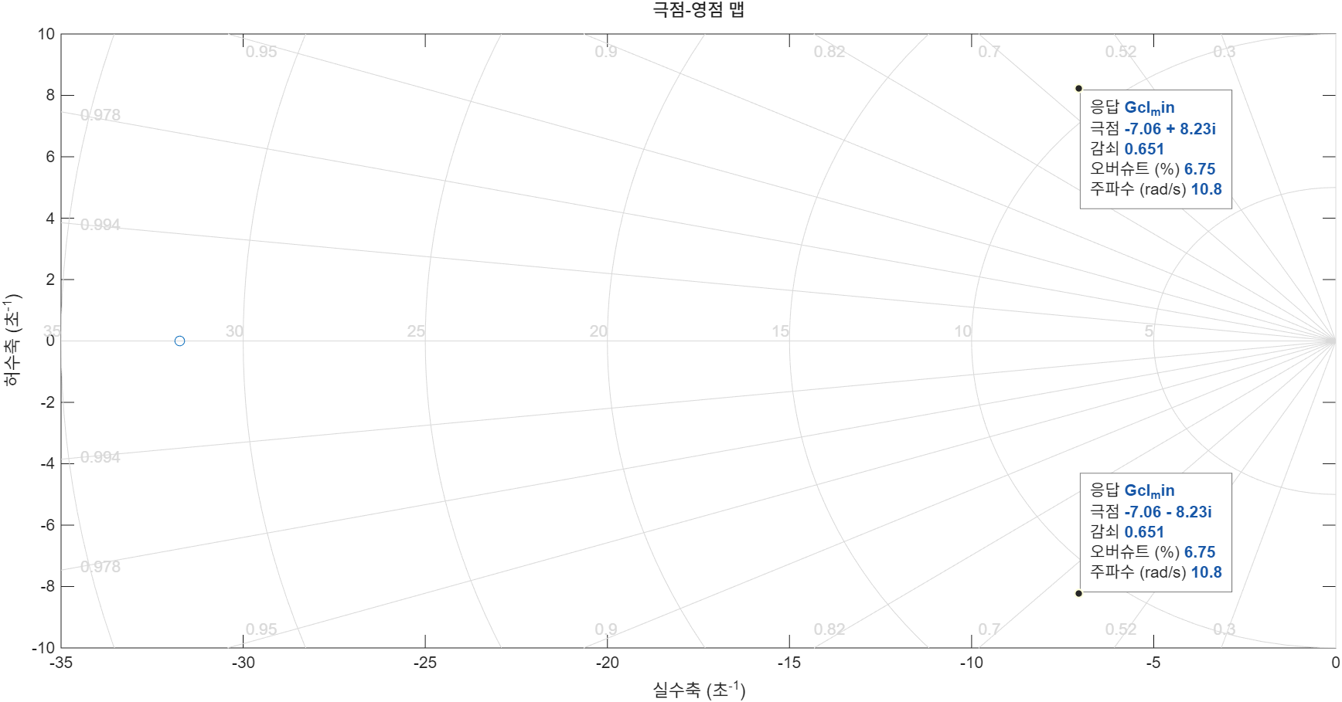

3. Model Design Method
Control Gain Design
Selected Values
$ω_{n}=35 [rad/s]$
$ζ=0.7 \left[−\right]$
Result
$K_{p}=\frac{ω_{c}^{2}}{K_{m}}=0.090363$
$K_{d}=\frac{{2ζω_{c}−P}_{m}}{K_{m}}=0.002846$

Slide 6
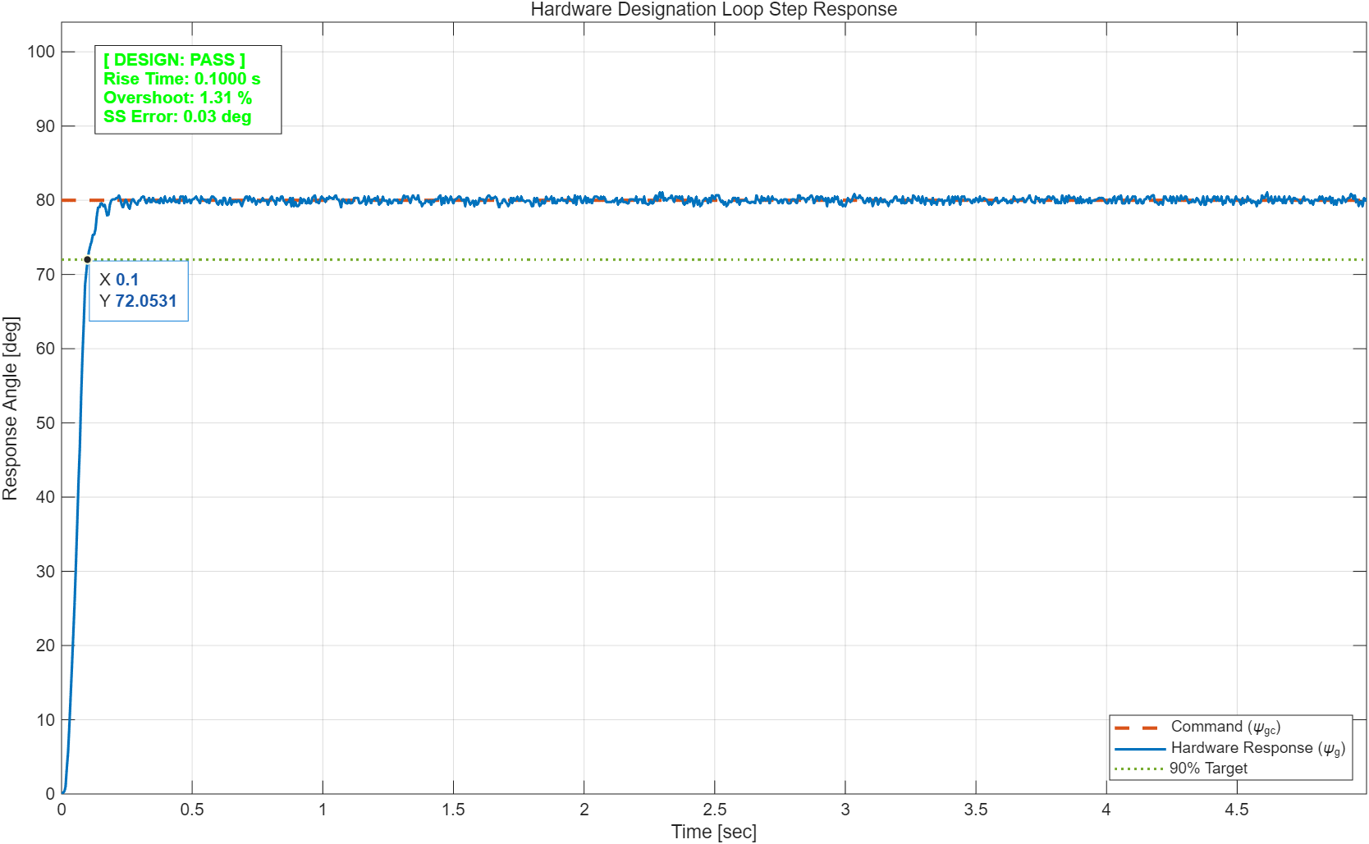
4. Design Model

Slide 7
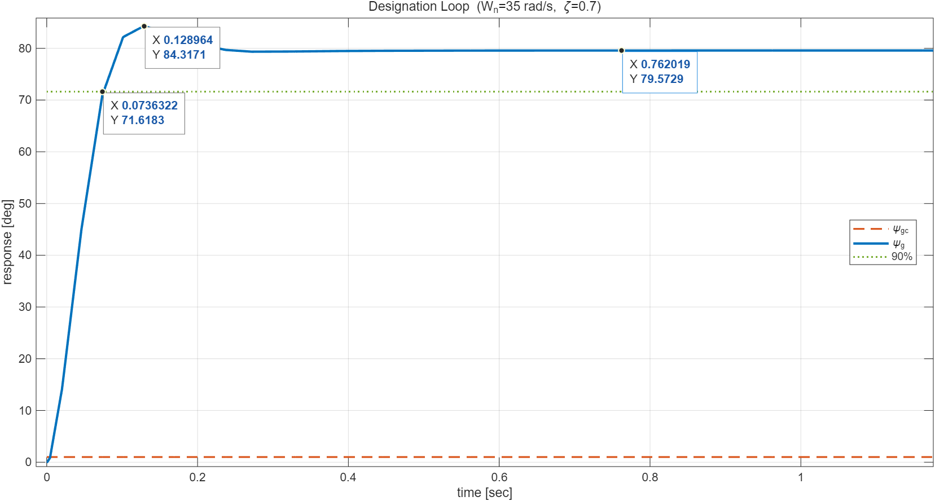
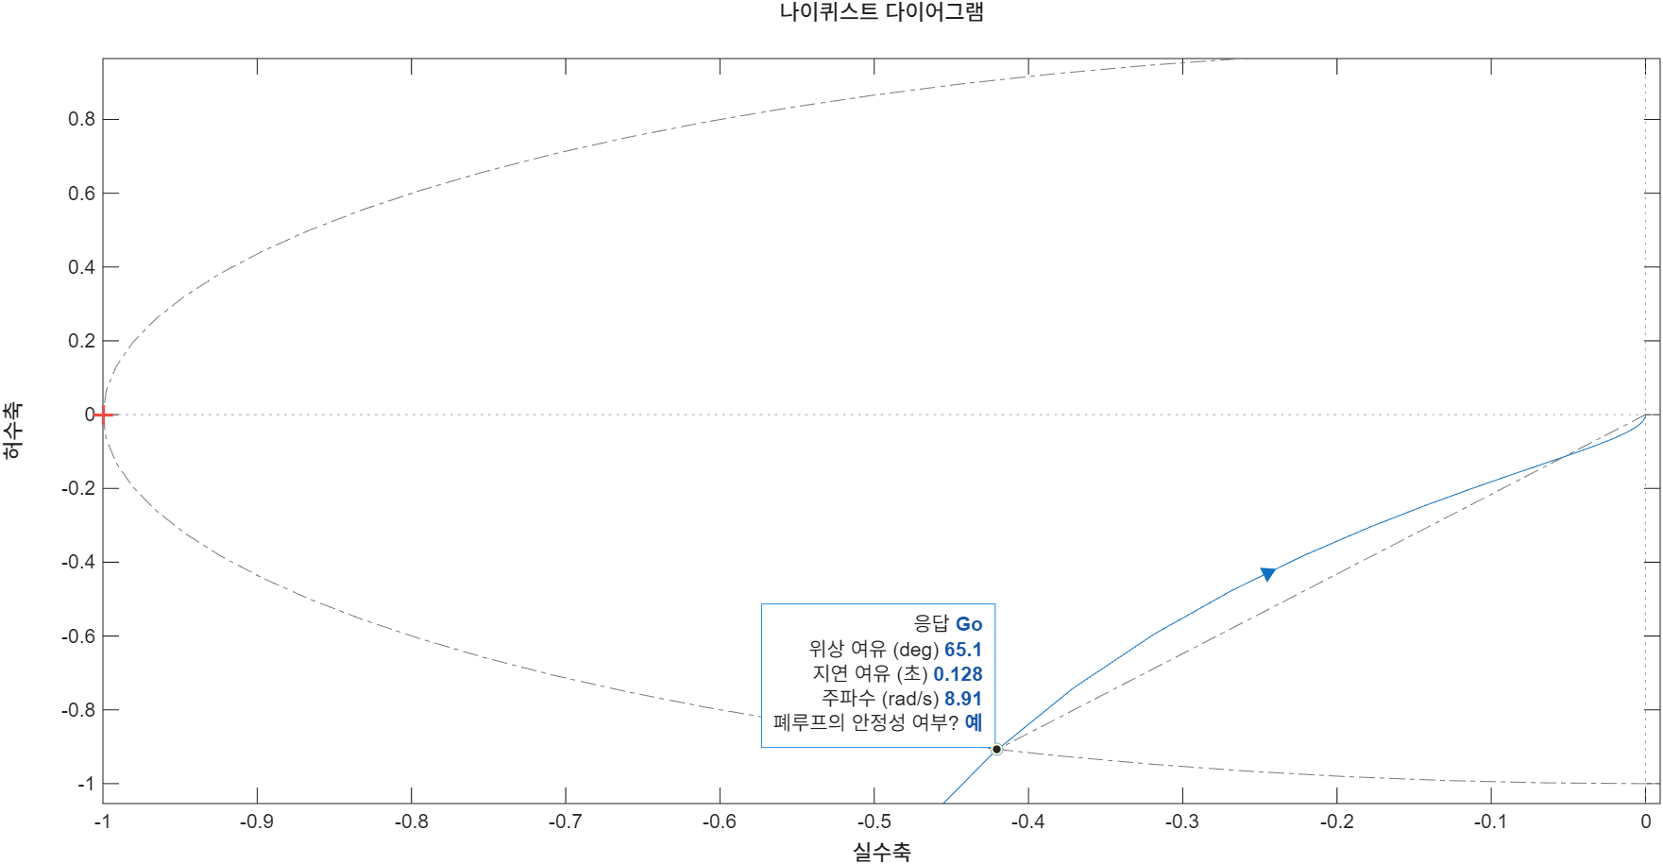

4. Performance Analysis
Control Gain Design
$\%OS=4.42\%$
$t_{r}^{90}=0.086 \left[sec\right]$
$e_{ss}=0.0025 [deg]$
$PM=65.15 \left[deg\right]$
$GM=Inf dB$

