Slide 1
LAB3. MOTOR VALIDATION
Student ID: 22200576, 22400448
Name: 이주영, 오유성

Slide 2
1. Goal of the Experiment
Obtain Motor Static Property
Motor Static Property vs Linearized Model
Linear Mapping
Linearization Validation
Check Slew Rate Limit
Sine Response - Bode Magnitude plot

Slide 3
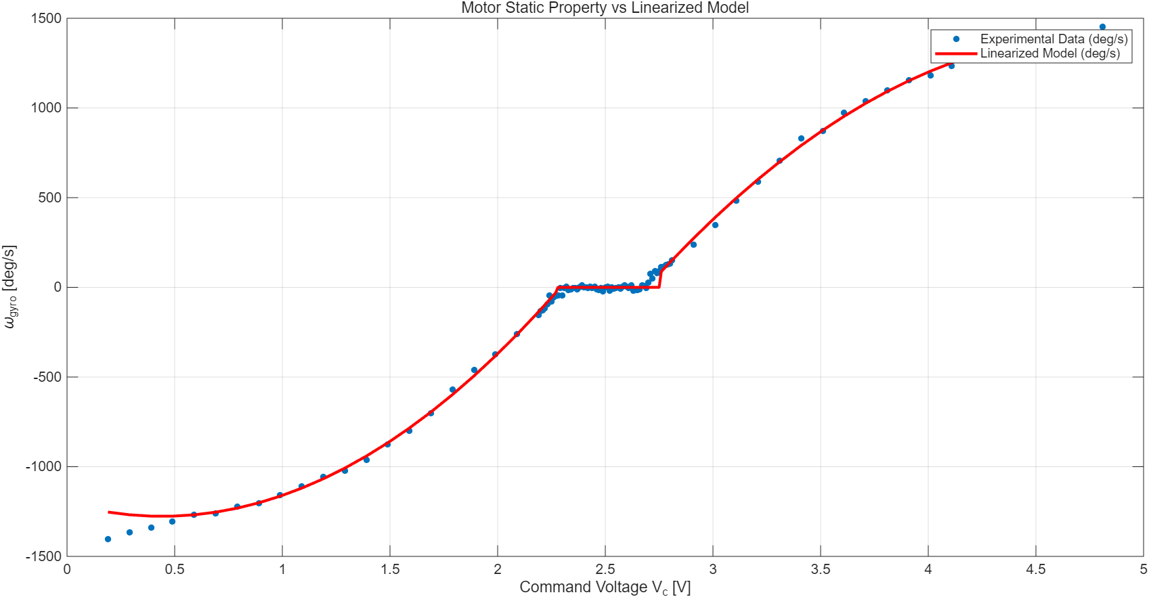
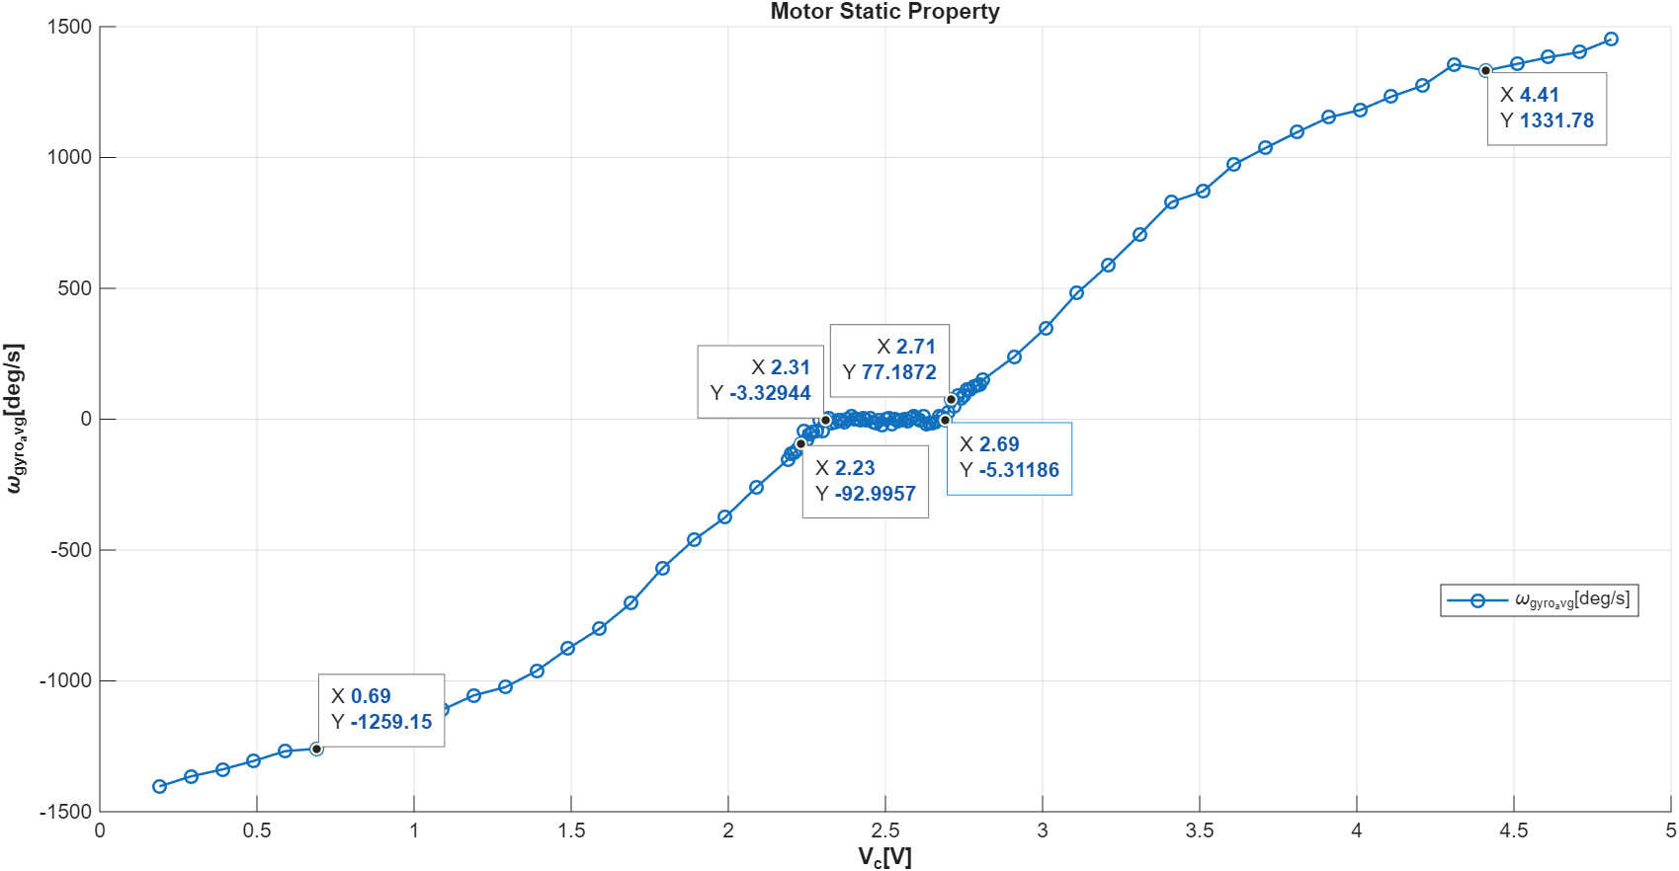
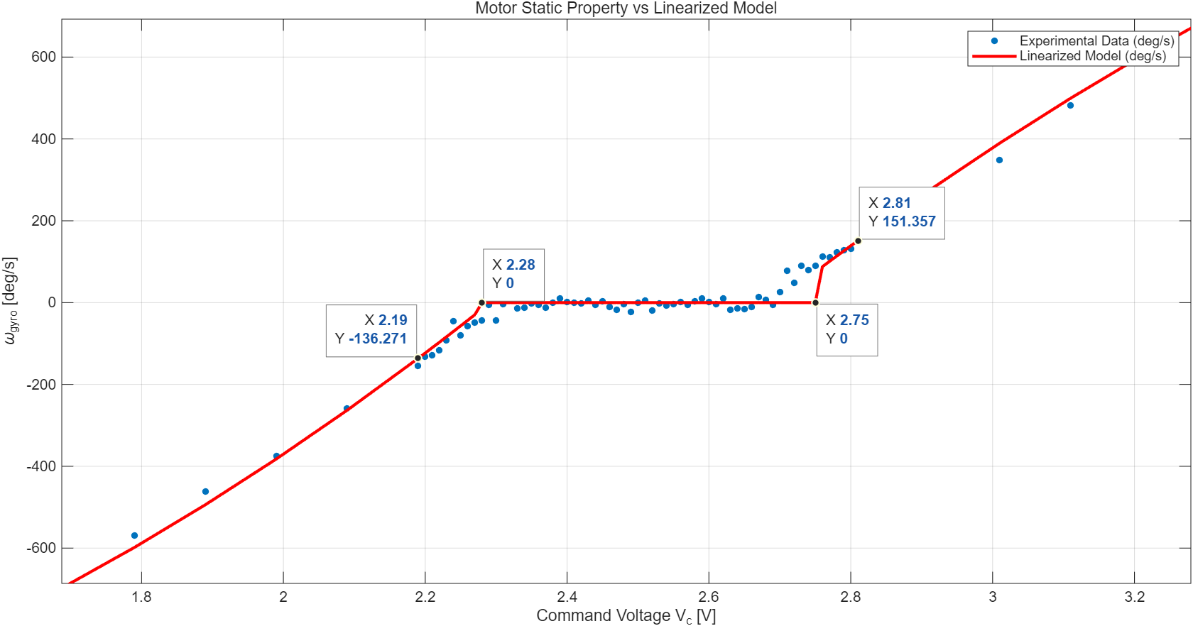
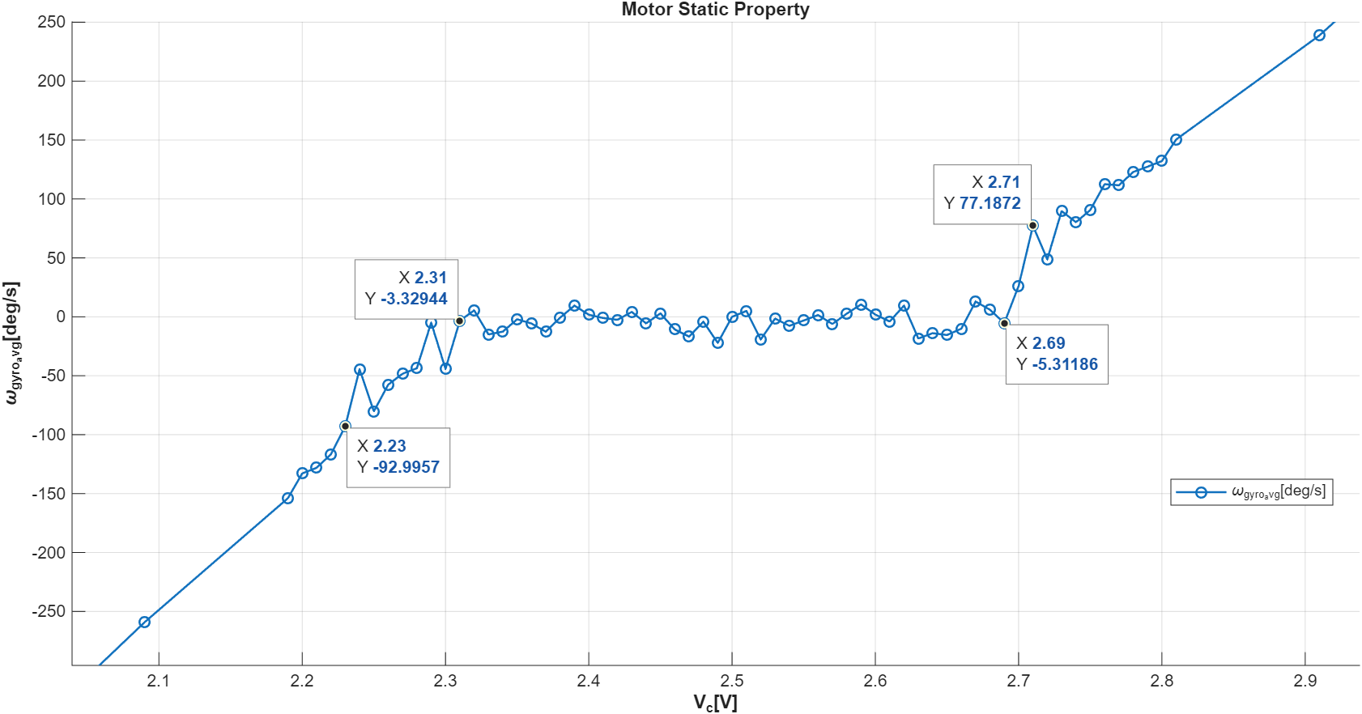
3. Motor Static Property vs Linearized Model
3-Point Mapping:
Quadratic Linearization through selecting 3 exclusive points.
2) Accuracy & Deviations:
The goal is to accurately trace the 3 points, especially near the deadzone region. Though, minor errors do exist in the remaining region.

Slide 4
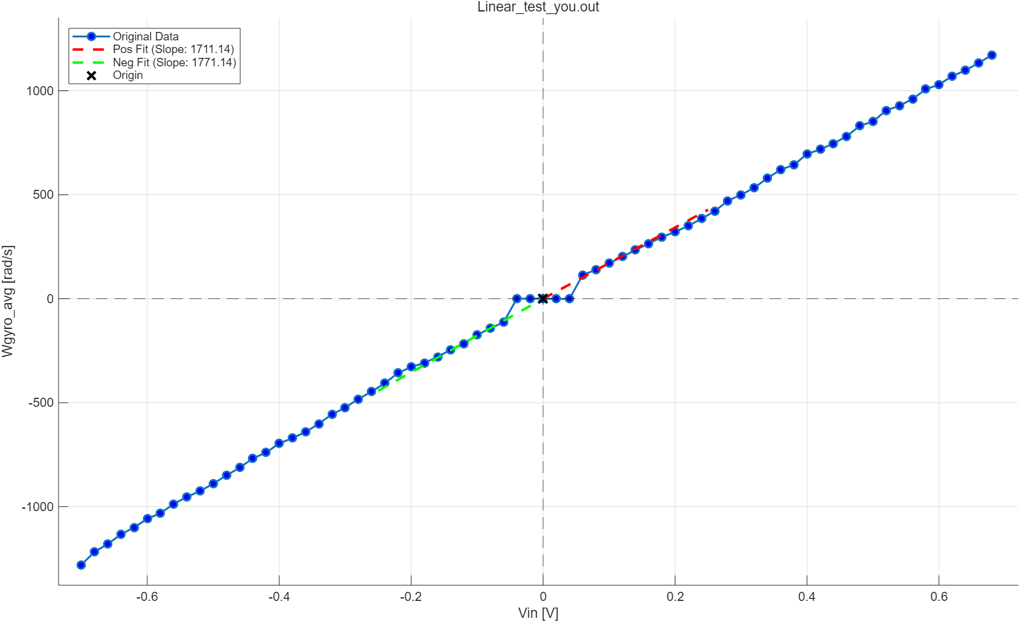
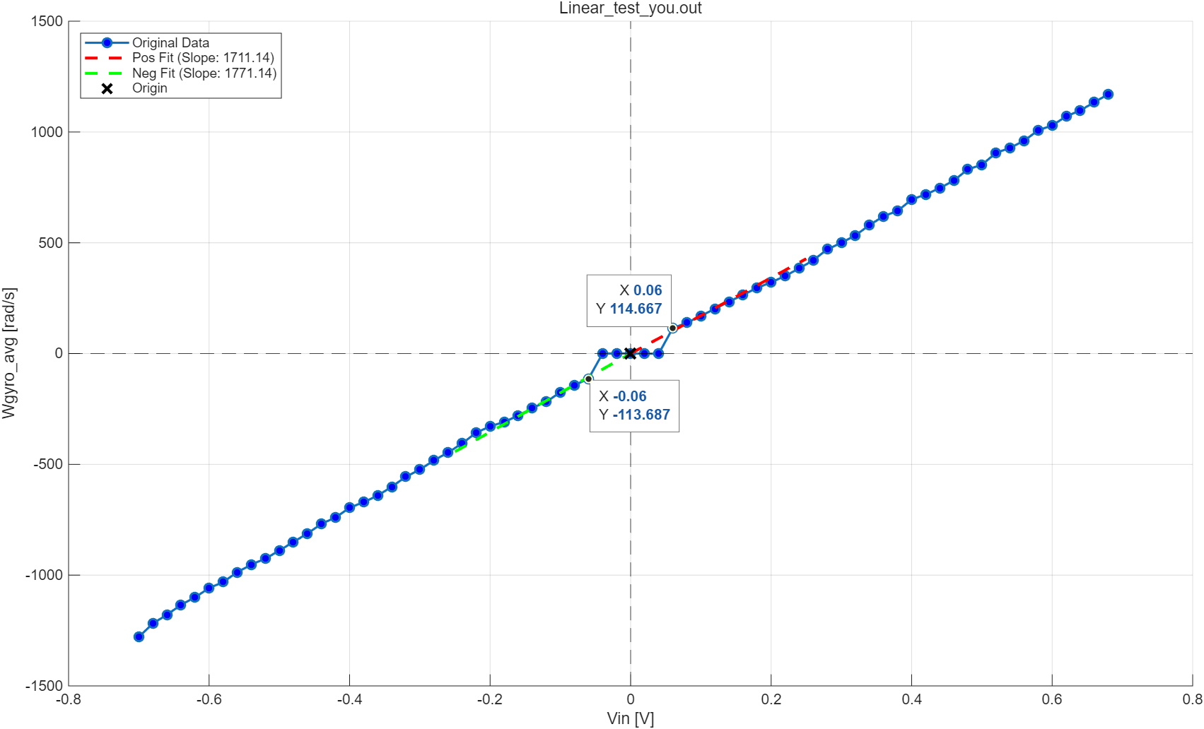
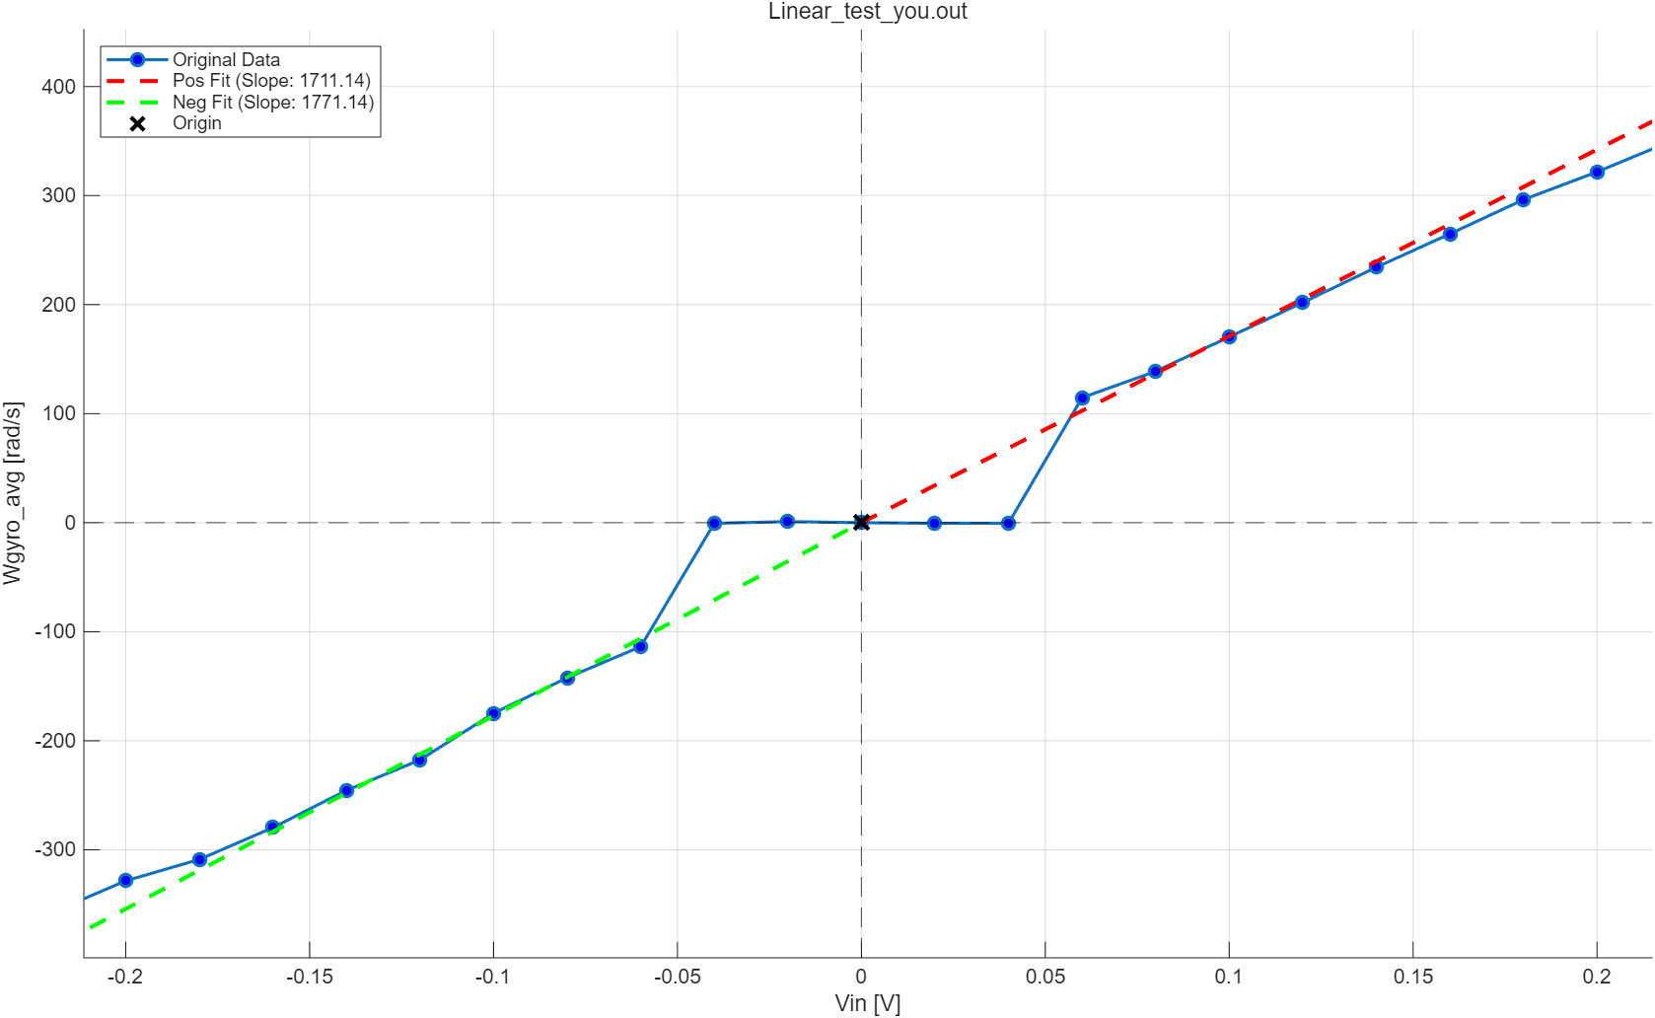
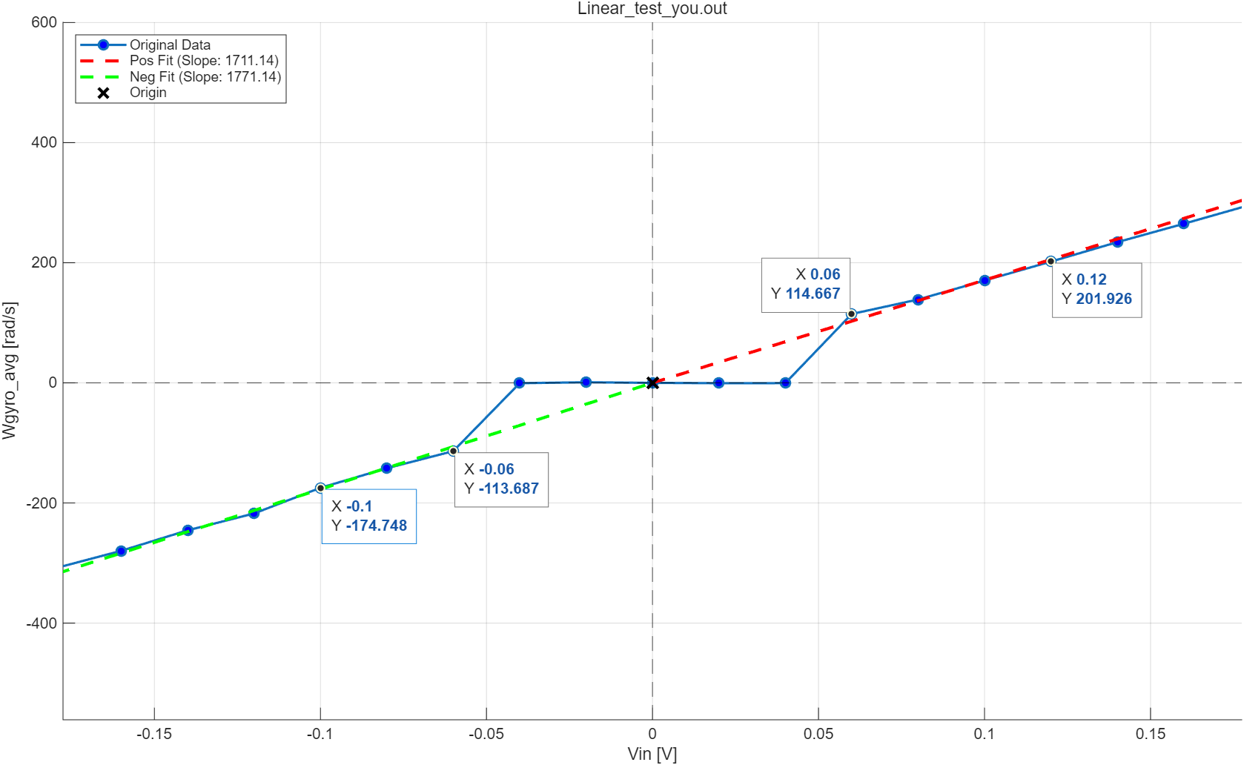
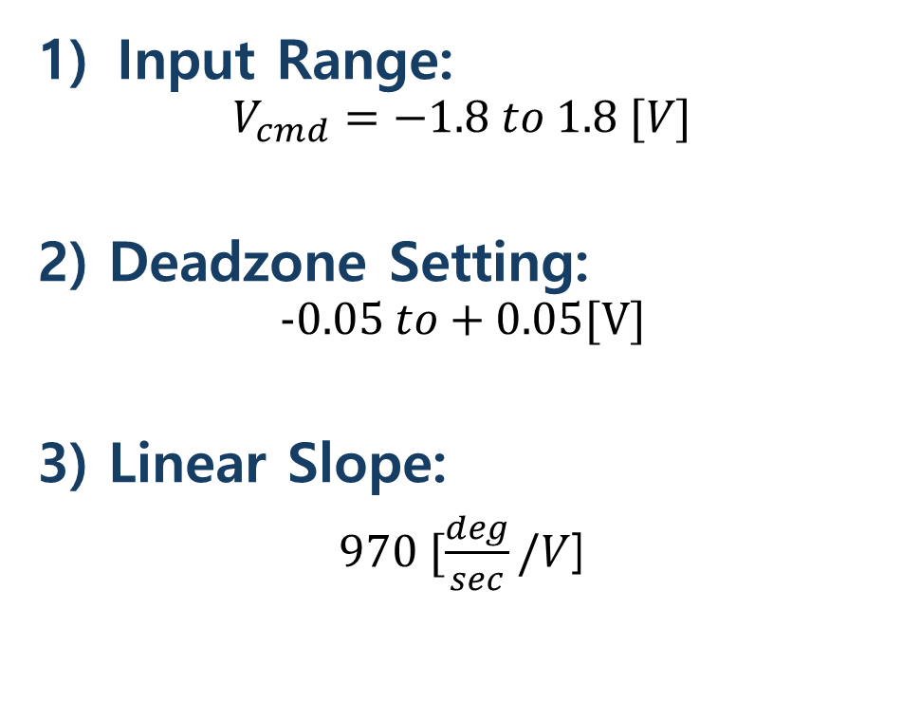
4. Linear Mapping
Input Range:
$$V_{cmd}=−1.8 to 1.8 [V]$$
2) Deadzone Setting:
$$−0.05 to+0.05[V]$$
3) Linear Slope:
$970 [\frac{deg}{sec}/V$]

Slide 5
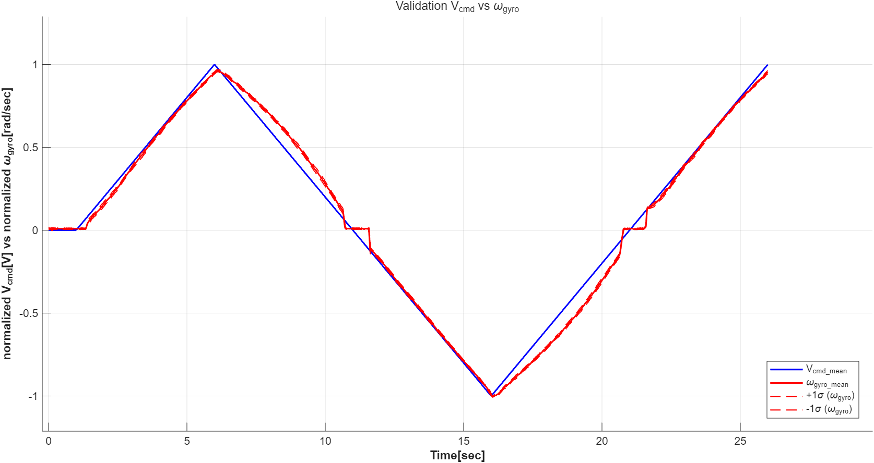
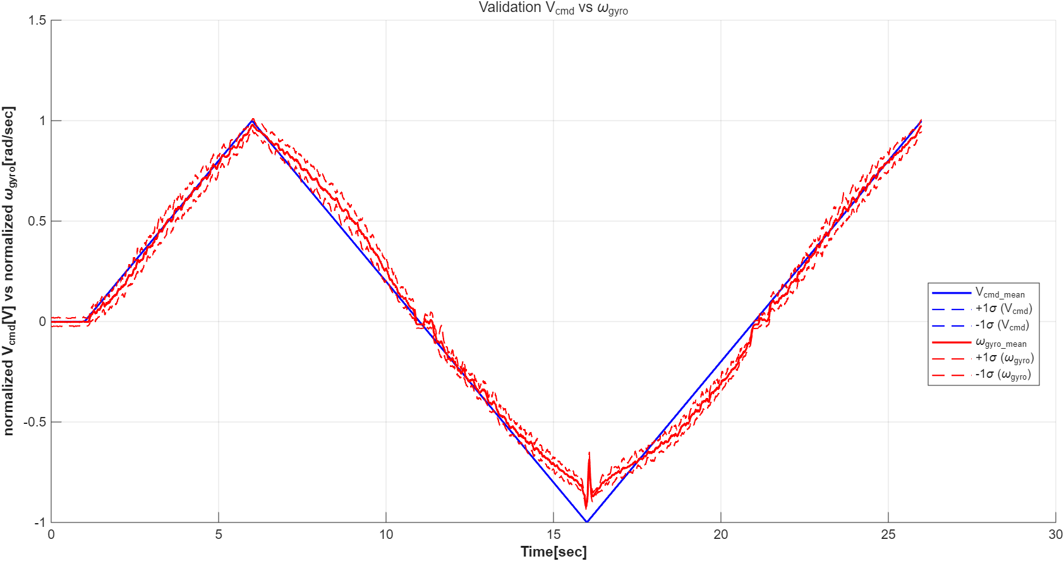
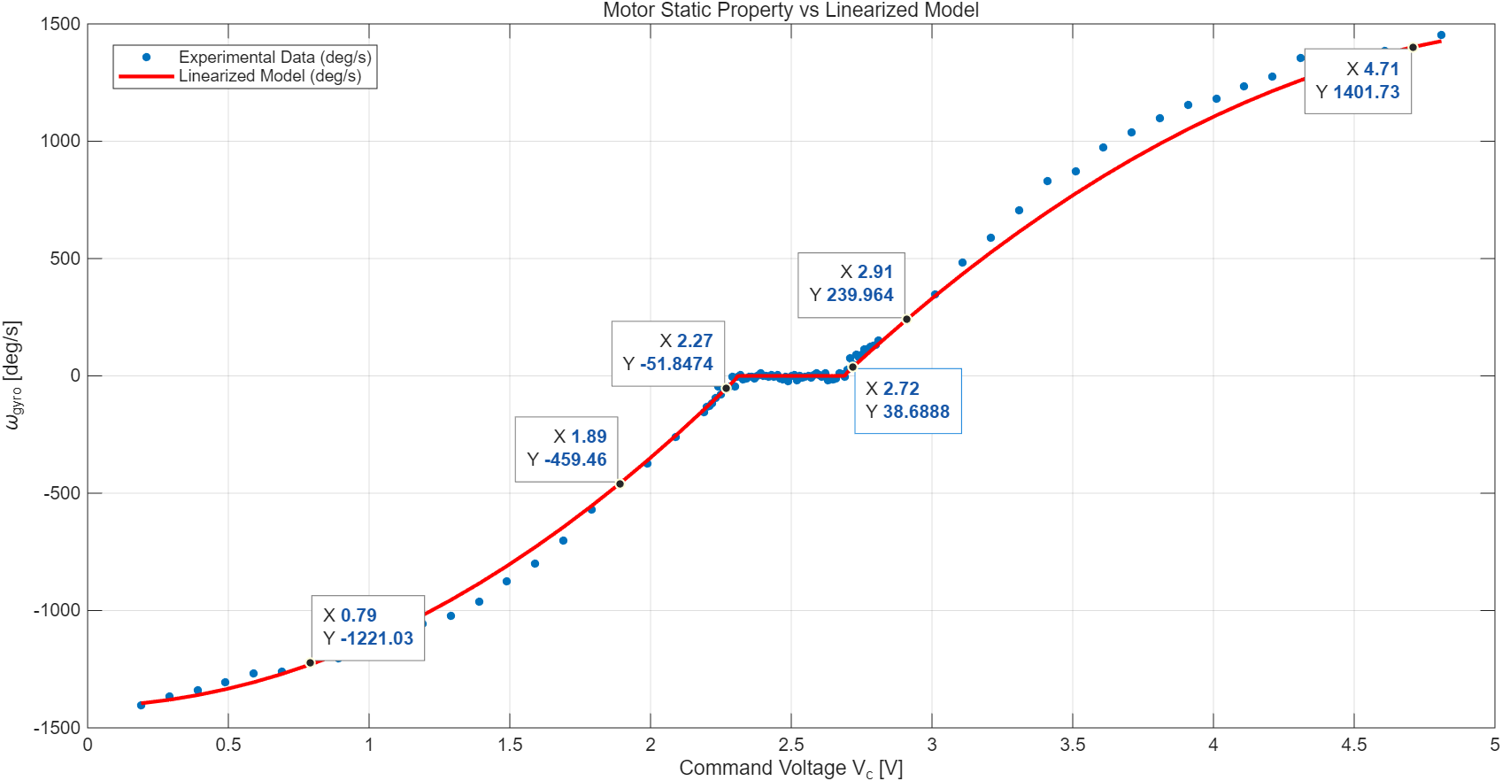
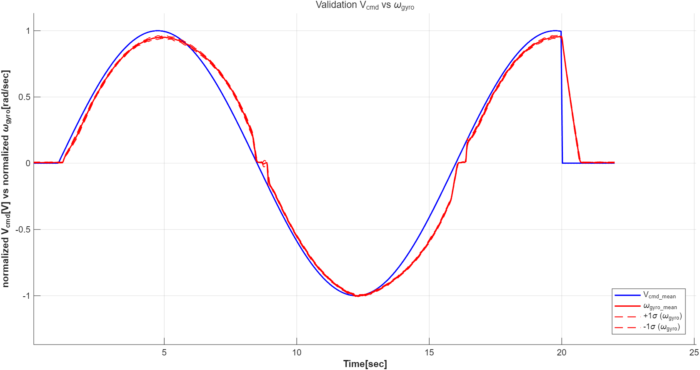
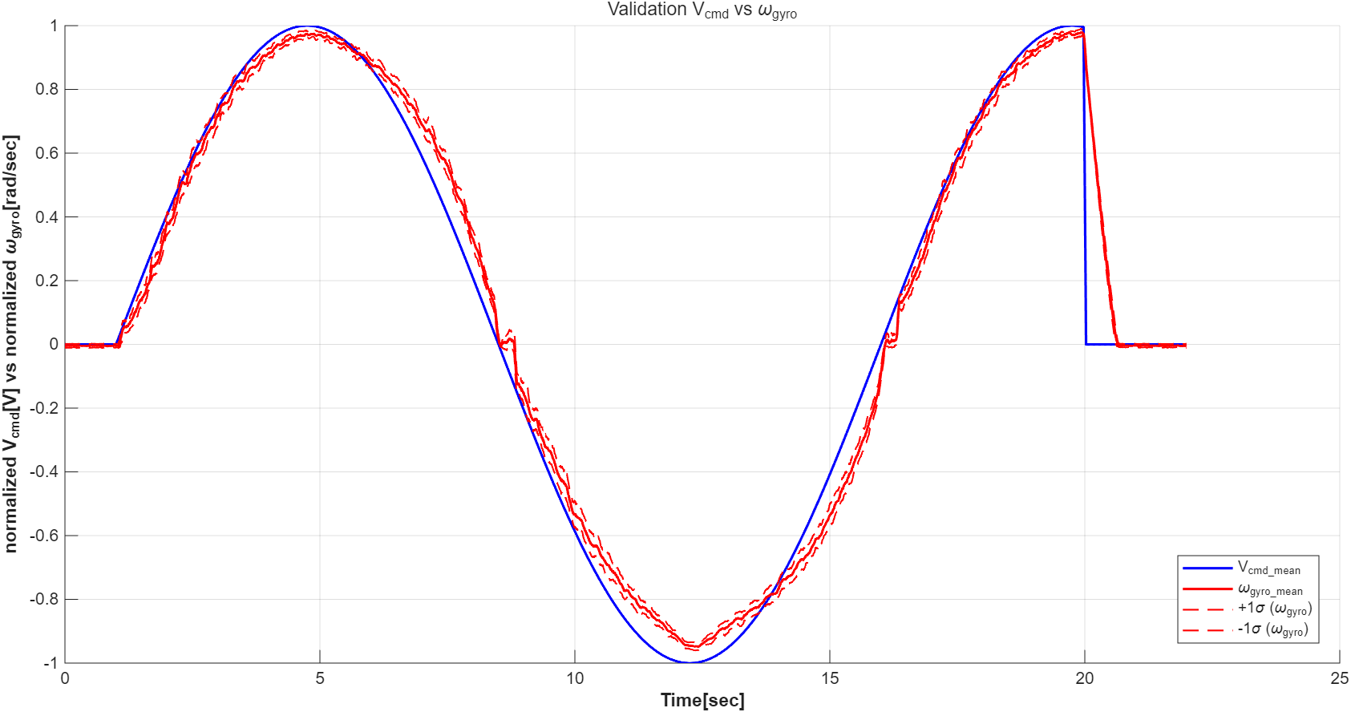
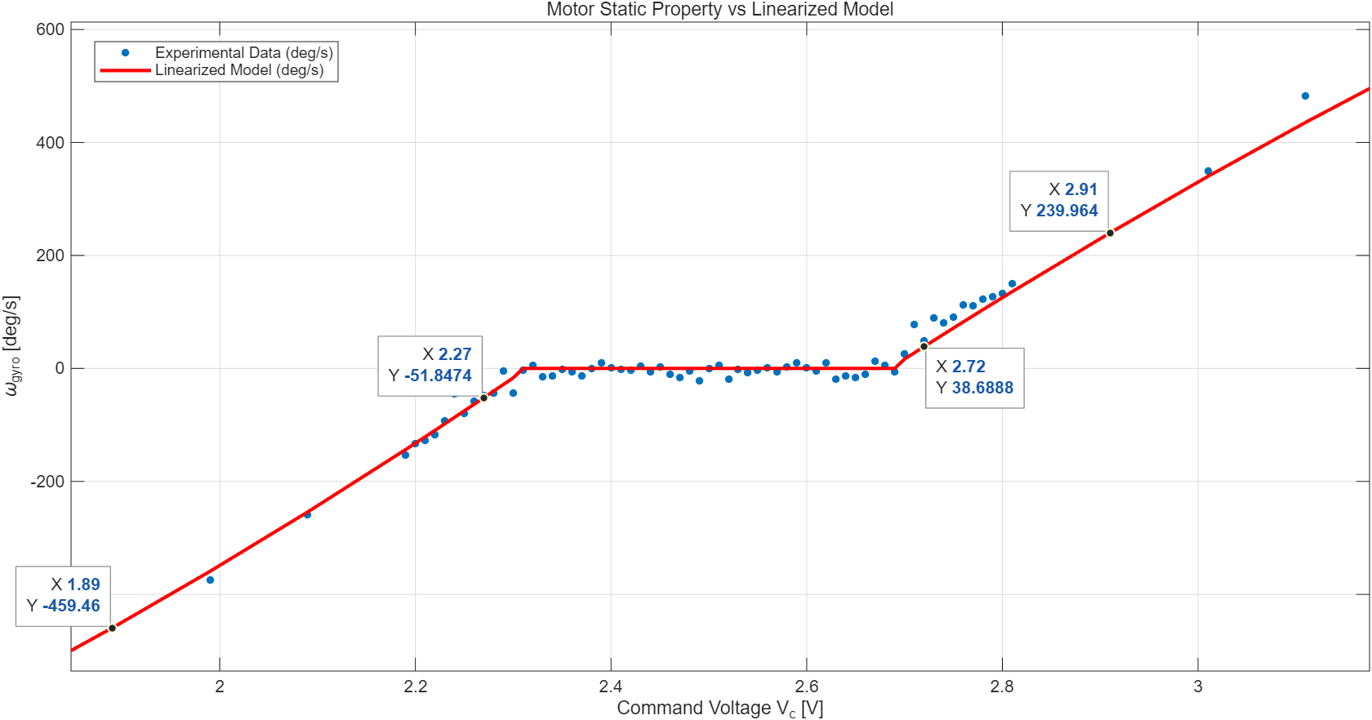

5. Linearization Validation
Full-Range Verification: Applied both triangle and sine waves to sweep the entire spectrum of input $V_{cmd}$.

Slide 6
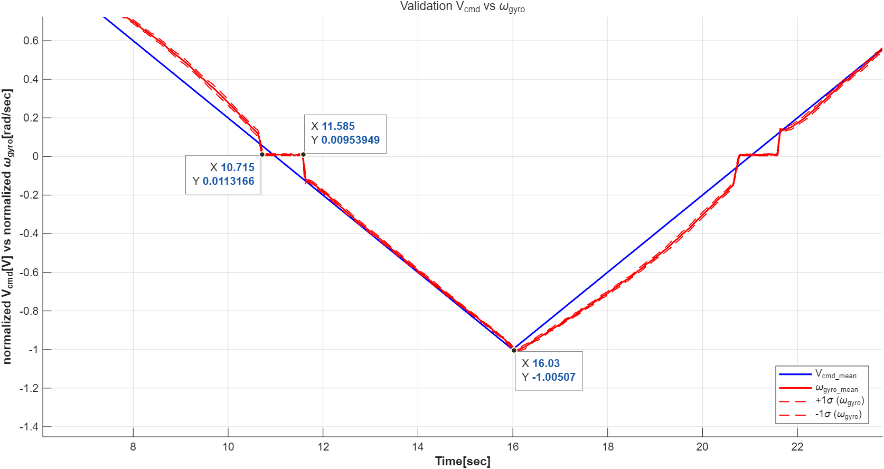
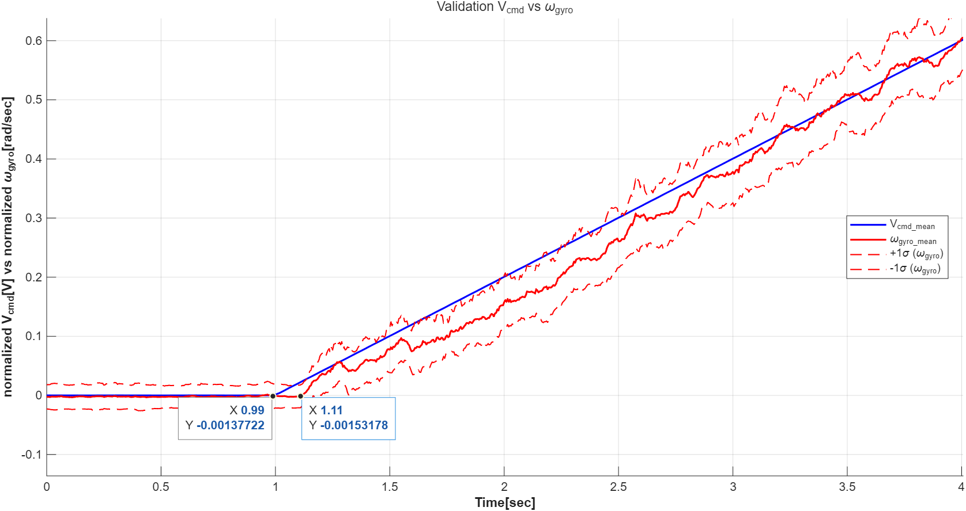
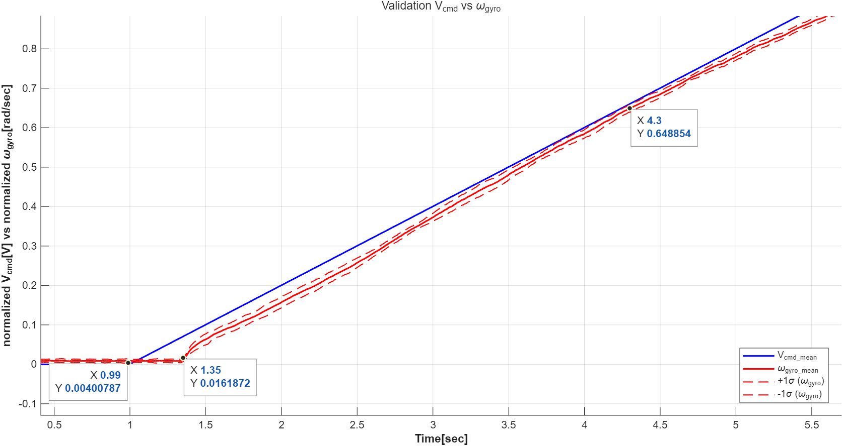
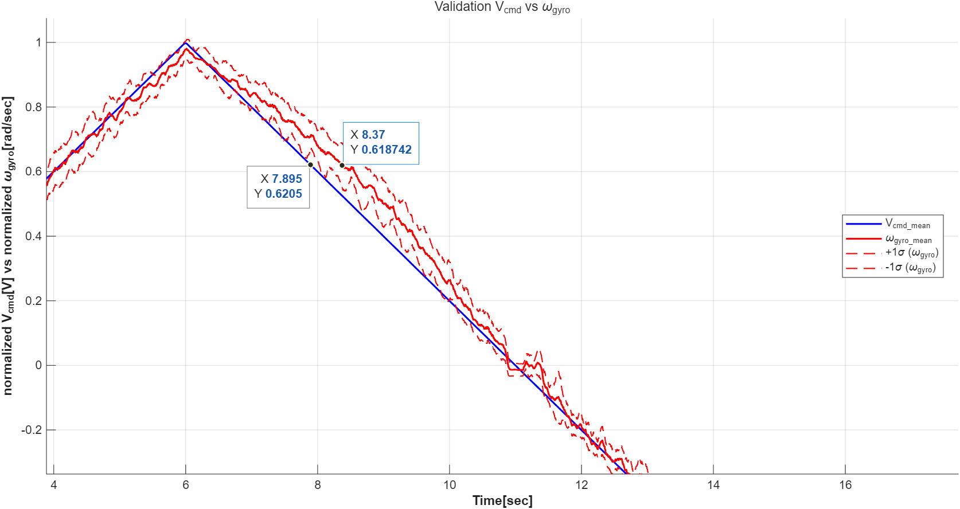
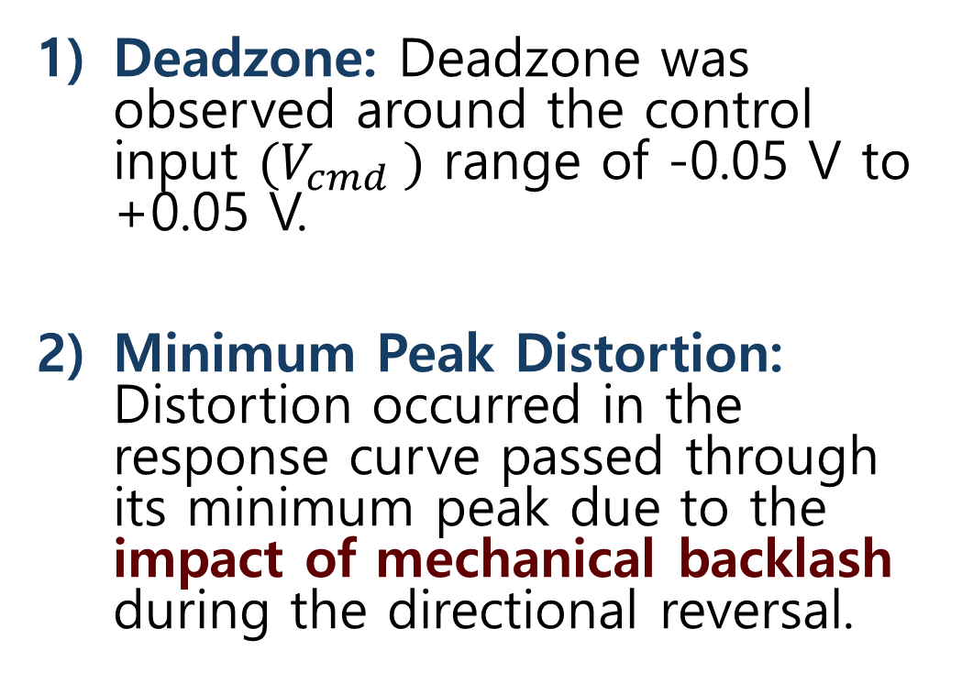
5. Linearization Validation
Deadzone: Deadzone was observed around the control input $(V_{cmd} )$ range of -0.05 V to +0.05 V.
Minimum Peak Distortion: Distortion occurred in the response curve passed through its minimum peak due to the impact of mechanical backlash during the directional reversal.

Slide 7
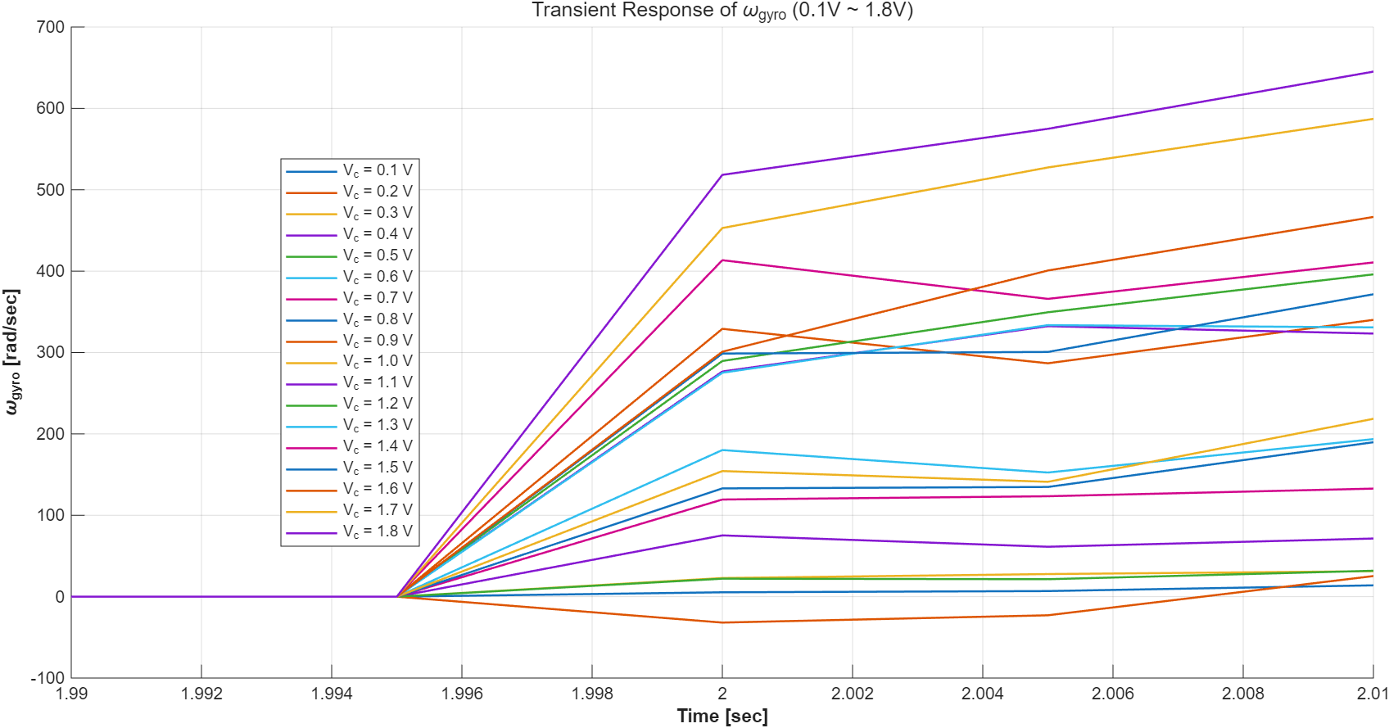
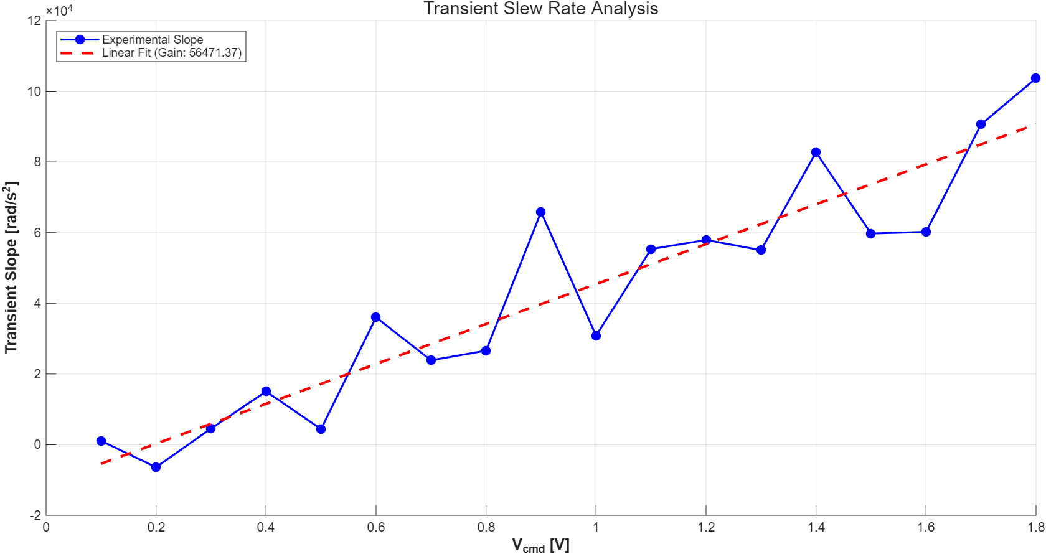
6. Check Slew Rate Limit
Response Linearity: The transient slope of the output increased linearly in proportion to the pulse input magnitude from 0V up to 1.8V.
Limit Verification: The lack of slope saturation confirms that the system is not affected by slew rate limits within the tested operational range.

Slide 8
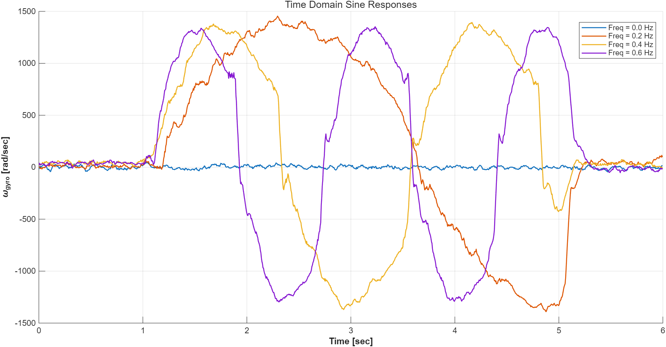
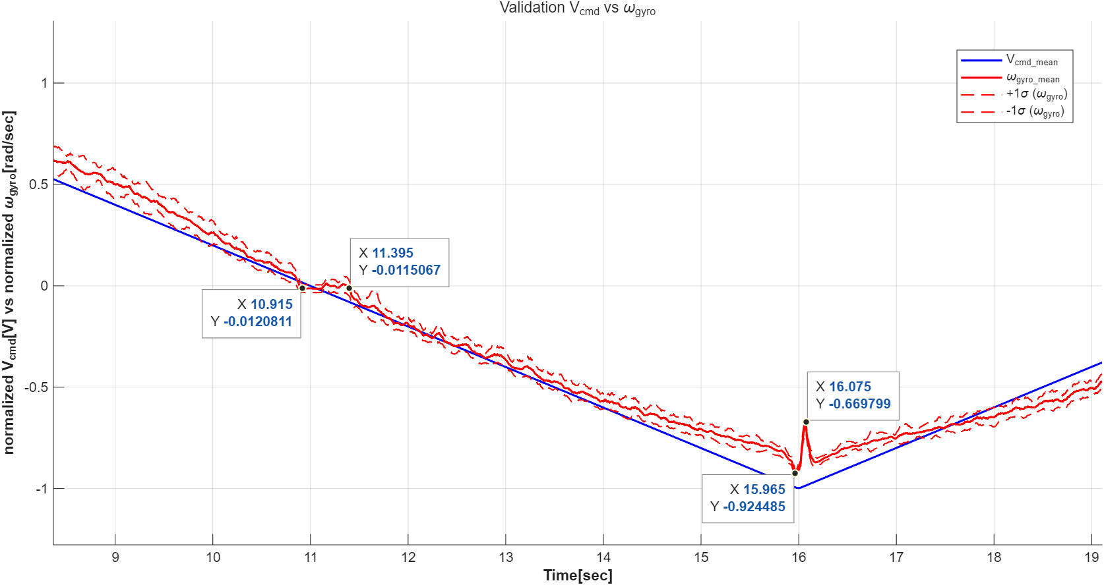
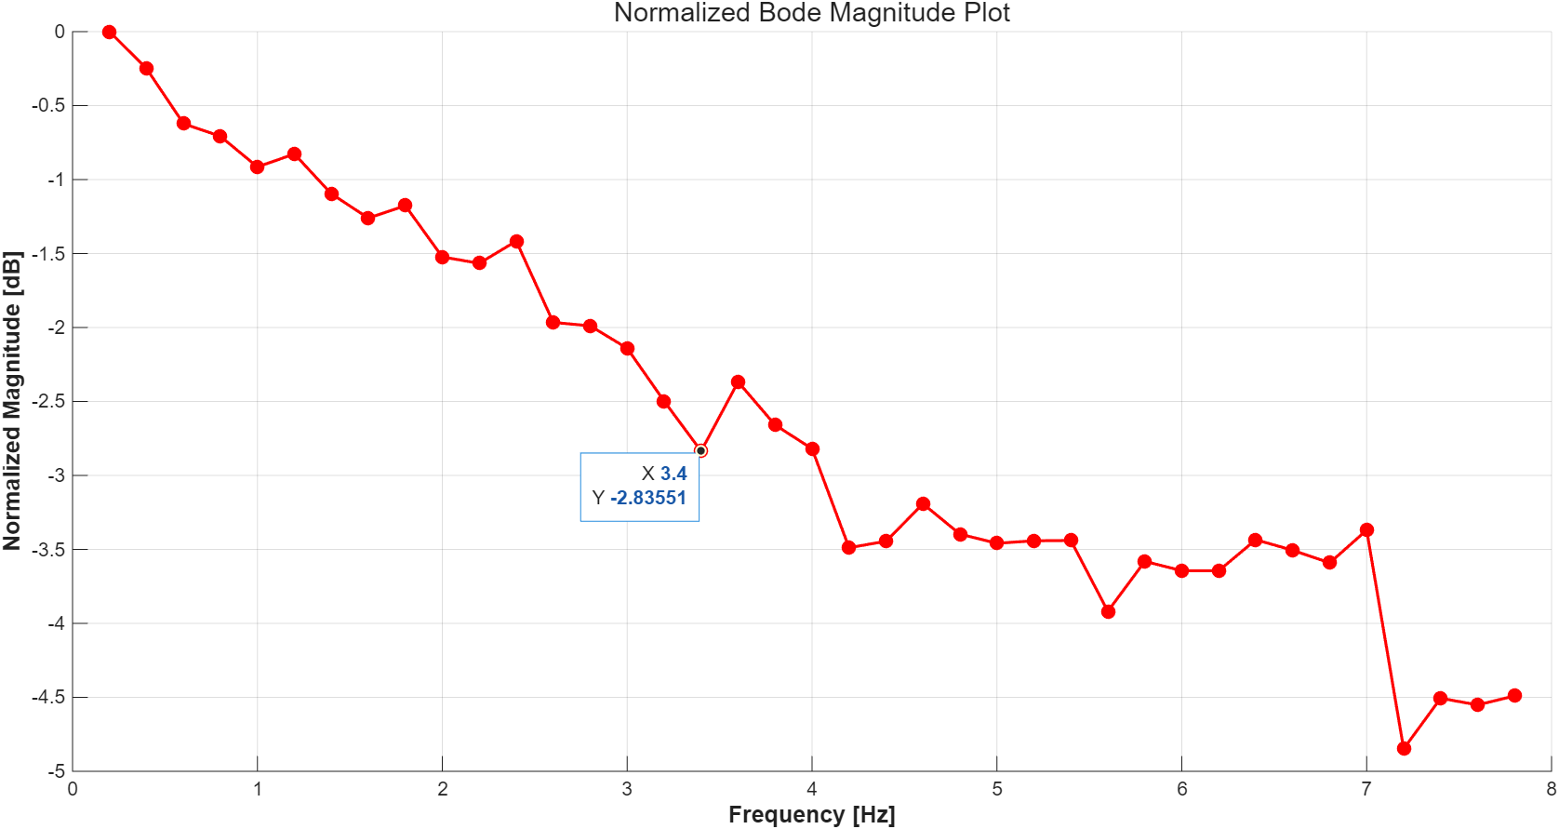
7. Sine Response - Bode Magnitude plot
Sine Wave Input: Evaluated the frequency response by sequentially applying sine wave inputs from DC to 8Hz.
Bandwidth Identification: Determined the system bandwidth to be 3.4Hz by identifying the point where the gain drops to -3dB.

