Slide 1

Module-V RTOS BASED EMBEDDED SYSTEMS DESIGN

Slide 2
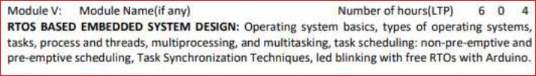

Slide 3
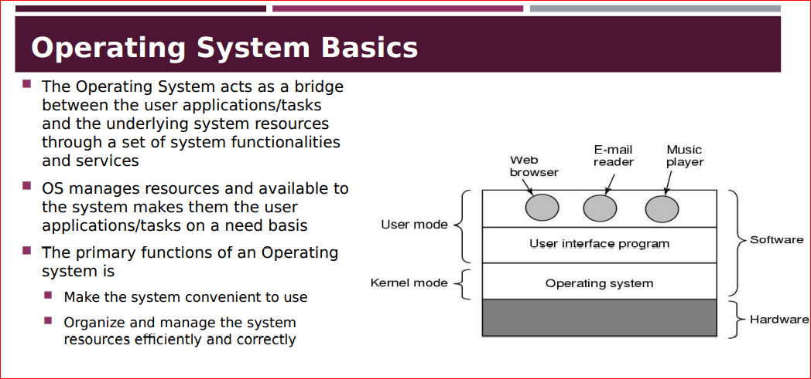

Slide 4
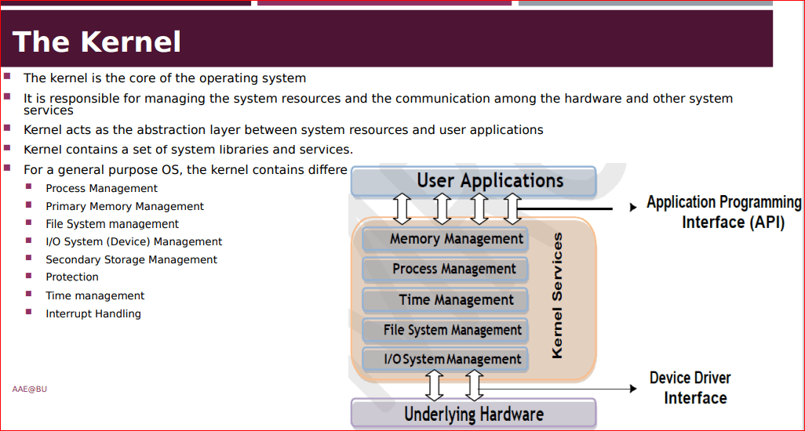

Slide 5

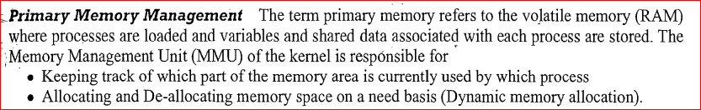
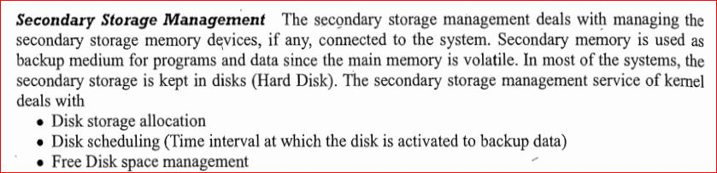

Slide 6

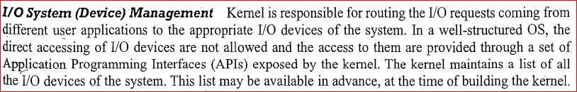

File System management:

Slide 7
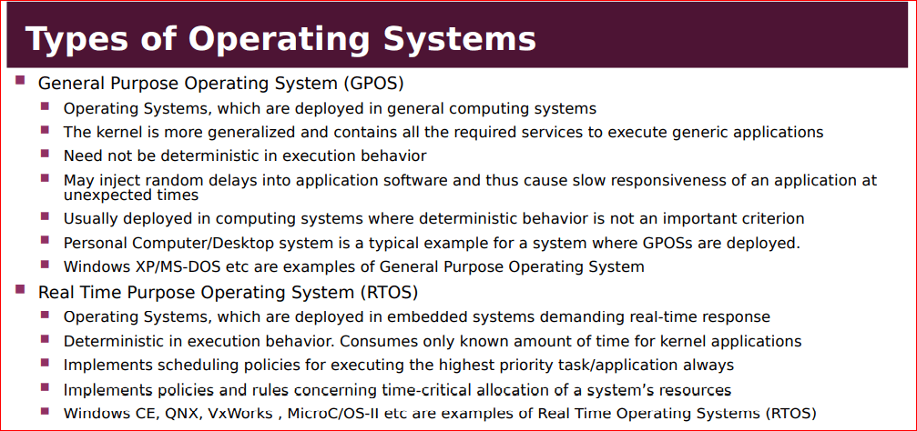

Slide 8
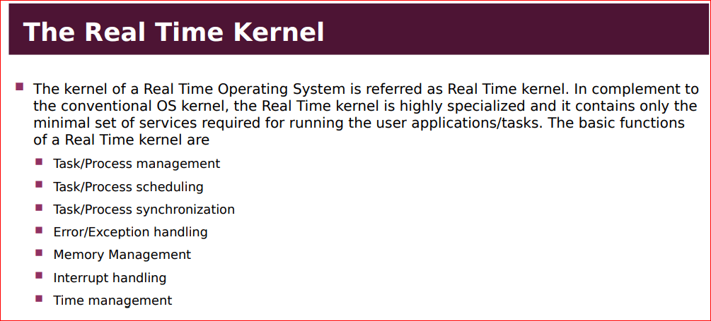

Slide 9
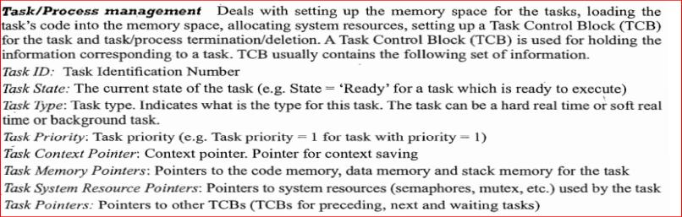
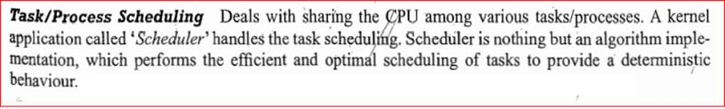
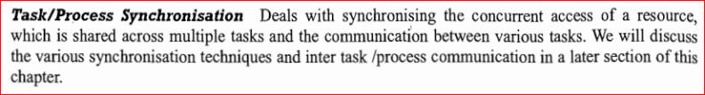

Slide 10
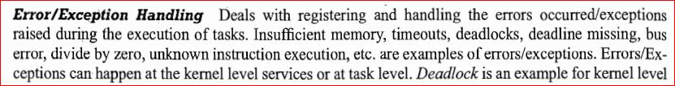

Slide 11
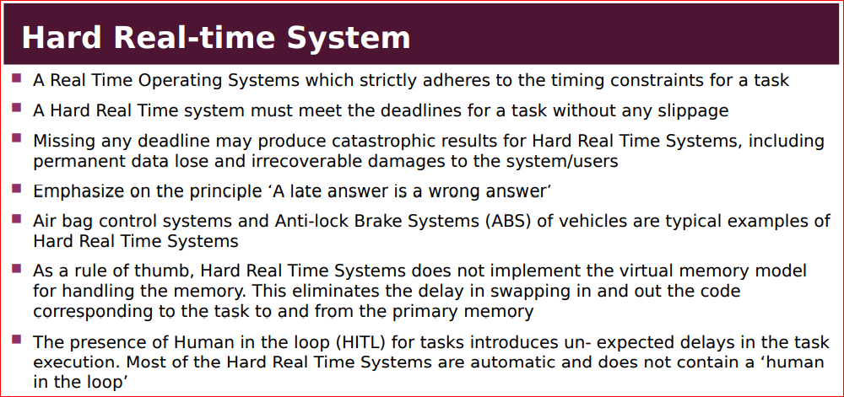

Slide 12
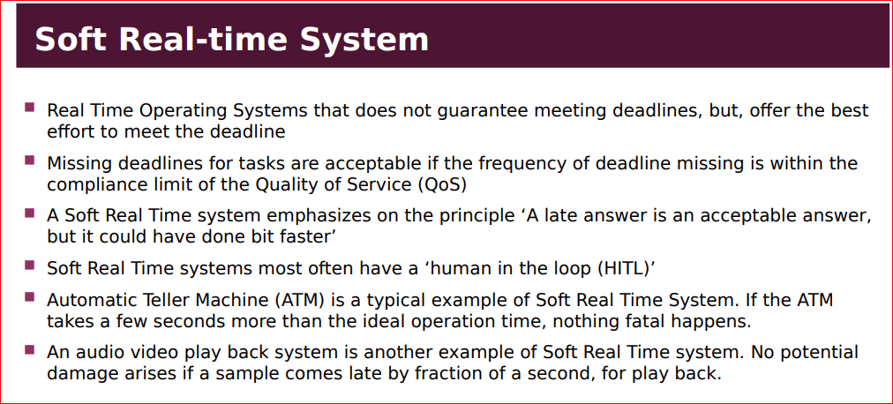

Slide 13
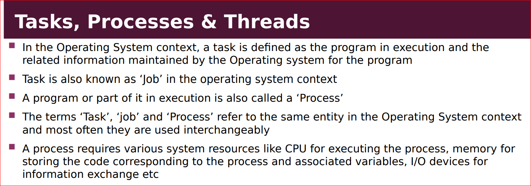
13

Slide 14

Structure of a Process
The concept of process leads to concurrent execution.
concurrent execution is achieved through the sharing of CPU among the processes.
A Process mimics a processor in properties & holds a set of registers,process status, PC to point next executed instruction of the process, stack holds local variables of a process & code holds corresponding to process.
14

Slide 15
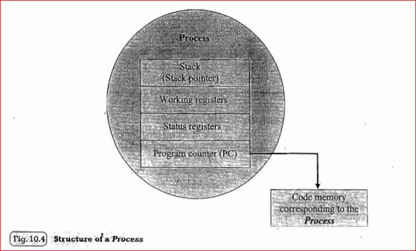
structure of a Process
.
15

Slide 16
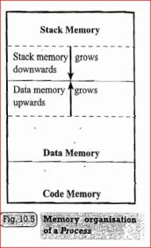
Memory organization of a process
The memory occupied by process is segregated into three regions namely;stack memory,data memory & code memory.
Stack memory holds all temporary data such as variables local to process.
Data memory holds all global data for process.
Code memory contains the program code
(Instructions) of the process.
16

Slide 17
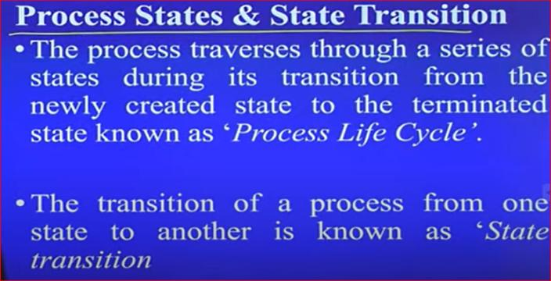
Process states & state transition
17

Slide 18
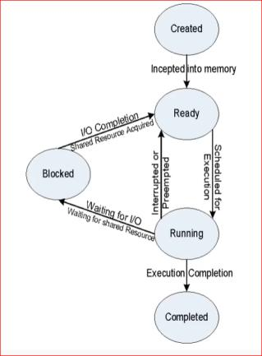
Process states & state transition representation
18

Slide 19
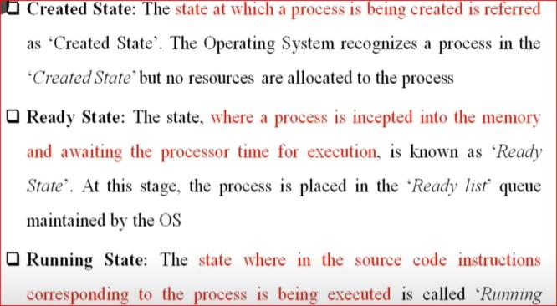
Process states & state transition representation
state.
19

Slide 20
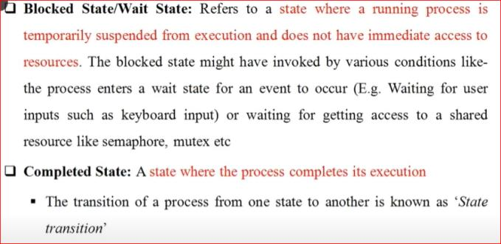
Process states & state transition representation
20

Slide 21
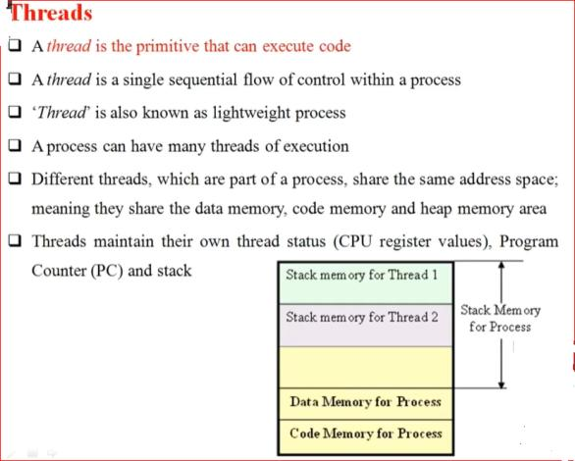

21

Slide 22
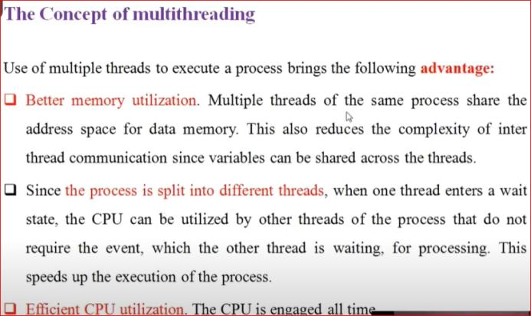
RISC Design policy
22

Slide 23
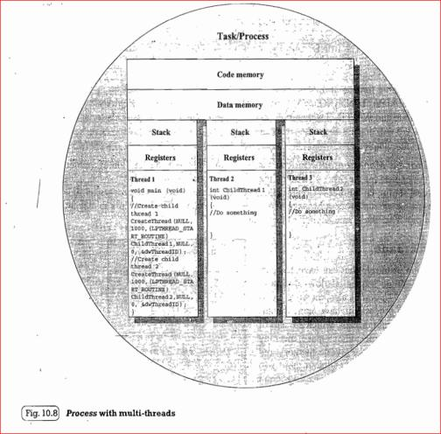
23

Slide 24
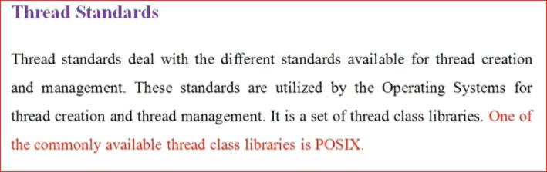
24

Slide 25
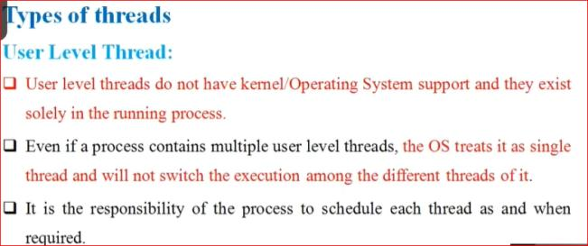
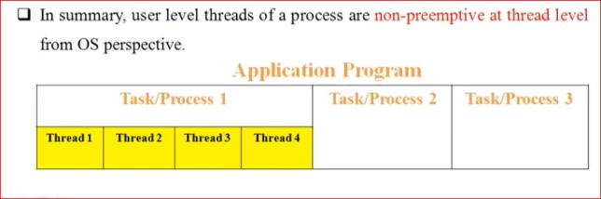
25

Slide 26
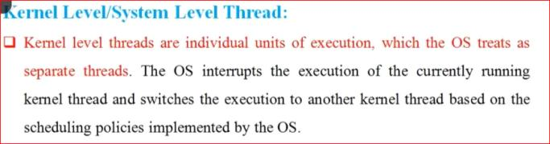
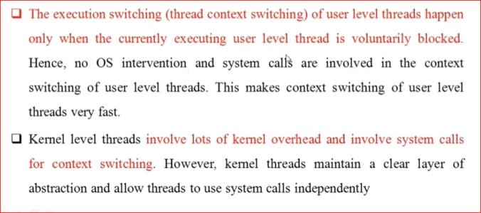
26

Slide 27
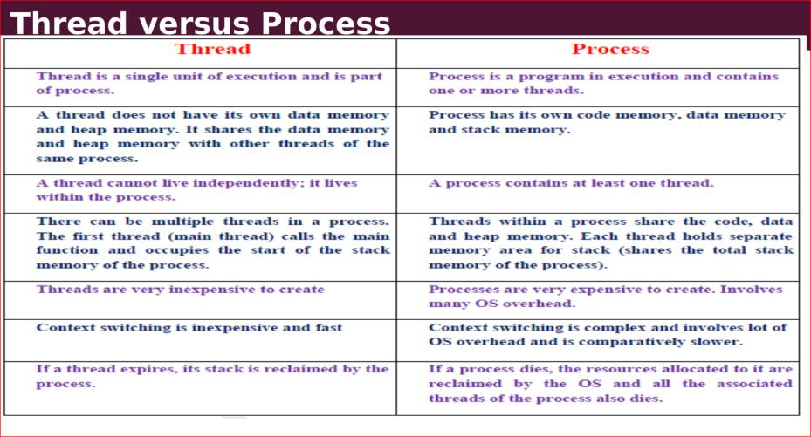
27

Slide 28
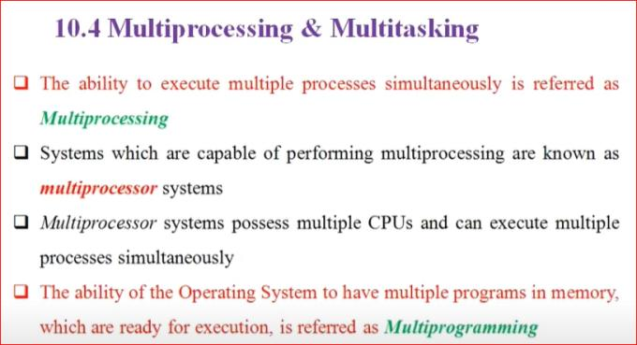
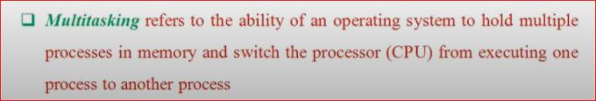
28

Slide 29
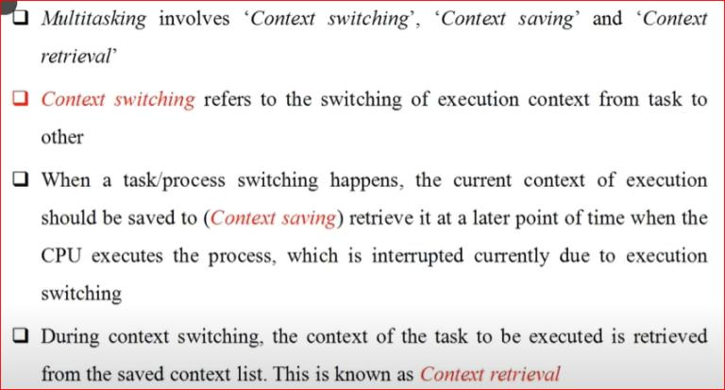
29

Slide 30
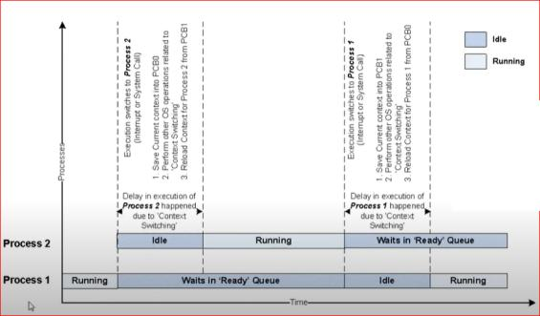

30

Slide 31
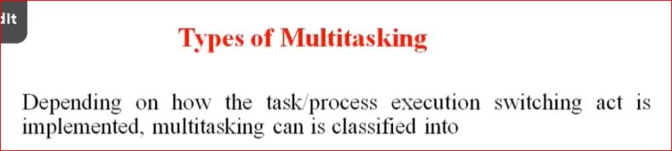
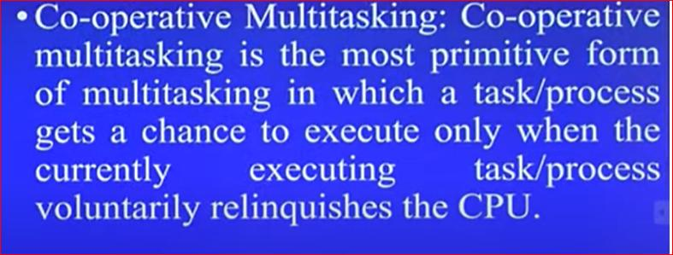
31

Slide 32
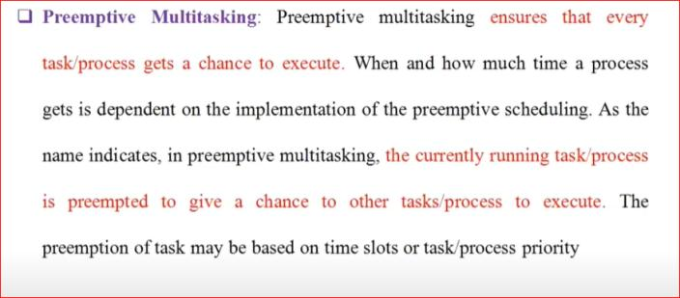
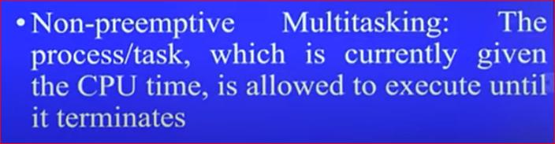
32

Slide 33
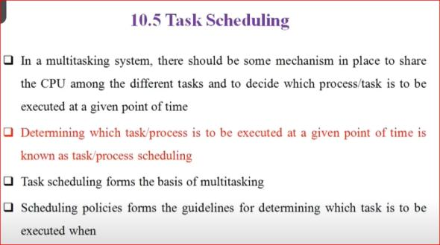
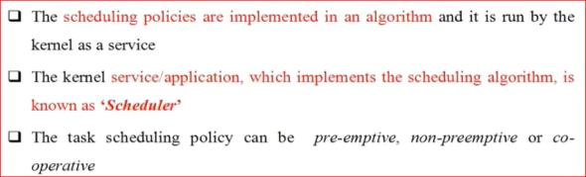
33

Slide 34
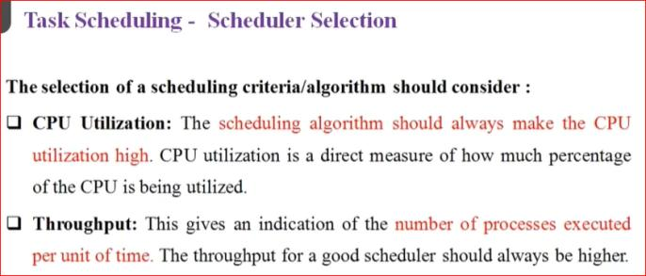
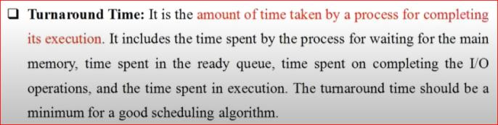
34

Slide 35
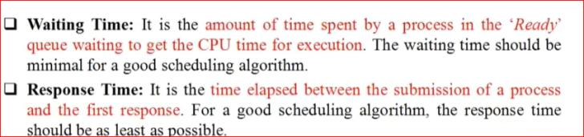
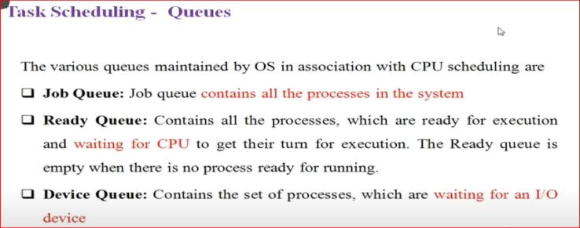
35

Slide 36
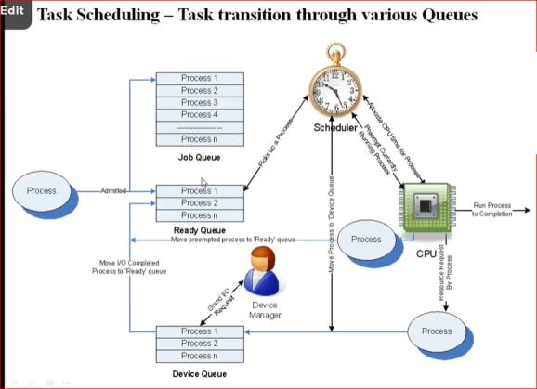
36

Slide 37
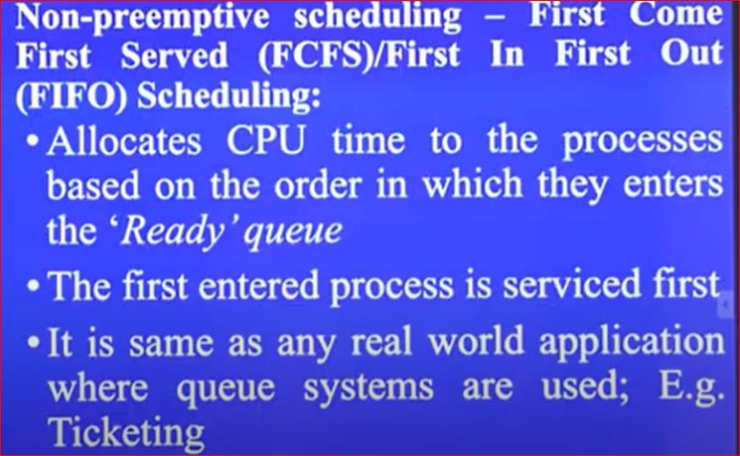
Non preemptive scheduling
37

Slide 38
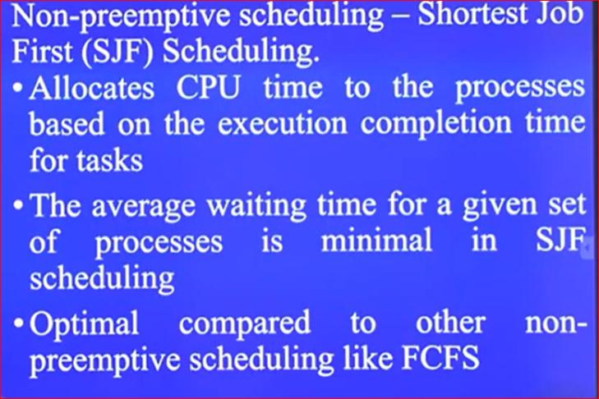
Non preemptive scheduling
38

Slide 39
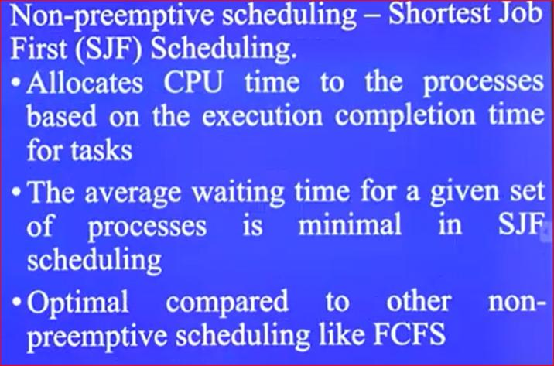
Non preemptive scheduling
39

Slide 40
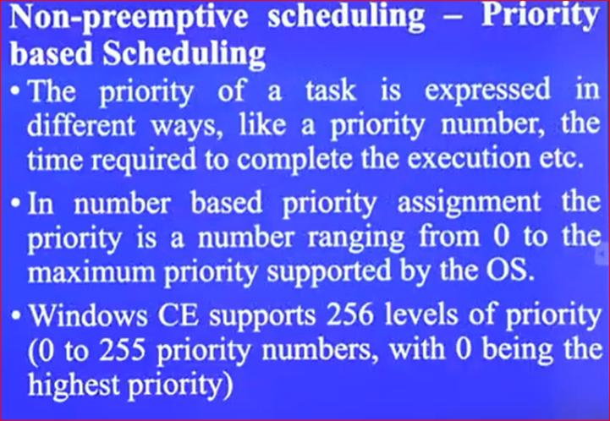
Non preemptive scheduling
40

Slide 41
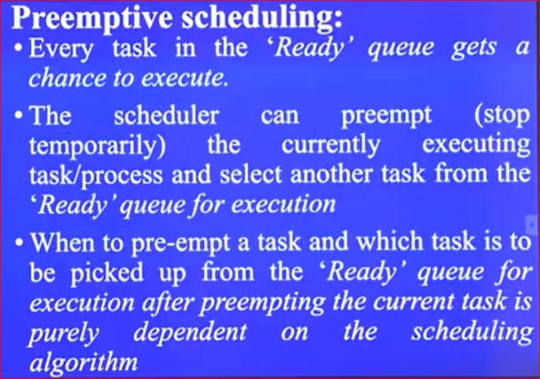
RISC Design policy
41

Slide 42

RISC Design policy
42

Slide 43

RISC Design policy
43

Slide 44



44

Slide 45

RISC Design policy
45

Slide 46

RISC Design policy
46

Slide 47


RISC Design policy
47

Slide 48


RISC Design policy
48

Slide 49


RISC Design policy
49

Slide 50


RISC Design policy
50

Slide 51


RISC Design policy
51

Slide 52

RISC Design policy
52

Slide 53

RISC Design policy
53

Slide 54

RISC Design policy
54

Slide 55

RISC Design policy
55

Slide 56

RISC Design policy
56

Slide 57

RISC Design policy
57

Slide 58

RISC Design policy
58

Slide 59

RISC Design policy
59

Slide 60

RISC Design policy
60

Slide 61


RISC Design policy
61

Slide 62

RISC Design policy
62

Slide 63

63

Slide 64

RISC Design policy
64

Slide 65

RISC Design policy
65

Slide 66

RISC Design policy
66

Slide 67

RISC Design policy
67

