Slide 1

Module-III Arithmetic and Logic Instructions and Programs

Slide 2

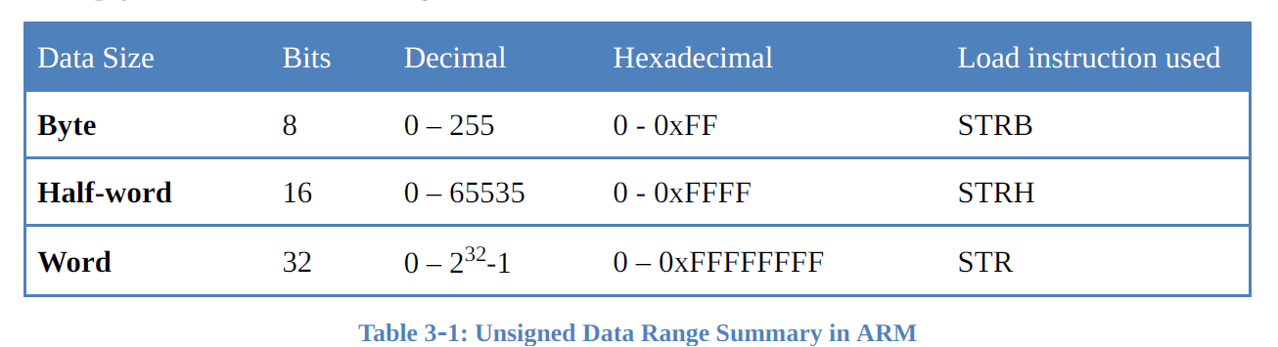
Arithmetic Instructions
Unsigned numbers are defined as data in which all the bits are used to represent data and no bits are set aside for the positive or negative sign.
Affecting flags in ARM instructions
A unique feature of the execution of ARM arithmetic instructions is that it does not affect (updates) the flags unless we specify it.
This is different from other microcontrollers and CPUs such as 8051 and x86. In the x86 and 8051 the arithmetic instructions automatically change the Z and C flags regardless of we want it or not.

Slide 3
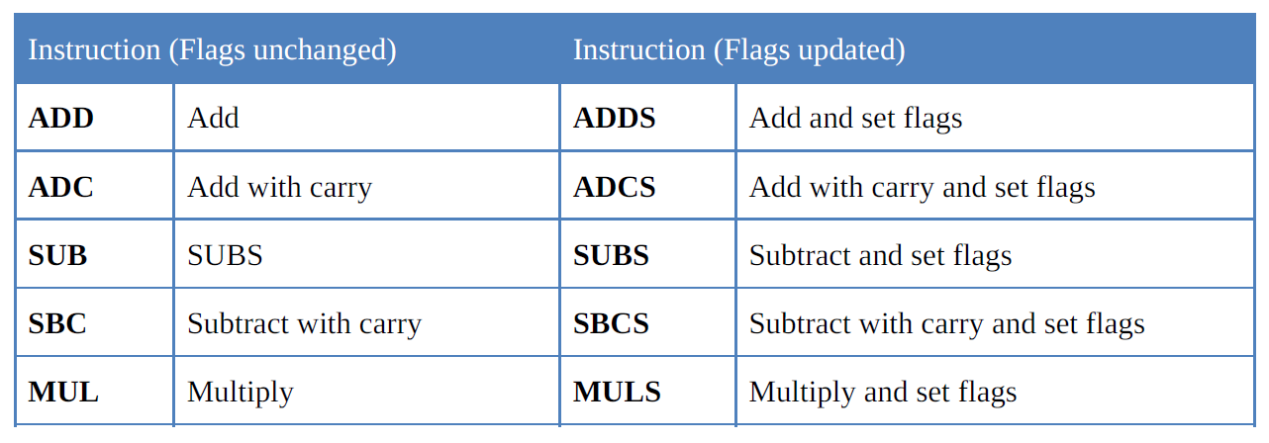
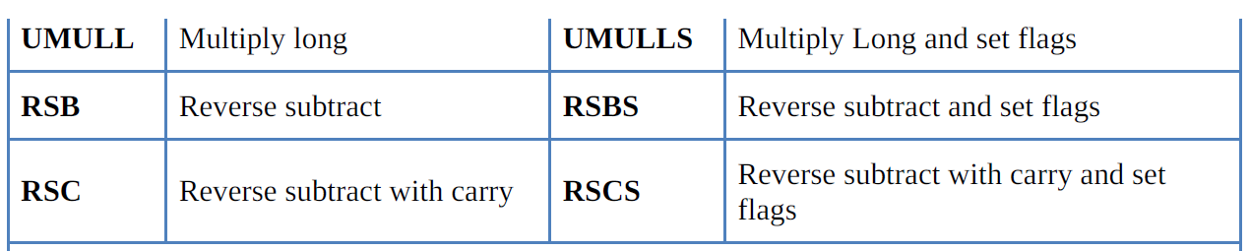
Arithmetic Instructions
The default for the ARM instruction is not to affect these flags after the
execution of arithmetic instructions such as ADD and SUB.
We override the default by having letter S in the instruction
For example, we must use SUBS instead of SUB
3

Slide 4
Arithmetic Instructions
Addition of unsigned numbers
The form of the ADD instruction is
ADD Rd,Rn,Op2 ;Rd = Rn + Op2
The destination operand must be a register.
The Op2 operand can be a register or immediate.
Memory-to-register or memory-to-memory arithmetic and logic operations are never allowed in ARM Assembly language since it is a RISC processor.
The effect of the ADDS instruction on the overflow (V) and N (negative) flags they are used in signed number operations
4

Slide 5
Arithmetic Instructions
a) LDR R2,=0xFFFFFFF5 ;R2=0xFFFFFFF5 (notice the = sign)
MOV R3,#0x0B
ADDS R1,R2,R3 ;R1=R2 + R3 and update the flags
b) LDR R2,=0xFFFFFFFF
ADDS R1,R2,#0x95 ;R1=R2 + 95 and update the flags
No increment instruction in ARM
There is no increment instruction in the ARM processor.
we use ADD to perform this action.
The instruction “ADDS R4,R4,#1” will increment the R4 and places the result in R4 register.
5

Slide 6
Arithmetic Instructions
ADC (add with carry)
This instruction is used for multiword (data larger than 32-bit) numbers. The form of
the ADC instruction is
ADC Rd,Rn,Op2 ;Rd = Rn + Op2 + C
In discussing addition, the following two cases will be examined:
1. Addition of individual word data
2. Addition of multiword data
CASE 1: Addition of individual word data
LDR R2,=0xFFFFFFF1 ;R2 = 0xFFFFFFF1
MOV R3,#0x0F
ADDS R3,R3,R2 ;R3 = R3 + R2 and update the flags
ADD R3,R3,#0x7 ;R3 = R3 + 0x7 and flags unchanged
6

Slide 7
Arithmetic Instructions
CASE 2: Addition of multiword numbers
Analyze the following program which adds 0x35F62562FA to 0x21F412963B:
LDR R0,=0xF62562FA ;R0 = 0xF62562FA
LDR R1,=0xF412963B ;R1 = 0xF412963B
MOV R2,#0x35 ;R2 = 0x35
MOV R3,#0x21 ;R3 = 0x21
ADDS R5,R1,R0 ;R5 = 0xF62562FA + 0xF412963B
;now C = 1
ADC R6,R2,R3 ;R6 = R2 + R3 + C
; = 0x35 + 21 + 1 = 0x57
7

Slide 8
Arithmetic Instructions
Subtraction of unsigned numbers
SUB Rd,Rn,Op2 ;Rd = Rn - Op2
In subtraction, the ARM microprocessors use the 2’s complement method.
Although every CPU contains adder circuitry, it would be too cumbersome (and take too many logic gates) to design separate subtractor circuitry.
1. Take the 2’s complement of the subtrahend (Op2 operand).
2. Add it to the minuend (Rn operand).
3. Place the result in destination Rd.
4. Set the carry flag if there is a carry.
8

Slide 9
Arithmetic Instructions
Show the steps involved for the following cases:
a)
MOV R2,#0x4F ;R2 = 0x4F
MOV R3,#0x39 ;R3 = 0x39
SUBS R4,R2,R3 ;R4 = R2 – R3
Solution:
0x4F 0000004F
– 0x39 + FFFFFFC7 2’s complement of 0x39
________ ________________
1 00000016 (C = 1 step 4)
The flags would be set as follows: C = 1, and Z = 0. The programmer must look at the carry flag (not the sign flag) to determine if the result is positive or negative.
9

Slide 10
Arithmetic Instructions
Notice that, unlike x86 CPUs, ARM does not invert the carry flag after SUBS so C=0 when there is borrow and C=1 when there is no borrow.
It means that after the execution of SUBS, if C=1, the result is positive; if C = 0, the result is negative and the destination has the 2’s complement of the result.
Analyze the following instructions:
MOV R1,#0x4C ;R1 = 0x4C
MOV R2,#0x6E ;R2 = 0x6E
SUBS R0,R1,R2 ;R0 = R1 – R2
Following are the steps for “SUB R0,R1,R2”:
4C 0000004C
–6E + FFFFFF92 (2’s complement of 0x6E)
______________ ____________
– 22 FFFFFFDE (C = 0 step 4) result is negative, fins the 2’s complement of this number to get the result
10

Slide 11
Arithmetic Instructions
SBC (subtract with borrow)
SBC Rd,Rn,Op2 ;Rd = Rn – Op2 – 1 + C
This instruction is used for subtraction of multiword (data larger than 32-bit) numbers.
ARM the carry flag is not inverted after subtraction and carry flag is invert of borrow.
To invert the carry flag while running the subtract with borrow instruction it is implemented as
“Rd = Rn – Op2 – 1 + C”
11

Slide 12
Arithmetic Instructions
Analyze the following program which subtracts 0x21F62562FA from 0x35F412963B:
LDR R0,=0xF62562FA ;R0 = 0xF62562FA,
LDR R1,=0xF412963B ;R1 = 0xF412963B
MOV R2,#0x21 ;R2 = 0x21
MOV R3,#0x35 ;R3 = 0x35
SUBS R5,R1,R0 ;R5 = R1 – R0
; = 0xF412963B – 0xF62562FA, and C = 0
SBC R6,R3,R2 ;R6 = R3 – R2 – 1 + C
; = 0x35 – 0x21 – 1 + 0 = 0x13
12

Slide 13
Arithmetic Instructions
No decrement instruction in ARM
Instead we use SUB to perform the action. The instruction “SUB R4,R4,#1” will decrement one from R4 and places the result in R4 register.
RSB (reverse subtract)
The format for the RSB instruction is
RSB Rd,Rn,Op2 ;Rd = Op2 – Rn
Notice the difference between the RSB and SUB instruction.
They are essentially the same except the way the source operands are subtracted is reversed.
This instruction can be used to get 2’s complement of a 32-bit operand
Ex: MOV R1,#0x6E ;R1=0x6E
RSB R0,R1,#0 ;R0= 0 – R1

Slide 14
Arithmetic Instructions
RSC (reverse subtract with carry)
The form of the RSC instruction is
RSC Rd,Rn,Op2 ;Rd = Op2 – Rn – 1 + C
Notice the difference between the RSB and RSC instructions.
They are essentially the same except the way the source operands are subtracted is reversed.
This instruction can be used to get the 2’s complement of the 64-bit operand

Slide 15
Classification of embedded system
Arithmetic Instructions
Show how to create 2’s complement of a 64-bit data in R0 and R1 register. The R0 hold
the lower 32-bit.
Solution:
LDR R0,=0xF62562FA ;R0 = 0xF62562FA
LDR R1,=0xF812963B ;R1 = 0xF812963B
RSB R5,R0,#0 ;R5 = 0 – R0
; = 0 – 0xF62562FA = 9DA9D06 and C = 0
RSC R6,R1,#0 ;R6 = 0 – R1 – 1 + C
; = 0 – 0xF812963B – 1 + 0 = 7ED69C4

Slide 16
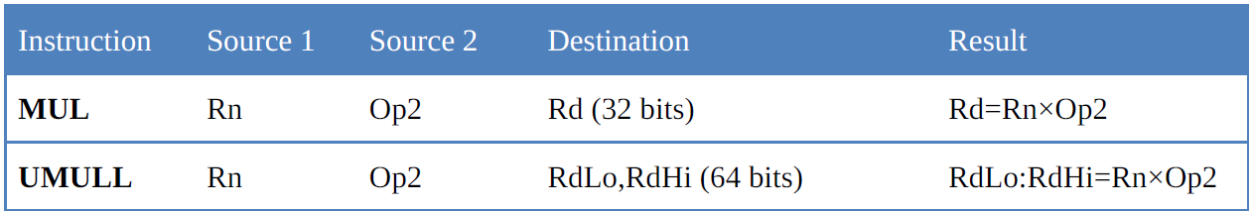
Classification of embedded system
Arithmetic Instructions
Multiplication and division of unsigned numbers
Not all CPUs have instructions for multiplication and division.
All the ARM processors have a multiplication instruction but not the division.
Some family members such as ARM Cortex have both the division and multiplication instructions.
Multiplication of unsigned numbers in ARM
normal multiply - MUL is used when the result is less than 32-bit
long multiply-MULL must be used when the result is greater than 32-bit.

Slide 17
Classification of embedded system
Arithmetic Instructions
MUL (multiply)
MUL Rd,Rn,Op2 ;Rd = Rn × Op2
The operands must be in registers
UMULL (unsigned multiply long)
UMULL RdLo,RdHi,Rn,Op2 ;RdHi:RdLoRd = Rn × Op2
The operands must be in registers
LDR R1,=0x54000000 ;R1 = 0x54000000
LDR R2,=0x10000002 ;R2 = 0x10000002
UMULL R3,R4,R2,R1 ;0x54000000 × 0x10000002
; = 0x054000000A8000000
;R3 = 0xA800000, the lower 32 bits
;R4 = 0x05400000, the higher 32 bits

Slide 18
Classification of embedded system
Arithmetic Instructions
Multiply and Accumulate Instructions in ARM
In some application such as digital signal processing (DSP) we need to multiply two registers and add the result with another register.
The format of MLA (multiply and add) instruction is as follows:
MLA Rd,Rm,Rs,Rn ;Rd = Rm × Rs + Rn
The operands must be in registers
UMLAL (unsigned multiply and add long)
UMLAL RdLo,RdHi,Rn,Op2 ;RdHi:RdLo = Rn × Op2 + RdHi:RdLo
Division of unsigned numbers in ARM
Some ARM families do not have an instruction for division of unsigned numbers since it takes too many gates to implement it.
We can use SUB instruction to perform the division.

Slide 19
Classification of embedded system
PSR Transfer (MRS, MSR)
The instruction is only executed if the condition is true.
The MRS and MSR instructions are formed from a subset of the Data Processing operations and are implemented using the TEQ, TST, CMN and CMP instructions without the S flag set.
These instructions allow access to the CPSR and SPSR registers.
The MRS instruction allows the contents of the CPSR or SPSR_<mode> to be moved to a general register.
The MSR instruction allows the contents of a general register to be moved to the CPSR or SPSR_<mode> register.
The MSR instruction also allows an immediate value or register contents to be transferred to the condition code flags (N,Z,C and V) of CPSR or SPSR_<mode> without affecting the control bits.

Slide 20
Classification of embedded system
PSR Transfer (MRS, MSR)
In this case, the top four bits of the specified register contents or 32 bit immediate value are written to the top four bits of the relevant PSR.
In User mode the instructions behave as follows:
MSR CPSR_all,Rm ; CPSR[31:28] <- Rm[31:28]
MSR CPSR_flg,Rm ; CPSR[31:28] <- Rm[31:28]
MSR CPSR_flg,#0xA0000000; CPSR[31:28] <- 0xA
;(set N,C; clear Z,V)
MRS Rd,CPSR ; Rd[31:0] <- CPSR[31:0]
In privileged modes the instructions behave as follows:
MSR CPSR_all,Rm ; CPSR[31:0] <- Rm[31:0]
MSR CPSR_flg,Rm ; CPSR[31:28] <- Rm[31:28]
MSR CPSR_flg,#0x50000000; CPSR[31:28] <- 0x5
;(set Z,V; clear N,C)

Slide 21
Classification of embedded system
PSR Transfer (MRS, MSR)

Slide 22
Classification of embedded system
Single Data Swap (SWP)

Slide 23
Classification of embedded system
Single Data Swap (SWP)
The swap address is determined by the contents of the base register (Rn).
The processor first reads the contents of the swap address. Then it writes the contents of the source register (Rm) to the swap address and stores the old memory contents in the destination register (Rd).
The same register may be specified as both the source and destination.
SWP R0,R1,[R2] ; Load R0 with the word addressed by R2, and
store R1 at R2.
SWPB R2,R3,[R4] ; Load R2 with the byte addressed by R4, and
store bits 0 to 7 of R3 at R4.
SWPEQ R0,R0,[R1] ; Conditionally swap the contents of the
word addressed by R1 with R0.

Slide 24
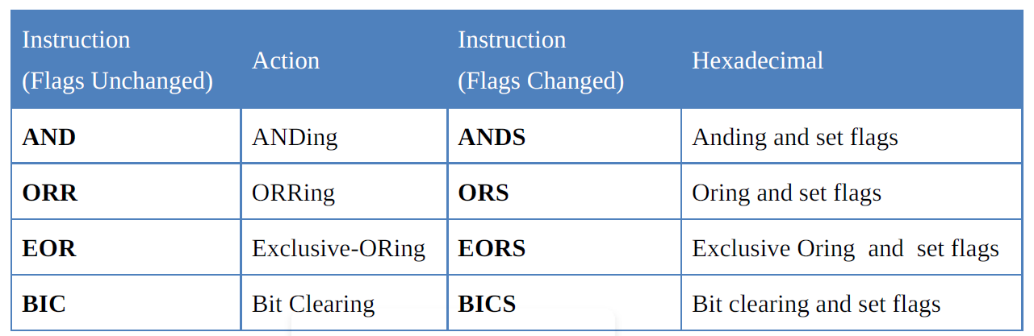
Classification of embedded system
Logic Instructions
AND
AND Rd, Rn, Op2 ;Rd = Rn ANDed Op2
The destination and the first source operands are registers.
Op2 -can be a register or an immediate value of less than 0xFF
ORR
ORR Rd, Rn, Op2 ;Rd = Rn ORed Op2

Slide 25
Classification of embedded system
Logic Instructions
EOR
EOR Rd,Rn,Op2 ;Rd = Rn Ex-ORed with Op2
EOR can also be used to see if two registers have the same value. make Z = 1 if both registers have the same value
Another widely used application of EOR is to toggle bits of an operand
EOR R2,R2,#0x04 ;EOR R2 with 0000 0100
BIC (bit clear)
BIC Rd,Rn,Op2 ;clear certain bits of Rn specified by the Op2 and place the result in Rd
The bits that are HIGH in Op2 will be cleared and bits with LOW will be left unchanged.
For example, assuming that R3 = 00001000 the instruction “BIC R2,R2,R3” will clear bit 3 of R2 and leaves the rest of the bits unchanged.

Slide 26
Classification of embedded system
Logic Instructions
MVN (move negative)
MVN Rd, Rn ;move negative of Rn to Rd
The MVN (move negative) instruction is used to generate one’s complement of an operand.
Ex-OR instruction to generate one’s complement of an operand.
Ex-ORing an operand with 0xFFFFFFFF will generate the 1’s complement
LDR R2,=0xAAAAAAAA ;R2 = 0xAAAAAAAA
MVN R0,#0 ;R0 = 0xFFFFFFFF
EOR R2,R2,R0 ;R2 = R2 ExORed with 0xFFFFFFFF
; = 0x55555555

Slide 27
Classification of embedded system
Barrel Shifter
The barrel shifter is a functional unit.
It provides five types of shifts and rotates which can be applied to Operand2.

Slide 28
Classification of embedded system
Using the Barrel Shifter: The Second Operand
Operand 1
Operand 2
Register, optionally with shift operation applied.
Shift value can be either be:
5 bit unsigned integer
Specified in bottom byte of another register.
Barrel Shifter
ALU
Result

Slide 29
Classification of embedded system
Operand 2 and the barrel shifter
The first operand for all data processing operations must always be a register.
The second operand is much more flexible and can be either an immediate value (#x), a register (Rm), or a register shifted by an immediate value or register "Rm, shift #x" or "Rm, shift Rs".
five shift operations:
LSL(Left Shift),LSR(Logical Right Shift),ASR(Arithmetic Right
Shift),ROR(Rotate Right),RRX(Rotate Right Extended)

Slide 30
Classification of embedded system
Rotate and Barrel Shifter
Although ARM Cortex has shift and rotate instructions
ARM7 we can perform the shift and rotate operations as part of other instructions such as MOV.
Barrel Shifter
There are two kinds of shifts: logical and arithmetic.
The logical shift is for unsigned operands and the arithmetic shift is for signed operands.
LSR (logical shift right)
The operand is shifted right bit by bit, and for every shift the LSB (least significant bit) will go to the carry flag (C) and the MSB (most significant bit) is filled with 0.

Slide 31
Classification of embedded system
Rotate and Barrel Shifter
One can use an immediate operand or a register to hold the number of times it is to be shifted.
MOV R0,#0x9A ;R0 = 0x9A
MOVS R1,R0,LSR #3 ;shift R0 to right 3 times and then move (copy) the result to R1
Another way
MOV R0,#0x9A
MOV R2,#0x03
MOV R1,R0,LSR R2 ;shift R0 to right R2 times and move the result to R1
LDR R0,=0x88 ;R0=0x88
MOVS R1,R0,LSR #3 ;shift R0 right three times (R1 = 0x11)

Slide 32
Classification of embedded system
Rotate and Barrel Shifter
LSL (Logical Shift Left)
Shift left is also a logical shift
After every shift, the LSB is filled with 0 and the MSB goes to C.
LDR R1,=0x0F000006
MOVS R2,R1,LSL #8
ASR (arithmetic shift right)
MOV Rn,Op2, ASR count

Slide 33
Classification of embedded system
Rotate and Barrel Shifter
Rotating the bits of an operand right and left
There are two types of rotations. One is a simple rotation of the bits of the operand, and the other is a rotation through the carry.
ROR (rotate right)
In rotate right, as bits are shifted from left to right they exit from the right end (LSB) and enter the left end (MSB).
In addition, as each bit exits the LSB, a copy of it is given to the carry flag.
In other words, in ROR the LSB is moved to the MSB and is also copied to C flag, as shown in the diagram.

Slide 34
Classification of embedded system
Rotate and Barrel Shifter
MOV R1,#0x36 ;R1 = 0000 0000 0000 0000 0000 0000 0011 0110
MOVS R1,R1,ROR #1 ;R1 = 0000 0000 0000 0000 0000 0000 0001 1011 C=0
MOVS R1,R1,ROR #1 ;R1 = 1000 0000 0000 0000 0000 0000 0000 1101 C=1
MOVS R1,R1,ROR #1 ;R1 = 1100 0000 0000 0000 0000 0000 0000 0110 C=1
Rotate left
There is no rotate left option in ARM7
since one can use the rotate right (ROR) to do the job.
That means instead of rotating left n bits we can use rotate right 32–n bits to do the job of rotate left.
Using this method does not give us the proper carry if actual instruction of ROL was available

Slide 35
Classification of embedded system
Rotate and Barrel Shifter
RRX rotate right through carry
In RRX, as bits are shifted from left to right, they exit from the right end (LSB) to
the carry flag, and the carry flag enters the left end (MSB).
In other words, in RRX the LSB is moved to C and C is moved to the MSB.
C flag acts as if it is part of the operand.
That means the RRX is like 33-bit register since the C flag is 33th bit.
The RRX takes no arguments and the number of times an operand to be rotated is fixed at one.
MOV R2,#0x26
MOVS R2,R2,RRX

Slide 36
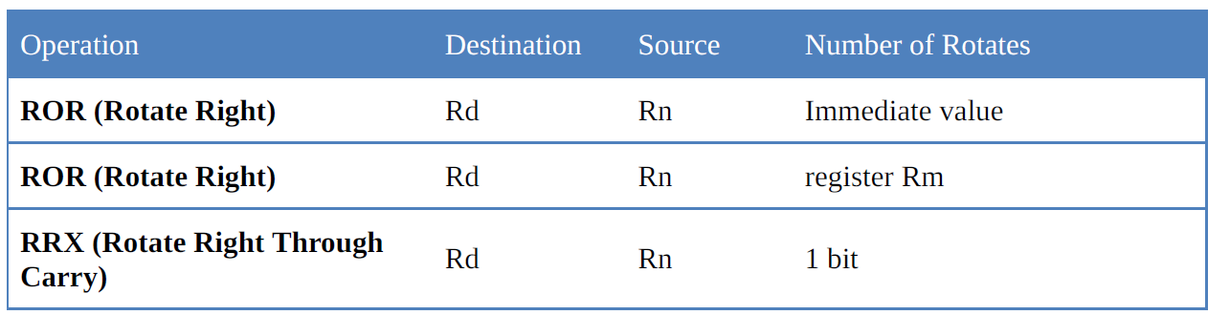
Classification of embedded system
Rotate and Barrel Shifter

Slide 37
Classification of embedded system
Branch, Call, and Looping in ARM
In the sequence of instructions to be executed, it is often necessary to transfer program control to a different location.
Examples: when a function is called, execution of a loop is repeated, or an instruction executes conditionally
Looping and Branch Instructions:
Looping in ARM
Repeating a sequence of instructions or an operation a certain number of times is called a loop.
Using instruction BNE for looping
BNE (branch if not equal) instruction uses the zero flag in the status register

Slide 38
Classification of embedded system
Branch, Call, and Looping in ARM
The BNE instruction is used as follows:
BACK ……… ;start of the loop
……… ;body of the loop
……… ;body of the loop
SUBS Rn,Rn,#1 ;Rn = Rn - 1, set the flag Z = 1 if Rn = 0
BNE BACK ;branch if Z = 0
The Rn (e.g. R2 or R3) is decremented; if it is not zero, it branches (jumps) back to the target address referred to by the label
BNE instruction refers to the Z flag of the status register affected by the previous instruction, SUBS.

Slide 39
Classification of embedded system
Branch, Call, and Looping in ARM
Write a program to (a) clear R0, (b) add 9 to R0 a thousand times, then
(c) place the sum in R4.
Use the zero flag and BNE instruction.
AREA EXAMPLE4_1, CODE, READONLY
ENTRY
LDR R2,=1000 ;R2 = 1000 (decimal) for counter
MOV R0,#0 ;R0 = 0 (sum)
AGAIN ADD R0,R0,#9 ;R0 = R0 + 9 (add 09 to R1, R1 = sum)
SUBS R2,R2,#1 ;R2 = R2 - 1 and set the flags. Decrement counter
BNE AGAIN ;repeat until COUNT = 0 (when Z = 1)
MOV R4,R0 ;store the sum in R4
HERE B HERE ;stay here
END
Looping a trillion times with loop inside a loop
we use a loop inside a loop, which is called a nested loop. In a nested loop, we use two registers to hold the count.

Slide 41
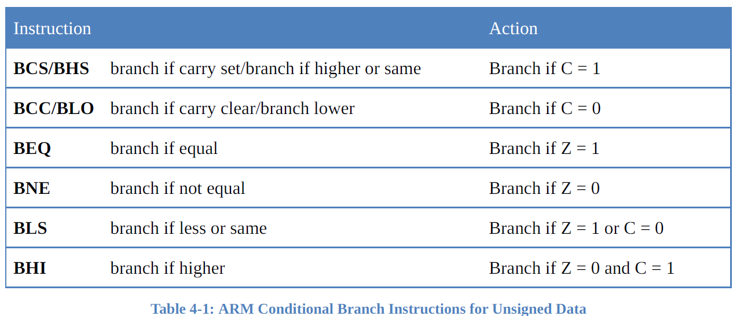
Classification of embedded system
Branch, Call, and Looping in ARM
Other conditional Branches

Slide 42
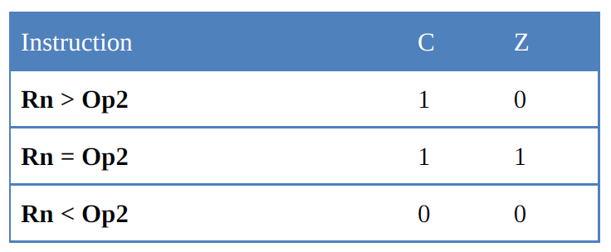
Classification of embedded system
Branch, Call, and Looping in ARM
Comparison of unsigned numbers
CMP Rn,Op2 ;compare Rn with Op2 and set the flags
The CMP instruction compares two operands and changes the flags according to the result of the comparison.
The operands themselves remain unchanged.
There is no destination register and the second source operands can be a register or an immediate value not larger than 0xFF

Slide 43
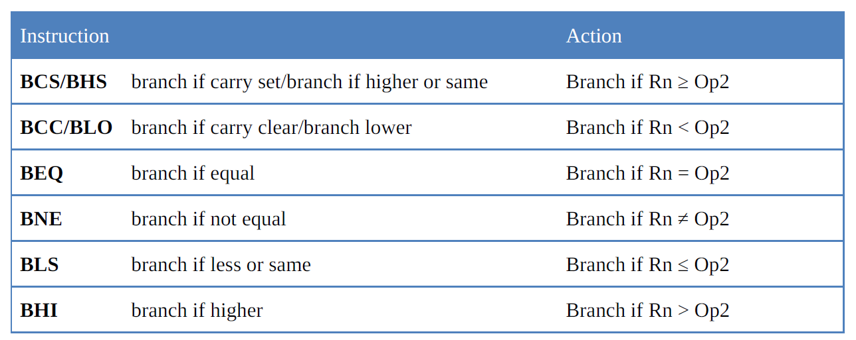
Branch, Call, and Looping in ARM
Although BCS (branch carry set) and BCC (branch carry clear) check the carry flag and can be used after a compare instruction, it is recommended that BHS (branch higher or same) and BLO (branch below) be used for two reasons.
One reason is that assemblers will unassemble BCS as BLO, and BCC as BHS, which may be confusing to beginner programmers.
Another reason is that “branch higher” and “branch below” are easier to understand

Slide 44
Division of unsigned numbers in ARM
The older ARM family members do not have an instruction for division of unsigned Numbers
In ARMs with no divide instructions, we can use SUB instruction to perform the division
AREA PROG_4_2, CODE, READONLY ;Division by subtractions
ENTRY
LDR R0,=2012 ;R0 = 2012 (numerator )
MOV R1,#10 ;R1 = 10 ( denominator )
MOV R2,#0 ;R2 = 0 ( quotient )
L1 CMP R0,R1 ;Compare R0 with R1 to see if less than 10
BLO FINISH ;if R0 < R1 jump to finish
SUB R0,R0,R1 ;R0 = R0 - R1 (division by subtraction)
ADD R2,R2,#1 ;R2 = R2 + 1 (quotient is incremented)
B L1 ;goto L1 (B is discussed in the next section)
FINISH B FINISH

Slide 45
Classification of embedded system
Branch, Call, and Looping in ARM
TST (Test)
TST Rn,Op2 ;Rn AND with Op2 and flag bits are updated
The TST instruction is used to test the contents of register to see if any bit is set to HIGH.
After the operands are ANDed together the flags are updated
if result is zero, then Z flag is raised and one can use BEQ (branch equal) to make decision.
MOV R0,#0x04 ;R0=00000100 in binary
LDR R1,=myport ;port address
OVER LDRB R2,[R1] ;load R2 from myport
TST R2,R0 ;is bit 2 HIGH?
BEQ OVER ;keep checking

Slide 46
Classification of embedded system
Branch, Call, and Looping in ARM
TEQ (test equal)
TEQ Rn,Op2 ;Rn EX-ORed with Op2 and flag bits are set
The TEQ instruction is used to test to see if the contents of two registers are equal.
The source operands are Ex-ORed together the flag bits are set according to the result. if result is 0, then Z flag is raised and one can use BEQ (branch zero) to make decision.
TEMP EQU 100
MOV R0,#TEMP ;R0 = Temp
LDR R1,=myport ;port address
OVER LDRB R2,[R1] ;load R2 from myport
TEQ R2,R0 ;is it 100?
BNE OVER ;keep checking

Slide 47
Classification of embedded system
Unconditional branch (jump) instruction
The unconditional branch is a jump in which control is transferred unconditionally to the target location.
In the ARM there are two unconditional branches: B (branch) and BX (branch and exchange).
B (Branch): B (branch) is an unconditional jump that can go to any memory location in the 32M byte address space of the ARM.
CMP R1,R2
BHS L1
MOV R3,#2
B OVER
L1 MOV R3,#5
OVER
HERE B HERE ;stay here
HERE BAL HERE ;stay here

Slide 48
Classification of embedded system
Calling Subroutine with BL
Another control transfer instruction is the BL (branch and link) instruction, which is used to call a subroutine.
Subroutines are often used to perform tasks that need to be performed frequently. This makes a program more structured in addition to saving memory space.
In the ARM there is only one instruction for call and that is BL (branch and link).
To use BL instruction for call, we must leave the R14 register unused since that is where the ARM CPU stores the address of the next instruction where it returns to resume executing the program.

Slide 49
Classification of embedded system
Calling Subroutine with BL
BL (Branch and Link) instruction and calling subroutine
In the 32-bit instruction BL, 8 bits are used for the opcode and the other 24 bits, k23–k0, are used for the address of the target subroutine
BL can be used to call subroutines located anywhere within the 32M address space of the ARM
To make sure that the ARM knows where to come back to after execution of the called subroutine, the ARM automatically saves in the link register (LR), the R14, the address of the instruction immediately below the BL.

Slide 50
Classification of embedded system
Calling Subroutine with BL
When a subroutine is called by the BL instruction, control is transferred to that subroutine, and the processor saves the PC (program counter) in the R14 register and begins to fetch instructions from the new location.
After finishing execution of the subroutine, we must use “BX LR“ instruction to transfer control back to the caller.
Every subroutine needs “BX LR” as the last instruction for return address.

Slide 51
Classification of embedded system
Calling Subroutine with BL
Write a program to toggle all the bits of address 0x40000000 by sending to it the values 0x55 and 0xAA continuously. Put a time delay between each issuing of data to address location.
Solution:
AREA EXAMPLE4_8, CODE, READONLY
ENTRY
RAM_ADDR EQU 0x40000000 ;change the address for your ARM
LDR R1,=RAM_ADDR ;R1 = RAM address
AGAIN MOV R0,#0x55 ;R0 = 0x55
STRB R0,[R1] ;send it to RAM
BL DELAY ;call delay (R14 = PC of next instruction)
MOV R0,#0xAA ;R0 = 0xAA
STRB R0,[R1] ;send it to RAM
BL DELAY ;call delay
B AGAIN ;keep doing it
;––––––—DELAY SUBROUTINE

Slide 52
Classification of embedded system
Calling Subroutine with BL
DELAY LDR R3,=5 ;R3 =5, modify this value for different size delay
L1 SUBS R3,R3,#1 ;R3 = R3 - 1
BNE L1
BX LR ;return to caller
;––––––—end of DELAY subroutine
END ;notice the place for END directive
In above program, in place of “BX LR” for return, we could have used “BX R14”, “MOV R15,R14”, or “MOV PC, LR” instructions. All of them do the same thing; but it is recommended to use the “BX LR” instruction.

Slide 53
Classification of embedded system
ALP for Factorial
AREA factorial, CODE, Readonly ;program to find factorial
MOV R0,#5 ;int c =1
MOV R1,#1 ;int n=1
CMP R0,#0
BEQ STOP
MOV R1,R0
NEXT SUBS R0,#01
CMP R0,#01
BEQ STOP
MUL R2,R1,R0
MOV R1,R2
B NEXT
STOP NOP
L B L
END

