Slide 1
Agile Modeling and XP

Slide 2
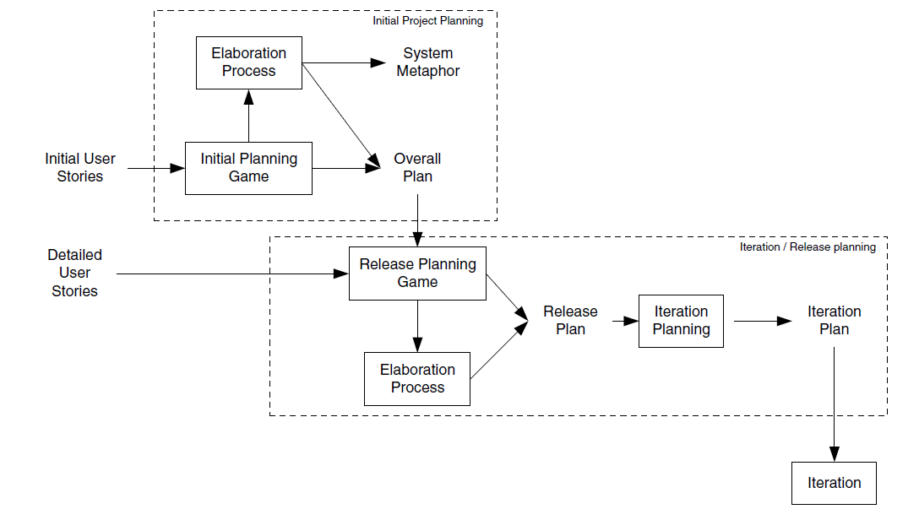
Planning aspects of XP project life cycle

Slide 3
Agile Modelling and Planning XP Projects
We will consider how and where Agile Modelling fits into the project-planning aspects of an XP project.
An XP project is planned at a number of levels and at various points during an XP projects lifetime
This means that Agile Modelling practises may be more or less relevant at different stages during this process.
We will consider the planning process and where Agile Modelling can be exploited to the benefit of XP.

Slide 4
Agile Modelling and Planning XP Projects Contd..
Initial planning game. During this process, business and development may resort to modelling to help them clarify the user stories.
By applying Agile Modelling practises, this modelling can be controlled and focused.
An example of where they might do this is when a User Interface mock up might be created, with some simple flowcharts to prototype system behaviour as a way of elaborating a user story.

Slide 5
Agile Modelling and Planning XP Projects Contd..
Iteration/Release Planning
During the iteration/release planning stages, modelling is again important.
Release planning game. As with the initial planning game, Agile Modelling practises can help focus the modelling activities used to clarify user requirements.
Elaboration process. Although this is typically a shorter process than for the initial project planning phase, some modelling often still takes place and Agile Modelling can be applied to ensure that modelling does not become a burden
Iteration planning. In order to break down user stories into tasks, it may be necessary to model how the user stories might be implemented.
This might involve initial class structures, behaviour, etc.
This can allow tasks to be identified, clarified or split up. Note that this is not large up-front design, as the models may be discarded and may only be intended to help elaborate the tasks.

