Slide 1
DSDM

Slide 2
DSDM or The Dynamic Systems Development Method
DSDM or The Dynamic Systems Development Method provides a framework of controls and best practice for Rapid Application Development (RAD).
It is particularly suitable for application development projects that need to develop complex business solutions within tight timeframes.
In DSDM, time is fixed for the life of a project, and resources are fixed as far as possible.

Slide 3
DSDM is based on nine overriding principles, these are:
1. Active user involvement is imperative.
2. The team must be empowered to make decisions.
3. The focus is on frequent delivery of products.
4. Fitness for business purpose is the essential criterion for acceptance of deliverables.
5. Iterative and incremental development is necessary to converge on an accurate business solution.
6. All changes during development are reversible.
7. Requirements are base lined at a high level.
8. Testing is integrated throughout the life cycle.
9. Collaboration and cooperation between all stakeholders is essential.

Slide 4
The key users within a DSDM
project are know as Ambassador Users. Ambassador Users
They have an ambassadorial role between the project team and the actual end users.
They promote two-way communication and compromise between the end user community and the project development team.
DSDM promotes the use of Facilitated Workshops

Slide 5
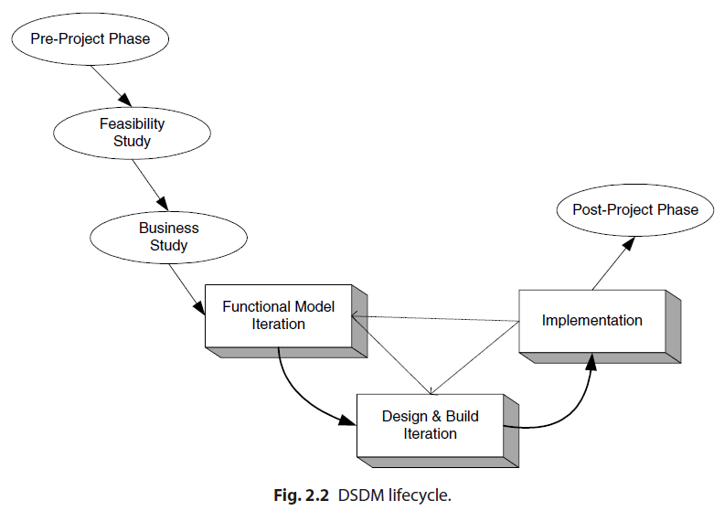
DSDM LIFE CYCLE

Slide 6
DSDM LIFE CYCLE (Contd..)
The first three phases (namely, the Pre-Project, Feasibility and Business Studies phases) are done sequentially in order.
These phases set the ground rules for the rest of development process allowing users and teams to understand the world within which the application must execute as well as what will be expected of the end product.

Slide 7
DSDM LIFE CYCLE (Contd..)
The Feasibility Study phase is expected only to last a few weeks.
The output of this phase is a “feasibility report” that assesses whether or not to use DSDM for the particular project.

Slide 8
DSDM LIFE CYCLE (Contd..)
The Business Study phase of the project should have three outputs;
Business Area Definition. Identifies the high-level requirements and provides a process description of the end product.
System Architecture Definition. Sketches out the architecture of end system. Note that it is likely that this will evolve over the life of the project.
Outline Prototyping Plan. This states the prototyping strategy to be adopted for the development of the end product.

Slide 9
DSDM LIFE CYCLE (Contd..)
The FMI Phase involves:
Analysis of the features to be designed and implemented.
The production of the Functional Model. This is the primary output of this phase. It may include prototype code as well as analysis models.
Coding and prototyping. Prototypes may be used to help improve the analysis or understanding of the system. These prototypes may continue to evolve (particularly in the next phase) until the quality level achieved is high enough that they can be used in the delivered system.

Slide 10
DSDM LIFE CYCLE (Contd..)
The DBI Phase involves:
Designing and Building the features to be implemented during this phase. This involves reviewing the designs produced so far, the functional prototypes, as well as the creation of code to implement the required functionality.
The primary output of this state is the tested system. This system must meet all the requirements selected as essential in the particular iteration being implemented.
The Implementation Phase involves:
The transfer of the completed system from the development environment to the production environment.
The provision of other deliverables such as User training, the creation of the User Manual and the Project Review Report. If issues arise, then the project can be reiterated back to the appropriate phase.

Slide 11
The core three phases, the FMI, the DBI and the Implementation Phase are expected to be iterative and incremental.
DSDM refines the concept of time boxing by nesting shorter time boxes of 2–6 weeks within the overall time frame.
Each time box will typically pass through three phases.
Investigation – a quick pass to see whether the team is taking the right direction.
Refinement – to build on the comments resulting from the review at the end of investigation.
Consolidation – the final part of the time box to tie up any loose ends.

Slide 12
The prioritisation of the requirements throughout the timebox is checked and possibly reassigned using the MoSCoW Rules.
MoSCoW stands for:
Must haves: fundamental to the projects success “on time”
Should haves: important but the projects success does not rely on these
Could haves: can easily be left out without impacting on the project “on budget”
Won’t have this time round: can be left out this time and done at a later date
A clear prioritisation is developed ensuring that the essential work is completed within the given timeframe.

