Slide 1
UNIT-III INTRODUCTION

Slide 2
Robotics Terminology
Robot: An electromechanical device with multiple degrees-of-freedom (DOF) that is programmable to accomplish a variety of tasks.
Industrial robot:The Robotics Industries Association (RIA) defines robot in the following way:
“An industrial robot is a programmable, multi-functional manipulator designed to move materials, parts, tools, or special devices through variable programmed motions for the performance of a variety of tasks”

Slide 3
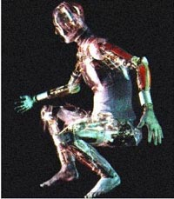
Robotics Terminology
Robotics: The science of robots. Humans working in this area are called roboticists.

Slide 4
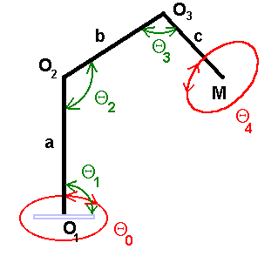
Robotics Terminology
DOF degrees-of-freedom: the number of independent motions a device can make. (Also called mobility)
this is the number of independent movements the end effectors can make along the axes of its coordinate system. For example, movement along the X Y Z coordinates only constitutes 3 DoF, whilst adding rotation around the Z axis equals 4 DoF.
five degrees of freedom

Slide 5
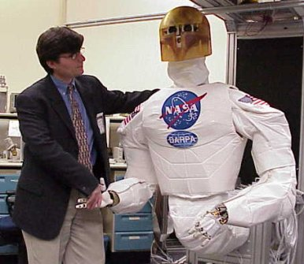
Robotics Terminology
Anthropomorphic: Like human beings.
ROBONAUT (ROBOtic astroNAUT), an anthropomorphic robot with two arms,
two hands, a head, a torso, and a stabilizing leg.

Slide 6
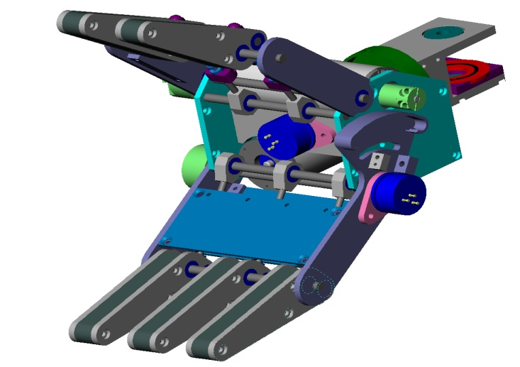
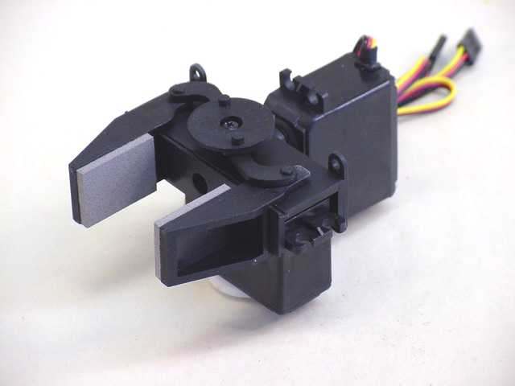
Robotics Terminology
End-effector: The tool, gripper, or other device mounted at the end of a manipulator, for accomplishing useful tasks.
End effector also known as end of arm tooling, this is the ‘hand’ attached to the end of the robot arm or wrist. End effectors include grippers, vacuum cups, spray guns, welding tools and electro-magnetic pick-ups, their performance being vital to precision and repeatability.

Slide 7
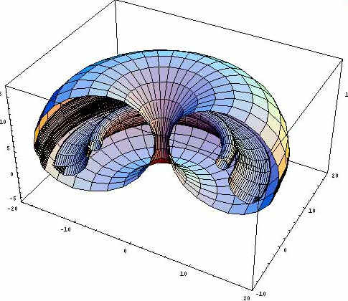
Robotics Terminology
Workspace: The volume in space that a robot’s end-effector can reach, both in position and orientation.
A cylindrical robots’ half workspace

Slide 8
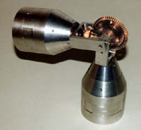
Robotics Terminology
Position: The translational (straight-line) location of something.
Orientation: The rotational (angle) location of something. A robot’s orientation is measured by roll, pitch, and yaw angles.
Link: A rigid piece of material connecting joints in a robot.
Joint: The device which allows relative motion between two links in a robot.
A robot joint

Slide 9
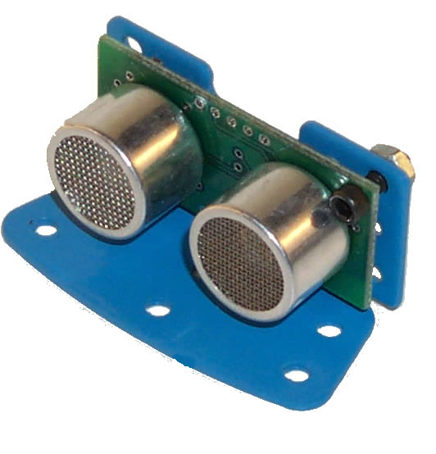
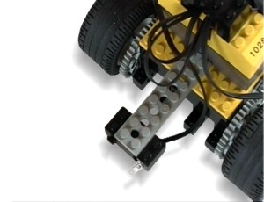
Robotics Terminology
Kinematics: The study of motion without regard to forces. is the actual arrangement of joints/axes and rigid links in the robot, as well as being the study of motion in robotics. Common robot kinematics, or configurations, include Cartesian, Articulated, Parallel and SCARA.
Dynamics: The study of motion with regard to forces.
Actuator: Provides force for robot motion.
Sensor: Reads variables in robot motion for use in control.

Slide 10
Robotics Terminology
Speed
The amount of distance per unit time at which the robot can move, usually specified in inches per second or meters per second.
The speed is usually specified at a specific load or assuming that the robot is carrying a fixed weight.
Actual speed may vary depending upon the weight carried by the robot.
Load Bearing Capacity
The maximum weight-carrying capacity of the robot.
Robots that carry large weights, but must still be precise are expensive.

Slide 11
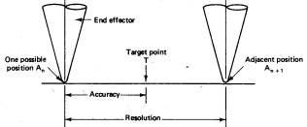
Spatial Resolution
Smallest increment of motion at the wrist end that can be controlled by the robot
Depends on the position control system, feedback measurement, and mechanical accuracy

Slide 12
Accuracy
Capability to position the wrist at a target point in the work volume
The ability of a robot to go to the specified position without making a mistake. Accuracy is therefore defined as the ability of the robot to position itself to the desired location with the minimal error (usually 25 μm).
• One half of the distance between two adjacent resolution points
• Affected by mechanical Inaccuracies
• Manufacturers don’t provide the accuracy (hard to control)

Slide 13
Repeatability: It is the ability of the robot to position the end effector to the previously positioned location.
The ability of a robot to repeatedly position itself when asked to perform a task multiple times.
Accuracy is an absolute concept, repeatability is relative.
A robot that is repeatable may not be very accurate, visa versa.

Slide 14
Weight Carrying Capacity
• The lifting capability provided by manufacturer doesn’t include the weight of the end effector
• Usual Range 2.5lb-2000lb
• Condition to be satisfied:
Load Capability > Total Wt. of workpiece +Wt. of end effector + Safety range

Slide 15
Speed of Movement
Speed with which the robot can manipulate the end effector
•Acceleration/deceleration times are crucial for cycle time.
•Determined by
–Weightoftheobject –Distancemoved – Precision with which object must be positioned

Slide 16
Axis/axes – an axis is a line across which a rotating body turns. Two axes are required to reach any point in a straight plane, while three axes (X Y Z) are needed to reach any point in space. Three further axes (roll, pitch and yaw) are needed to control the orientation of the end of the robot arm or wrist.
Axes that allow rotations are known as revolute joints
Axes that allow movement in a straight line are known as prismatic joints

Slide 17
Joints – robot joints are described as either rotational or translational. Rotational joints have a rotary action along the joint axis and are also referred to as revolute. Translational joints have a linear or sliding motion along the joint axis and are also known as prismatic.
Actuators – also referred to as drives, these are devices that convert electrical, hydraulic and pneumatic energy into robot motion. Nowadays, actuators are typically fast, accurate AC servo drives, while the robot base rotates using a harmonic drive or, less commonly, ring gear.
Work envelope – this is the total volume of space that the end effector of the manipulator can reach and is also known as workspace and work volume. The size and shape of the work envelope is determined by the robot kinematics and the number of DoF; it should be large enough to accommodate all the points the end effector needs to reach.

Slide 18
The operating and performance parameters against which any particular configuration and type is specified:
Payload (kg) – maximum load or carrying capacity, including weight of the end effector.
Reach (mm) – the maximum distance a robot can extend its arm to perform a task.
Speed (mm/sec) – how fast a robot can position its end effector or rotate an axis (deg/sec).
Acceleration (mm/sec) – defines how quickly an axis can accelerate to top speed.
Accuracy (± mm) – how closely a robot can move to specified place in the work envelope.
Repeatability (± mm) – how precisely a robot can return repeatedly to a given position.
Mounting – robots can also be ceiling or wall mounted, freeing up effective workspace.
Footprint (m2) – installation space required, often minimised by overhead or wall mounting.
Cycle Time (secs) – cumulative time for completing one full set of process operations.

Slide 19
What is a joint?
A joint of robot is similar to a joint in the human body
Each joint gives the robot with a degree-of-freedom(d.o.f)of motion
In the nearly all cases, only 1 d.o.f is allowed to a joint

Slide 20
What is a robot link?
Links are rigid components that form a chain connected together by joints
Each joint has two links, known as an input link and an output link

Slide 21
Types of robot joints
Linear joint
Orthogonal joint
Rotational joint
Twisting joint
Revolving joint

Slide 22
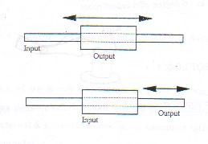
Linear joint
The relative movement
between the input link
and the output link is a
linear sliding motion,
with the axes of the two
links being parallel

Slide 23
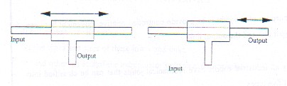
Orthogonal joint
This is also linear
sliding motion, but the
input and output links
are perpendicular to
each other during the
move

Slide 24
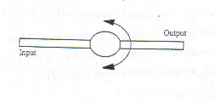
Rotational joint
This type provides a
rotational relative
motion of the joints, with
the axis of rotation
perpendicular to the
axes of the input and
output links

Slide 25
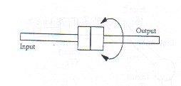
Twisting joint
This joint also involves
a rotary motion, but the
axis of rotation is
parallel to the axes of
the two links

Slide 26
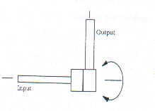
Revolving joint
In this types, the axis of
the input link is parallel
to the axis of rotation of
the joint, and the axis of
the output link is
perpendicular to the
axis of rotation

Slide 27
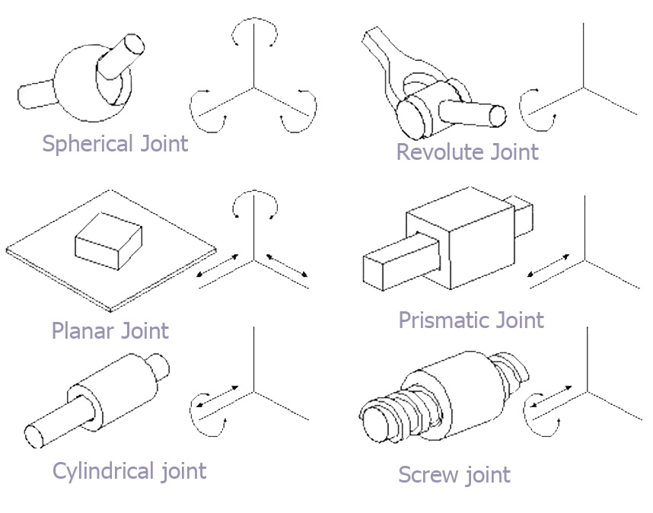

Slide 28
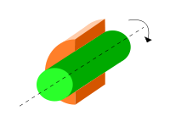
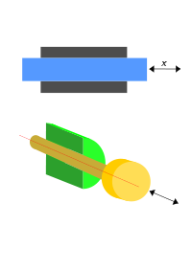
Revolute joint
A revolute joint (also called pin joint or hinge joint) is a
one degree of freedom kinematic pair used in mechanisms.
Revolute joints provide single-axis rotation function
Prismatic joint
A prismatic joint (also called sliders) is a one degree of freedom kinematic pair used in mechanisms. Prismatic joints provide single-axis sliding function

Slide 29
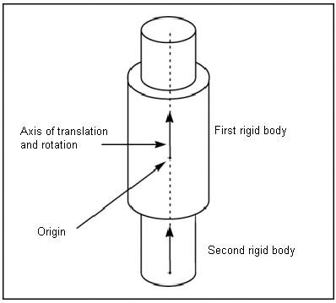
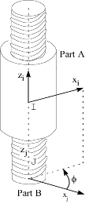
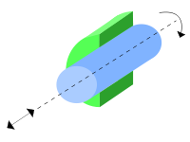
Cylindrical joint
A cylindrical joint is a two degrees of freedom kinematic pair used in mechanisms. Cylindrical joints provide single-axis sliding function as well as a single axis translation, providing a way for two rigid bodies to translate and rotate freely.
Screw joint
A screw joint is a one degree of freedom kinematic pair used in mechanisms. Screw joints provide single-axis translation by utilizing the threads of the threaded rod to provide such translation.

Slide 30
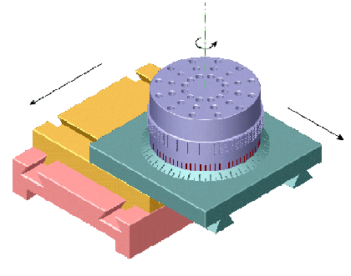
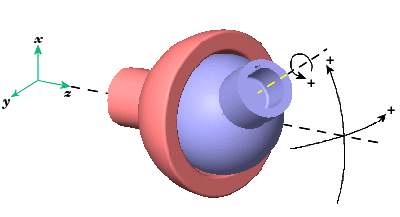
Planar joint
A planar joint represent composite joint with two translational DOF’s and one rotational DOF, with rotational axis orthogonal to plane of translational axes
Spherical joint
The Spherical block represents three rotational degrees of freedom (DoFs) at a single pivot point, a "ball-in-socket" joint. Two rotational DoFs specify a directional axis, and a third rotational DoF specifies rotation about that directional axis. The sense of each rotational DoF is defined
by the right-hand rule, and the three rotations together form a right-handed system.

Slide 31
Industrial Robotics
Sections:
Robot Anatomy
Robot Control Systems
End Effectors
Industrial Robot Applications

Slide 32
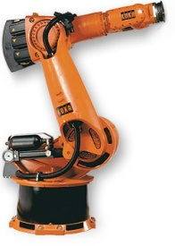
Robot Anatomy
Manipulator consists of joints and links
Joints provide relative motion
Links are rigid members between joints
Various joint types: linear and rotary
Each joint provides a “degree-of-freedom”
Most robots possess five or six degrees-of-freedom
Robot manipulator consists of two sections:
Body-and-arm – for positioning of objects in the robot's work volume
Wrist assembly – for orientation of objects
Link3
Joint3
End of Arm
Link2
Link1
Joint2
Joint1
Link0
Base

Slide 33

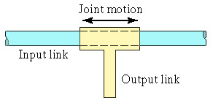
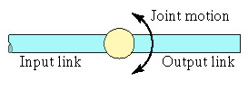
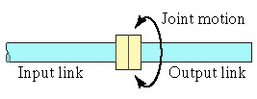
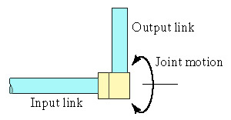
Manipulator Joints
Translational motion
Linear joint (type L)
Orthogonal joint (type O)
Rotary motion
Rotational joint (type R)
Twisting joint (type T)
Revolving joint (type V)

Slide 34
Need, Scope and Limitations of Robots:
The world needs robots for a countless number of reasons, including hazardous jobs and automated manufacturing.
Robots work without breaks or the need to sleep or eat, allowing manufactures to streamline processes and improve output. Robots are employed in roles ranging from cleaning up dangerous waste and chemical spills to disarming bombs and protecting soldiers in the field.
New, humanoid robots originally designed for military use, are now being developed in the private sector for uses ranging from manual labor to helping those with handicaps and mobility issues.

Slide 35
Need, Scope and Limitations of Robots:
Robots also provide a level of precision that is unmatched by the human hand, and one which is repeatable over indefinite time frames.
These characteristics make them ideal for precision cutting, welding and assembly processes. Robots are also revolutionizing medical procedures, allowing many types of surgery to be performed with non-invasive, out-patient procedures, as opposed to traditional procedures requiring longer recovery times.
Medical robots are now so advanced that they are being employed in brain, heart and eye surgeries, allowing doctors to treat conditions that were previously only possible through treatments nearly as dangerous as the offending condition.

Slide 36
Robot Classification Based On Kinematic Structure: Body-Arm Configuration:
Normally, robot manipulators are classified
according to their arm geometry or kinematic
structure. The majority of these manipulators fall into one of these five configuration:
Cartesian Type Configuration (PPP)
Cylindrical Type Configuration (RPP)
Spherical Type Configuration (RRP)
SCARA Type Configuration (RRP or PRR)
Revolute Type Configuration (RRR)

Slide 37
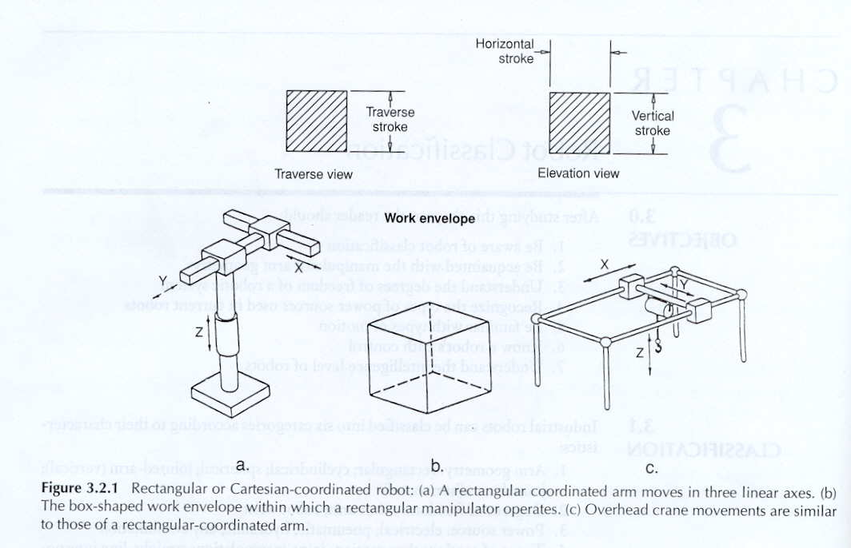
Cartesian Type Configuration (PPP)

Slide 38
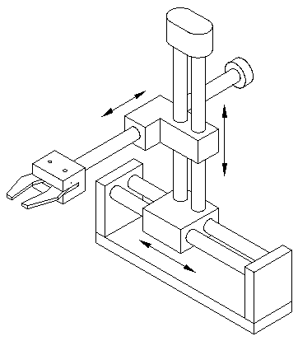
Cartesian

Slide 39
Manipulator whose first three joints are prismatic are known as a Cartesian manipulator.. Cartesian manipulator are useful for table‑top assembly applications and, as gantry robots for transfer of material and cargo
Advantages:
- 3 linear axes
- Easy to visualize
- Rigid structure
- Easy to program off‑line
- Linear axes make for easy mechanical stops
Disadvantage:
- Can only reach in front of itself
- Requires large floor space for size of work envelop
- Axes hard to seal

Slide 40
APPLICATION:
PICK-AND-PLACE OPERATIONS.
ADHESIVE APPLICATIONS(MOSTLY LONG AND STRAIGHT).
ADVANCED MUNITION HANDLING.
ASSEMBLY AND SUBASSEMBLY(MOSTLY STRAINGHT).
AUTOMATED LOADING CNC LATHE AND MILLING OPERATIONS.
NUCLEAR MATERIAL HANDLING.
WELDING.

Slide 41

Cylindrical Type Configuration (RPP)
For cylindrical type manipulator, its first joint is revolute which produces a rotation about the based, while its second and third joints are prismatic.
Advantages:
- 2 linear axes, 1 rotating axis
- Can reach all around itself
- Reach and height axes rigid
- Rotational axis easy to seal.
Disadvantages:
- Cannot reach above itself
- Base rotation axis is less rigid than a linear axis
- Linear axes hard to seal
- Will not reach around obstacles
- Horizontal motion is circular

Slide 42
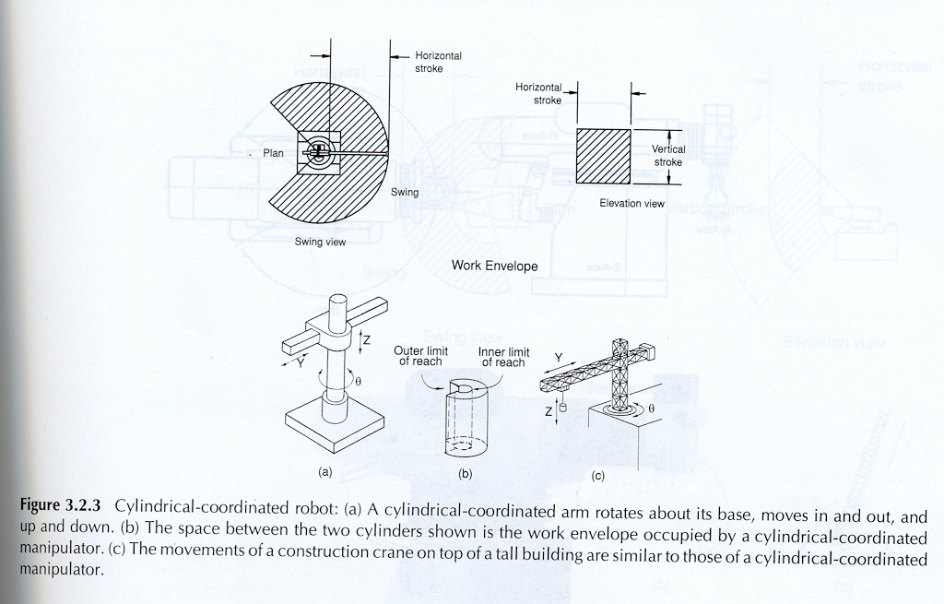
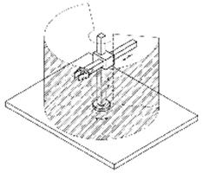

Slide 43
APPLICATION:
ASSEMBLY
COATING APPLICATIONS.
CONVEYOR PALLET TRANSFER.
DIE CASTING.
FOUNDARY AND FORGING APPLICATIONS.
INSPECTION MOULDING.
INVESTMENT CASTING.
MACHINE LOADING AND UNLOADING.

Slide 44
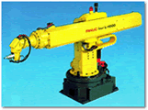
Spherical Type Configuration (RRP)
The first two joints of this type of manipulators are revolute, while its third Joint is prismatic.
Advantages:
- 1 linear axis, 2 rotating axes
- Long horizontal reach
Disadvantages:
- Cannot reach around obstacles
- Generally has short vertical reach

Slide 45
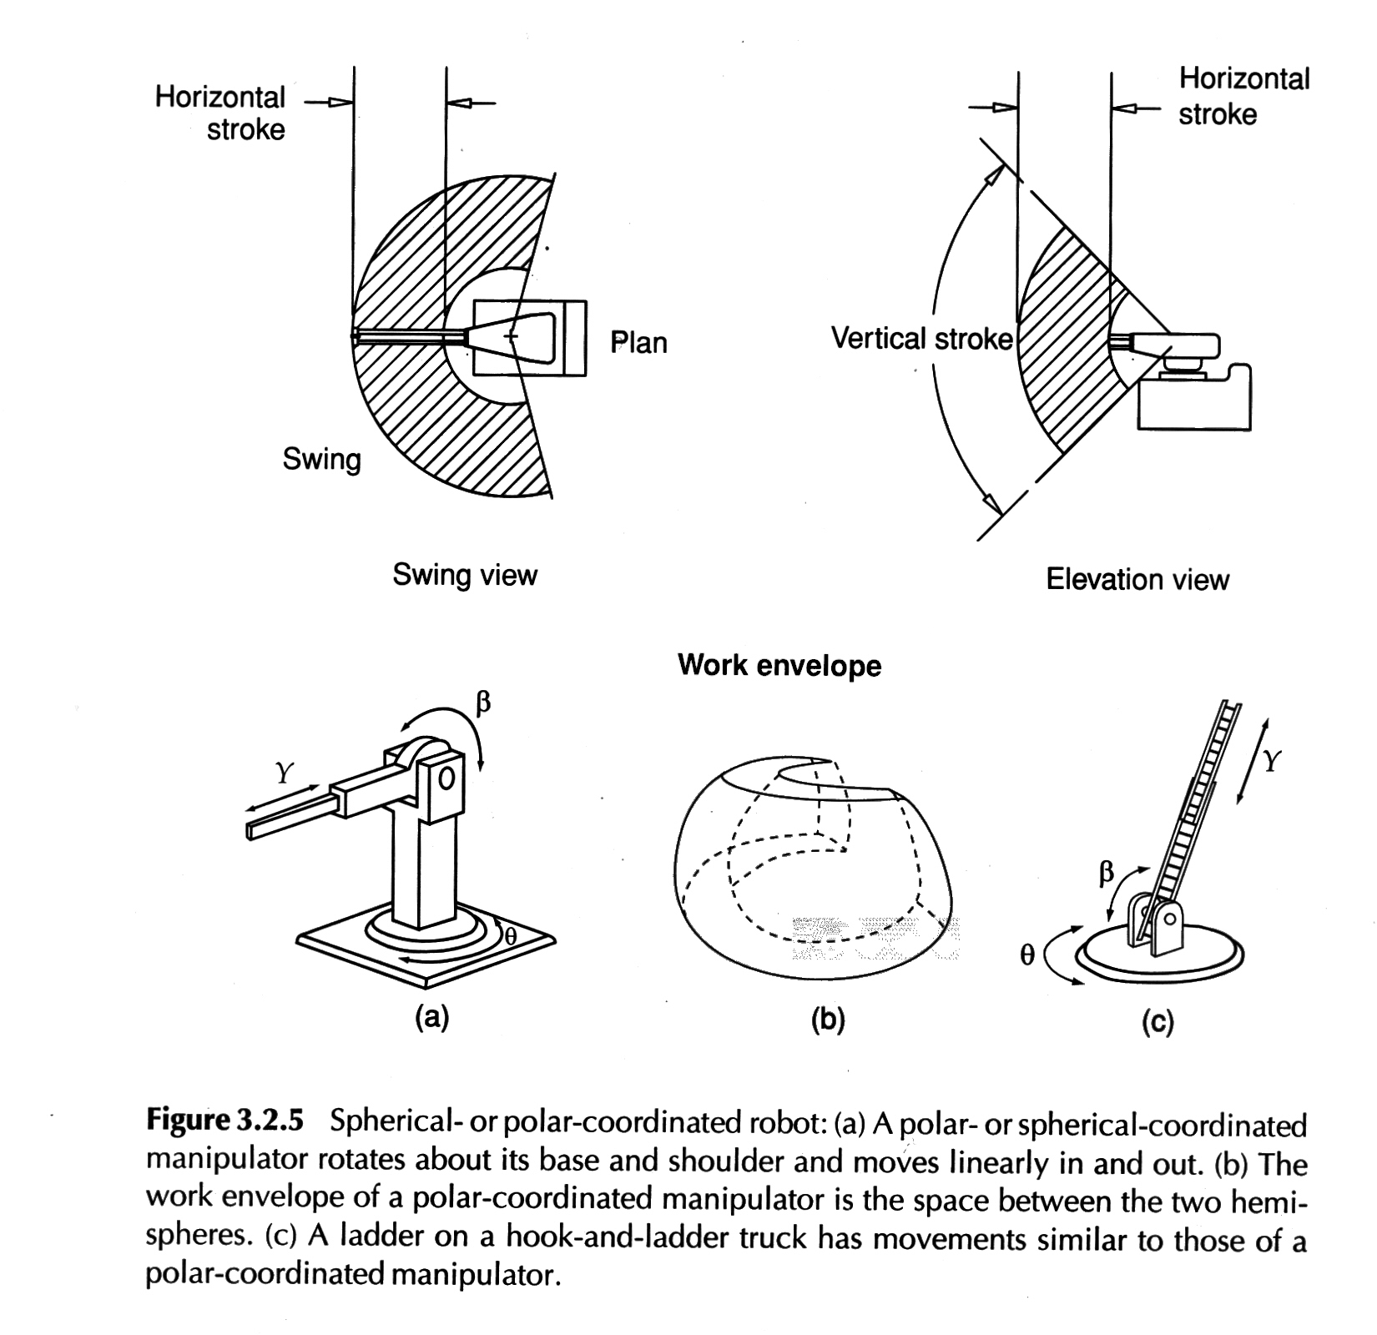
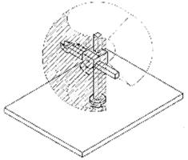

Slide 46
APPLICATIONS:
DIE CASTING
DIP COATING
FORGING
GLASS HANDLING
HEAT TREATING
INJECTION MOLDING
MACHINE TOOL HANDLING
MATERIAL TRANSFER
PARTS CLEANING
PRESS LOADING
STACKING AND UNSTICKING.

Slide 47
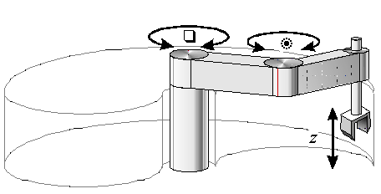
SCARA Type Configuration (RRP or PRR)
The word SCARA stands for Selective Compliance Articulated Robot for Assembly. There are two type of SCARA robot configuration: either the first two joints are revolute with the third joint as prismatic, or the first joint is revolute with the second and third Joints as prismatic.
Advantages:
- 1 linear axis, 2 rotating axes
- Height axis is rigid
- Large work area floor space
- Can reach around obstacles
- Two ways to reach a point
Disadvantages:
- Difficult to program off‑line
- Highly complex arm

Slide 48
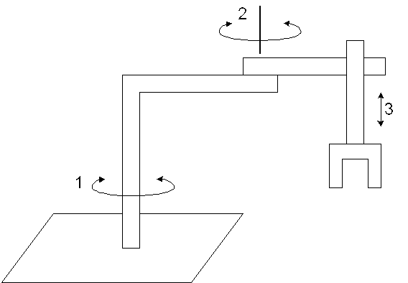
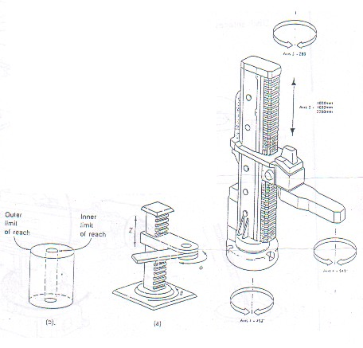
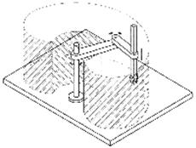

Slide 49
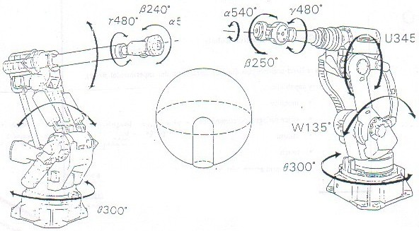
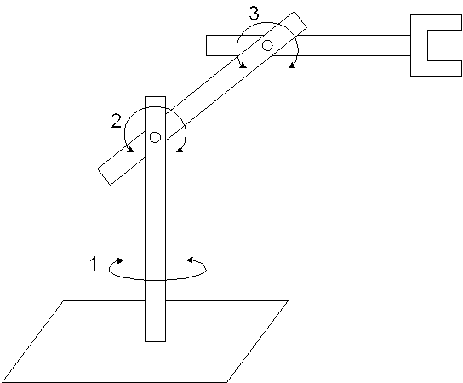
Revolute Type Configuration (RRR)

Slide 50

Revolute Type Configuration (RRR)
Revolute manipulator is also called articulated or anthromorphic manipulator. These type of robot resembles human arm. Two common revolute designs are the elbow type manipulator such as the PUMA and the parallelogram linkage such as the Cincinnati Milacron T3 735.
Advantages:
- 3 rotating, axes
- Can reach above or below obstacles
- Largest work area for least work space
- Two or four ways to reach a point
Disadvantages:
- Difficult to program off‑line
- The most complex manipulator

Slide 51
Configuration | Advantages | Disadvantages
Cartesian coordinates | 3 linear axes, easy to visualize, rigid structure, easy to program | Can only reach front of itself, requires large floor space, axes hard to seal
Cylindrical coordinates | 2 linear axes +1 rotating, can reach all around itself, reach and height axes rigid, rotational axis easy to seal | Can’t reach above itself, base rotation axis as less rigid, linear axes is hard to seal, won’t reach around obstacles
SCARA coordinates | 1 linear + 2 rotating axes, height axis is rigid, large work area for floor space | 2 ways to reach point, difficult to program off-line, highly complex arm
Spherical coordinates | 1 linear + 2 rotating axes, long horizontal reach | Can’t reach around obstacles, short vertical reach
Revolute coordinates | 3 rotating axes can reach above or below obstacles, largest work area for least floor space | Difficult to program off-line, 2 or 4 ways to reach a point, most complex manipulator

Slide 52
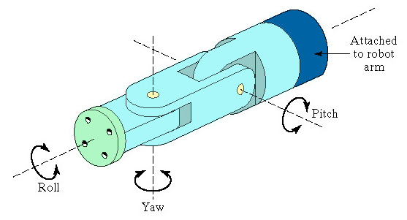
Wrist Configurations:
Wrist assembly is attached to end-of-arm
End effector is attached to wrist assembly
Function of wrist assembly is to orient end effector
Body-and-arm determines global position of end effector
Two or three degrees of freedom:
Roll
Pitch
Yaw
Notation :RRT

Slide 53
Examples:
Q. Sketch following manipulator configurations
(a) TRT:R, (b) TVR:TR, (c) RR:T.
Solution:

Slide 54
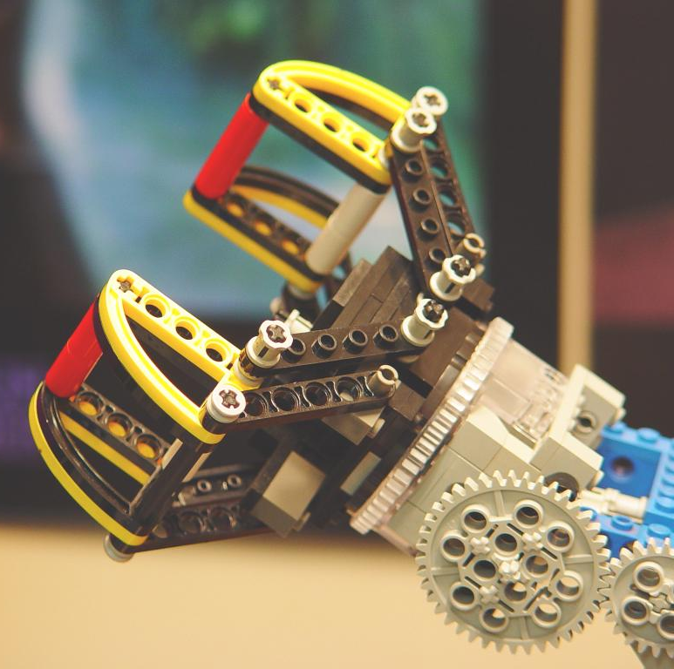
End Effectors
The special tooling for a robot that enables it to perform a specific task
Two types:
Grippers – to grasp and manipulate objects (e.g., parts) during work cycle
Tools – to perform a process, e.g., spot welding, spray painting

Slide 55
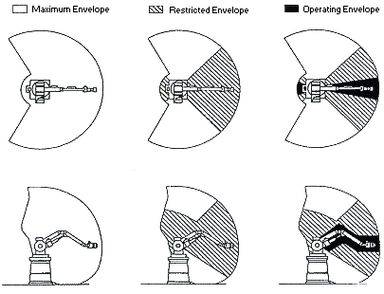
Working Envelope

Slide 56
♦Forward Kinematics:
to determine where the robot’s hand is?
(If all joint variables are known)
♦Inverse Kinematics:
to calculate what each joint variable is?
(If we desire that the hand be
located at a particular point)

Slide 57
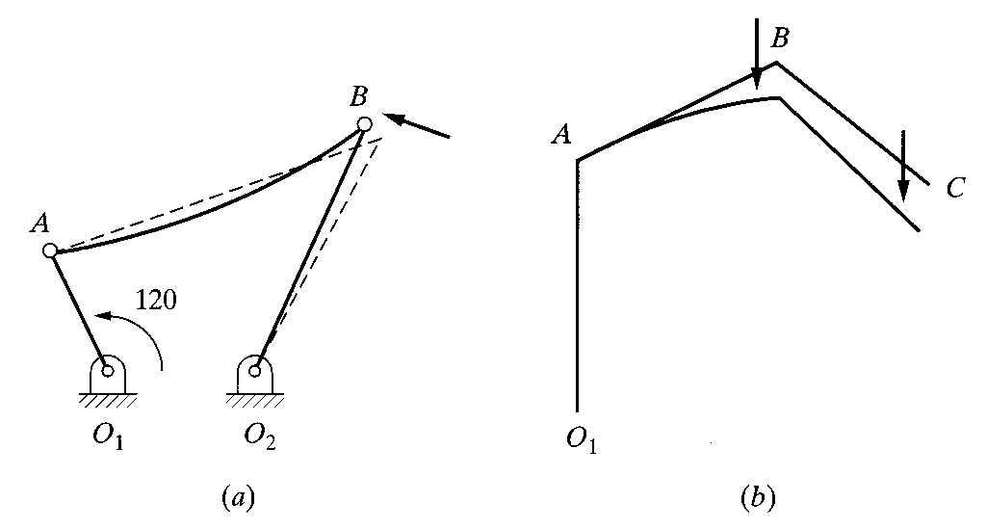
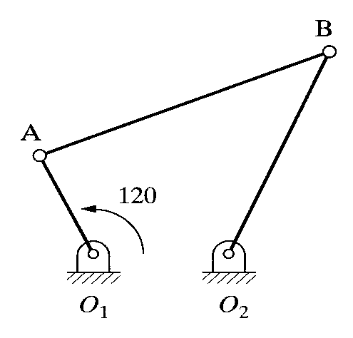
2.2 ROBOTS AS MECHANISM
♦Multiple type robot have multiple DOF.
(3 Dimensional, open loop, chain mechanisms)
Fig. 2.1 A one-degree-of-freedom closed-loop
four-bar mechanism
Fig. 2.2 (a) Closed-loop versus (b) open-loop mechanism

Slide 58
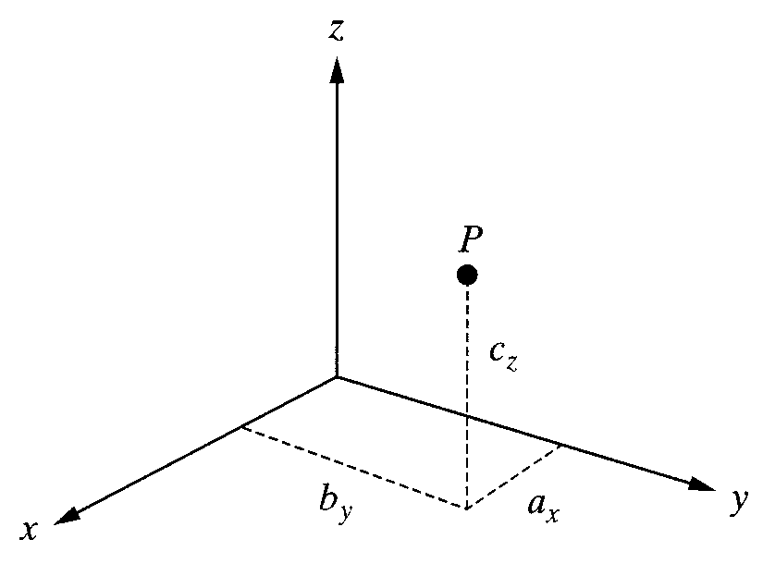
Robot Kinematics: Position Analysis
2.3 MATRIX REPRESENTATION
2.3.1 Representation of a Point in Space
♦A point P in space :
3 coordinates relative to a reference frame
Fig. 2.3 Representation of a point in space

Slide 59
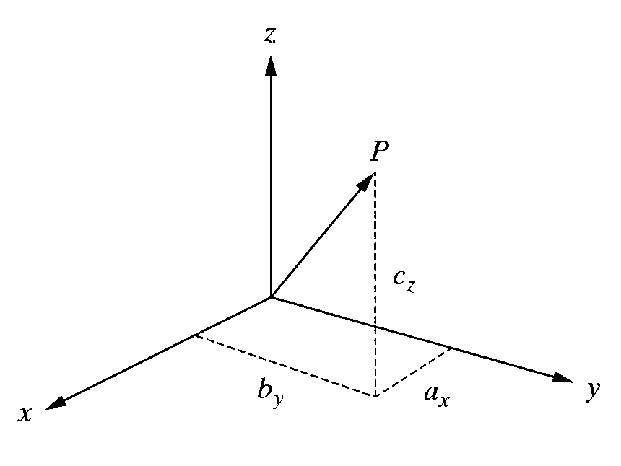
Robot Kinematics: Position Analysis
2.3 MATRIX REPRESENTATION
2.3.2 Representation of a Vector in Space
♦A Vector P in space :
3 coordinates of its tail and of its head
Fig. 2.4 Representation of a vector in space

Slide 60
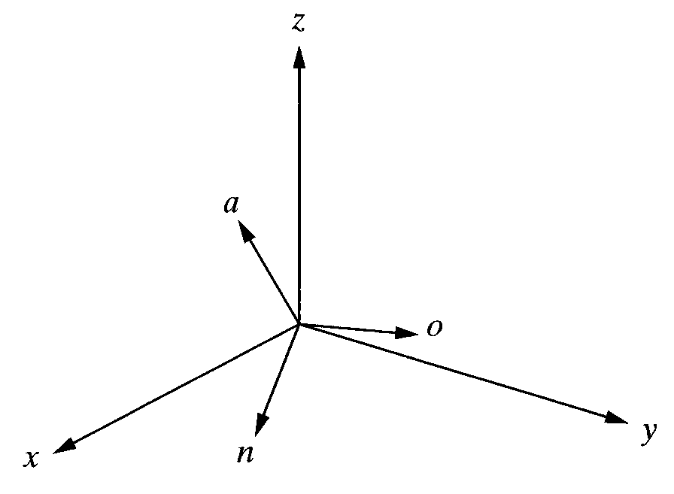
Robot Kinematics: Position Analysis
MATRIX REPRESENTATION
Representation of a Frame at the Origin of a Fixed-Reference Frame
♦Each Unit Vector is mutually perpendicular. :
normal, orientation, approach vector
Fig. 2.5 Representation of a frame at the origin of the reference frame

Slide 61
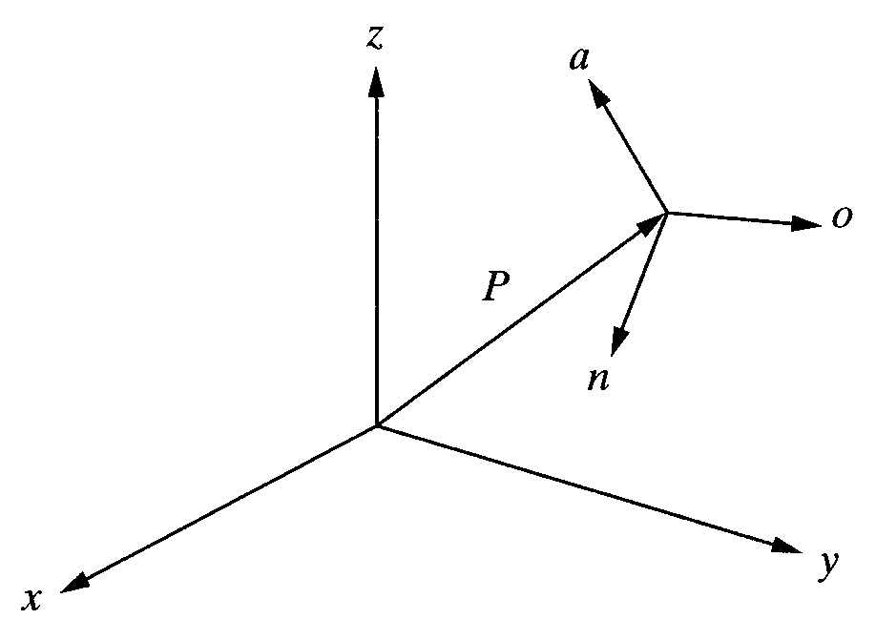
Robot Kinematics: Position Analysis
2.3 MATRIX REPRESENTATION
Representation of a Frame in a Fixed Reference Frame
♦Each Unit Vector is mutually perpendicular. :
normal, orientation, approach vector
Fig. 2.6 Representation of a frame in a frame

Slide 62

Robot Kinematics: Position Analysis
2.3 MATRIX REPRESENTATION
2.3.5 Representation of a Rigid Body
♦An object can be represented in space by attaching a frame
to it and representing the frame in space.
Fig. 2.8 Representation of an object in space

Slide 63
Robot Kinematics: Position Analysis
2.4 HOMOGENEOUS TRANSFORMATION MATRICES
♦A transformation matrices must be in square form.
It is much easier to calculate the inverse of square matrices.
To multiply two matrices, their dimensions must match.

Slide 64

Robot Kinematics: Position Analysis
2.5 REPRESENTATION OF TRANSFORMATINS
2.5.1 Representation of a Pure Translation
♦A transformation is defined as making a movement in space.
A pure translation.
A pure rotation about an axis.
A combination of translation or rotations.
Fig. 2.9 Representation of an pure translation in space

Slide 65


Robot Kinematics: Position Analysis
2.5 REPRESENTATION OF TRANSFORMATINS
2.5.2 Representation of a Pure Rotation about an Axis
♦Assumption : The frame is at the origin of the reference frame and parallel to it.
Fig. 2.10 Coordinates of a point in a rotating
frame before and after rotation.
Fig. 2.11 Coordinates of a point relative to the reference
frame and rotating frame as viewed from the x-axis.

Slide 66


Robot Kinematics: Position Analysis
2.5 REPRESENTATION OF TRANSFORMATINS
2.5.3 Representation of Combined Transformations
♦A number of successive translations and rotations….
Fig. 2.13 Effects of three successive transformations
Fig. 2.14 Changing the order of transformations will
change the final result

Slide 67

Robot Kinematics: Position Analysis
2.5 REPRESENTATION OF TRANSFORMATINS
2.5.5 Transformations Relative to the Rotating Frame
♦Example 2.8
Fig. 2.15 Transformations relative to the current frames.

Slide 68

Robot Kinematics: Position Analysis
2.6 INVERSE OF TRANSFORMATION MATIRICES
♦Inverse of a matrix calculation steps :
• Calculate the determinant of the matrix.
• Transpose the matrix.
• Replace each element of the transposed matrix by its own minor(adjoint matrix).
• Divide the converted matrix by the determinant.
Fig. 2.16 The Universe, robot, hand, part, and end effecter frames.

Slide 69

Robot Kinematics: Position Analysis
2.7 FORWARD AND INVERSE KINEMATICS OF ROBOTS
♦Forward Kinematics Analysis:
• Calculating the position and orientation of the hand of the robot.
• If all robot joint variables are known, one can calculate where the robot is
at any instant.
• Recall Chapter 1.
Fig. 2.17 The hand frame of the robot relative to the reference frame.

Slide 70
Robot Kinematics: Position Analysis
2.7 FORWARD AND INVERSE KINEMATICS OF ROBOTS
2.7.1 Forward and Inverse Kinematics Equations for Position
♦Forward Kinematics and Inverse Kinematics equation for position analysis :
(a) Cartesian (gantry, rectangular) coordinates.
(b) Cylindrical coordinates.
(c) Spherical coordinates.
(d) Articulated (anthropomorphic, or all-revolute) coordinates.

Slide 71

Robot Kinematics: Position Analysis
2.7 FORWARD AND INVERSE KINEMATICS OF ROBOTS
2.7.1 Forward and Inverse Kinematics Equations for Position
2.7.1(a) Cartesian (Gantry, Rectangular) Coordinates
♦IBM 7565 robot
• All actuator is linear.
• A gantry robot is a Cartesian robot.
Fig. 2.18 Cartesian Coordinates.

Slide 72

Robot Kinematics: Position Analysis
2.7 FORWARD AND INVERSE KINEMATICS OF ROBOTS
2.7.1 Forward and Inverse Kinematics Equations for Position
2.7.1(b) Cylindrical Coordinates
♦2 Linear translations and 1 rotation
• translation of r along the x-axis
• rotation of α about the z-axis
• translation of l along the z-axis
Fig. 2.19 Cylindrical Coordinates.

Slide 73

Robot Kinematics: Position Analysis
2.7 FORWARD AND INVERSE KINEMATICS OF ROBOTS
2.7.1 Forward and Inverse Kinematics Equations for Position
2.7.1(c) Spherical Coordinates
♦2 Linear translations and 1 rotation
• translation of r along the z-axis
• rotation of β about the y-axis
• rotation of γ along the z-axis
Fig. 2.20 Spherical Coordinates.

Slide 74

Robot Kinematics: Position Analysis
2.7 FORWARD AND INVERSE KINEMATICS OF ROBOTS
2.7.1 Forward and Inverse Kinematics Equations for Position
2.7.1(d) Articulated Coordinates
♦3 rotations -> Denavit-Hartenberg representation
Fig. 2.21 Articulated Coordinates.

Slide 75
Robot Kinematics: Position Analysis
2.7 FORWARD AND INVERSE KINEMATICS OF ROBOTS
2.7.2 Forward and Inverse Kinematics Equations for Orientation
♦ Roll, Pitch, Yaw (RPY) angles
♦ Euler angles
♦ Articulated joints

Slide 76

Robot Kinematics: Position Analysis
2.7 FORWARD AND INVERSE KINEMATICS OF ROBOTS
2.7.2 Forward and Inverse Kinematics Equations for Orientation
2.7.2(a) Roll, Pitch, Yaw(RPY) Angles
♦Roll: Rotation of about -axis (z-axis of the moving frame)
♦Pitch: Rotation of about -axis (y-axis of the moving frame)
♦Yaw: Rotation of about -axis (x-axis of the moving frame)
Fig. 2.22 RPY rotations about the current axes.

Slide 77

Robot Kinematics: Position Analysis
2.7 FORWARD AND INVERSE KINEMATICS OF ROBOTS
2.7.2 Forward and Inverse Kinematics Equations for Orientation
2.7.2(b) Euler Angles
♦Rotation of about -axis (z-axis of the moving frame) followed by
♦Rotation of about -axis (y-axis of the moving frame) followed by
♦Rotation of about -axis (z-axis of the moving frame).
Fig. 2.24 Euler rotations about the current axes.

Slide 78
Robot Kinematics: Position Analysis
2.7 FORWARD AND INVERSE KINEMATICS OF ROBOTS
2.7.2 Forward and Inverse Kinematics Equations for Orientation
2.7.2(c) Articulated Joints
Consult again section 2.7.1(d)…….

Slide 79
Robot Kinematics: Position Analysis
2.7 FORWARD AND INVERSE KINEMATICS OF ROBOTS
2.7.3 Forward and Inverse Kinematics Equations for Orientation
Assumption : Robot is made of a Cartesian and an RPY set of joints.
Assumption : Robot is made of a Spherical Coordinate and an Euler angle.
Another Combination can be possible……
Denavit-Hartenberg Representation

Slide 80

2.8 DENAVIT-HARTENBERG REPRESENTATION OF
FORWARD KINEMATIC EQUATIONS OF ROBOT
Denavit-Hartenberg Representation :
@ Simple way of modeling robot links and
joints for any robot configuration,
regardless of its sequence or complexity.
@ Transformations in any coordinates
is possible.
@ Any possible combinations of joints
and links and all-revolute articulated
robots can be represented.
Fig. 2.25 A D-H representation of a general-purpose joint-link combination

Slide 81
Robot Kinematics: Position Analysis
2.8 DENAVIT-HARTENBERG REPRESENTATION OF
FORWARD KINEMATIC EQUATIONS OF ROBOT
Denavit-Hartenberg Representation procedures:
Start point:
Assign joint number n to the first shown joint.
Assign a local reference frame for each and every joint before or
after these joints.
Y-axis does not used in D-H representation.

Slide 82
Robot Kinematics: Position Analysis
2.8 DENAVIT-HARTENBERG REPRESENTATION OF
FORWARD KINEMATIC EQUATIONS OF ROBOT
Procedures for assigning a local reference frame to each joint:
٭ All joints are represented by a z-axis.
(right-hand rule for rotational joint, linear movement for prismatic joint)
٭ The common normal is one line mutually perpendicular to any two
skew lines.
٭ Parallel z-axes joints make a infinite number of common normal.
٭ Intersecting z-axes of two successive joints make no common
normal between them(Length is 0.).

Slide 83
Robot Kinematics: Position Analysis
2.8 DENAVIT-HARTENBERG REPRESENTATION OF
FORWARD KINEMATIC EQUATIONS OF ROBOT
Symbol Terminologies :
⊙ θ : A rotation about the z-axis.
⊙ d : The distance on the z-axis.
⊙ a : The length of each common normal (Joint offset).
⊙ α : The angle between two successive z-axes (Joint twist)
 Only θ and d are joint variables.

Slide 84
Robot Kinematics: Position Analysis
2.8 DENAVIT-HARTENBERG REPRESENTATION OF
FORWARD KINEMATIC EQUATIONS OF ROBOT
The necessary motions to transform from one reference
frame to the next.
(I) Rotate about the z_{n}-axis an able of θ_{n+1}. (Coplanar)
(II) Translate along z_{n}-axis a distance of d_{n+1} to make x_{n} and x_{n+1}
colinear.
(III) Translate along the x_{n}-axis a distance of a_{n+1} to bring the origins
of x_{n+1} together.
(IV) Rotate z_{n}-axis about x_{n+1} axis an angle of α_{n+1} to align z_{n}-axis
with z_{n+1}-axis.

Slide 85
Robot Kinematics: Position Analysis
2.9 THE INVERSE KINEMATIC SOLUTION OF ROBOT
Determine the value of each joint to place the arm at a
desired position and orientation.

Slide 86
Robot Kinematics: Position Analysis
2.9 THE INVERSE KINEMATIC SOLUTION OF ROBOT

Slide 87
Robot Kinematics: Position Analysis
2.9 THE INVERSE KINEMATIC SOLUTION OF ROBOT

