Slide 1
Employee Data Analysis using Excel
STUDENT NAME:R.SRIDEVI
REGISTER NO:312208424-asunm1330312208424
DEPARTMENT: ACCOUNTING AND FINANCE
COLLEGE: CHELLAMMAL WOMEN’S COLLEGE

Slide 2
PROJECT TITLE
Employee Performance Analysis using Excel

Slide 3


AGENDA
Problem Statement
Project Overview
End Users
Our Solution and Proposition
Dataset Description
Modelling Approach
Results and Discussion
Conclusion
3/21/2024 Annual Review

Slide 4

PROBLEM STATEMENT
Climate Adaptation: “Create a plan for a coastal city to manage rising sea levels and severe weather.” Healthcare Access: “Design a telemedicine solution to improve healthcare in rural areas.” Remote Learning: “Build a platform to enhance remote learning for high school students.” Waste Management: “Develop a waste management system to reduce landfill use in a city.”

Slide 5

PROJECT OVERVIEW
Climate change. Adaptation strategies include enhancing infrastructure to withstand flooding, improving emergency response systems, and engaging communities in resilience-building efforts. Healthcare Access: Rural areas often have limited access to medical services. Telemedicine can bridge this gap by providing remote consultations and treatment, overcoming geographic barriers, and integrating with local healthcare systems to improve overall access and quality of care.
.

Slide 6

WHO ARE THE END USERS?
Climate Adaptation: Residents and businesses in coastal cities.
Healthcare Access: Patients and healthcare providers in rural areas.
Remote Learning: High school students and teachers.
Waste Management: City residents and waste management authorities.
Inventory Optimization: E-commerce companies and their customers.

Slide 7

OUR SOLUTION AND ITS VALUE PROPOSITION
Climate Adaptation: Solution: Coastal defense systems. Value Proposition: Reduces flood and storm damage, safeguarding communities. Healthcare Access: Solution: Telemedicine platform. Value Proposition: Expands access to healthcare in rural areas, improving health services. Remote Learning: Solution: Interactive learning platform. Value Proposition: Boosts student engagement and learning effectiveness. Waste Management: Solution: Smart waste management system. Value Proposition: Minimizes landfill use and improves recycling. Inventory Optimization: Solution: Inventory management algorithm. Value Proposition: Balances stock levels, reducing waste and shortages

Slide 8
Dataset Description
Climate Adaptation: Dataset: Weather patterns, sea level data, infrastructure condition.
Healthcare Access: Dataset: Telemedicine usage, patient demographics, provider availability.
Remote Learning: Dataset: Student engagement, course completion rates, interaction logs.
Waste Management: Dataset: Waste collection data, recycling rates, community participation.
Inventory Optimization: Dataset: Inventory levels, sales data, demand forecasts.

Slide 9

THE "WOW" IN OUR SOLUTION
Climate Adaptation: Wow Factor: Real-time predictive models to prevent damage. Healthcare Access: Wow Factor: AI-driven remote diagnostics for enhanced rural care. Remote Learning: Wow Factor: Immersive virtual classrooms that simulate in-person learning. Waste Management: Wow Factor: Smart bins and dynamic recycling incentives.
3/21/2024 Annual Review
9

Slide 10
MODELLING
1Remote Learning: Modeling: Engagement and performance models for personalized learning. Waste Management: Modeling: Optimization algorithms for waste collection and recycling. Inventory Optimization: Modeling: Demand forecasting and inventory algorithms.
10

Slide 11
MODELLING
Climate Adaptation: Modeling: Predictive analytics for weather and sea level impacts.
Healthcare Access: Modeling: Machine learning for patient needs and resource allocation.
Remote Learning: Modeling: Engagement and performance models for personalized learning.
11

Slide 12
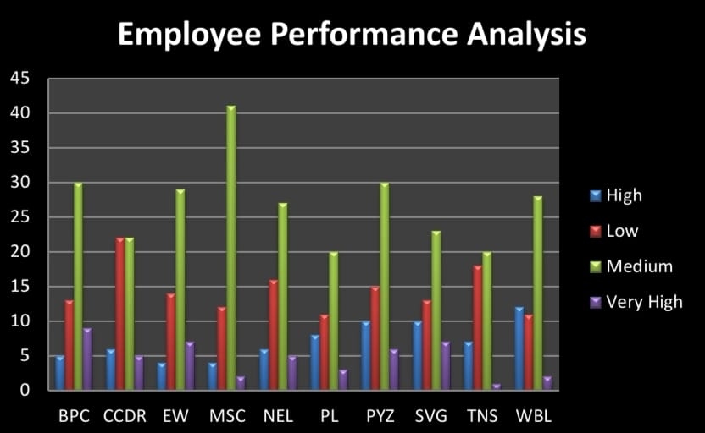
RESULTS
12

Slide 13
conclusion
Healthcare Access: Conclusion: AI-driven telemedicine solutions can bridge healthcare gaps in rural areas, providing timely and equitable medical care. Remote Learning: Conclusion: Interactive and personalized learning platforms can greatly enhance remote education, making it more engaging and effective. Waste Management: Conclusion: Smart waste management systems can optimize recycling and reduce landfill use, leading to more sustainable urban environments.

