Slide 1
NeoRL – Overview
CireNeikual

Slide 2
What is NeoRL?
Algorithmic neocortex-like simulation
Online predictor of temporal data streams
Reinforcement learner
Unsupervised spatio-temporal feature extractor

Slide 3
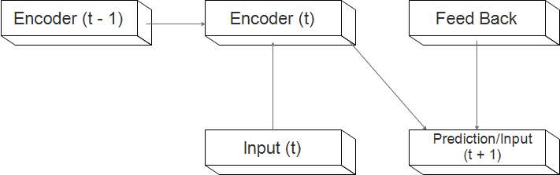
NeoRL's Architecture
NeoRL can be seen as a deep recurrent neural network
Each layer consists of an encoder and a decoder
The encoder forms sparse distributed representations (SDRs) of the input
The decoder uses these to predict the next timestep of input
The encoder has recurrent connections to itself (t – 1)
The decoder has feedback connections from higher layers

Slide 4
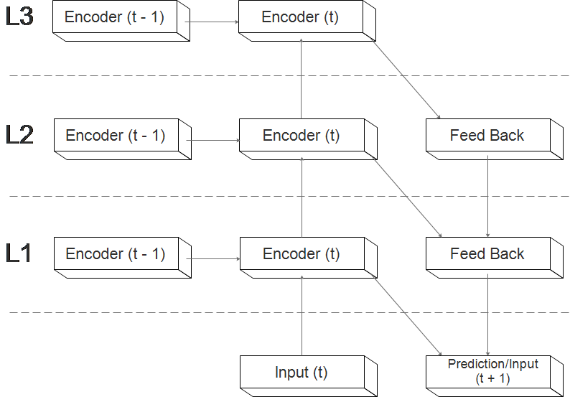
NeoRL's Architecture: Hierarchy
Layers can be stacked to form a bidirectional hierarchy
Processing happens in 2 passes: The up pass (feature extraction) and the down pass (prediction)
Each layer's prediction is used as feed-back input to the next lower layer
Recurrent connections are intra-layer only

Slide 5
Running NeoRL
The encoder and decoder form a sort of predictive autoencoder
The hidden states of the encoder are kept sparse through a K-sparsity restriction
This encoder-decoder pair is then trained with backpropagation (1-step). The decoder also trains feedback connections as an additional input layer
But what about the recurrent connections? Could use backpropagation through time... but there is something more efficient

Slide 6
Running NeoRL
The encoder and decoder form a sort of predictive autoencoder
The hidden states of the encoder are kept sparse through a K-sparsity restriction
This encoder-decoder pair is then trained with backpropagation (1-step). The decoder also trains feedback connections as an additional input layer
But what about the recurrent connections? Could use backpropagation through time... but there is something more efficient

Slide 7
Predictive Coding
NeoRL uses a form of predictive coding (PC) to organize its hidden state to allow for accurate predictions in partially observable (memory-requiring) tasks
The predictive coding idea works as follows: Have the recurrent connections try to predict the next network state, then OR this prediction with the actual state to produce the final hidden state
This means that when an incorrect prediction is made, more nodes will be active which can then be used for other predictions. So, as soon as an input cannot be predicted based off of the current timestep (reactive), it will start using additional nodes to bridge the gap

Slide 8
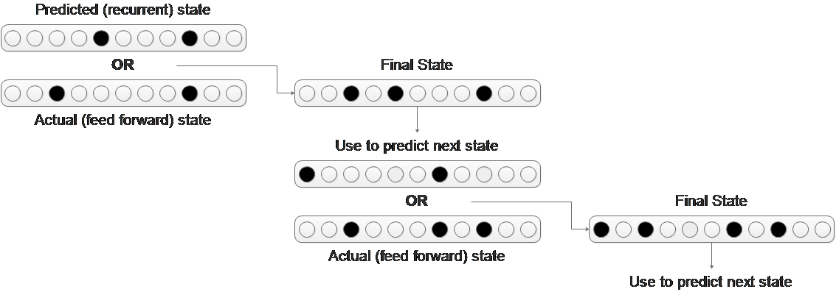
Predictive Coding Example
If the next state cannot be predicted from the current state, this will produce a prediction error
If this error is not resolved, it will propagate further and further back in time

Slide 9

Eligibility Traces
NeoRL uses eligibility traces to help more quickly propagate reward and prediction errors back in time
Eligibility traces come from reinforcement learning
Has biological evidence
Involves storing an additional value for each weight
This value decays exponentially normally, but activity causes it to increment or decrement in order to represent the history of the network
Allows current updates to update based on past information as well
Example trace over time:

Slide 10

Reinforcement Learning
How can we use this predictive hierarchy for reinforcement learning?
Good ol' TD (temporal difference) learning
Basic idea: Learn to predict the reward ahead of time, then if you get more then expected you did well otherwise you did poorly (this is the temporal difference error)
Reward is propagated back in time (credit assignment)
Results in this Bellman equation (Q learning shown here, NeoRL uses SARSA which is similar):

Slide 11
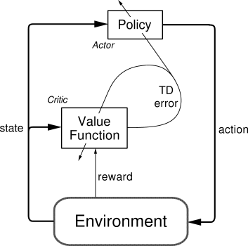
Actor-Critic
NeoRL uses an actor-critic architecture
However, the actor and critic networks use the same hierarchy
One part predicts Q and another part predictions actions
Actor defines actions
Critic measures TD error
Both are updated based on TD error

Slide 12
Reinforcement Learning: Updating the Actor
NeoRL updates the actor based on the CACLA (continuous actor-critic learning automaton) algorithm
CACLA uses the sign of the TD error to update actions towards their exploratory versions upon positive TD error and does nothing when TD error is negative
NeoRL extends CACLA using eligibility traces to update past actions based on new temporal difference error information

Slide 13
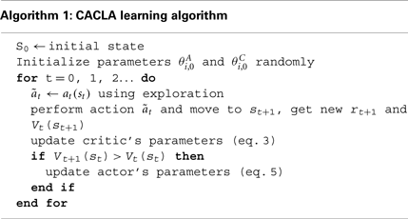
The CACLA algorithm pseudocode

Slide 14
Reinforcement Learning with NeoRL
We must predict the cumulative reward at each timestep
Set aside a certain set of predictions which will count as actions
These actions are updated to predict whatever they are currently outputting (reinforcement) in the presence of a positive temporal difference error, and stay the same if the temporal difference error is negative
NeoRL extends this further by using eligibility traces to propagate reward back in time efficiently

Slide 15
Feeding inputs to NeoRL
NeoRL works best when inputs are pre-processed a bit
In particular, a whitening transform helps with better distributing the SDRs across the input space
Further, scalars are best encoded by performing several random transformations on them, again to better distribute the SDRs

Slide 16
NeoRL's Data Whitener
NeoRL uses a simple local whitening transformation to process images
This removes correlations in the image, good for input to a sparse coder that assumes decorrelated input
Once in sparse form, input is already decorrelated, so no further whitening is necessary
It works by examining pixels in a radius, measuring covariance with the center pixel, and then boosting/weakening the pixel based on this. It also has a normalizing effect, as the image gets transformed into the [-1, 1] range

Slide 17


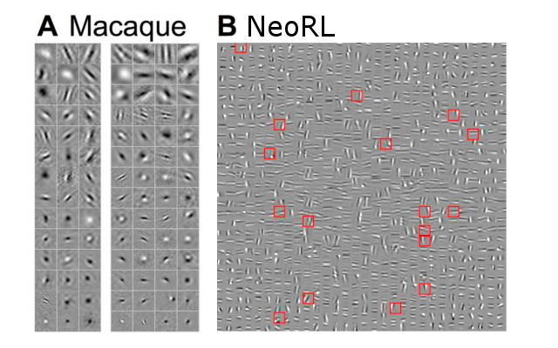
Whitening Example
Filters learned:

Slide 18
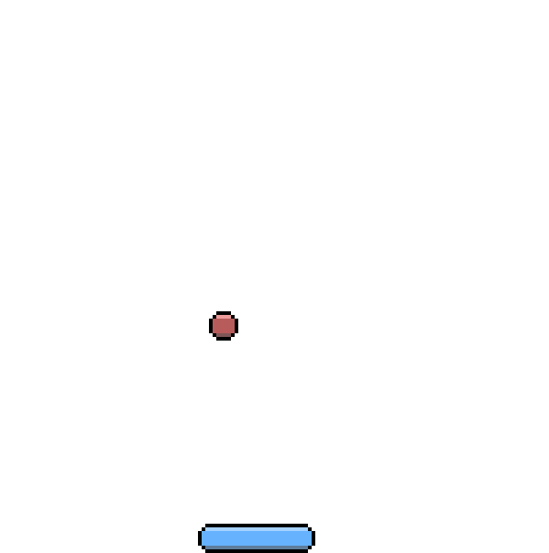
Experiments with NeoRL
Single-player pong
Character prediction

Slide 19
The End
NeoRL: https://github.com/222464/NeoRL
MiniNeoRL: https://github.com/222464/MiniNeoRL

