Slide 1








Disease prediction using Machine Learning

Slide 2








Department of computer science and engineering
Presentation
On
Disease prediction using Machine Learning
Team members-
Name | Roll no.
Aman | 2100290140020
Shibhangi | 2100290140133
Supervised By- Dr-ARUN TRIPATHI

Slide 3



Table of Contents
He
03
Architectural design for proposed system
01
Introduction
02
Objective
04
Algorithms
05
Application area
06
Reference

Slide 4





Introduction
The load of cardiovascular diseases is rapidly increasing all
over the world from the past few years. Even if these diseases
has found as the most important source of death, it has been
announced as the most manageable and avoidable disease [1].
Mainly, blockage in arteries causes heart stroke. It occurs when
heart does not pump the blood around the body efficiently.
Having high blood pressure is also one of the main causes of
getting a heart disease.

Slide 5



objective
There is a demand of such a system that will help end users to predict diseases on the basis of symptoms given in it without visiting physician.
It will decrease the rush at OPD of hospitals and bring down the workload on medical staff.
This system will reduce the costly treatment and panic moment at the end stages so that proper medication can be provided at right time and we can lower down the death rate as well.
This system is also consists of a feature of Database which stores data entered by the end users that can be used as a past record and will help in further treatment in future.
Altogether this system will help in easier health management.

Slide 6




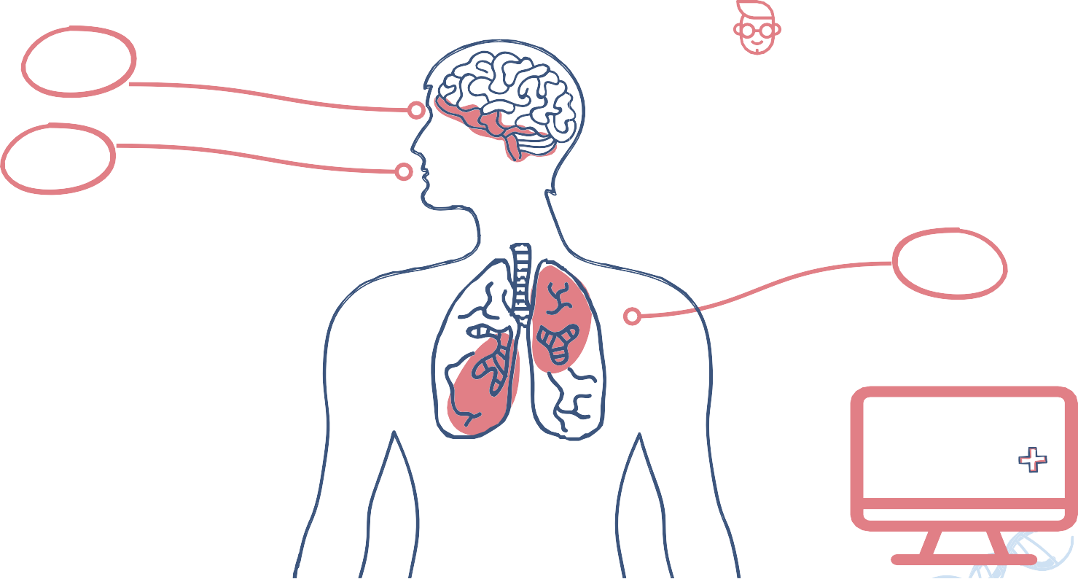




Symptoms of the Disease
Loss of smell
01
03
Runny nose
Redness of eyes
02
Mild fever
Allergy
Watering from eyes

Slide 7









References
Sarthak Khurana ,Atishay Jain,Shikhar Kataria,Kunal Bhasin,Sunny Arora and Dr.Akhilesh Das Gupta ,”Disease Prediction System”,in International Research Journal Of Engineering and Technology ,ISSN:2395-0056,Volume :06, Issue :05—May 2019.
Megha Kamboj ,”Heart Disease Prediction with Machine Learning Approaches”,in International Journal Of Science and Research ,ISSN:2319-7064, Volume :9,Issue :7,July 2020.
Miss Sangya ware ,Mrs.Shanu K Rakesh and Mr.Bharat Choudhary,”Heart Attack Prediction By Using Machine Learning Techniques”in International Journal Of Recent Technology and Engineering,ISSN:2277-3878, Volume :8,Issue: 5, January 2020
Shraddha ,Subhash ,Shiddat, Prof. Shubhangi Patil ,”Disease Prediction Using Machine Learning over Big Data ”,in International Journal Of Innovative Research in Science and Technology ,ISSN:2319-8753,Vol. 7, Issue 6, June 2018.

Slide 8









Thanks!
Does anyone have any questions?
CREDITS: This presentation template was created by Slidesgo, including icons by Flaticon, and infographics & images by Freepik and illustrations by Stories

