Slide 1
Online Tiffin Service

Slide 2
Team Members
Parimestha Shukla(Leader)
Apoorv Rastogi
Anuj Kumar
Ankit Gangwar
Project Supervisor
Dr. Shashank Bharadwaj

Slide 3
INTRODUCTION
This application is mainly for ordering home cooked food from available franchises. This project provides a Web page application through which people can order Dabba i.e. tiffin service online using the internet. In our busy schedule fresh and homemade food preparation is difficult in such a hectic schedule rather it be breakfast or lunch before going to work or it be dinner after coming from work. But with the help of our web application it is made possible add homemade food and deliver the same.

Slide 4
Technologies Software Requirements
JavaScript
Php
MySql
HTML
CSS
Bootstrap
Visual Studio 2022
Xampp
SQL Server

Slide 5
Minimum Hardware Requirement
Processor: 11th Gen Intel(R) Core(TM) i3
System Type 32-bit operating system
Speed: 3.00 GHz
Hard Disk Space: 256 GB
Ram Memory: 4 GB
Operating System: Windows 8

Slide 6
Modules Description
User Interface
It is the First Page to be shown to the user as it is a single page website so the website is very dynamic, smooth and interactive with user and easy to understand.
The Interface will provide shoppers with information about the various products that are for sale. The information will include prices, product descriptions, stock availability as well as photographs of the products.This will help user to purchase products.
2. Identity
This module if responsible for providing authorized access to the website.
If a user is already registered then they can use their credentials to login.

Slide 7
3. Pagination
Pagination is the method of separating digital content into different pages on a website. Users can navigate between these pages by clicking links, often in the form of numbers located at the bottom of a page.
4. Basket
This module is helpful for user to collect items from the website add them to an Basket .The Basket or Cart will contain all the products that are added by the user to collect so that it will be easy for user to purchase them together and proceed to checkout.

Slide 8
5. Order
This page will display the information about the order and the total amount is calculated automatically.
User will be able to add or delete items and can view the items he/she have added to the basket.
6. Checkout
This module lets the user to place an order securely. It takes the user to login if he/she has not logged in and then the user is asked to add the shipping address. The user can also save it as default address and for the next time it will show this address automatically but if they want to change then they can.

Slide 9
Reports / Outputs
The output of this project is a website that can be used to shop goods online.
This can be helpful for small vendors as they can increase their reach by selling goods online at various locations which generally would require salesman and they can make commendable profits.

Slide 10
CONCLUSION
The website “Online Tiffin Service” is an E-commerce website developed using latest technologies which is inclined at providing the user a hustle free shopping experience.

Slide 11
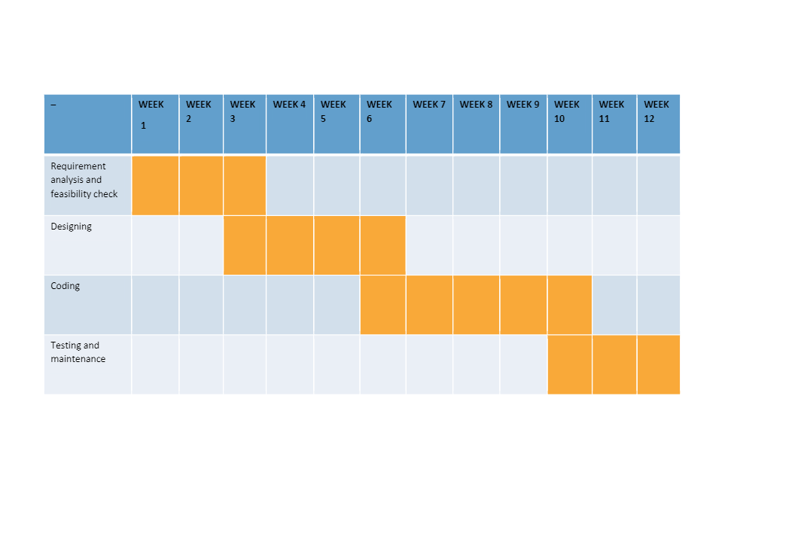
Gantt Chart

Slide 12
Thank you

