Slide 1
Online Grocery Store management System
TEAM MEMBERS: AYUSH TYAGI
MOHIT YADAV
KARTIK
MANMOHAN
PROJECT SUPERVISOR: DR. SHASHANK BHARDWAJ

Slide 2
INTRODUCTION
The "Grocery Shop System" has been developed to override the problems prevailing in the practicing manual system. This software is supported to eliminate and in some cases reduce the hardships faced by this existing system.
A grocery store is a retail store that primarily sells food. A grocer is a bulk seller of food
As pollution around the world has increased buying food on the road side is not advisable.
The application is reduced as much as possible to avoid errors while entering the data. It also provides error message while entering invalid data. No formal knowledge is needed for the user to use this system. Thus by this all it proves it is user-friendly. Grocery Shop Management System, as described above, can lead to error free, secure, reliable and fast management system. It can assist the user to concentrate on their other activities rather to concentrate on the record keeping.

Slide 3
Project Specifications
Project Title : Grocery store Management System Front End Tools : Asp.net , C#, CSS, Java Script Back End Tool : SQL Server Operating System : Microsoft windows 10 Web Browser : chrome Editor : Visual studio Hardware : 64-bit processor, 1.70 GHz, 4.00 GB RAM

Slide 4
EXISTING SYSTEM
A grocery store is a retail store that primarily sells food. A grocer is a bulk seller of food.
Grocery stores often offer nonperishable food that is packaged in cans, bottles and boxes,with some also having butchers, delis, and bakeries.
As pollution around the world has increased buying food 0n the road side is not advisable.Whether in charge of a small individually owned grocery store or one that is part of largerchain maintaining a grocery store successfully involves considerable responsibility.
Grocery store managers must ensure that the store runs smoothly that items are priced comparatively and that customers are satisfed.

Slide 5
PROPOSED SYSTEM
Understanding of key concepts involved in effective grocery store management is imperative for any manager dedicated to the success of his store.
Particularly if manages the small grocery store inventory requires more than simply keeping enough of every item in stock.
This is a internet based application that is accessed through web This system can be used to search for all grocery and fresh vegetables which are available in the market

Slide 6
MODULES
Customer Management Module: Used for managing the Customer details.
Stock Module: Used for managing the details of Stock
Product Type Module: Used for managing the Product Type Information
Login Module: Used for managing the login details
Users Module: Used for managing the users of the system

Slide 7
System Development Strategy
As per the requirement of the project, We have choose
the Spiral as a strategy of developing the project, because
in Spiral-SDLC model starts with a small set of requirement
and goes through each development phase for those set of
requirements, so the appropriate strategy is spiral model.

Slide 8
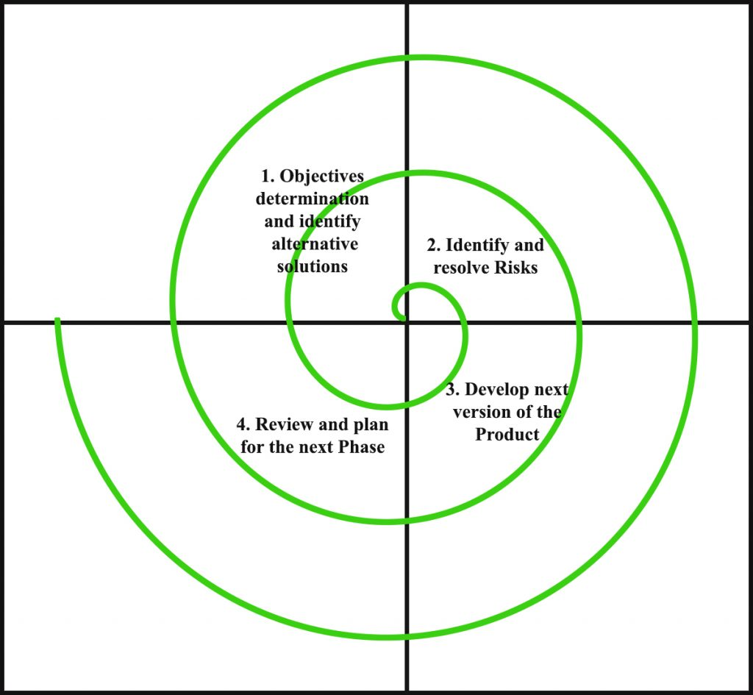
Spiral Module

Slide 9
CONCLUSION
By implementing this grocery management system we are getting the more flexibility for the users.
which can operate from the home itself by implementing the pay and pickup and pay now options.

Slide 10
Thank You..!

