Slide 1

Online Voting System

Slide 2
Anand Kumar Gupta (Team Leader) Ayushi Dixit (Team Member) Miss . Divya Singhal
Team Member
Project Supervisor

Slide 3
Online Voting System
Online Voting System is an online voting technique
It is base on the other online service like “Online reservation System”.
In this system people who have citizenship of INDIA and whose age is above 18 years of any [censored] can give his her vote online without going to any polling booth.
This project is designed to automate the voting system where multiple parties are added and process then with the maximum votes, a leader is chosen.
The working of our system is that , he/she has to fill a registration form to register herself/ himself, all the entries are checked by the database which has already all information about the voter, if all the entries are correct then a USER ID and PASSWORD is given to the voter, by using id and password he/she can give a vote.
So our main objective to build this system is to reduce the time and help the elders, disable persons to give the vote online.

Slide 4
Why Online Voting System?
Manual Voting Process
Voter
Voter Booth

Physically
Visits
Enter in Queue.
Wait for few
Days/month for
Declaring a result.
Wait in queue until
Front queue is empty
Registers vote to
Particular one
Candidate.
Voter sees the candidate’s name

Slide 5
Need For the System
It was decided to Computerize the System in order to overcome the following problems:-
To increase the Voting Percentage.
To make Voter easy to Vote from anywhere.
Time Wastage.
To avoid thing like Booth Capturing.

Slide 6
System : Pentium i3 Processor Hard Disk : 500 GB minimum Monitor : 15’’ LED Input Devices : Keyboard, Mouse Ram : 2 GB
Hardware Requirement

Slide 7
SOFTWARE REQUIREMENTS
Windows 7/8/10(32- bit or 64-bit)
ANDROID STUDIO
4GB RAM Minimum
Processor i3 or i5

Slide 8
Modules
Admin Module
Add Elections
Add Candidate.
View Voter and approve voters
View the Vote and results
Voter Module
Voter Registration
View Candidate details
Vote

Slide 9
Modules Descriptions Admin Module : This module has to maintain the information of the candidate and shows the details of the candidate. And also maintains the records of the party and the candidate. Add Elections Description: This module the admin can able to create new elections. The elections will be set with the date and so after that date the voters can not able to vote to that particular election. Add Candidate Description: This module the admin can able to add the candidates who are going to constitute in the particular election. First they need to select the name of the election, then add candidate name, Party name, Address, Contact number, Photo etc. Once these added, then the voter can able to see the candidate details in their login. View voter and approve Voters: Description: In this sub module we can view the entire details of the voters coming from the users who are registered. The admin can able to verify and approve or reject it accordingly. Once the admin approves it, then the user can login View the vote and results: Description: In this sub module we can get the results of the election i.e who had won the election with how many votes.

Slide 10
Voter Module : This allows user to vote for the respective candidate and allows the user to view the candidate details, allows user to view the details of the respective person he voted for. Voter Registration: Description: In this sub module the voter register themselves by add the details such as Name, Date of birth, email id, gender, Phone Number, address, password. Once the voter registers, then the admin should view it and approve it, then only the voter can able to vote in the election. The voter can only login if the admin approves it or else the voter cannot login if the admin rejects. View Candidate details: Description: In this sub module we can view the details of the candidates who constitute in the election with their photo, party details etc. Vote: Description: In this sub module we can register our vote. Once the user has registered his vote then again he is not allowed to vote again i.e. only one user can vote only at one time.

Slide 11
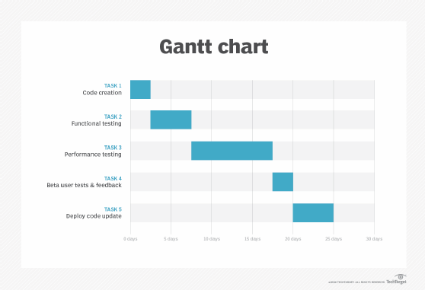

Slide 12
Conclusion
The objective of the VOTING SOFTWARE is to provide better information for the users
of this system easily they can vote from anywhere without facing any difficulty.
The proposed system does not require any physical presence during vote polling or counting.
So it is very easy to conduct elections even during the pandemic situations without any spread of disease or human live losses.
The proposed system has good authentication so only authorized person can able to vote and also cannot vote multiple types.
Vote Counting can be made very quickly and results will be displayed in few minutes.

Slide 13
THANK YOU

