Slide 1

School Management System

Slide 2
Our Team Infographics
Mrs. Divya Singhal
Vishal Chaturvedi
Shagun Maheshwari
Vishal Rajput
Project Supervisor
Member
Team Leader
Member

Slide 3
Introduction
School Management System
The objective is to automate all functionalities of a school. By using this system we can manage all school management work like admission, fee submission, time table management, result declaration etc.

Slide 4
Software Requirments
Operating System: Window 11
SDE: Android Studio
Programming Language: Java
Back-end: Firebase

Slide 5
Hardware Requirement
Processor: i3 -7th generation or equivalent
Ram: 4 GB or higher
Disk Space: 30 GB

Slide 6
Module Description
Student/Faculty Login
Profile
Study Material
Result interface
Payment Interface

Slide 7
Benefits
Time Saving
Student can access Notes any time
Fee record maintaining
Attendance maintaining

Slide 8
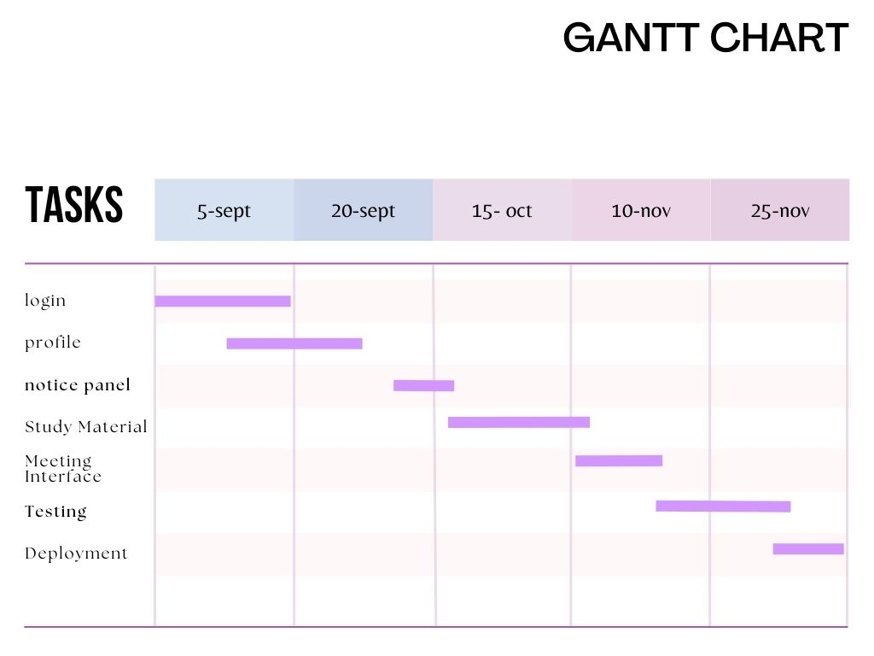

Slide 9

Outcome
Fully functional application, which provide on-demand access of the resources to the students as well as the management of the school.

Slide 10
Thank You!

