Slide 1

Resume Builder
WEB Application

Slide 2
Team Members
Vikas Parmar(Leader)
Vidhi Sharma
Shivam Kumar
Ayush Sharma
Project Supervisor
MRS. Divya Singhal (Associate Professor)

Slide 3
INTRODUCTION
Creating a resume is a bit tedious task for any working professional from any industry. One has to keep it short, simple, and with the latest work experience, and constantly update it over a while.
This project will help you through the process that can be followed to build your resume-builder using ReactJS. Implementing the project will give you the satisfaction of auto-generating it on your own and helping working professionals with the same.

Slide 4
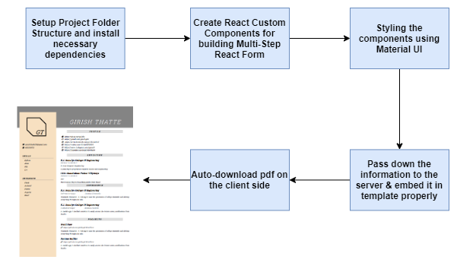
The Project Consists of following stages:

Slide 5
Technologies Software Requirements
HTML
CSS
JAVASCRIPT
REACT js
BOOTSTRAP
MATERIAL UI
Visual Studio 2022
Nodejs

Slide 6
Minimum Hardware Requirement
Processor: Intel Pentium 4 or later
System Type 32-bit operating system
Hard Disk Space: 256 GB
Ram Memory: 2GB minimum ,4 GB recommended
Operating System: Windows 8 or later
Internet : Required

Slide 7
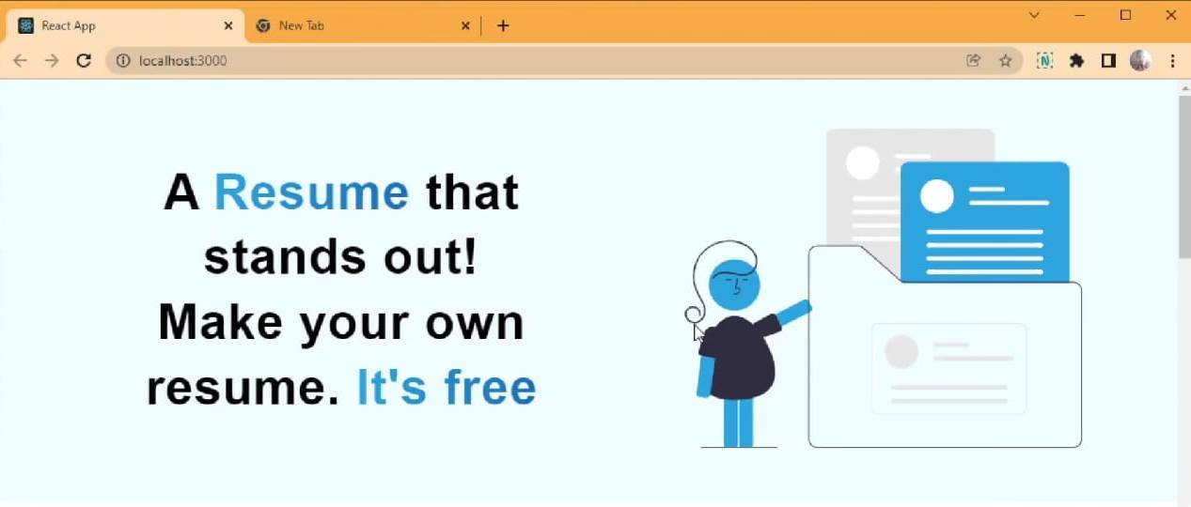
Modules Description
User Interface
This is a first page of website that displays the welcome screen for the user .

Slide 8
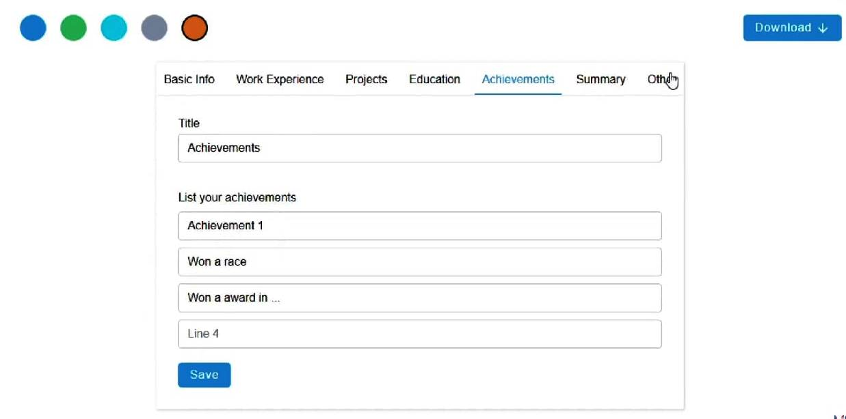
The Second Part deals with the details required to be filled while making a Resume.
The details are like the Basic info, Work Experience , LinkedIn ID Link, Education Details, Work Experience, Achievements, Projects etc.

Slide 9
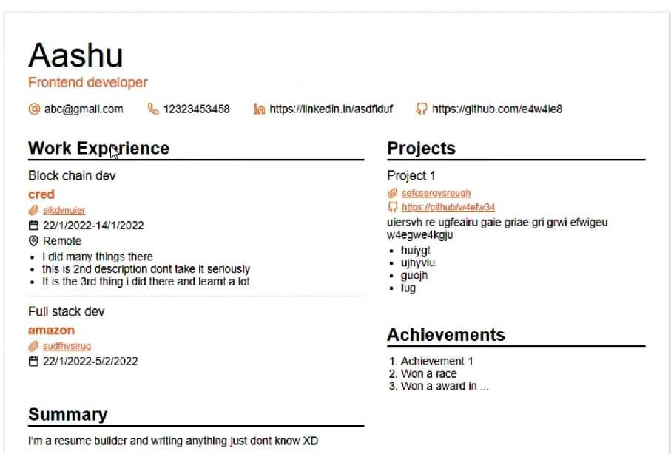
The Third and The Final Part deals with the Final Customized Resume Formed .

Slide 10
Reports / Outputs
It generates the Formatted Resume and one can easily download it in the form of a pdf.

Slide 11
CONCLUSION
At last, we would like to conclude the Resume Making is a tiresome task and time consuming.
Choosing Specified type of template according to the user’s requirements also takes a lot of time . By using this Web Application a full formatted resume is obtained with its own general template.

