Slide 1

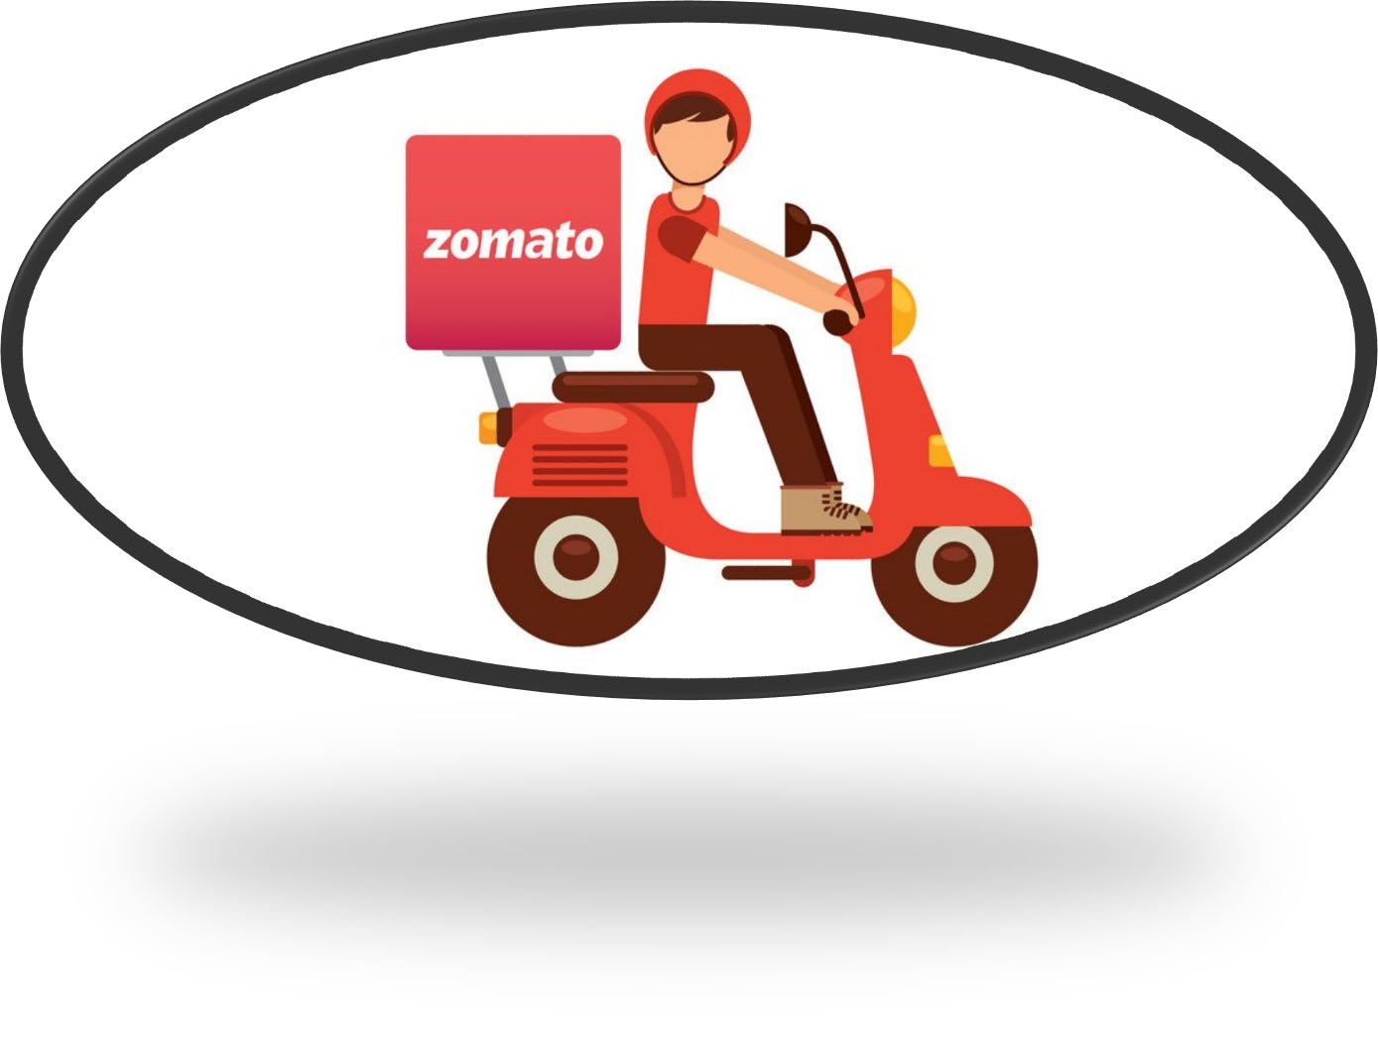

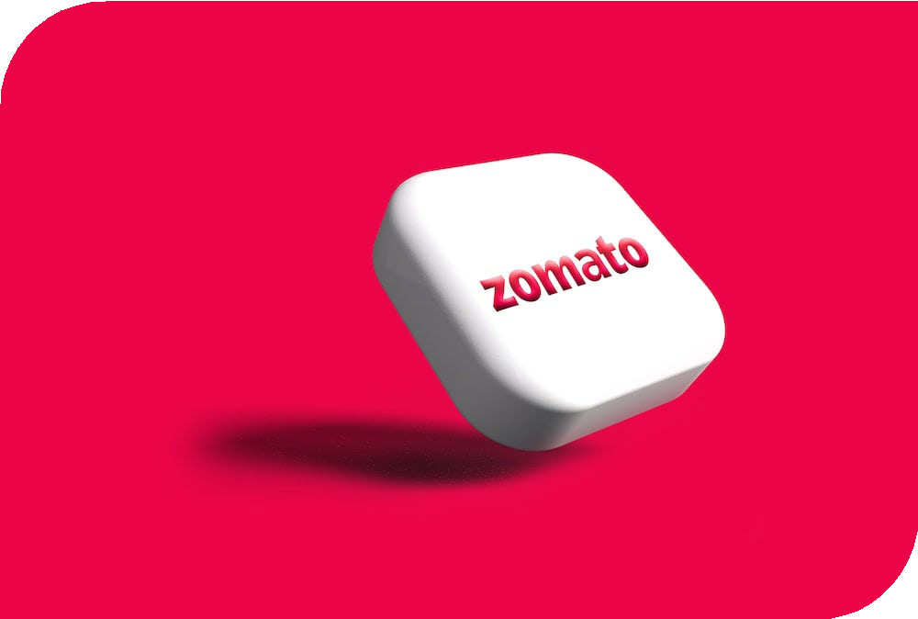
ZOMATO CLONE
TUSHAR NAGPAL & TUSHAR KUMAR
Mentor – Dr AKASH RAJAK

Slide 2


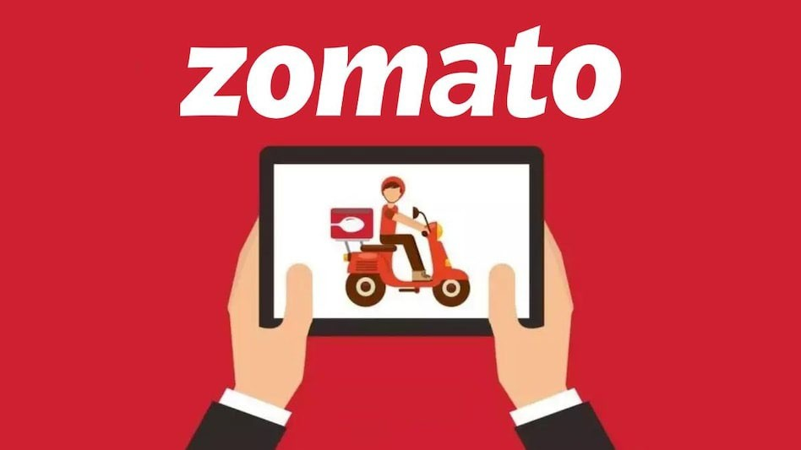
INTRODUCTION
Zomato clone website revolutionizes the dining experience by offering a seamless and convenient platform for users to explore a diverse array of culinary delights from the comfort of their homes. With a user-friendly interface, intuitive search features. Customers can effortlessly browse menus, customize orders, and securely make payments, while also benefiting from realtime order tracking and delivery updates. We prioritize user experience, ensuring a hassle-free, secure, and efficient ordering process.

Slide 3

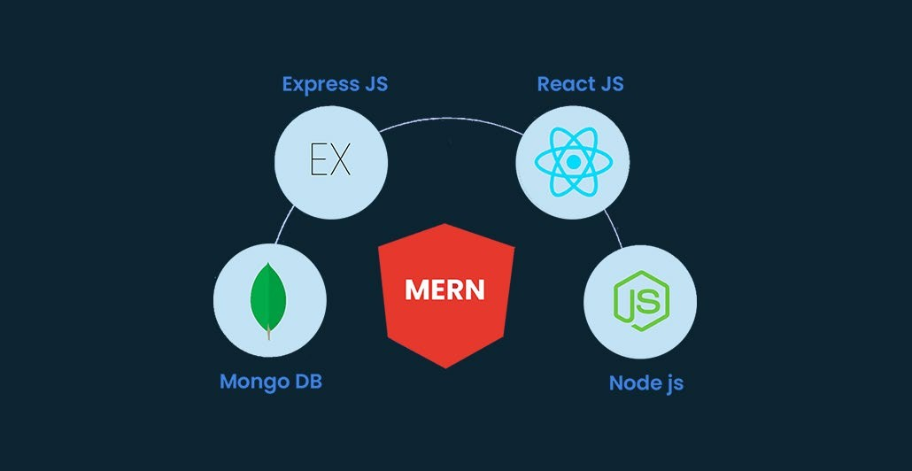
TECHNOLOGIES REQUIRED
Front End – React JS
Back End – Node JS, Express JS
Database – Mongo DB

Slide 4
MODULES
A food ordering website typically consists of several key modules to ensure its functionality and user-friendliness.
User Registration and Authentication: This module allows users to create accounts, log in securely, and manage their profiles. It is essential for personalizing the user experience and ensuring order history.
Menu Management: Restaurants can manage their menus through this module, including adding, editing, and deleting dishes, along with setting prices and descriptions
Order Placement: Users can select items from menus, customize orders (e.g., choosing toppings or specifying cooking preferences), and place orders.
Shopping Cart: Users can view and edit their orders in a virtual cart before finalizing the purchase. This module calculates the total cost, including taxes and delivery fees.
Admin Dashboard: Administrators can manage the platform, including user accounts, restaurant partnerships, menu approval, and resolving disputes.

Slide 5
CONCLUSION
In conclusion, the development of a Zomato clone holds immense potential in the ever-expanding food delivery and restaurant discovery market. By replicating the successful features and functionalities of the original Zomato platform, a clone can provide users with a convenient and user-friendly experience for finding, ordering, and enjoying their favorite cuisines.
As the competition in the food delivery industry remains fierce, a Zomato clone should aim to differentiate itself through unique features, exceptional customer service, and an extensive network of restaurants. With the right strategy and execution, a Zomato clone has the potential to become a valuable player in the online food delivery ecosystem, offering both restaurants and customers a reliable and efficient platform to connect and transact.

Slide 6
THANK YOU

