Slide 1

SYNOPSIS
Report on
SALOON MANAGEMENT SYSTEM
By
HARSH AWASTHI - 2200290140063
HARSH CHAUHAN - 2200290140064
Session:2023-2024 (III Semester)
Under the supervision of
MS. SHALIKA ARORA (Asst. Professor)
KIET Group of Institutions, Delhi-NCR, Ghaziabad
DEPARTMENT OF COMPUTER APPLICATIONS KIET GROUP OF INSTITUTIONS, DELHI-NCR,GHAZIABAD-201206
( 2022- 2023)
1

Slide 2
TABLE OF CONTENTS
Abstract
Introduction
Implementations
Flow Diagram
Tools/Application
Literature Review
Functional Requirements
2

Slide 3
ABSTRACT
With tremendous increase in technology, information technology is a fast-developing field. Technology which is in vogue today might become redundant tomorrow. This ever-changing scenario makes it possible to provide the latest and most modern IT solutions to various business and institutions. I am doing my project on Salon Management System. This project is an endeavor to provide a solution to this.
The proposed system enables an administrator to keep track of customer orders and maintaining records of the customers.. He can view the reports generated by him and can also sent approvals or rejections instantly. Thus the project is a sincere effort in simplifying the task of administrators in an easily usable format. I finalized to make this project and hence planned to develop this system using REACT for front end and MySQL as the Back End.
•
3

Slide 4
INTRODUCTION
In this project we use PHP and MySQL database. It has two modules admin and user.
Admin :
Dashboard: In this section admin can see all detail in brief like total number of customer, Total number of appointment, Rejected Appointment, Accepted Appointment, Total Services, Today’s sales, yesterday’s sale, Last seven days sales and total sales.
Services: In this section admin can manage services of parlor (add and update).
Pages: In this section admin can manage about us and contact us pages.
Appointment: In this section admin can view the detail of appointments and have right to reject and select appointment.
Subscriber: In this section, admin can view subscriber emails.
Add Customer: In this section admin can mange customer (add/update).
Customer List: In this section admin can view customer list and assign services and make invoices of services which is taken by customer.
Invoice: In this section there is the list of total invoices which is viewed by admin
Search Appointment: In this section admin can search appointment with the help of his/her appointment number, name and contact number.
Search Invoice: In this section admin can search invoices with the help of his/her invoice number. Admin can also update his profile, change password and recover password.
User :
Home Page: User can take appointment with Salon on particular date and time.
Services: User views the services which is offer by Salon.
About Us: User sees the details of Salon.
Contact Us: User can contact with Salon.

Slide 5
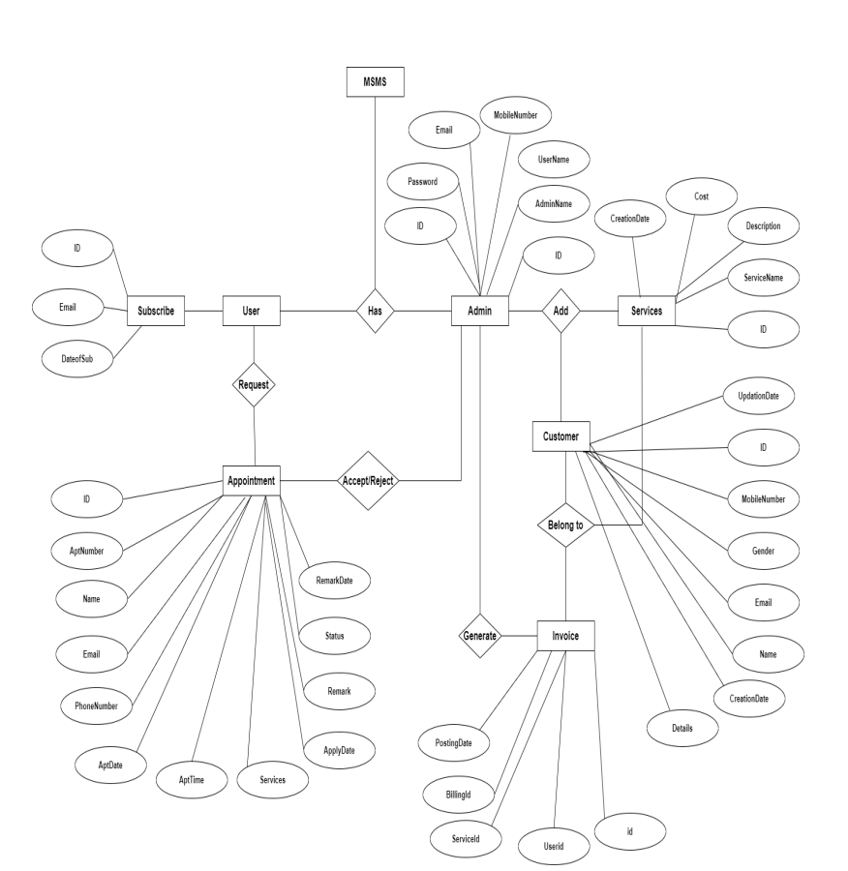
IMPLEMENTATIONS
Diagrams: Below are some important diagrams which explains the working and will be used in implementing the project.

Slide 6
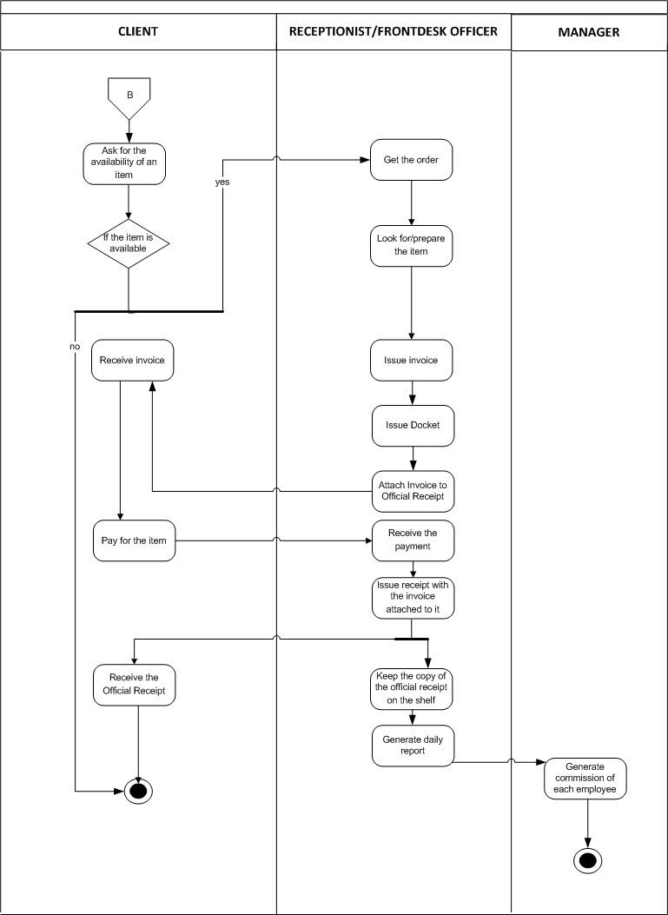
FLOWCHART:

Slide 7
TOOLS
HTML
CSS
JavaScript
ReactJS
MySQL
Database
Hardware requirement :
▪ Processor : Intel Pentium dual core, i3 or above ▪ Ram: 2 GB or more ▪ Hard Disk: 70 GB or more
Software requirement :
▪ Windows 7/ Windows 8/ Windows 10 ▪ Notepad ▪ XAMPP and Wamp

Slide 8
FUCTIONAL REQUIREMENTS
User Authentication and Access Control:
The system should have user roles (e.g., admin, staff, manager) with different levels of access.
Appointment Management:
Users should be able to schedule, modify, and cancel appointments.
Automated appointment reminders should be sent to clients via email or SMS.
Client Management:
Create and maintain client profiles with contact information, preferences, and appointment history.
Record and track client preferences for services, products, and preferred stylists.
Inventory Management:
Track and manage salon inventory, including products and supplies.
Set up automatic reorder points to prevent stockouts.
Record product sales and generate inventory reports.
Point of Sale (POS) System:
Process payments securely and efficiently.
Accept various payment methods, including cash, credit cards, and digital wallets. Generate invoices and receipts for transactions.
Reporting and Analytics:
Provide detailed reports on sales, appointments, and inventory.
Analyze customer data to identify trends, preferences, and purchasing habits.

Slide 9
FUCTIONAL REQUIREMENTS
Security and Privacy:
Implement robust data security measures to protect client and business information.
Ensure compliance with privacy regulations (e.g., GDPR, HIPAA) in handling client data.
Provide the ability to back up and restore data to prevent data loss.
Online Booking Integration:
Sync online and offline bookings to maintain an accurate appointment schedule.
Provide a user-friendly interface for clients to select services, stylists, and time slots
Service Selection:
Clients should be able to browse available services and view detailed descriptions.
Select desired services, stylists, and preferred time slots.
Real-Time Availability:
Display real-time availability of stylists and appointment times.
Prevent double bookings by updating availability in real-time.
Booking Confirmation:
Provide an instant booking confirmation to clients.
Send email or SMS notifications with appointment details

Slide 10
LITERATURE REVIEW
Annie Chai, Chuah Chai Wen:
In accordance with ISO 9000:2000, management system
is defined as a set of interrelated or interacting elements to
establish policy and objectives, and to achieve those
objectives [1, 2].
2. Adarsh Kumar Gulshan, Amir Khan:
A saloon management system is a website that manages the appointment scheduling functionality. This system connects users and Salon in an online platform where user can browse salon and their services.
In the salon and beauty industry, the Online Reservation System is suitable for use to reduce customer waiting time and experience a hassle-free environment.
3. Journal of University of Shanghai for Science and Technology:
The findings of the study can help the beauty industry to develop a way that advances toward better management strategies for their services.
Various applications studied during the research have also provided additional features such as suggestions, connections, and chatbots also some applications provide an all-in-one platform for various streams.

Slide 11
THANK YOU!
11

