Slide 1
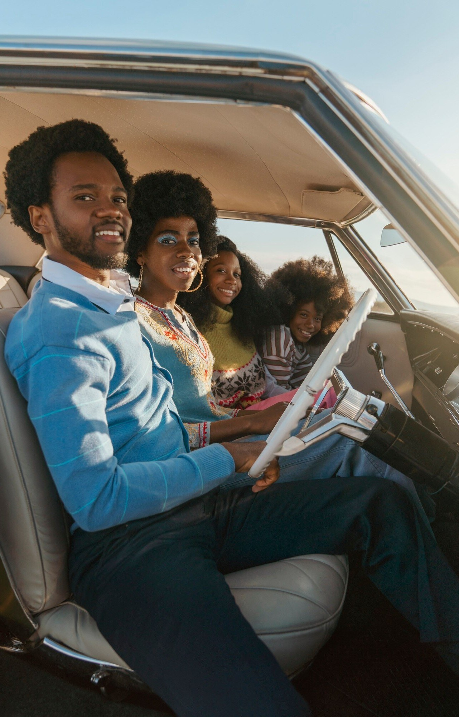
Project On : Car Pooling Under the guidance of Dr. Sangeeta Arora Presented By------------------- Ujjawal Tyagi 2200290140166

Slide 2
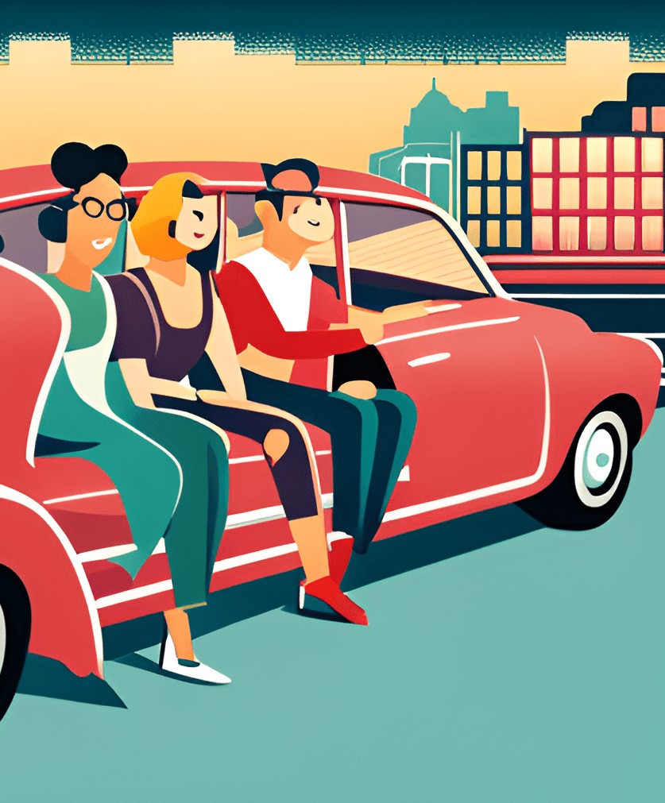
What is carpooling?
Beneﬁts of carpooling
How to start carpooling?
Carpooling safety
Carpooling etiquette
Join the carpooling movement

Slide 3
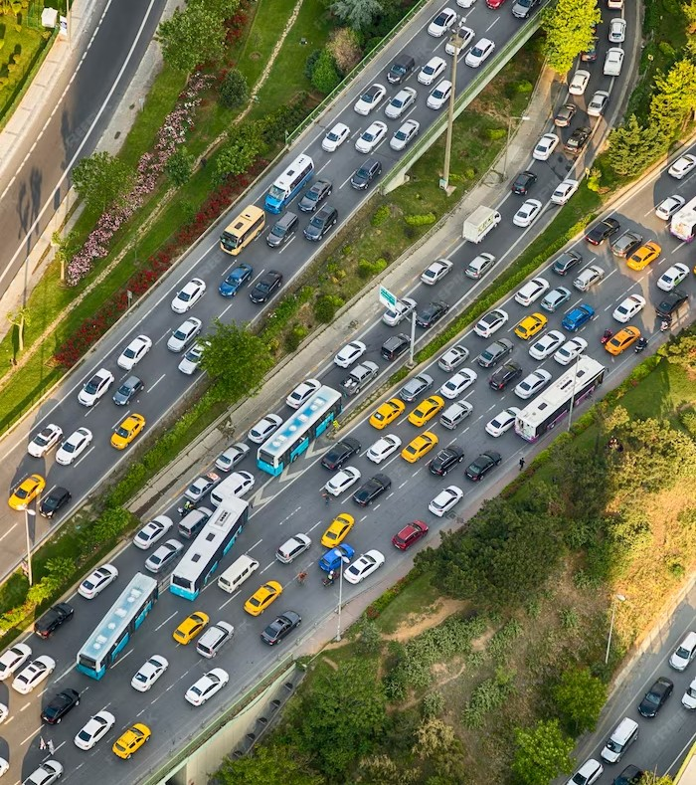
What is carpooling?
Carpooling is the practice of sharing a ride with others who are traveling in the same direction. It's a simple and eIective way to reduce tra c congestion, save money on gas, and lower carbon emissions. By carpooling, you can also make new friends and enjoy a more social commute.Carpooling is important because it helps to reduce the number of cars on the road, which in turn reduces tra c congestion and air pollution. It also saves money on gas and wear and tear on your vehicle.

Slide 4
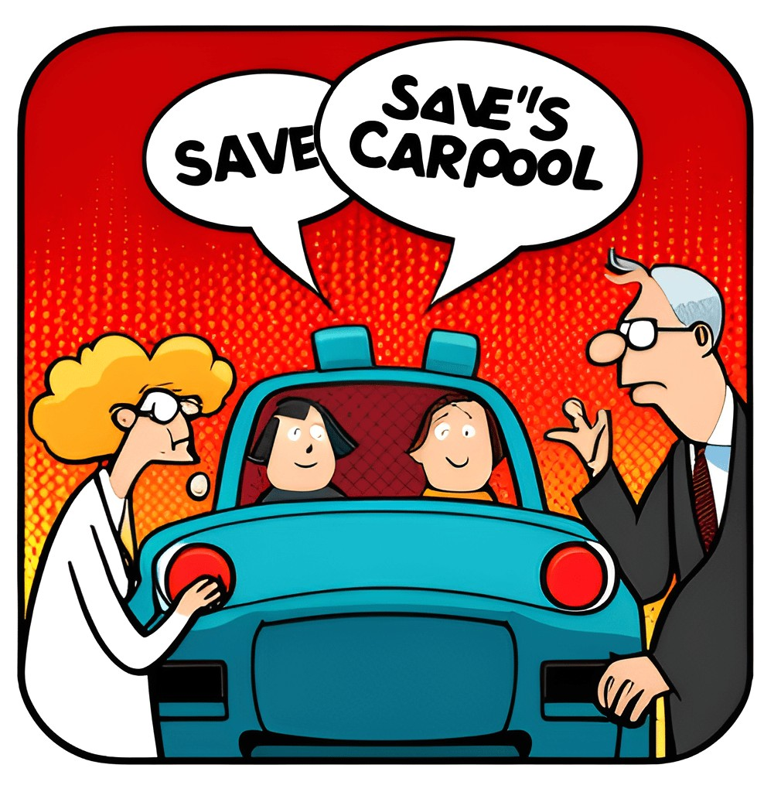

Beneﬁts of carpooling
Carpooling is not only a great way to save money, but it also h as a positive impact on the environment. By sharing rides with others, you can signiﬁcantly reduce your carbon footprint and help alleviate tra c congestion. In addition to the environmental beneﬁts, carpooling can also be a social
e perience. You have the opportunity to meet new people and build
relationships with your fellow carpoolers.

Slide 5
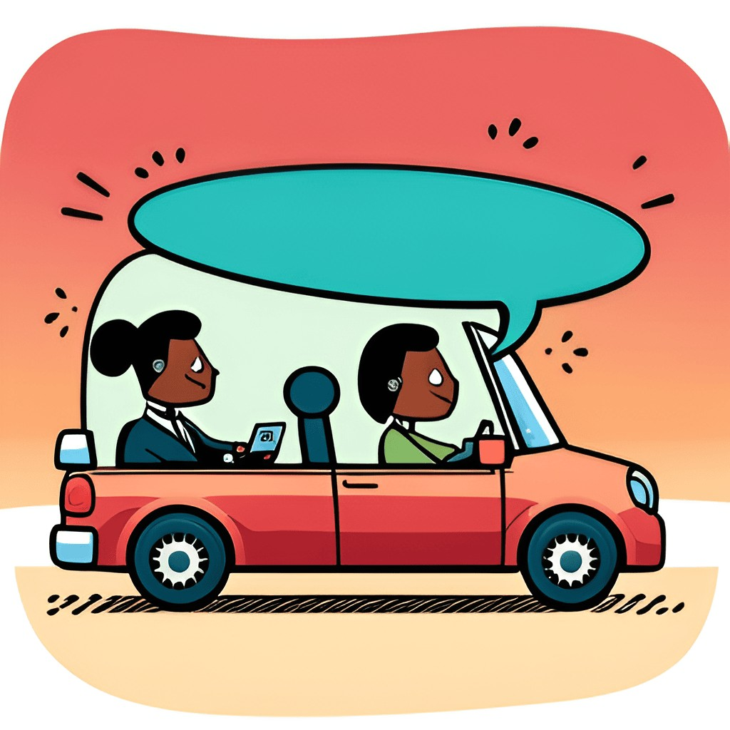

How to start carpooling
Finding carpool partners can be a daunting task, but it doesn't have to be. Start by asking your coworkers or neighbors if they're interested in carpooling. You can also use online resources such as CarpoolWorld.com or Zimride.com to ﬁnd potential carpool partners in your area.
Once you've found some potential carpool partners, it's important to establish clear communication and e pectations.

Slide 6
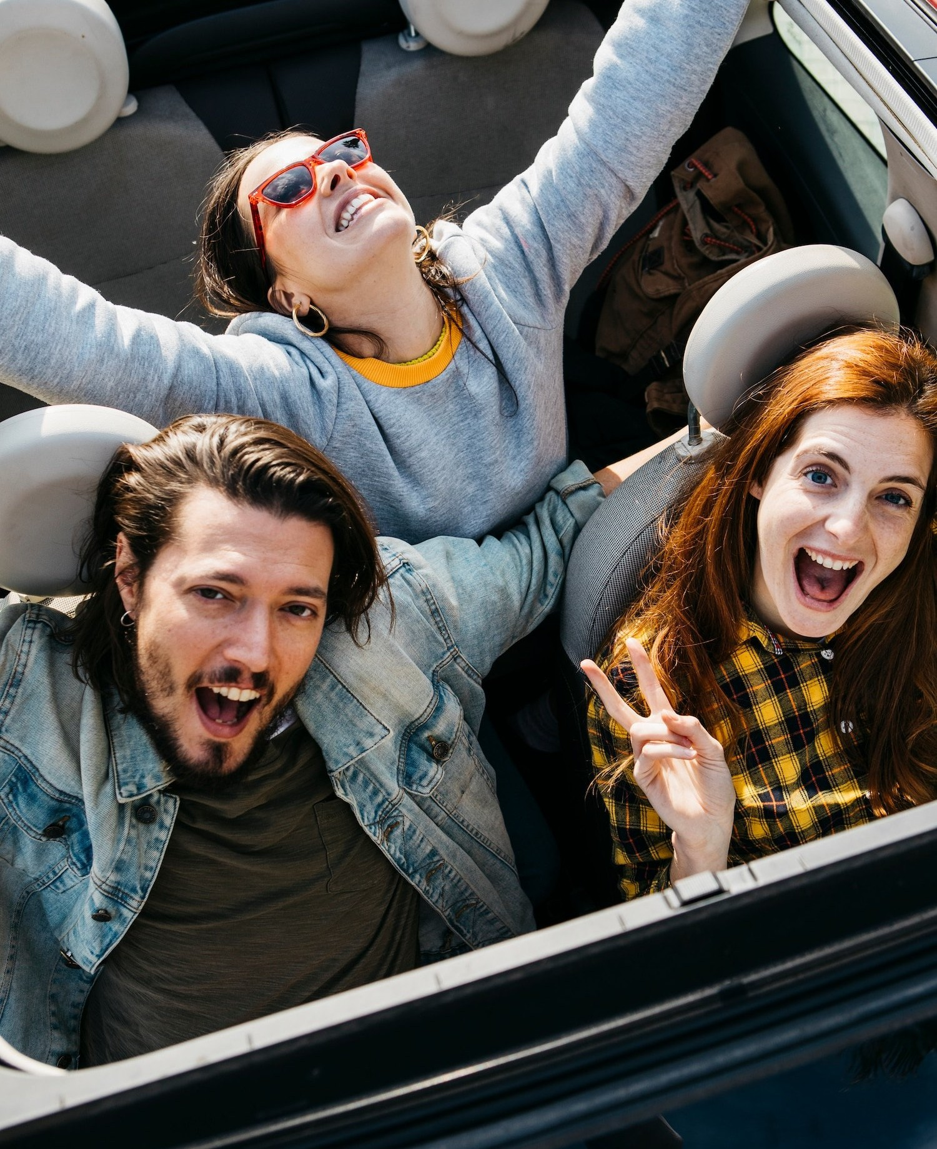

Carpooling safety
When it comes to carpooling, safety should always be the top priority. To ensure a safe and comfortable ride for everyone involved, it's important to follow some basic guidelines. First and foremost, make sure that your vehicle is in good working condition before you hit the road. Check the brakes, tires, and lights, and make sure that everything is in proper working order.
It's also important to drive defensively and obey all tra c laws. Avoid distractions such as te ting or eating while driving, and always wear your seatbelt. As a passenger, be respectful of the driver and their rules.

Slide 7
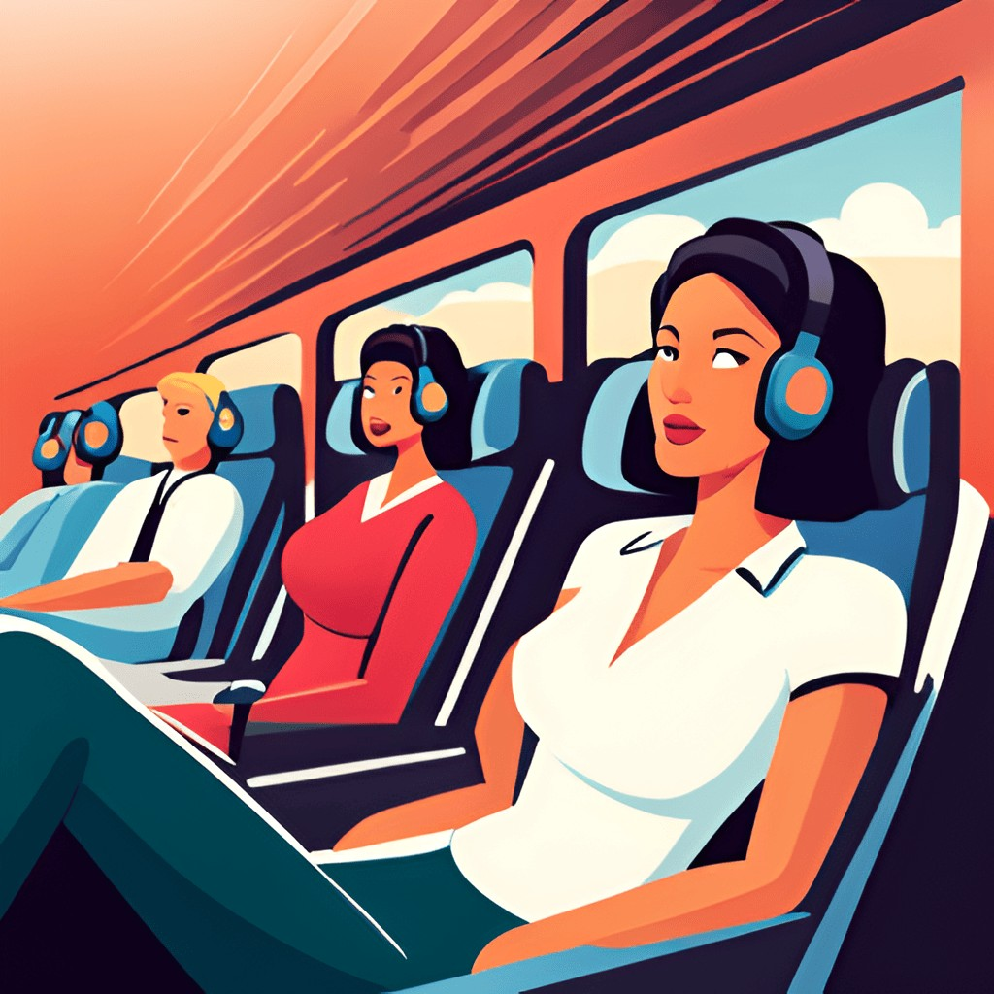
Carpooling etiquete
Being a good carpooler is not just about sharing rides, it's also about respecting your fellow passengers and making the e perience as enjoyable as possible for
everyone. Here are some e amples of good carpooling etiquet e: -
Be punctual: Arrive at the pickup location on time so that you don't keep your fellow passengers waiting. -
Be courteous: Say hello and goodbye to your fellow passengers and thank the driver for the ride. -
Be respectful: Don't smoke or eat food
with strong odors in the car without asking permission from your fellow passengers. -

Slide 8
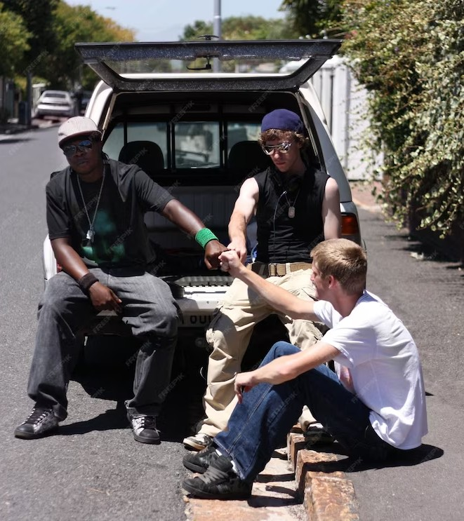
Join the carpooling movement
Joining the carpooling movement is not only a smart choice, but also a responsible one. By sharing rides with others, you can reduce traffic congestion and lower carbon emissions, all while saving money on gas and vehicle maintenance.
To ﬁnd carpool partners, start by asking friends, family, and coworkers if they are interested.

Slide 9
Conclusion
Carpooling: Transforming Commutes for Good Carpooling offers a myriad of advantages, including reduced
trafﬁc congestion, cost savings, social connections, and a positive environmental impact. By embracing carpooling, we can make a signiﬁcant difference in our daily lives and create a more sustainable future.

Slide 10
Thanks!

