Slide 1

Project Open Book Circle Website
Welcome to our Open Book Circle where you can find your perfect reading match. Explore our vast collection, create an account to personalize recommendations, and get started on a literary adventure

Slide 2

Project supervisor: Mr. Amit kr. Goyal
Team Member: Jyoti Mishra, Kumari Surbhi
Team Leader: Jyoti Mishra

Slide 3

Introduction
Welcome to the world of Open Book Circle! Discover the power of connecting readers and sharing knowledge through our user-friendly platform.
The application also features a recommendation engine that suggests new books based on users’ reading history and community ratings.
Python is the primary programming language used to develop the Open Book Circle web application . Python’s simplicity, versatility, and extensive libraries make it an ideal choice for building interactive web applications

Slide 4
Technologies / Software Requirements
Python
Machine Learning
Utilize the Python programming language to build the backend logic and functionality of the Open Book Circle website.
Leverage machine learning techniques to provide personalized book recommendations based on user preferences and reading habits.
HTML & CSS
Flask Framework
Create visually appealing and responsive web pages using HTML and CSS, ensuring an intuitive and enjoyable user experience.
Implement the Flask framework in the development process, allowing for efficient routing and handling of user requests.

Slide 5
Modules Description
1
Create Account
Step 1: Sign Up
Step 2: Share Your Interests
Step 3: Start Exploring
2
Book Recommendation
Implement a sophisticated recommendation system that suggests books based on user interests.
3
Search Functionality
Enable users to easily search for books based on genres, authors, titles, and other criteria, enhancing their exploration of the literary world.
Notification
4
Receive notifications about new book releases, personalized recommendations, and exclusive offers tailored just for you.
5
Contact Us
Reach out to our dedicated support team for any questions, technical issues, or assistance.
Feedback
6
We value your input. Share your thoughts, suggestions, and ideas to help us improve our book recommendation system.
7
Help and Support
The user may get help about the software through this option.
Logout
8
By logging out, you temporarily pause receiving recommendations until you log back in and your personalized reading journey resumes.

Slide 6
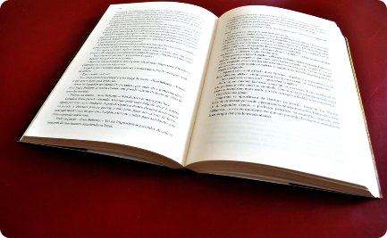


Outputs
Engaging User Interface
Personalized Recommendations
Efficient Book Search
Create an attractive and intuitive user interface, ensuring a seamless and enjoyable browsing experience.
Develop a powerful search functionality that provides quick and accurate results, allowing users to find their desired books effortlessly.
Deliver tailored book recommendations to users, sparking their curiosity and helping them discover new literary gems.

Slide 7
How to Serve the Society
Open Book Circle aims to serve the society by promoting reading culture, supporting authors.
A book recommendation system project can serve society in several meaningful ways by promoting literacy, education, and cultural enrichment while fostering and facilitating access to knowledge.

Slide 8
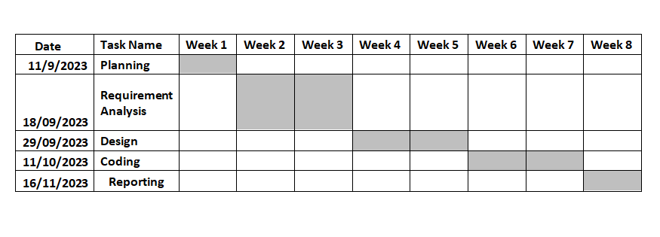
Gantt Chart

Slide 9

Conclusion
Join the Open Book Circle community today and embark on a journey full of literary adventures. Experience the joy of discovering new books and connecting with fellow readers!

