Slide 1

KIET Group of Institutions
Presentation (Project Activity)
MCA 2nd Year (3rd Semester)
2022-2023
Submitted by: Under the guidance of :
Vivek Kumar Dr.AmitKumar
Vishal Nehra

Slide 2

Online Food ordering application

Slide 3

introduction
Online Food Ordering has become an indispensable part of everyone\'s lives. The internet has grown so big on a various scale like what was it before and that has greatly affected the lifestyle of the whole world. This introduced a new concept of online ordering and delivery of food services. Thus, Online Food Ordering Application primarily helps in delivering the following tasks of order and delivery of food services. The online food ordering system provides convenience and is made for catering to the needs of the customers. Nowadays every person prefers to order food online rather than cooking food at home because of the quick and easy availability of these services.

Slide 4

abstract
In this document the requirements specification for an online food ordering system designed primarily for use in the food delivery industry.
My system will allow restaurants to quickly and easily manage an online menu which customers can browse and use to place orders with just a few clicks. The system then relays these orders to restaurant employees through an easy to navigate graphical interface for efficient processing.

Slide 5

“Business opportunities are like buses. There’s always another one coming.”
Richard Branson

Slide 6
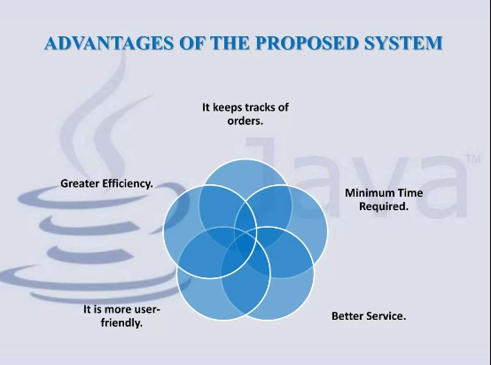
Advantage of the proposed system

Slide 7

Timeline
Sep
oct
nov
dec
jan
Synergize scalable
e-commerce
Disseminate standardized
metrics
Coordinate
e-business applications
Foster holistically superior methodologies
Deploy strategic networks with compelling
e-business needs

Slide 8
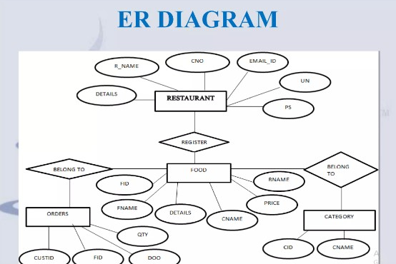

Slide 9
KOTLIN
Kotlin is a cross-platform, statically typed, general-purpose high-level programming language with type inference. Kotlin is designed to interoperate fully with Java, and the JVM version of Kotlin's standard library depends on the Java Class Library,^{[3][failed verification]} but type inference allows its syntax to be more concise. Kotlin mainly targets the JVM, but also compiles to JavaScript (e.g., for frontend web applications using React or native code via LLVM (e.g., for native iOS apps sharing business logic with Android apps).^{[5]} Language development costs are borne by JetBrains, while the Kotlin Foundation protects the Kotlin trademark.^{[6]}
On 7 May 2019, Google announced that the Kotlin programming language was now its preferred language for Android app developers.^{[7]} Since the release of Android Studio 3.0 in October 2017, Kotlin has been included as an alternative to the standard Java compiler.

Slide 10
My sql
In this project, MySQL is used as the backend database. MySQL is an open source database management system.
The feature of MySQL are given below :
Scalability: MySQL offers excellent scalability, supporting both small-scale applications and large, high-traffic websites or databases.
Performance: It's known for its high performance, providing fast query execution, indexing techniques, and memory caching to optimize data retrieval.
Security: MySQL offers robust security features including access controls, encryption, and authentication mechanisms to safeguard data.
Replication and High Availability: It supports replication, allowing data to be copied across multiple servers for backup and improved availability in case of failure.

Slide 11

Summary
A food ordering application revolutionizes dining experiences by offering a user-friendly platform for browsing diverse restaurant menus, placing orders, and making secure payments from the convenience of a smartphone or computer. Overall, food ordering applications simplify the way people discover, order, and enjoy a wide array of choice, and satisfaction in the realm of dining.

Slide 12


Thank you

