Slide 1



Slide 2

MentorU

Slide 3
Team member
Ajay Singh Yadav
Abhishek Pandey Project mentor
Ms. Neelam Rawat

Slide 4
Hardware requirement
System : i3 Processor
Hard Disk : 500 GB minimum
Monitor
Input Devices : Keyboard, Mouse
Ram : 2 GB minimum

Slide 5
SOFTWARE REQUIREMENTS
Windows 7/8/10/11(32- bit or 64-bit)
Visual Studio Code
4GB RAM Minimum
Processor i3 or i5

Slide 6
INTRODUCTION
Online College Student Mentoring Web Application :
Welcome to our presentation on the Online College Student Mentoring Web Application! In today's digital age, the importance of mentorship in educational and professional development cannot be overstated. With the increasing demand for personalized guidance and support, we are thrilled to introduce our innovative solution designed to bridge the gap between mentors and mentees in the online college community.

Slide 7
Technologies
HTML (HyperText Markup Language):
Use HTML to structure the content of your web pages. Define the layout, headings, paragraphs, forms, and other elements that make up your application's interface.
CSS (Cascading Style Sheets):
Apply CSS to style the appearance of your HTML elements. Define colors, fonts, spacing, borders, and other visual aspects to make your web application visually appealing and user-friendly.
Bootstrap:
Bootstrap is a front-end framework that provides pre-designed components and styles for building responsive web applications quickly and efficiently.
MySQL:
MySQL is a popular relational database management system (RDBMS) that is commonly used for storing and managing data in web applications.
PHP (Hypertext Preprocessor):
PHP is a server-side scripting language that is commonly used for building dynamic web applications.
Use PHP to handle form submissions, process user input, interact with the MySQL database, and generate dynamic content for your web pages.

Slide 8
PROPOSED SYSTEM
User Registration and Authentication:
Users (mentors and mentees) can register for an account with their email address or social media accounts.
User Profiles:
Users create profiles that include personal information, academic background, career interests, and areas of expertise (for mentors).
Mentor-Mentee Matching:
The system uses an algorithm to match mentees with mentors based on compatibility criteria.
Matching criteria include academic interests, career goals, availability, geographic location, and preferences.
Messaging and Communication:
The platform provides a messaging system for mentors and mentees to communicate securely.
Appointment Scheduling:
An integrated calendar and scheduling system allows mentors and mentees to plan and manage mentoring sessions.

Slide 9
MODULE DESCRIPTION
User Management Module:
This module handles user registration, authentication, and profile management.
Functionalities include user registration, login, logout, password reset, and profile editing.
Mentor-Mentee Matching Module:
This module facilitates the matching process between mentors and mentees.
It includes algorithms or criteria for matching based on user preferences, interests, and goals.
Users can view recommended matches and express interest in mentoring or being mentored.
Messaging and Communication Module:
This module enables secure communication between mentors and mentees.
Features include real-time chat, messaging threads, file sharing, and scheduling of mentorship sessions.
Resource Sharing Module:
This module provides a repository of resources for mentors to share with their mentees.
Users can browse, search, and access resources such as articles, videos, presentations, and online courses.
Mentors can recommend resources to their mentees based on their individual needs and goals.

Slide 10
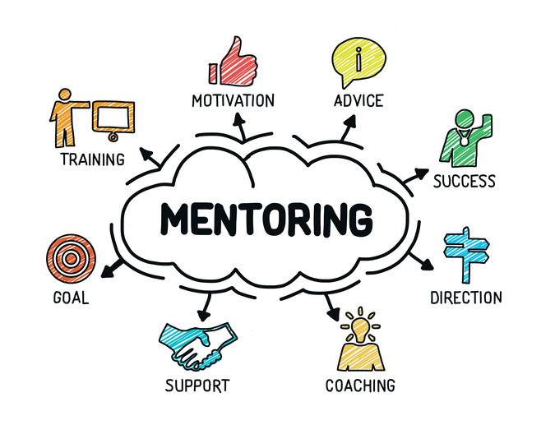

Slide 11
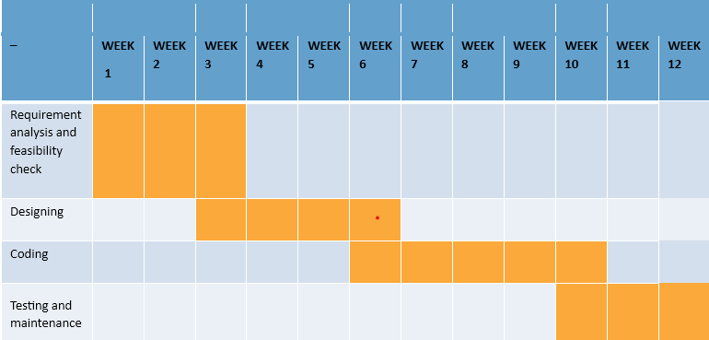
GANTT CHART

Slide 12
CONCLUISON
The development of an online college student mentoring web application presents a promising opportunity to enhance the educational experience and professional growth of students. By leveraging modern technologies such as HTML, CSS, Bootstrap, MySQL, and PHP, along with thoughtful design and functionality, we can create a platform that fosters meaningful mentorship connections between mentors and mentees.
Through user-friendly interfaces, secure communication channels, and robust features like mentor-mentee matching, goal setting, progress tracking, and resource sharing, our platform aims to empower users to achieve their academic and career aspirations. By facilitating mentorship relationships that are personalized, flexible, and supportive, we can foster a culture of collaboration, learning, and mentorship excellence within the online college community.

Slide 13


