Slide 1
CodeX
Programming Learning Web application

Slide 2
Made By:- Under Supervision of :-
Ashutosh Modanwal Ms. Annu Yadav

Slide 3
Introduction
The CodeX project is a comprehensive web-based platform designed to revolutionize programming education. Leveraging modern technologies such as MERN Stack, TailwindCSS. CodeX offers a dynamic learning experience for students and instructor both.
CodeX is a web application aimed at providing a platform for learning programming through a wide range of courses. It is designed to cater to both administrators and students, offering a seamless experience for managing courses and acquiring programming knowledge

Slide 4
Software REQUIREMENT
Font End
HTML,CSS,React.JS,Java script
Back End
Node JS, Express JS,
Windows
Windows 10
Data Base
Mongo-DB

Slide 5
Hardware requirement
PROCESSOR
Intel dual Core(32 bit)
RAM
2 GB

Slide 6
Modules Description
1. User Authentication Module
Description: This module handles user registration, login, and authentication. It includes functionalities for email verification through OTP (One-Time Password) and password reset.
Key Features:
User Registration
Email Verification with OTP
Secure Password Handling
Login and Logout Functionality
Password Reset via Email

Slide 7
2. Admin Dashboard Module
Description: This module is designed for administrators to manage courses efficiently. It provides a user-friendly interface to perform tasks such as adding, editing, and deleting courses.
Key Features:
Course Management (Add, Edit, Delete)
View List of Existing Courses
Add New Courses with Details
3. Student Dashboard Module
Description: This module caters to students, offering them access to a catalog of available courses. Students can enroll in courses, view their progress, and manage their profile.
Key Features:
Browse Available Courses
View Course Details (Title, Description, Price)
Enroll in Courses by Making Payments
View Enrolled Courses and Progress.

Slide 8
4. Course Management Module
Description: This module focuses on the management of individual courses. It allows administrators to specify course details like title, description, price, and associated image.
Key Features:
Add and Edit Course Details
Assign Title, Description, and Price
Associate Images with Courses
Categorize Courses for Easy Navigation
5. Payment Processing Module
Description: This module integrates the Stripe API for secure payment processing. It handles transactions and updates student enrollment status based on successful payments.
Key Features:
Integration with Stripe API
Secure Payment Processing
Record Successful Transactions
Update Enrollment Status

Slide 9
6. User Profile Module
Description: This module allows users to view and manage their profiles. Students can see their enrolled courses, while admins have access to additional administrative functionalities.
Key Features:
View User Profile Information
List Enrolled Courses (for Students)
Additional Admin Functionalities (for Admins)
8. Notification Module
Description: This module handles the generation and sending of email notifications for actions such as registration, password reset, and successful course enrollment.
Key Features:
Send Email Notifications for User Actions
Notify Users of Successful Registrations and Enrollments

Slide 10
9. Feedback and Rating Module
Description: This module allows students to provide feedback and ratings for courses they have completed. Admins can view and respond to student feedback.
Key Features:
Students Provide Feedback and Ratings
Admins View and Respond to Feedback
10. Security and Data Privacy Module
Description: This module focuses on ensuring the security and privacy of user data. It includes measures like password hashing and secure handling of personal and payment information.
Key Features:
Password Hashing and Storage
Data Encryption for Personal and Payment Information

Slide 11
OUTCOME
Empowering Learning: CodeX aims to empower individuals with a user-friendly platform for learning programming. It provides access to a diverse range of courses, allowing users to acquire valuable skills and knowledge in the field of programming.
Efficient Course Management: The Admin Dashboard facilitates efficient course management, enabling administrators to add, edit, and delete courses effortlessly. This streamlines the process of keeping course content up-to-date and relevant.
Secure Authentication and Verification: The user authentication module ensures secure registration and login processes. The email OTP verification mechanism adds an extra layer of security, protecting user accounts from unauthorized access.

Slide 12
Monetization through Payments: The integration with Stripe API enables secure payment processing. This allows students to enroll in courses by making payments, providing a monetization model for the platform.
Engaging User Experience: The Student Dashboard offers an engaging user experience, with features like course browsing, enrollment, and progress tracking. Students can easily navigate through available courses and monitor their learning journey.
Feedback and Improvement: The feedback and rating module encourages user engagement and provides valuable insights for course improvement. Admins can respond to feedback, fostering a sense of community and continuous improvement.

Slide 13
conclusion
CodeX is a comprehensive programming learning web application built on a powerful technology stack. By utilizing MERN, TailwindCSS, Strapi and Stripe, the project offers a seamless experience for both administrators and students. With its user-friendly interface and robust features, CodeX aims to revolutionize the way programming education is delivered online. This project has the potential to be a game changer in online education.

Slide 14
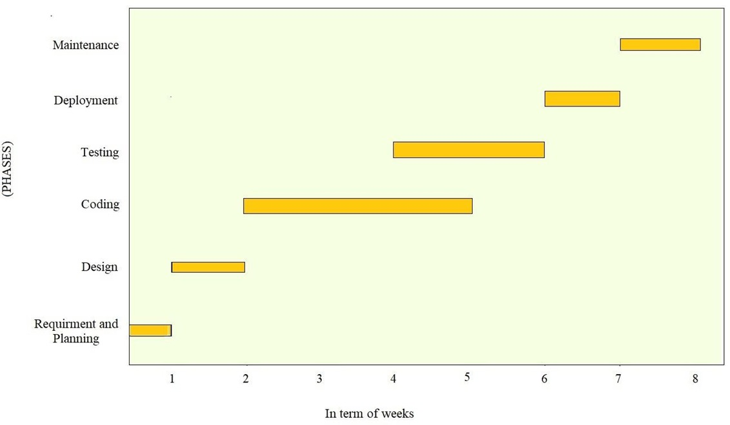
Gantt Chart

