Slide 1
PLANT KART : A Plant purchasing web application
Under the guidance of
Ms. Divya Singhal
Presented By-------------------
AMAN DHIMAN
2200290140023
AMAN KUMAR
2200290140024

Slide 2

Introduction
Welcome to Plant Kart, your one- stop destination for all things green and beautiful! At Plant Kart, we're passionate about plants and gardening, and our mission is to make it easier than ever for you to bring the joy of greenery into your life. Our user-friendly website is designed to simplify your plant shopping experience, oIering a diverse range of plant species and accessories, along with valuable information to help you nurture your botanical companions.

Slide 3

Project Objectives
The objective of Plant Kart, a plant purchasing website, is to empower individuals and gardening enthusiasts with a convenient, accessible, and comprehensive platform for buying a wide array of plants and gardening supplies. Our mission is to foster a love for gardening and green living by oIering an extensive catalog of healthy, high-quality plants, gardening tools, and resources, while ensuring a seamless and secure shopping experience.

Slide 4

Research Methodology
The research methodology for PlantKart, a plant purchasing website, encompasses a multi-faceted approach that integrates both qualitative and quantitative methods. Initially, market research will be conducted to identify current trends and customer preferences in the plant industry, using surveys and data analytics to gather insights. User personas and journey mapping will be employed to understand the target audience's needs and pain points. Competitive analysis will also be conducted to benchmark against similar platforms. Additionally, user testing and feedback collection will be crucial for iterative website development, ensuring user-friendliness and satisfaction

Slide 5
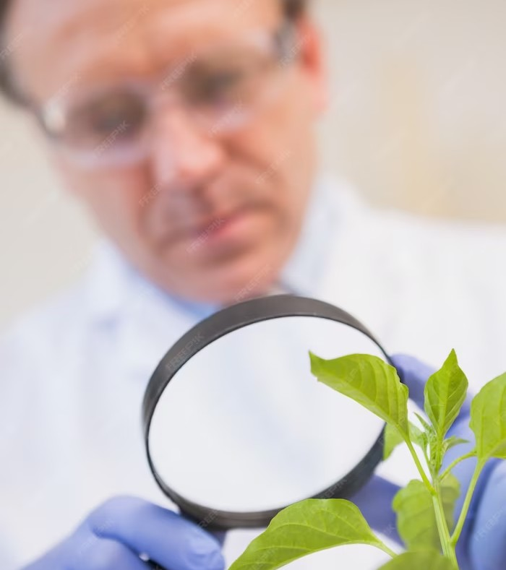
Project Outcomes
The outcomes of Plant Kart, our plant purchasing website, are multi-faceted. Firstly, we aim to foster a community of green enthusiasts who can create and maintain beautiful, sustainable gardens, contributing to a greener planet. Through our platform, customers can access a wide variety of plants and gardening supplies, leading to increased accessibility and diversity in their green spaces. We also strive to provide valuable information and resources to educate and empower our users, enhancing their gardening skills and knowledge.

Slide 6

References
What is Advanced Java? – ( GeeksforGeeks )
Introduction • Bootstrap v4.5 (getbootstrap.com)
Java: The Complete Reference, Twelfth Edition, 12th Edition by
Herbert Schildt.

Slide 7
Conclusion
In conclusion, Plant Kart stands as a dedicated and customer-focused plant purchasing website committed to enriching lives through the beauty and beneﬁts of nature. Our mission to provide a wide variety of
high-quality plants and gardening supplies, coupled with expert guidance and sustainable practices, has been met with the goal of inspiring and supporting gardeners of all levels. By fostering a thriving online community of plant enthusiasts, continuously researching market trends, and prioritizing user feedback, we aspire to create an ecosystem that not only simpliﬁes plant shopping but also promotes responsible and sustainable gardening. With Plant Kart, we aim to empower individuals to cultivate their green spaces, thereby contributing to a greener, more beautiful world for all.

Slide 8
Thanks!

