Slide 1
TALKALYTICS: WhatsApp chat analyzer
Author :- Amritesh kaur

Slide 2
INDEX
Introduction
Objective
Literature Review
Methodology
System Architecture
Results
Conclusion

Slide 3

Introduction
WhatsApp is a widely used application nowadays. Which makes it all the more relevant to dig up our daily conversations in order to get an insight about quality of our relationships, our overall mental health and well-being.
Application can help us understand what topics interest us more, what topics we are more comfortable discussing with which people, how actively do we use WhatsApp and when which also helps in monitoring the time we spend on social media.

Slide 4

Objectives
Gain insight about WhatsApp conversation
Useful for small business operated on WhatsApp
Topic extraction
Behavioural analysis

Slide 5
Literature Review
WhatsApp chat analyzer is a tool that can help you in easy understanding of the conversations you are having with a person personal or professional. Now days we use different platforms to chat with people and stay connected but the analysis of that chat is much needed in this fast paced world.
Talkalytics help you analyze your conversations and get better idea about the quality of your conversation, also to know about the most discussed topics

Slide 6
Methodology
Selection of WhatsApp Conversations: Identify the scope of the analysis and select the WhatsApp conversations that will be included in the study. This could involve obtaining consent from participants or using publicly available datasets.
Data Extraction: Develop a method to extract WhatsApp chat data, considering factors such as message content, timestamps, sender/receiver information, and multimedia attachments.
Clean the text data by removing irrelevant information, handling special characters, and addressing any language-specific nuances.
Examine the flow and structure of the conversation to understand how topics evolve over time. Explore the relationships and interactions between different users within the conversation.
Identify frequently used words, phrases, or emojis to gain insights into common themes or patterns using different python libraries.

Slide 7
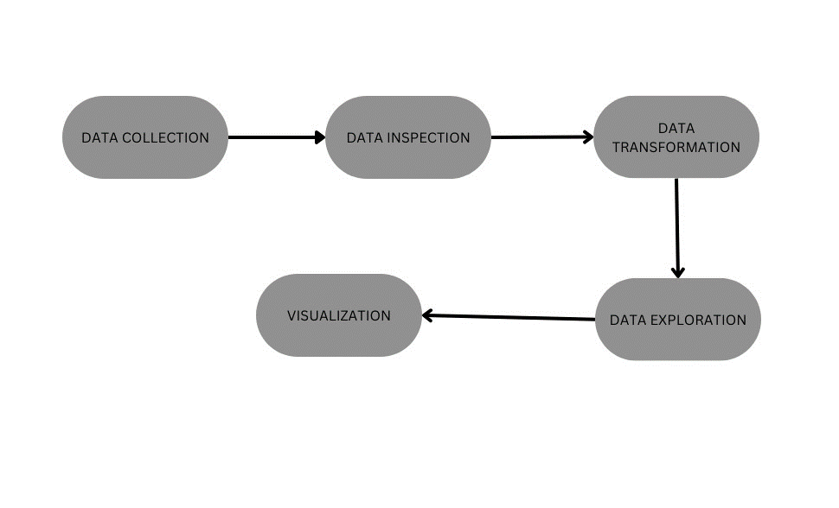
System architecture

Slide 8
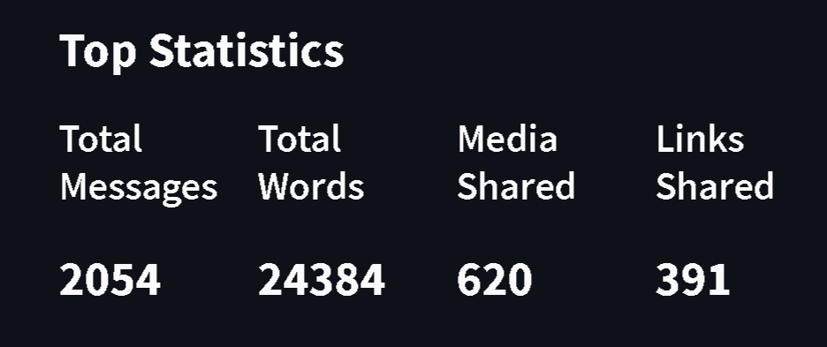
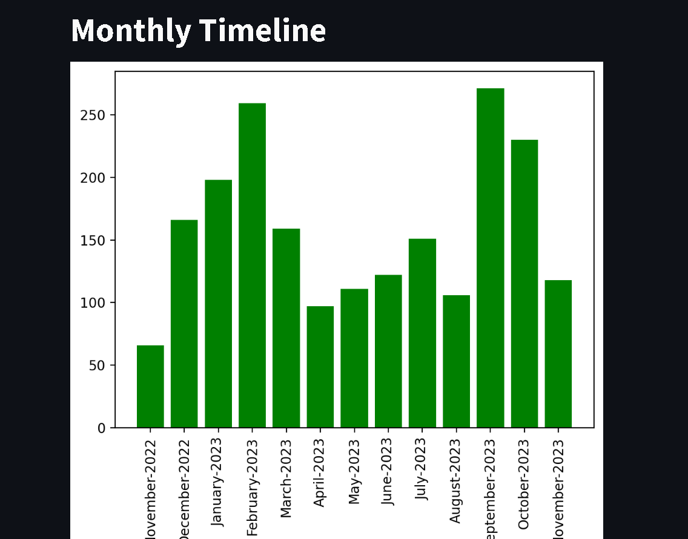
Results

Slide 9
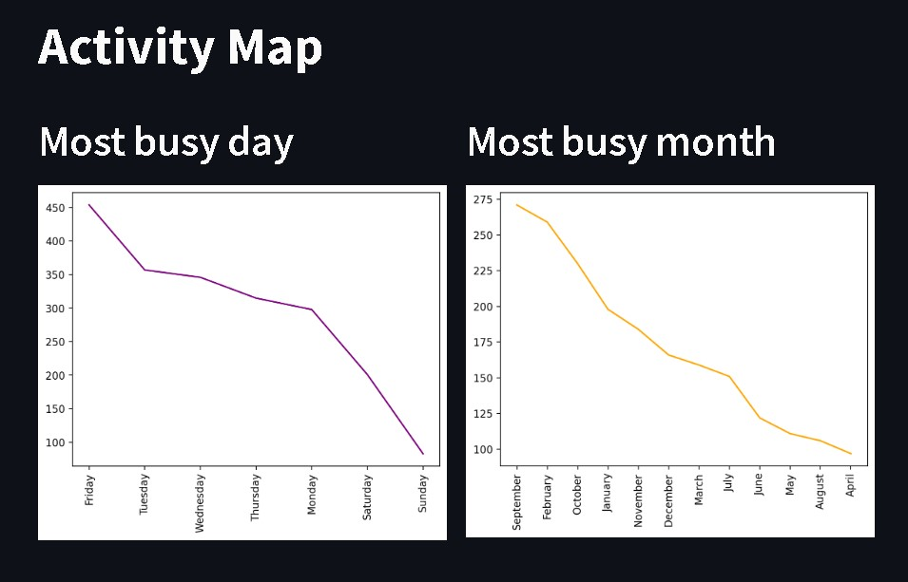
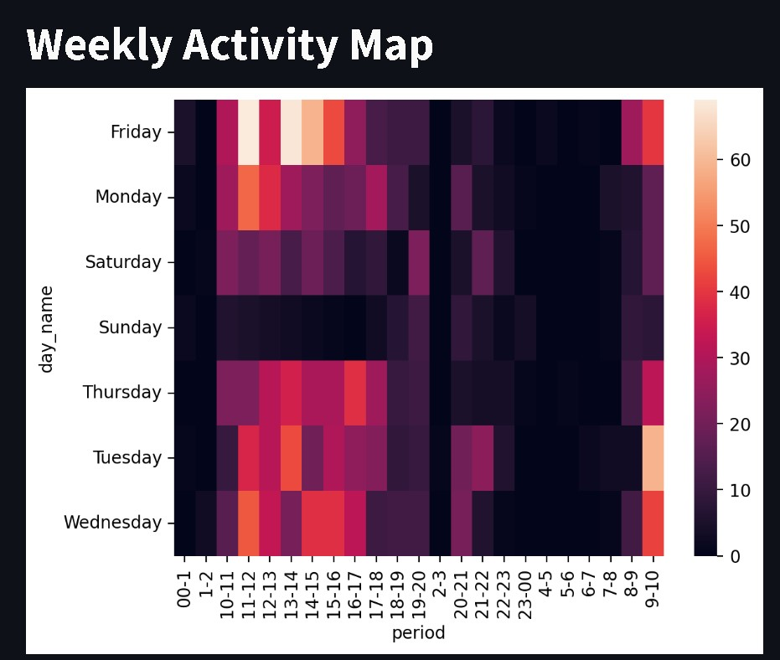
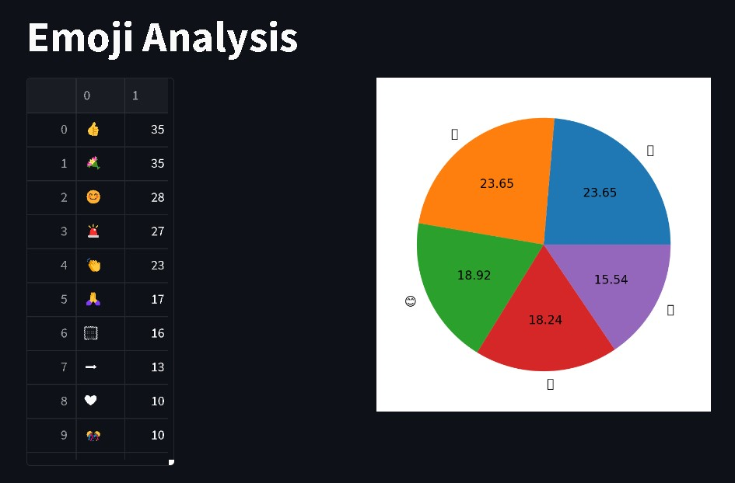

Slide 10
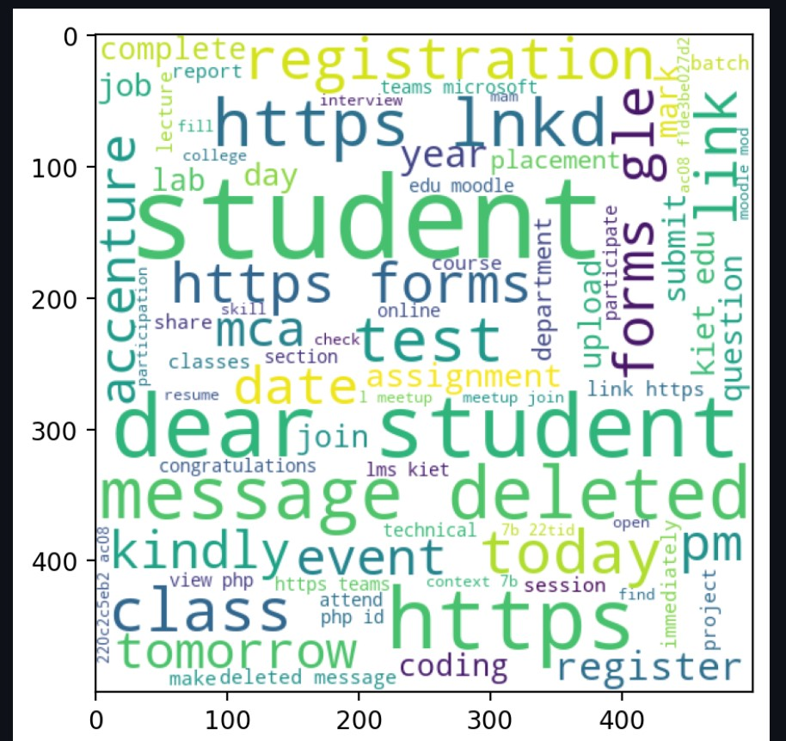
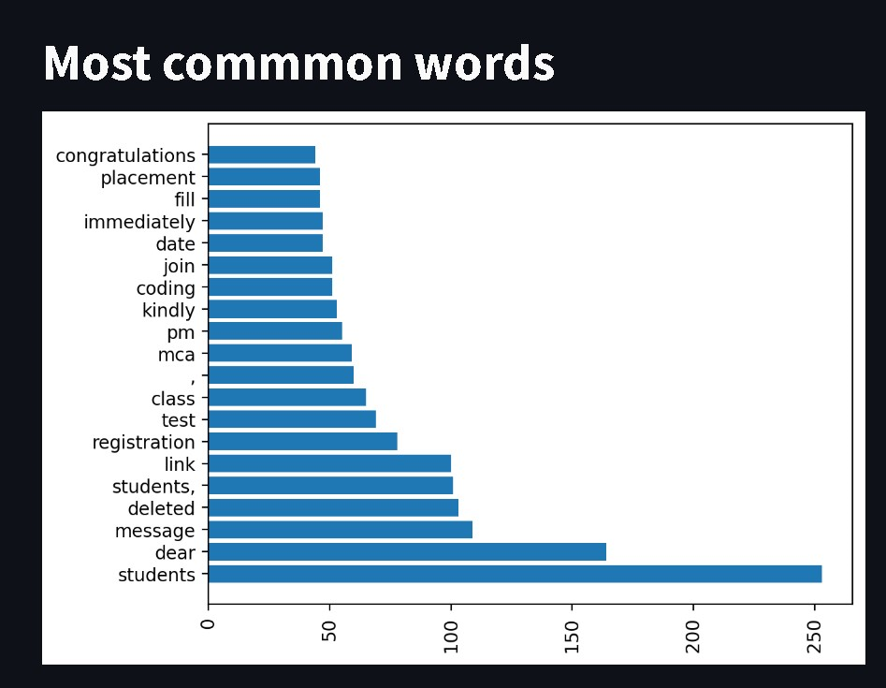

Slide 11
Conclusion
In conclusion, a WhatsApp chat Analyzer can be powerful tool for gaining insights into the group conversations or one to one conversation. By analyzing the messages, we can gain information about the frequency of the communication, the topics that have been mostly discussed and the overall active time period of the group. With the help of this information, we can actually identify the patterns and trends which in turn will help us understand the group dynamics and communicate effectively.

Slide 12


