Slide 1
Blogging System

Slide 2
Outline
Introduction
Features
Work Out
Tools and Languages
ER Diagram
➤DB Design
Site Tree
Conclusion

Slide 3
Introduction
➤ A blog is basically a web site which is used for chronological listing of blog posts.
➤ A blog has the most recent content shown first followed by the previously updated content.
➤ In a blog there are multiple categories and posts written by a large number of authors

Slide 4
Features
➤ The system we have developed allows users to create their own blog, where users can publish their own opinions.
➤ In this system there are admins who takes care of the Blog.
➤ If anyone wants to post first they will have to create a new blog as well as a site account.
The posts may verified by the admins.
There has category list where posts can be saved by relevant category.
➤ People can like, comment and share the posts

Slide 5
Tools and Languages
Tools
1. Notepad++ (v 7.1)
2. XAMPP (v 3.2.2)
Languages
SQL
PHP (v 7.0.4)
HTML (v 5)
CSS (v 3)
Java script

Slide 6
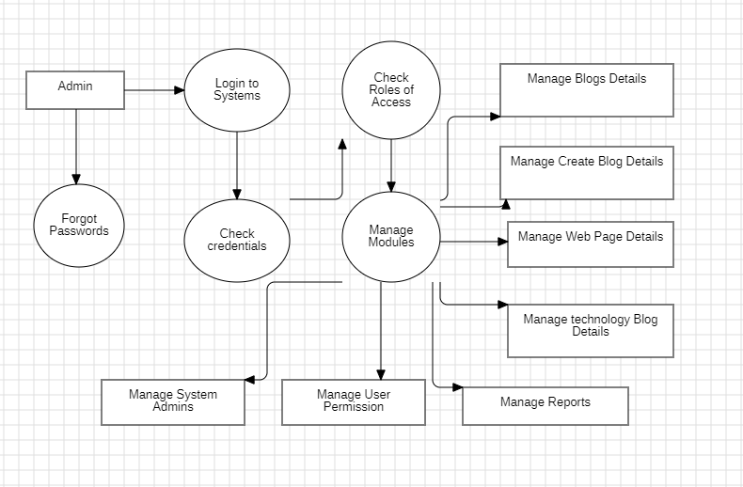
DFD

Slide 7
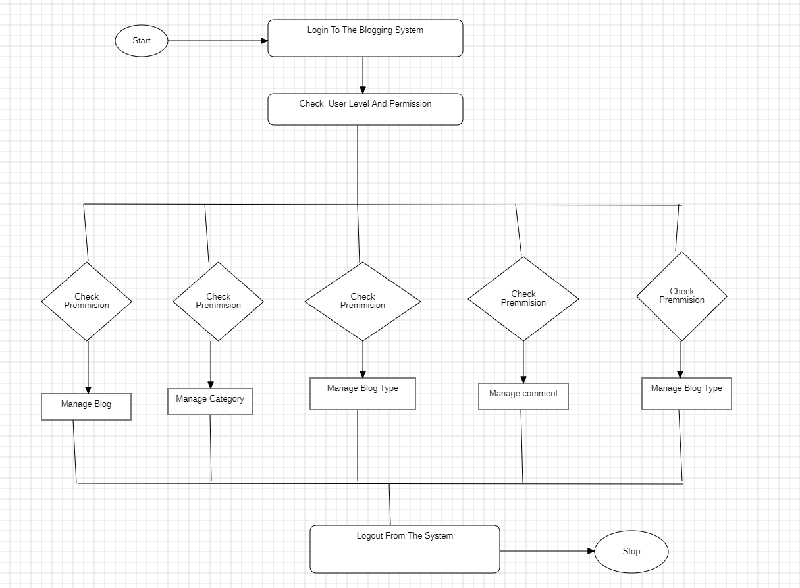
Flow Chart

Slide 8
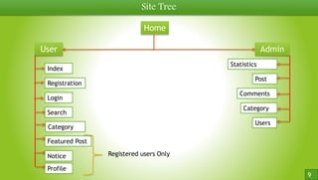
Site Tree

Slide 9
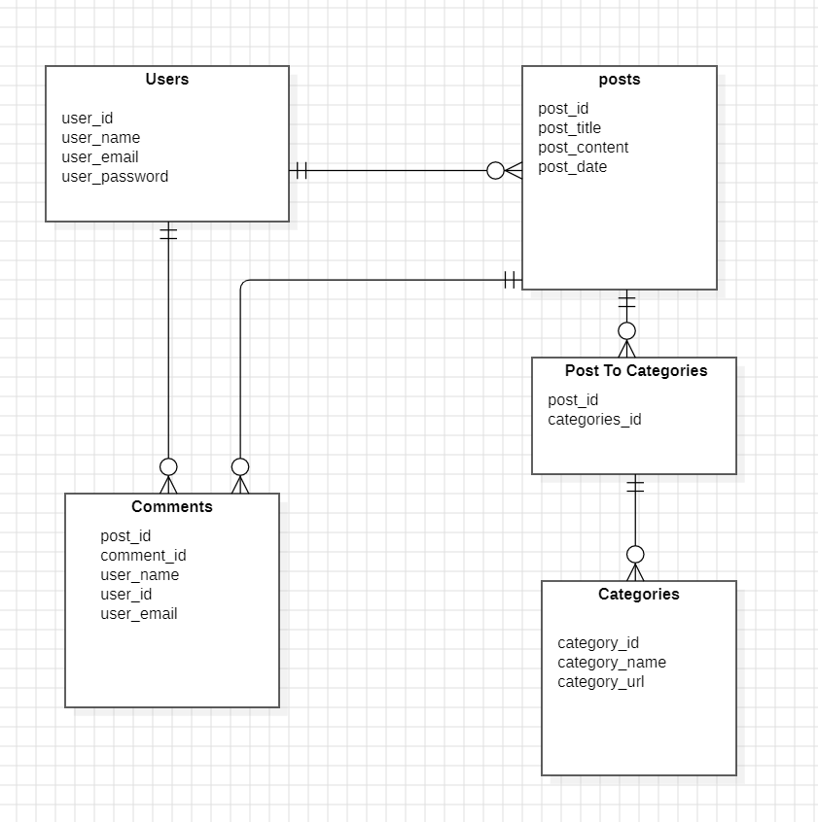
ER Diagram

Slide 10
Work out
➤ Let's take a tour in our blog

Slide 11
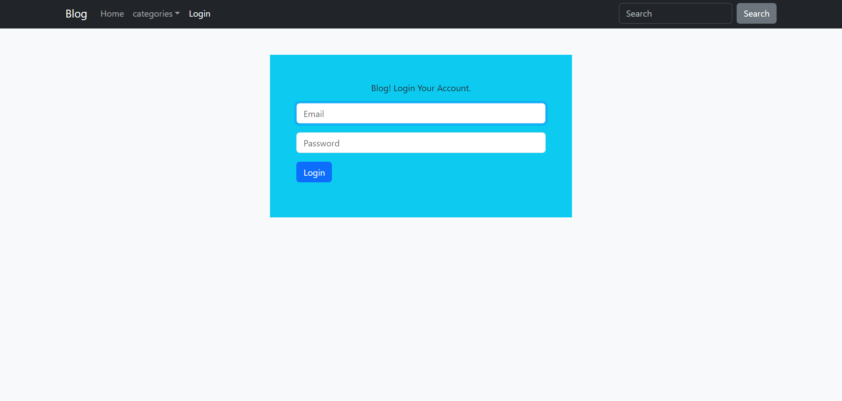

Slide 12
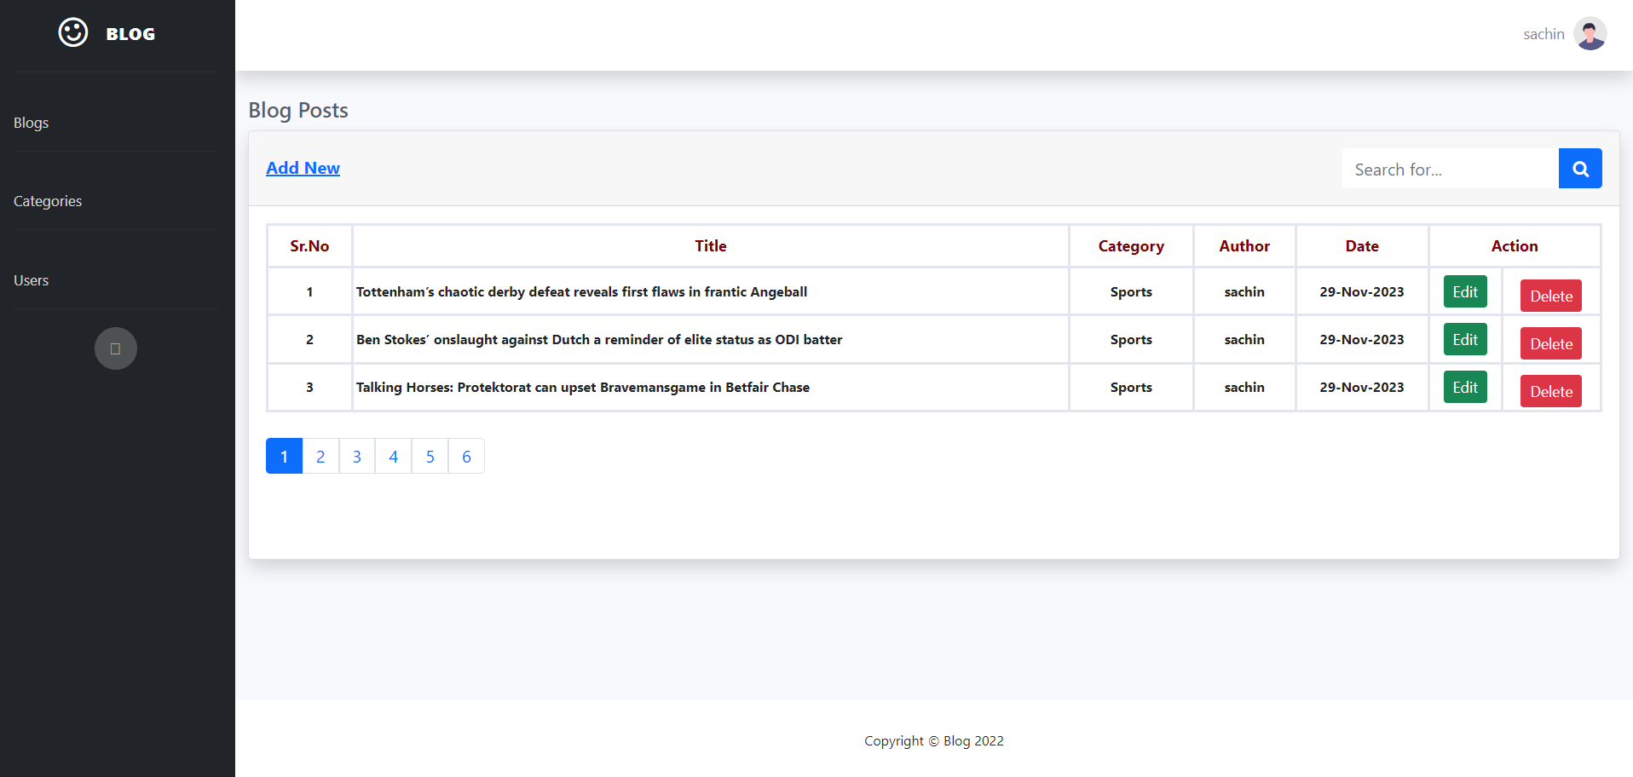

Slide 13
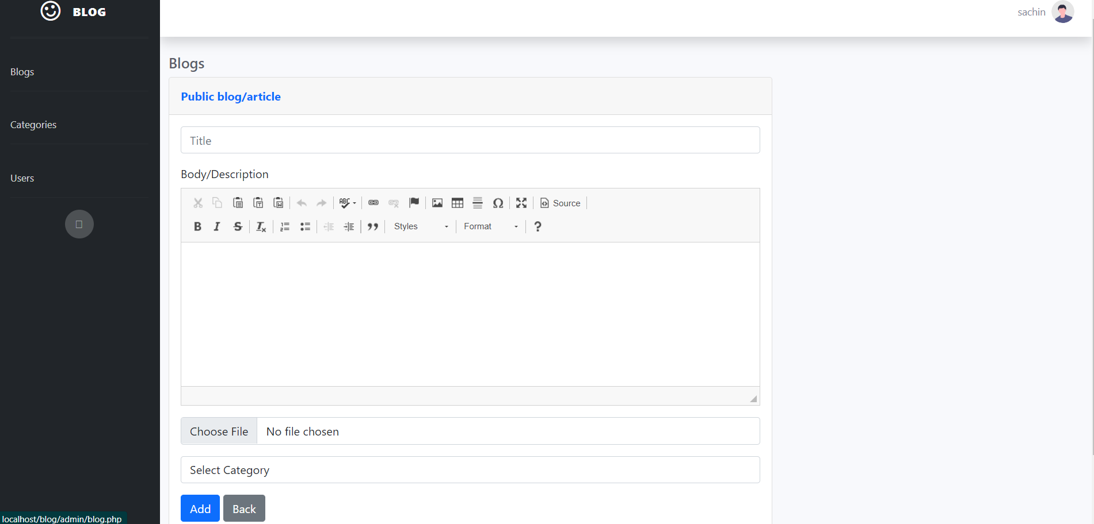

Slide 14
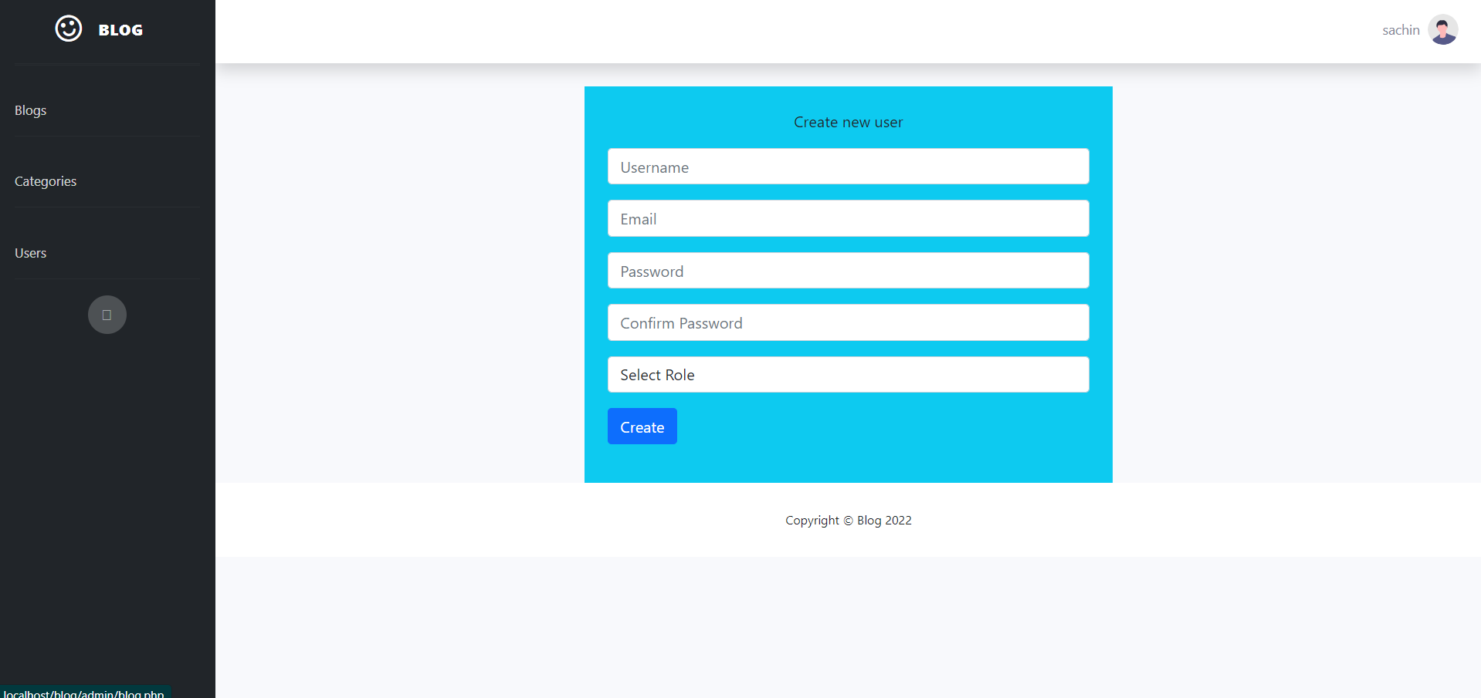

Slide 15
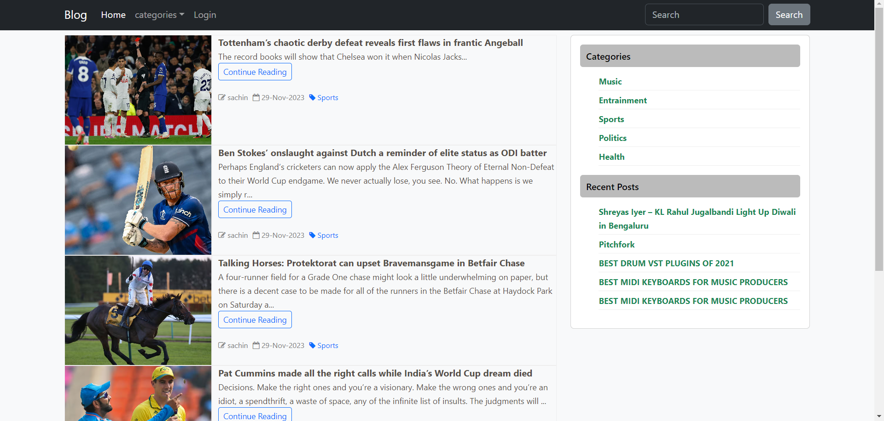

Slide 16
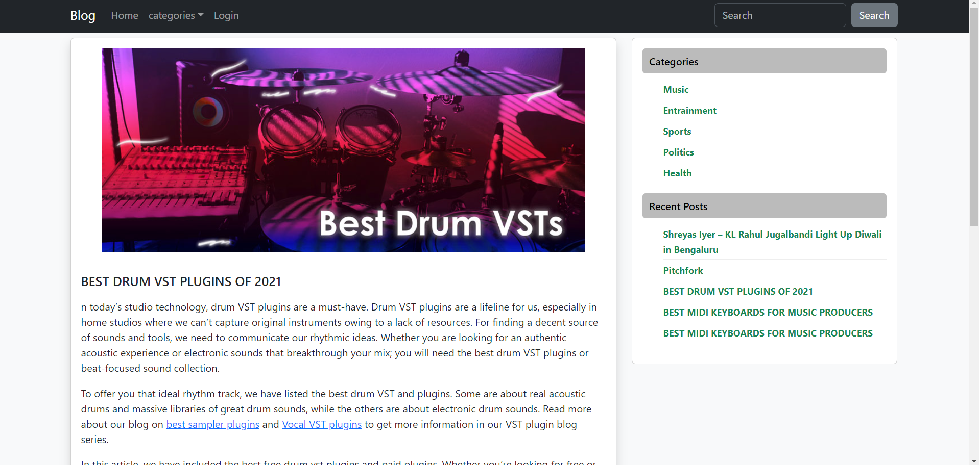

Slide 17
Conclusion
➤ Mail confirmation function implementation was not possible due to localhost server but we tested it.
➤ It wasn't our plan but we worked on adding profile picture and image on posts.

