Slide 1
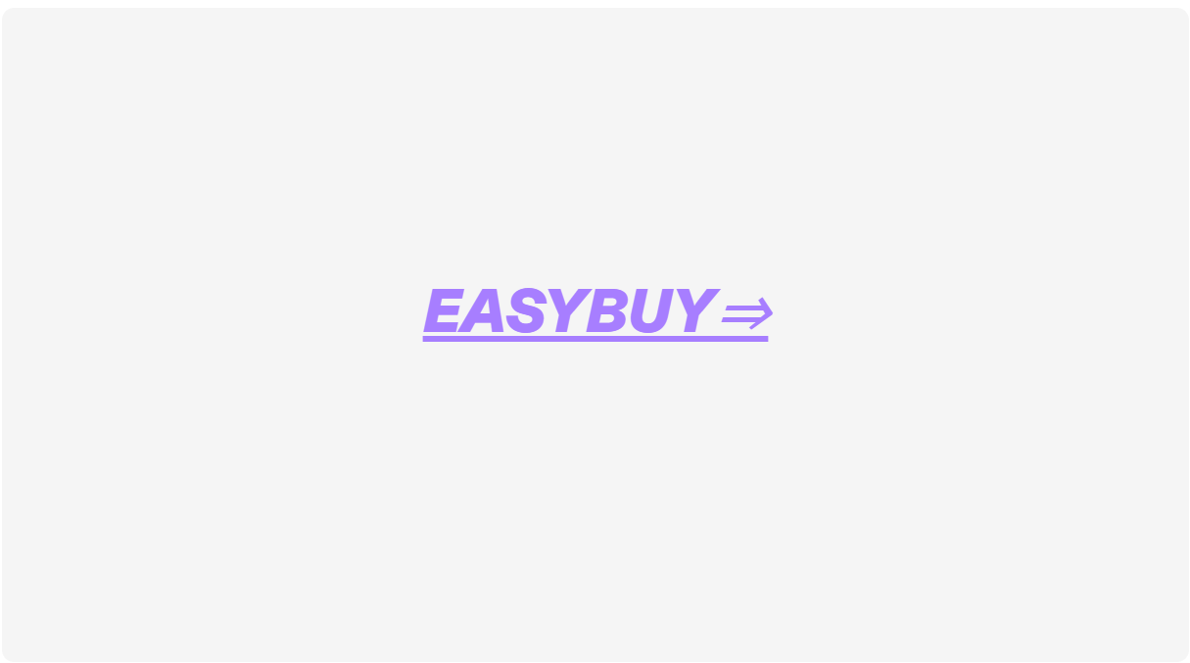

Slide 2
Introduction
What is E-commerce? Java for E-commerce
Spring Boot for E-commerce Vue.js for E-commerce
Building an E-commerce Web Application Security and Payment Processing
Testing and Deployment Conclusion

Slide 3

Introduction
Welcome to our presentation on e-commerce web application development using Java, Spring Boot, and Vue.js.In today's digital age, e-commerce has become an essential part of businesses worldwide.It allows consumers to shop conveniently from the comfort of their homes and enables businesses to reach a wider audience.Building a robust and scalable e-commerce web application is crucial for any business looking to succeed in the online marketplace.
Java, Spring Boot, and Vue.js are powerful technologies that can be used to build dynamic and responsive e­ commerce web applications. Java is a popular choice for building enterprise-level applications due to its
scalability and reliability.Spring Boot is a framework that
simplifies the process of building web applications by providing a set of pre-configured components. Vue.js is a progressive JavaScript framework that allows developers to create interactive user interfaces quickly. Together, these technologies offer a comprehensive solution for building high-performance e-commerce web applications.

Slide 4

What is E-commerce?
E-commerce, or electronic commerce, refers to the buying and selling of goods and services over the internet. It has revolutionized the way we do business by providing a platform for businesses to reach a global audience and for consumers to shop from the comfort of their homes.
There are several types of e-commerce, including 828 (business-to-busi ness),82C (business-to-consumer), C2C (consumer-to-consumer), and C28 (consumer-to­ business).Each type has its own benefits, such as cost savings, convenience, and increased market reach.

Slide 5
Java for E-commerce
Java is a popular choice for building e-commerce web applications due to its versatility and scalability.With Java, developers can create robust and high-performance applications that can handle large amounts of traffic and data.
In addition to its performance benefits,Java also offers a wide range of features and libraries that make it easy to build complex e-commerce systems. For example,the Spring Framework provides a powerful set of tools for building web applications, while Hibernate allows developers to easily manage database operations.
Some successful e-commerce sites built using Java include Amazon, eBay, and Alibaba.These sites have been able to handle massive amounts of traffic and transactions thanks to the power and flexibility of the Java platform.

Slide 6
Spring Boot for E-commerce
Spring Boot is a popular framework for building e-commerce web applications due to its ability to create robust and scalable systems.It offers a range of features such as auto-configuration, which simplifies the setup process,and Spring Data JPA,which provides easy integration with databases.
Another key benefit of Spring Boot is its ability to handle high traffic loads without sacrificing performance. This makes it an ideal choice for e-commerce sites that need to handle large volumes of transactions.Some successful e­ commerce sites built using Spring Boot include Alibaba and Paytm Mall.

Slide 7
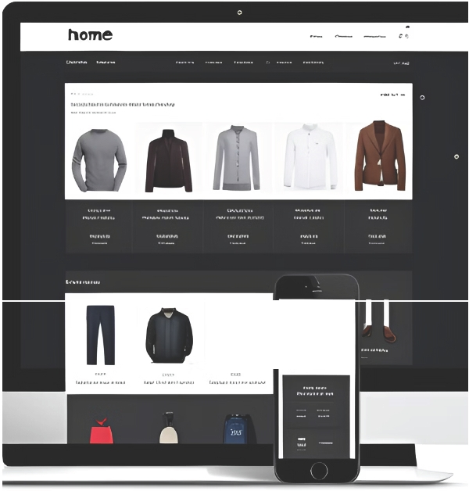
Vue.js for E-commerce
Vue.js is a JavaScript framework that can be used to build dynamic and responsive user interfaces for e­ commerce web applications. It offers a range of features and benefits that make it an ideal choice for building modern, high-performance web applications.
One of the key benefits of Vue.js is its simplicity. It has a
small learning curve, which makes it easy to get started with.Additionally,Vue.js is highly customizable,allowing developers to create unique and engaging user interfaces. Some popular e-commerce sites built using Vue.js include Alibaba.
..........,,..,....-......
'

Slide 8

Building an E-commerce Web Application
To build an e-commerce web application using Java, Spring Boot, and Vue.js, you need to follow a few steps. First, create a project in your preferred IDE and add the necessary dependencies for Spring Boot and Vue.js.
Then, design your database schema and create the necessary tables.
Next, develop your backend using Java and Spring Boot. Implement your business logic, such as handling user authentication and managing product inventory.Finally, create your frontend using Vue.js.Use Vuex to manage global state and Axios to make API calls to your backend. Don't forget to test your application thoroughly before deploying it to production.

Slide 9

Security and Payment Processing
Security and payment processing are critical components of any e-commerce web application. Customers need to feel confident that their personal information is safe when they make a purchase online, and businesses need to ensure that transactions are secure and fraud-free.
Implementing secure payment processing can be challenging, but using third-party services can help. These services handle the complex security requirements of payment processing, such as encryption and tokenization, so that businesses can focus on their core operations.It's important to choose a reputable service provider and to stay up-to-date with the latest security standards and regulations.

Slide 10
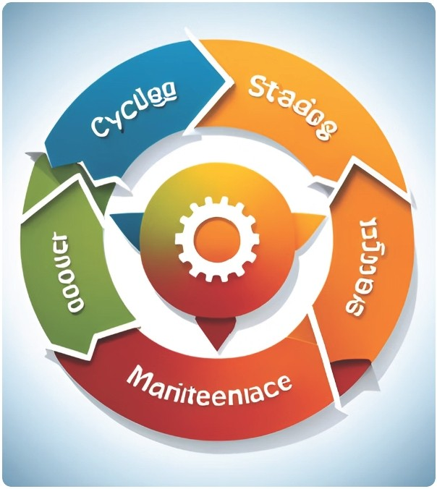
Testing and Deployment
Testing and deployment are critical components of any e-commerce web application.By thoroughly testing the application before deployment, developers can ensure that it is free of bugs and glitches that could negatively impact user experience. There are various types of testing, including unit testing, integration testing, and acceptance testing, each of which serves a different purpose in the development process.
Deployment strategies also play a crucial role in the success of an e-commerce web application. Developers must carefully consider factors such as scalability, reliability,and security when choosing a deployment strategy.Some popular deployment strategies include blue-green deployment, canary deployment, and rolling deployment.

Slide 11

Conclusion
In conclusion, we have discussed the importance of e­ commerce web applications and how they can benefit businesses and consumers.We have also explored the various technologies that can be used to build these applications, including Java, Spring Boot, and Vue.js.
By combining these technologies,developers can create robust and scalable e-commerce web applications that offer dynamic and responsive user interfaces,secure payment processing, and efficient testing and deployment strategies.

Slide 12
Thank You
Shivam Gupta

