Slide 1
Gmail CLONE

Slide 2
Made By:- Under Supervision of :-
Ayush Narayan Maurya Dr.Vipin Kumar

Slide 3
Introduction
Email communication has long been the backbone of modern correspondence, serving as a vital conduit for personal and professional interactions. Among the myriad of email services available, Gmail, developed by Google, has emerged as a dominant player, setting high standards for user experience, functionality, and security. Its widespread adoption speaks to the need for an efficient, user-friendly, and feature-rich email platform. In response to this demand, the "Gmail Clone" project is conceived.
The Gmail Clone project is an ambitious endeavor aimed at replicating the core functionalities and user experience of Gmail while incorporating contemporary web development technologies and innovative features. This project recognizes the enduring significance of email as a means of communication and the desire for alternatives that offer control, privacy, and customization

Slide 4
Software REQUIREMENT
Font End
HTML,CSS,React.JS,Java script
Back End
Node JS, Express JS
Windows
Windows 7
Data Base
Mongo-DB

Slide 5
Hardware requirement
PROCESSOR
Intel dual Core(32 bit)
RAM
2 GB

Slide 6
Modules DESCRIPTION
1. User Authentication and Account Management:
User Registration: Allows users to create new accounts with secure authentication methods.
Login and Logout: Handles user login and logout processes securely.
Profile Management: Allows users to update their profile information, including name, profile picture, and password.
2. Email Composition and Sending:
Compose Email: Provides a user-friendly interface for composing emails with options for rich text formatting, attachments, and multiple recipients.
Send Email: Handles the sending of emails, ensuring proper routing and delivery.
3. Inbox and Email Management:
Inbox: Displays received emails and provides options for organizing, starring, and archiving messages.
Labels and Folders: Allows users to create labels and folders to categorize and manage emails.
Search: Implements a robust search functionality to find specific emails quickly.
Filters: Enables users to set up filters to automatically categorize and sort incoming emails.
4. Notifications:
Delivers real-time notifications to users for new emails, message updates, and other relevant events.
5. Attachments:
Enables users to attach files to emails and provides options for uploading and storing attachments securely

Slide 7
5.Conversation View:
Threaded Conversations: Groups related emails into threaded conversations, making it easier for users to follow and respond to ongoing discussions.
6. Spam Filtering:
Spam Detection: Implements advanced spam filtering algorithms to identify and filter out unwanted emails.
7. Security and Privacy:
Encryption: Implements data encryption (e.g., SSL/TLS) to secure data transmission.
Authentication: Ensures secure user authentication with measures like OAuth2 or JWT.
Privacy Controls: Allows users to set privacy preferences, manage data sharing, and control account security settings.

Slide 8
OUTCOME
User-Centric Email Solution
Real-Time Notifications
Spam Filtering
Security and Privacy
Robust Email Management
Conversation Threads

Slide 9
conclusion
In conclusion, the Gmail Clone project aspires to deliver an open-source email solution that competes with Gmail while offering users greater control, privacy, and customization. The project outcome will provide individuals and organizations with a powerful email platform that prioritizes user experience, security, and accessibility, all while fostering a community-driven development environment.

Slide 10
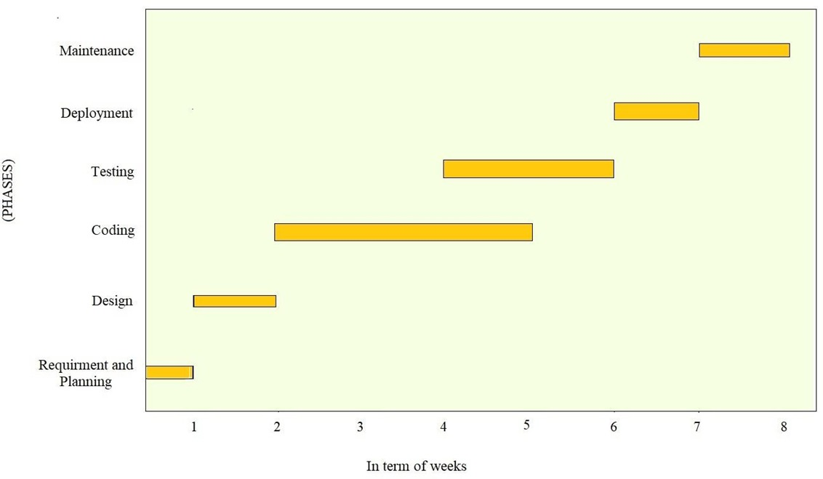
Gantt Chart

