Slide 1



Slide 2

WEATHERWISE

Slide 3
Team member
Abhishek Kumar Singh
Abhishek Gaur
Project mentor
ms. Neelam rawat

Slide 4
Hardware requirement
System : i3 Processor
Hard Disk : 500 GB minimum
Monitor
Input Devices : Keyboard, Mouse
Ram : 2 GB minimum

Slide 5
SOFTWARE REQUIREMENTS
Windows 7/8/10/11(32- bit or 64-bit)
Visual Studio Code
4GB RAM Minimum
Processor i3 or i5

Slide 6

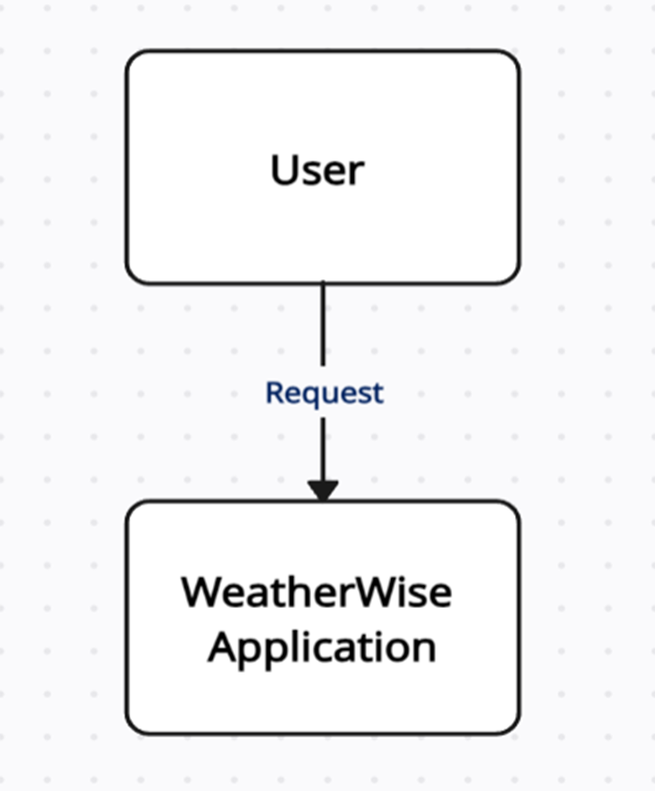

Slide 7
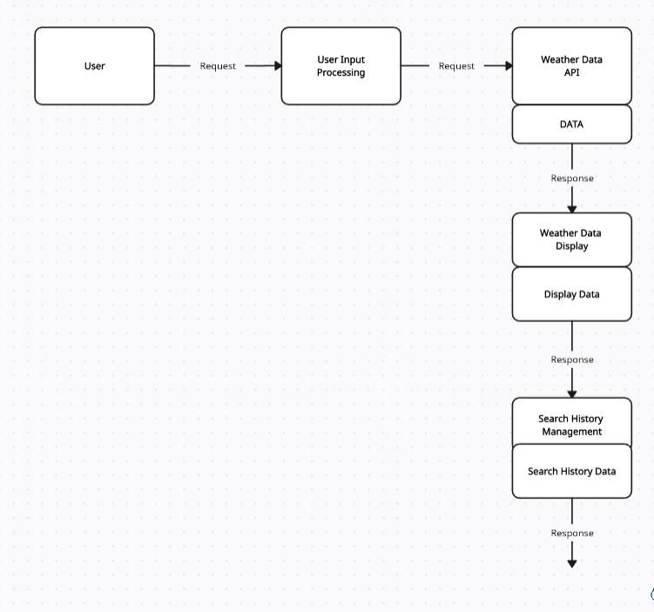
1 Level DFD

Slide 8
Table of Contents
1. Introduction
1.1 Purpose
1.2 Scope
1.3 References
2. System Overview
2.1 Front-end Interface
2.2 Back-end Server
2.3 Database
2.4 External APIs
3. Functional Requirements
3.1 User Input
3.2 Display Current Weather
3.3 Display 5-Day Weather Forecast
3.4 Search History

Slide 9
4 Non-Functional Requirements
4.1 Usability
4.2 Performance
4.3 Security
5. System Features
4.1 City Search
4.2 Current Weather Display
4.3 5-Day Weather Forecast
4.4 Search History
6. External Interface Requirements
6.1 User Interfaces
6.2 API Interfaces
7. Conclusion

Slide 10
1. Introduction
1.1 Purpose
The purpose of this document is to provide a comprehensive Software Requirements Specification (SRS) for the "WeatherWise" web application. This application will allow users to search for weather information for a specific city and view both current and future weather forecasts.
1.2 Scope
The WeatherWise web application will provide the following functionalities:
Users can search for weather information for a specific city.
The application will display the current weather information, including temperature, humidity, wind speed, and UV index.
Users can view a 5-day weather forecast for the selected city.
The application will support clearing the search history.
The application will be responsive and work on various devices.

Slide 11
2. System Overview
The WeatherWise application will consist of the following components:
2.1 Front-end Interface: The user interface where users can input a city name, view weather information, and access the 5-day weather forecast.
2.2 Back-end Server: A server that handles user requests, communicates with external weather data APIs, and processes data.
2.3 Database: To store user search history (city names).
2.4 External APIs: Integration with external weather data APIs to retrieve current and forecasted weather data
3. Functional Requirements
3.1 User Input
Description: Users can enter the name of a city in the search box

Slide 12
3.2 Display Current Weather
Description: The application will display the current weather information for the selected city, including temperature, humidity, wind speed, and UV index.
Dependencies: Integration with external weather data APIs
Preconditions: User must have entered a valid city name.
Postconditions: Current weather data is displayed.
3.3 Display 5-Day Weather Forecast
Description: The application will display a 5-day weather forecast for the selected city, including date, weather icons, temperature, and humidity.
Dependencies: Integration with external weather data APIs
Preconditions: User must have entered a valid city name.
Postconditions: 5-day weather forecast data is displayed.

Slide 13
3.4 Search History
Description: Users can view a list of previously searched city names.
Dependencies: Database for storing search history
Preconditions: User
Postconditions: The list of previous searches is displayed.
4. Non-Functional Requirements
4.1 Usability
The user interface should be intuitive and easy to use.
The application should provide feedback on search queries and loading times.
4.2 Performance
The application should respond to user queries quickly.
External API calls should be asynchronous to prevent blocking the user interface.
4.3 Security
User data, if collected in the future, should be stored securely.

Slide 14
5. System Features
5.1 City Search: Users can enter the name of a city or enter the pincode to search for weather information.
5.2 Current Weather Display: The page displays the current weather conditions for the searched city, including temperature, humidity, wind speed, and UV index.
5.3 5-Day Weather Forecast: A 5-day weather forecast for the searched city is provided, showing dates, temperatures, and humidity.
5.4 Search History: There's a "Clear history" button, suggesting a potential feature to track and display search history, although the code for this feature is not implemented in the provided code.
6. External Interface Requirements
6.1 User Interfaces:
City Search Interface: Allows users to input a city name for weather information.

Slide 15
Weather Display Interface: Displays current weather conditions and a 5-day forecast.
Search History Interface: Suggests a feature for displaying search history (not fully implemented).
6.2API Interfaces:
Weather Data API: Interfaces with an external weather data API to fetch weather information based on user input.
External CSS and JavaScript Libraries: Links to external libraries for styling and additional functionality.

Slide 16
7. Conclusion
WeatherWise is a web app that lets you check the weather for any city. It shows you the current weather, including temperature, humidity, wind speed, and UV index. You can also see a 5-day weather forecast. The app's features are powered by JavaScript, which handles data retrieval and user interactions. In simple terms, WeatherWise helps you stay informed about the weather in different cities with just a few clicks.

Slide 17


