Slide 1


Wellness Program
MANAGEMENT SYSTEM

Slide 2

TEAM MEMBERS
Tulika Omrey
Vartika Khare
Unnati Rastogi
Group no – GB32

Slide 3


Project Progress Details
1-We have completed the few modules of our project.
2- We have included them in this presentation with the screenshots of those completed modules.
3- Our modules include login page , Dashboard, Health Record, Doctor Expertise, Add Patient, Patient History, Add Report, Users

Slide 4
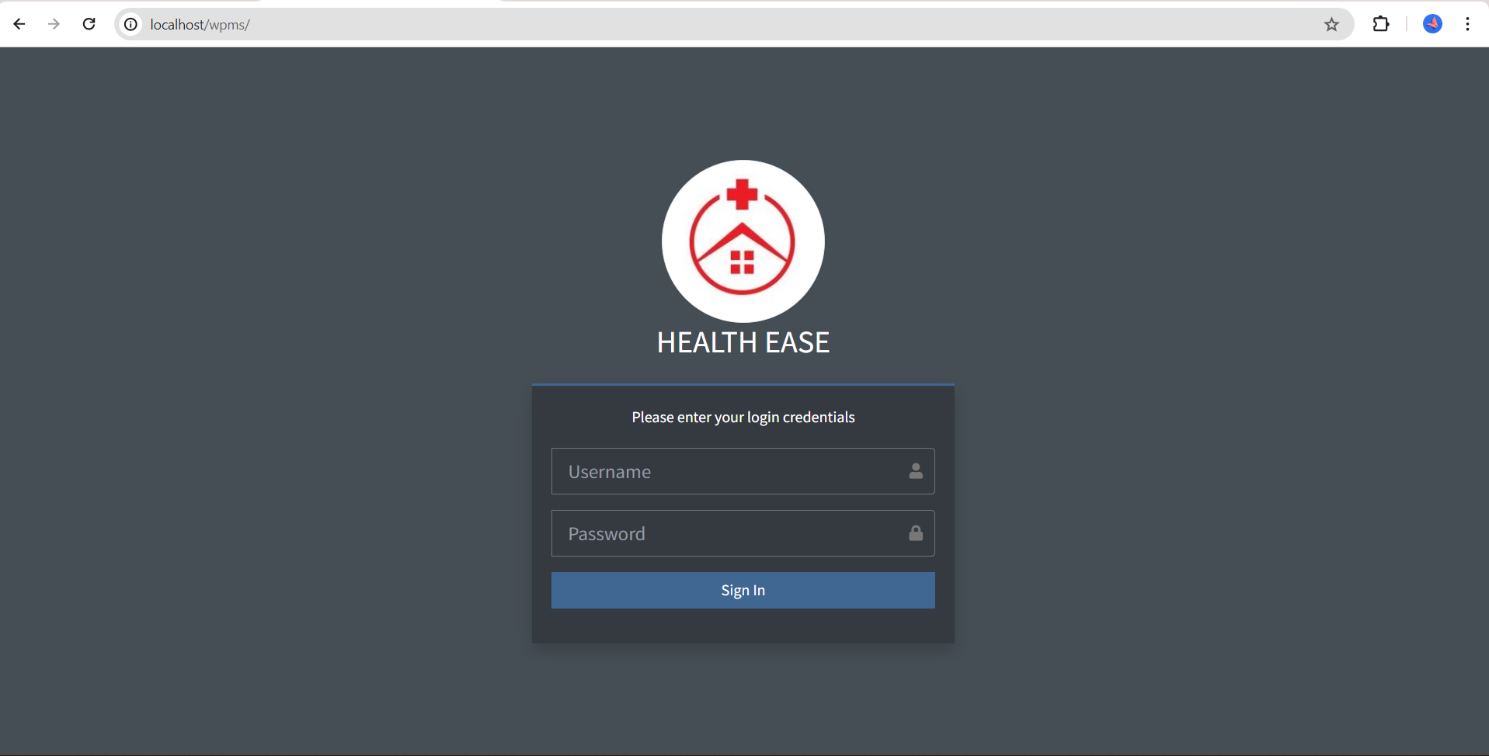
Login page

Slide 5
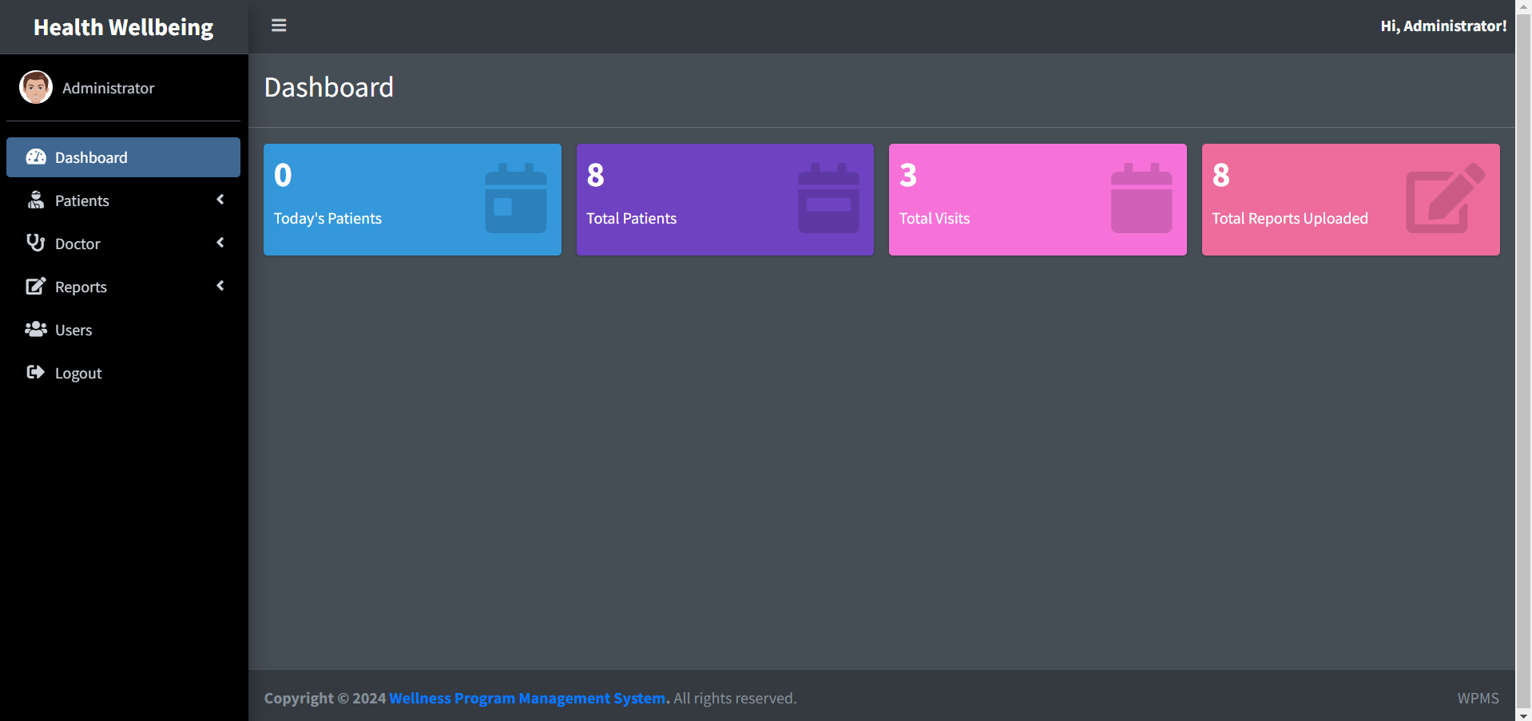
Dashboard Page

Slide 6
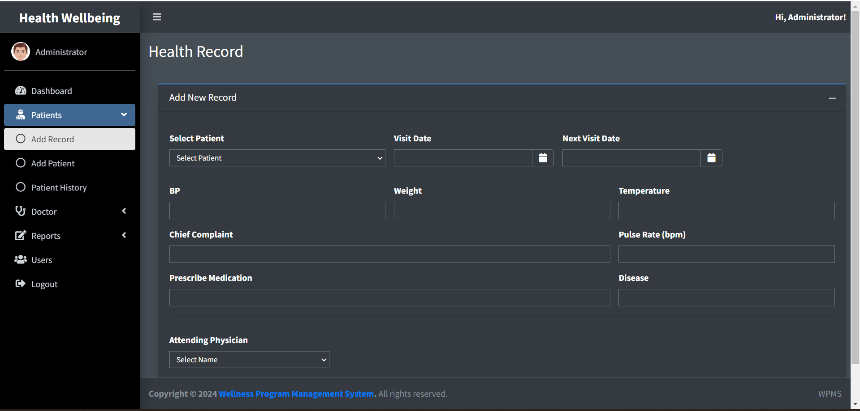
Health Record Page

Slide 7
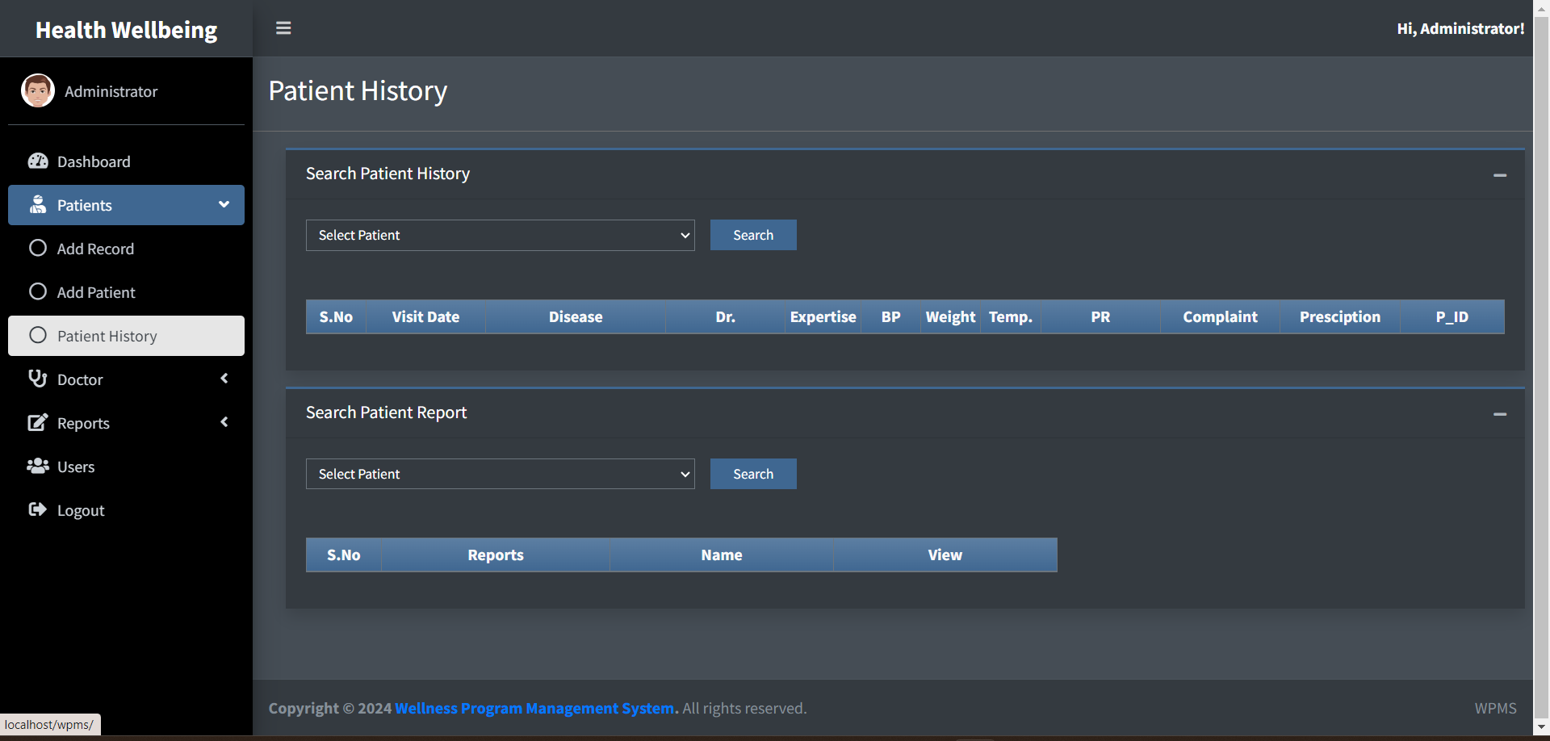
Patient History

Slide 8
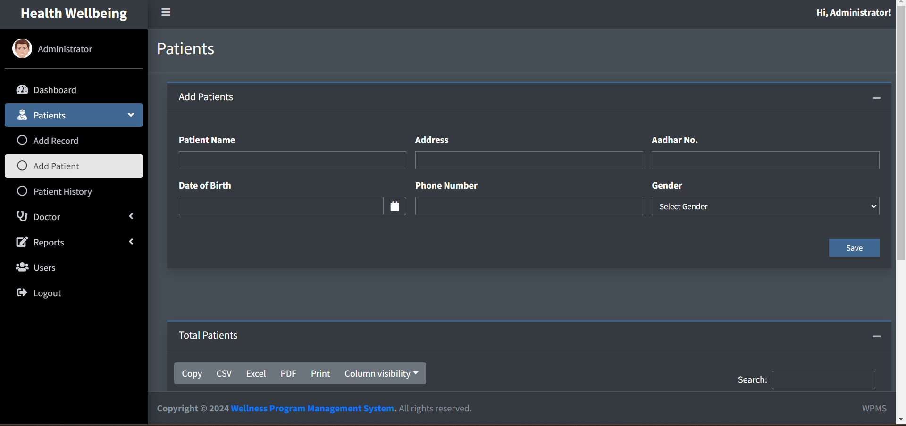
Add Patient

Slide 9
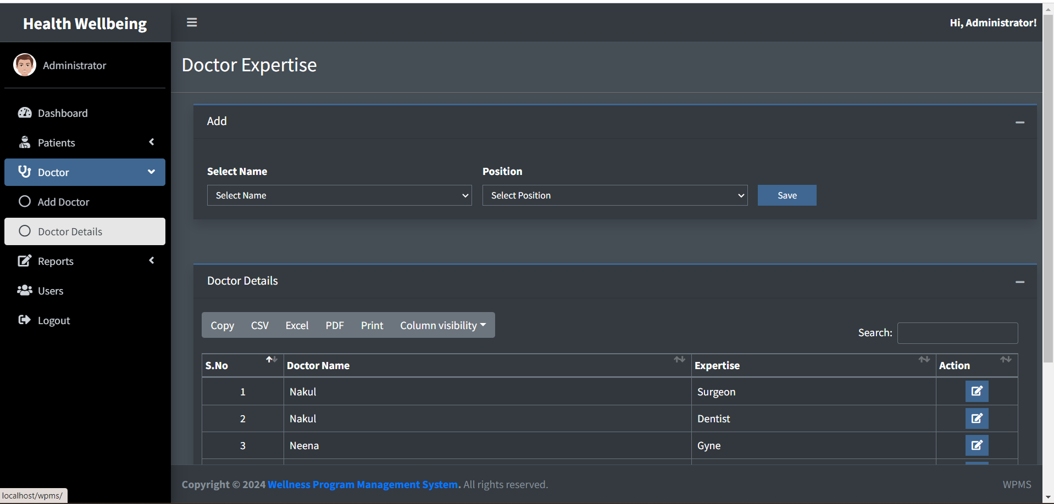
Doctor Expertise

Slide 10
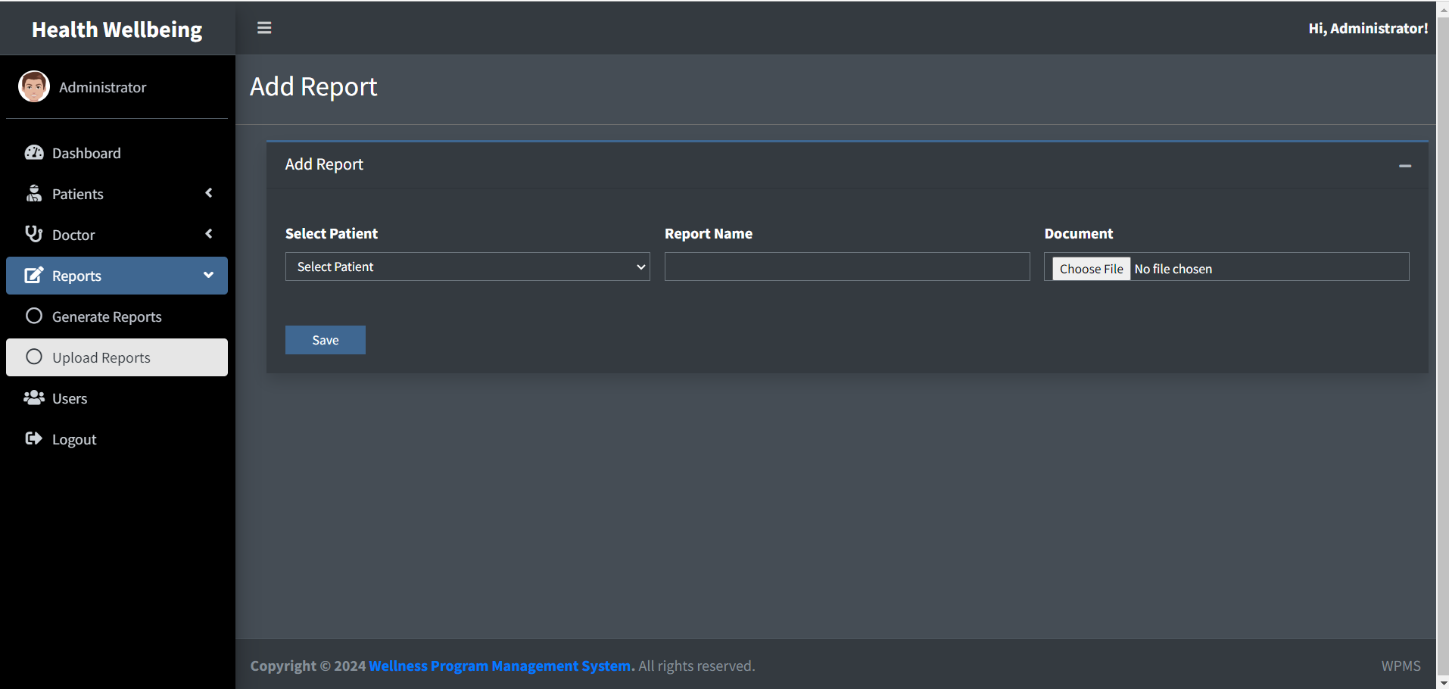
Add Report

Slide 11
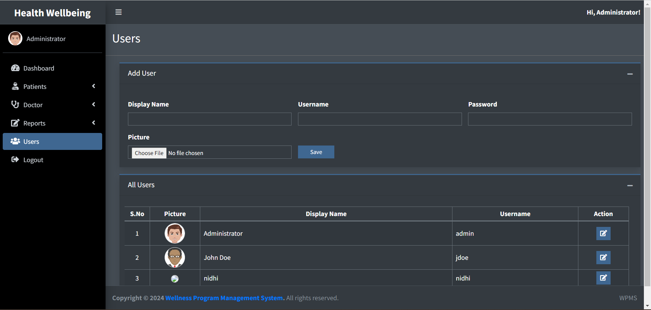
Users Page

Slide 12
THANK YOU

