Slide 1

Phishing Website Detection Using ML
Phishing attacks pose a significant threat to cybersecurity, with malicious actors attempting to deceive individuals into revealing sensitive information through fraudulent websites. This presentation explores the application of machine learning (ML) techniques to enhance the detection of phishing websites, providing a robust and cost-effective solution to combat this growing problem.
Presenter :- Yukta Pal
Ya

Slide 2

Limitations of Traditional Approaches
Traditional anti-phishing tools, such as Google Safe Browsing and antivirus software, often struggle to keep pace with evolving phishing tactics. These tools rely on blacklists and heuristic analysis, which may fail to detect new or sophisticated phishing attempts. Additionally, the reliance on standalone tools can lead to a false sense of security among users, highlighting the need for more advanced and effective detection methods.
1
Blacklist Limitations
2
Heuristic Analysis Shortcomings
Blacklists can only detect known phishing websites, leaving users vulnerable to new and evolving threats.
Heuristic-based approaches may not accurately identify all phishing websites, leading to false positives and false negatives.
3
Standalone Tool Reliance
Reliance on standalone anti-phishing tools can create a false sense of security, underscoring the need for a more comprehensive solution.

Slide 3
Machine Learning for Phishing Detection
The project aims to address the limitations of traditional anti-phishing measures by leveraging the power of machine learning (ML) techniques. ML algorithms offer a promising avenue for enhancing phishing website detection capabilities, as they can analyze a wide range of website features and patterns to accurately identify fraudulent websites.
Feature Extraction
Model Selection
Performance Evaluation
The project focuses on extracting relevant features from websites, such as URL characteristics, website content, and behavioral patterns, to train ML models for effective phishing detection.
The research explores the application of various ML algorithms, including K-Nearest Neighbor, Kernel Support Vector Machine, Decision Tree, and Random Forest Classifier, to identify the most effective approach for phishing website detection.
The project conducts a comprehensive performance evaluation of the selected ML models, assessing their accuracy, precision, recall, and F1-score to ensure the reliability and effectiveness of the phishing detection system.

Slide 4
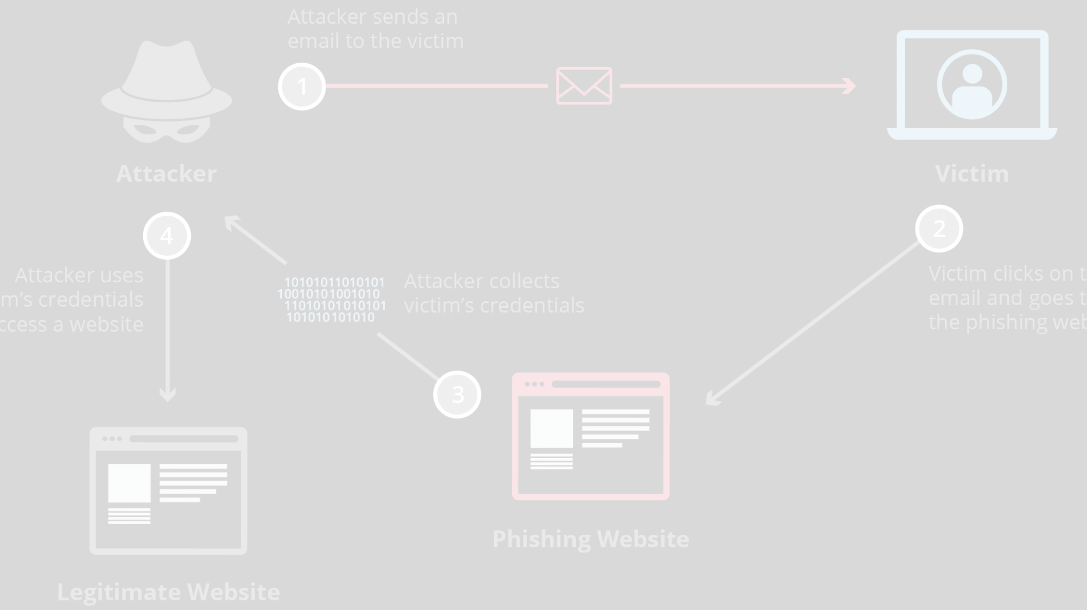
Robust Detection Mechanism
The core of the project lies in the development of a robust phishing website detection mechanism that leverages the power of machine learning. The system is designed to accurately classify websites as either legitimate or phishing, providing real-time feedback to users and enhancing cybersecurity defenses.
Data Acquisition
Model Training and Optimization
The project begins with the acquisition of a comprehensive dataset of legitimate and phishing websites, which serves as the foundation for training and evaluating the ML models.
The selected ML algorithms are trained on the curated dataset, and their performance is optimized through hyperparameter tuning and cross-validation techniques to achieve the highest possible detection accuracy.
1
2
3
Feature Engineering
Extensive feature engineering is conducted to identify the most relevant website characteristics that can effectively distinguish between legitimate and phishing websites, ensuring the accuracy of the detection system.

Slide 5
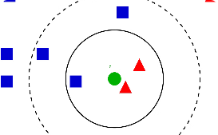
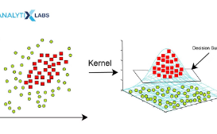
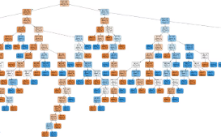
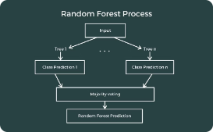
Performance Evaluation and Comparison
The project conducts a comprehensive performance evaluation of the developed phishing detection system, comparing the effectiveness of different ML algorithms to identify the most suitable approach for real-world deployment.
K-Nearest Neighbor
Kernel Support Vector Machine
Decision Tree
Random Forest
The Decision Tree classifier is examined for its performance in creating a hierarchical decision-making process to distinguish between phishing and legitimate websites.
The Random Forest Classifier, which combines multiple decision trees, is evaluated for its ability to provide robust and accurate phishing website detection.
The K-Nearest Neighbor (KNN) classifier is evaluated for its ability to accurately classify websites based on their proximity to known legitimate and phishing examples.
The Kernel Support Vector Machine (KSVM) algorithm is assessed for its capacity to identify the optimal hyperplane that separates phishing and legitimate websites.

Slide 6




Implications and Future Directions
The successful development of the phishing website detection system using machine learning techniques has significant implications for enhancing cybersecurity and protecting individuals and organizations from the growing threat of phishing attacks.
Real-Time Detection
Scalability
Adaptability
Cost-Effective Solution
The scalable design of the detection system allows it to handle increasing volumes of URL requests and adapt to evolving phishing techniques, ensuring its long-term effectiveness.
The machine learning-based approach enables the system to learn from new data and update its detection capabilities, ensuring it remains effective in the face of emerging phishing threats.
The system's ability to provide real-time phishing website detection enables immediate intervention and protection for users, reducing the risk of sensitive information being compromised.
The project's utilization of open-source tools and libraries provides a cost-effective solution for phishing detection, making it accessible to a wide range of users and organizations.

Slide 7





Conclusion and Future Research
The project's successful development of a machine learning-based phishing website detection system represents a significant contribution to the ongoing efforts in combating phishing attacks and enhancing cybersecurity defenses. The system's ability to accurately classify websites, provide real-time detection, and adapt to evolving threats highlights the potential of leveraging advanced technologies to address the growing challenge of phishing.
Comprehensive Evaluation
The thorough performance evaluation of various ML algorithms, including KNN, KSVM, Decision Tree, and Random Forest Classifier, provides valuable insights into the strengths and limitations of each approach, guiding future research and development efforts.
Ongoing Improvement
The project's findings pave the way for continued research and development, exploring new ML techniques, incorporating additional website features, and expanding the system's capabilities to address emerging phishing threats.
Collaborative Efforts
The project's open-source nature and cost-effective solution encourage collaborative efforts among researchers, cybersecurity professionals, and the broader community to further enhance the detection system and contribute to the fight against phishing attacks.

Slide 8
Acknowledgments
The successful completion of this project would not have been possible without the guidance and support of our esteemed supervisor, Dr. Akash Rajak, and the dedicated faculty members of the Department of Computer Applications at KIET Group of Institutions, Delhi-NCR, Ghaziabad. We extend our sincere gratitude for their invaluable insights, mentorship, and encouragement throughout the development process.
Presenter
Yukta Pal
Student ID
2200290140189
Session
2023-2024 (IV Semester)
Supervisor
Dr. Akash Rajak
Institution
KIET Group of Institutions, Delhi-NCR, Ghaziabad
Department
Department Of Computer Applications

