Slide 1
BLOGFUSE : uniting thoughts, igniting ideas
Made By - Tushar Nagpal

Slide 2
TOPICS
Introduction
Technology Required
Modules
Features
Conclusion

Slide 3
Introduction
Welcome to blogfuse, your one-stop destination for all things blogging! whether you're a seasoned writer looking to share your expertise or a budding blogger eager to express your thoughts and ideas, our platform provides the perfect space to unleash your creativity.
At blogfuse, we understand the power of storytelling and the importance of connecting with like-minded individuals. that's why we've created a user-friendly and intuitive platform designed to help you craft compelling blog posts, engage with your audience, and build a vibrant community around your passions.
with a sleek and modern interface, blogfuse offers a seamless blogging experience, allowing you to focus on what matters most – creating great content. whether you're writing about travel, technology, fashion, food, or any other topic under the sun, our platform provides the tools you need to bring your ideas to life.

Slide 4
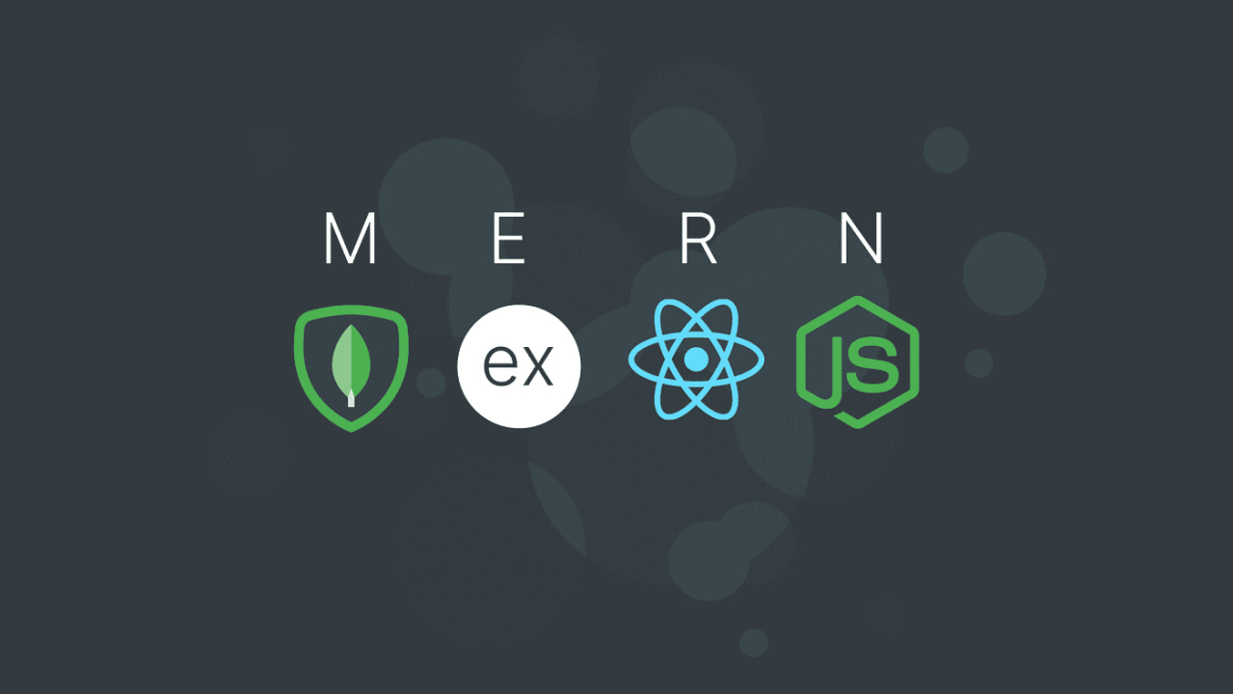
TECHNOLOGY REQUIRED
Frontend – react js
Backend – node js & express js
Database – mongo db

Slide 5
MODULES
User Registration and Authentication: This module allows users to create accounts, log in securely, and manage their profiles. it is essential for personalizing the user experience and ensuring order history.
Create Blog : The "create blog" module in a blog application typically involves functionality for users to compose and publish new blog posts.
Edit Blog : The “Edit blog" module in a blog application typically involves functionality for users to update and modify existing blog posts.
Delete Blog : The “Delete blog" module in a blog application using which user can easily delete existing blog.

Slide 6
Features
User authentication and authorization: allows users to register, login, and manage their accounts. Different permission levels (e.G., Admin, author, reader) may be assigned to users.
Content management system (cms) : A user-friendly interface for creating, editing, and organizing blog posts. It may include text formatting options, media upload capabilities, and scheduling features.
Comments: readers can leave comments on blog posts, fostering engagement and interaction. Administrators often have the ability to moderate comments.
Search functionality: allows users to search for blog posts based on keywords, categories, or tags.
Responsive design: ensures that the blog is accessible and functional across different devices and screen sizes

Slide 7

Thank you

