Slide 1

Online Task Management System
The "Online Task Management System" (OTMS) project aims to revolutionize task management processes within organizations by providing a comprehensive digital platform for task assignment, tracking, and collaboration. This innovative system leverages cutting-edge technologies to streamline workflows, enhance productivity, and foster seamless communication among team members. By transitioning from manual systems to a user-friendly online interface, OTMS empowers both employees and administrators to efficiently manage tasks, monitor progress, and maintain data integrity, ultimately contributing to the overall success of the organization.
by JYOTI MISHRA

Slide 2
Technological Framework
Frontend Technologies
Backend Technologies
Development Environment
The OTMS project utilizes a robust frontend technology stack, including HTML, CSS, and Bootstrap, to create a visually appealing and responsive user interface. These technologies enable the development of intuitive and user-friendly web pages that seamlessly adapt to various devices and screen sizes, ensuring a consistent and accessible experience for all users.
The backend of the OTMS system is powered by a combination of PHP, JavaScript, jQuery, and MySQL. These technologies work in tandem to provide dynamic functionality, data management, and secure communication between the user interface and the underlying database. The integration of these backend components ensures the system's reliability, scalability, and efficient data processing capabilities.
The OTMS project leverages the XAMPP local server for development and testing purposes. XAMPP provides a comprehensive and user-friendly environment that simplifies the setup and deployment of the system, allowing for efficient testing and troubleshooting during the development phase.

Slide 3
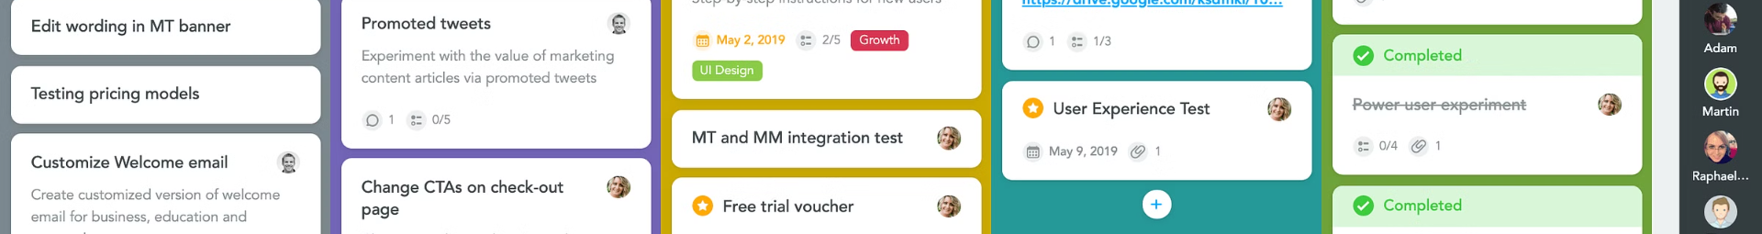
System Functionality
User Panel
1
The OTMS project features a dedicated User Panel that caters to the needs of registered users. Within this panel, users can access their personalized dashboard, view assigned tasks, update task statuses, apply for leave, and check the status of their leave requests. This user-centric design ensures a seamless and efficient task management experience for employees.
2
Admin Panel
Complementing the User Panel, the OTMS system also includes an Admin Panel, which empowers administrators with comprehensive task management capabilities. Administrators can create, edit, and delete tasks, manage leave applications, and approve or reject leave requests. This dual-panel structure enables effective collaboration and communication between users and administrators, fostering a cohesive and productive work environment.
Integrated Functionality
3
The OTMS project integrates various functionalities to provide a holistic task management solution. Users can access their assigned tasks, update task statuses, and communicate leave requests, while administrators can oversee the entire workflow, ensuring efficient task allocation, progress tracking, and leave management. This integrated approach streamlines the task management process and enhances overall organizational productivity.

Slide 4
Database Architecture
Structured Database
Data Integrity
The OTMS project utilizes a structured MySQL database named "tms_db" to store and manage relevant data. This database comprises several tables, including User, Task, Leaves, and Admin schemas, which define the structure and relationships of data entities within the system.
The database architecture ensures data integrity by implementing appropriate data types, constraints, and relationships between the various tables. This structured approach to data management enables seamless data retrieval, manipulation, and reporting, ensuring the reliability and accuracy of the information stored within the system.
Scalability and Security
Data-Driven Insights
The OTMS database is designed with scalability and security in mind. The schema allows for the efficient storage and retrieval of large volumes of data, accommodating the growing needs of the organization. Additionally, the system incorporates robust authentication mechanisms to protect sensitive information from unauthorized access, safeguarding the privacy and confidentiality of user data.
The structured database enables the OTMS system to generate valuable data-driven insights, supporting informed decision-making by administrators. Through comprehensive reporting and analytics, the system provides visibility into task progress, leave management, and other key performance indicators, empowering organizations to optimize their task management processes and enhance overall efficiency.

Slide 5
Project Objectives
1
Enhancing Task Management Efficiency
2
Facilitating Seamless Collaboration
The primary objective of the OTMS project is to enhance the efficiency of task management processes within organizations. By providing a digital platform for task allocation, monitoring, and administration, the project aims to streamline workflow processes and minimize manual intervention.
Through the implementation of user-friendly interfaces and dual-panel functionality, the OTMS project aims to facilitate seamless collaboration between managers and employees. Users can easily access assigned tasks, update task statuses, and communicate leave requests, fostering transparent communication and efficient workflow coordination.
3
Empowering Administrators
4
Ensuring Data Integrity and Security
The OTMS project empowers administrators with comprehensive tools to manage tasks effectively. Administrators can create, edit, and delete tasks as needed, monitor task statuses, and manage leave applications. This functionality enables administrators to maintain oversight and ensure the smooth functioning of task management processes.
The OTMS project prioritizes data integrity and security by implementing robust database structures and authentication mechanisms. Schemas are designed to organize and manage user data, task details, and leave-related information securely, ensuring that sensitive data is protected and only accessible to authorized users.

Slide 6
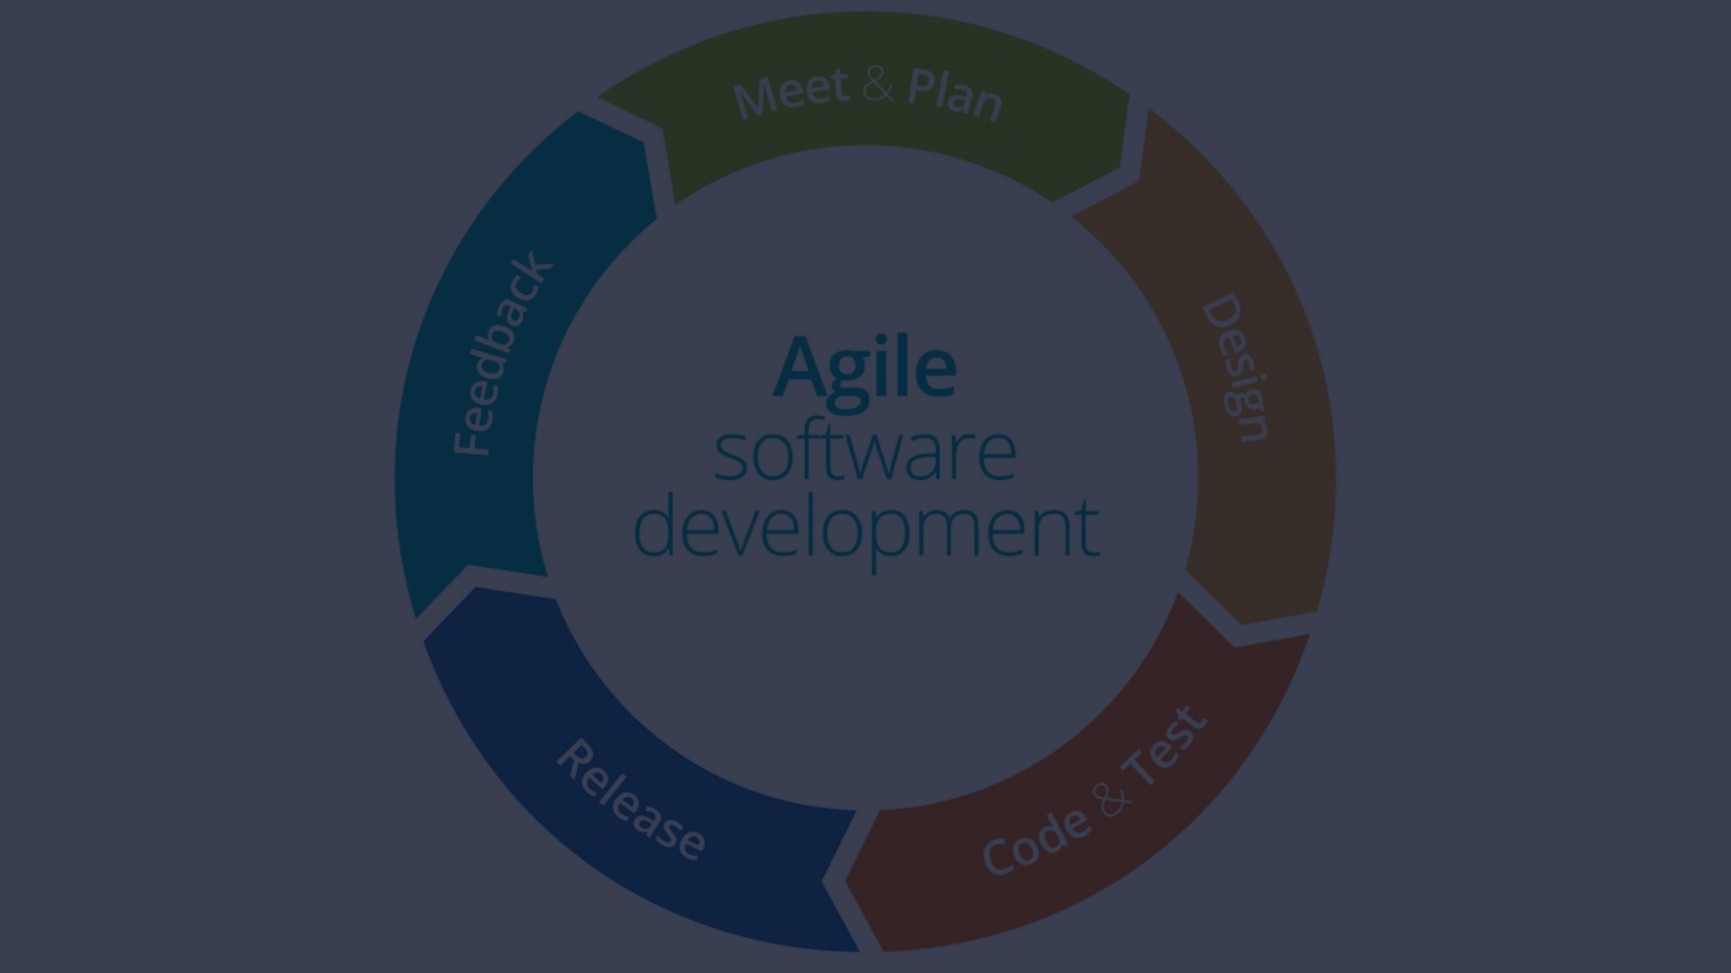



Continuous Improvement
Evaluation
User Feedback
Iterative Refinement
The OTMS project incorporates a comprehensive evaluation phase to assess the system's performance and impact. Key performance indicators, such as user adoption rates, task completion times, and system uptime, are closely monitored to gauge the effectiveness of the system.
Continuous feedback from users, both employees and administrators, is actively sought to identify areas for improvement. This user-centric approach ensures that the OTMS system evolves to meet the changing needs and preferences of its stakeholders.
Based on the evaluation findings and user feedback, the OTMS project team implements iterative refinement strategies to enhance the system's functionality, user experience, and overall effectiveness. This commitment to continuous improvement ensures that the OTMS system remains relevant, efficient, and aligned with the organization's evolving requirements.

Slide 7





Conclusion
Organizational Transformation
User-Centric Approach
Commitment to Innovation
Data Security and Integrity
The successful implementation of the OTMS project has the potential to transform the way organizations manage tasks, fostering increased productivity, enhanced collaboration, and improved data-driven decision-making.
By prioritizing user needs and delivering a seamless, intuitive user experience, the OTMS project has set the stage for widespread user adoption and satisfaction, ensuring the long-term success and sustainability of the system.
The OTMS project's dedication to continuous improvement, driven by evaluation, user feedback, and iterative refinement, demonstrates a commitment to innovation and a willingness to adapt to the evolving needs of the organization.
The robust database architecture and security measures implemented in the OTMS project ensure the protection of sensitive data, instilling confidence in users and safeguarding the organization's critical information assets.

